Slide 1
Update on Alignment and Calibration
07/03/2016 Claire Prouve - University of Bristol
on behalf of the Alignment & Calibration group

Slide 2
Overview alignment
Alignments
VELO alignment: Alignment of both halves for translations and rotation in x, y and z.
Tracker alignment:
Muon alignment: Alignment of both halves of each station for translations in x and y.
RICH mirror alignment: Alignment of all individual mirrors for rotations around x and y.

Slide 3
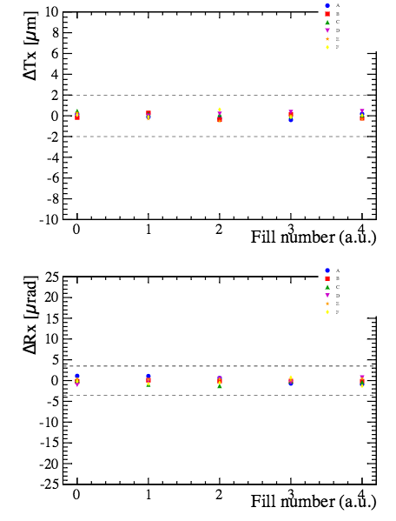
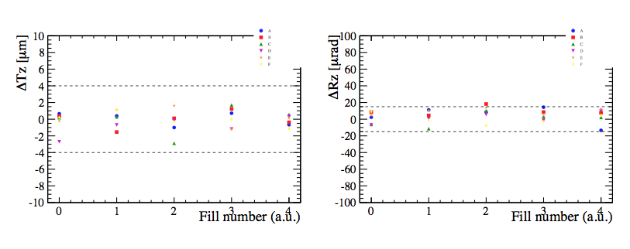
VELO alignment (1/2)
Alignment of both halves for translations and rotation in x, y and z.
Work during WS
Threshold for automatic update of alignment constants:
accuracy and precision used in 2015 taken from 2012 MC and 2012 data
If too small: sensitive to statistical fluctuations If too big: imperfect alignment
new stability study with data taken in 2015: several alignments made on different events from same fill
New thresholds determined and put in place

Slide 4
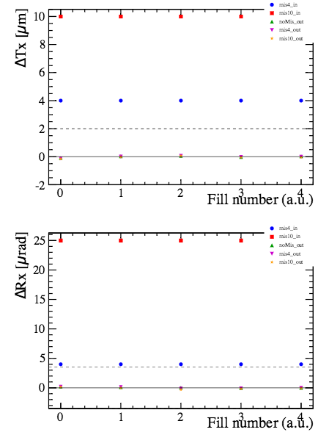
VELO alignment (2/2)
Dependence on initial alignment
stability study with data taken in 2015: several alignments made on same events starting from different alignments (optimal, small misalignment, big misalignment)
➔ New alignment does not significantly depend on the initial alignment
To be done:
optimization of the rate between collision and beam gas events in the HLT1 line (same HLT1 line as for the luminosity studies) to get more beam gas events
Plans for 2016 data-taking
Change the threshold for automatic update of alignment constants
Adjust the rate of beam-gas events to collision events
Continue running automatically as during the end of 2015
Big initial misalignment
Small initial misalignment
Resulting alignment

Slide 5
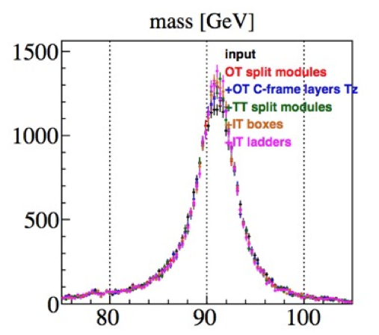
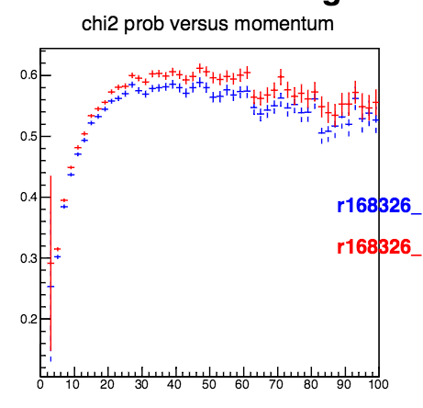
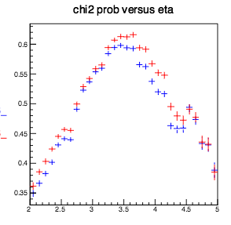
Tracker alignment
Work during WS
Z→ μμ decays + additional degrees of freedom:
Z→μμ decays collected in 2015
OT modules split above/below the beam pipe, OT C-frames in z, split TT modules, IT boxes, IT layers and ladders
➔ Z peak ~15% narrower, and improved track χ² after alignment
➔ IT internally misaligned
D⁰ decays + additional degrees of freedom:
Default D0 decays
OT modules split above/below the beam pipe, OT C-frames in z, IT boxes, IT layers and ladders
Improvements in track χ² and overlap-residuals as on Z sample
No improvement in D⁰ mass resolution
+ No internal alignment
+ Internal alignment

Slide 6
Tracker alignment
To be done:
Test alignment with high momentum tracks and tracks from J/Ψ + separate alignment for all modules
stability study for IT: moves when B-field changes BCAM shows the movement, but not yet the correlation with the tracker alignment
stability study for OT and TT: stability of alignments of the different elements
Plans for 2016 data-taking
1st alignment with all degrees of freedom at the beginning of data-taking
Use D⁰ events plus high-momentum tracks (and possibly J/Ψ events)
Detector was opened and IT box was moved ➔ expect significant misalignment at the start

Slide 7
Muon alignment
Alignment of both halves of each station for translations in x and y.
Work during WS
No work necessary, alignment was already stable in 2015.
Plans for 2016 data-taking
Muon system was opened during WS
misalignment in muon system can create asymmetry in L0Muon
➔ initial alignment needed
software alignment
if misalignment is big move the chambers mechanically
update new alignment
produce new LUT for L0Muon
Run in monitoring mode

Slide 8
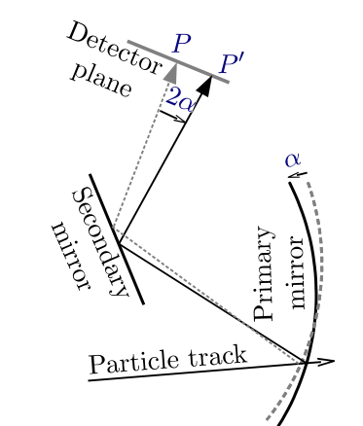
RICH Mirror Alignment (1/2)
Alignment of all individual mirrors for rotations around x and y.
Work during WS
Magnification coefficients:
translate the misalignment-on-the-detector-plane into actual mirror tilts
Previously calculated for every alignment for each iteration on data
Tested using the same set for all alignments and all iterations
➔ No significant difference in resulting mirror tilts and procedure 9 times faster!!!
Number of events needed to :
several alignments made on different runs from same time-period
1M events for RICH1, 2M events for RICH2

Slide 9
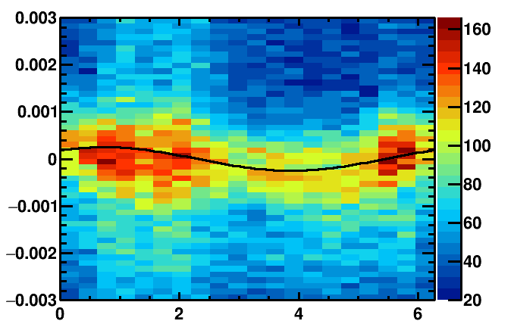
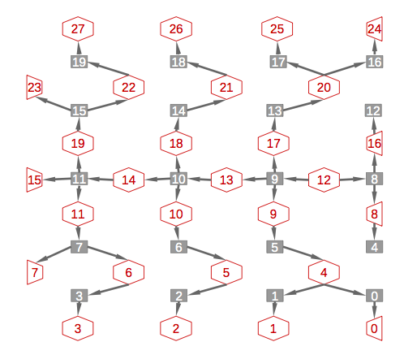
RICH Mirror Alignment (2/2)
New method for fitting histograms:
use same Gaussian width for each slice in phi
Same resulting mirror-tilts and 3 times faster
New method for determining individual mirror misalignments:
No more fixed mirrors
All mirrors aligned at the same time
➔ Less iterations needed obtaining the same Cherenkov angle resolution
Plans for 2016 data-taking
Adjust HLT1 prescale for RICH1 to get desired number of events for both RICHs in same time
Run every fill if possible to have more stability studies
Revisit in September if we can run less often
Δθ/ mrad
Φ angle/ rad
RICH2 mirror alignment chain

Slide 10
OT global t₀ calibration
Global time alignment for all modules: Fit to the residual of the drift-time to extract the global time delay t₀ caused by a difference in collision time and the phase of the LHC clock received at LHCb.
Work during WS
No conceptual work necessary, calibration already worked well in 2015. Some work on the monitoring.
Plans for 2016 data-taking
Continue running automatically on ~every run as during 2015.

Slide 11
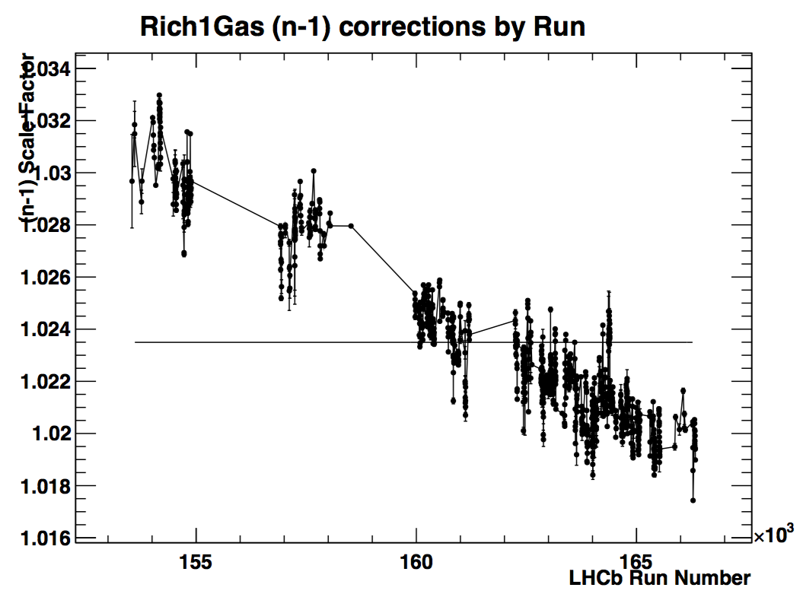
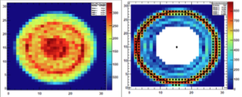
RICH calibration
Refractive index calibration: Fit to the (expected-reconstructed) Cherenkov angle and use offset of mean to calibrate the refractive index calculated from hardware sensors.
HPD Image calibration: Image fit performed for each HPD and used to provide calibration for each anode element.
Work during WS
No work conceptual necessary, calibration already worked well in 2015.
Plans for 2016 data-taking
Continue running automatically on ~every run as during 2015.
Stability plots
HPD image w/o and w/ Sobel filter

Slide 12
CALO calibration
work: ongoing on occupancy by Marie Noelle Minard because there was dependency on LHC condition. JF working the LED calibration was fully automatic in 2015. Silvia writes email to him. plan: I think that will be run per fill automatically as at end of 2015 only LED.

Slide 13
Pi0 calibration
????

Slide 14
Monitoring and Alarms
Work in progress:
Show development of alignment constants during the procedure
Show the stability of the alignment constants over time
alarm if something went wrong: change in constants too large, no convergence was reached…
Developing procedure for case of alarms

Slide 15
Conclusion
Many studies done during WS
Improvements in performance
Improvements in speed
Ready for data-taking!

