Slide 1
Update on Alignment and Calibration
09/03/2016 Claire Prouve - University of Bristol
on behalf of the Alignment & Calibration group

Slide 2
Overview alignments
Alignments
VELO alignment: Alignment of both halves for translations and rotations in x, y and z.
Tracker alignment: Alignment of TT, IT and OT for translations in x, rotations and translations in z (online) and translations and rotations in y (offline).
RICH mirror alignment: Alignment of all individual mirrors for rotations around x and y.
Muon alignment: Alignment of both halves of each station for translations in x and y.
Run on the HLT-farm at the beginning of every fill in the same order as above.
Automatic update of
alignment constants
Monitoring mode only

Slide 3
Overview calibrations
Calibrations
OT calibration: Global time alignment for all modules, extract the global time delay t₀ caused by a difference in collision time and the phase of the LHC clock received at LHCb.
RICH calibration:
Refractive index calibration: correct the refractive index calculated from hardware sensors.
HPD Image calibration: calibration of the image for each anode element.
Calorimeter calibration: Occupancy method and LED monitoring system, adjust the high voltage to compensate for the aging of the detector
Run on the monitoring histograms for ~every run (OT and RICH) or every fill (Calorimeter).
π⁰ calibration: Calibrate the gain in each cell using the π⁰ mass distribution with π⁰→γγ Run on the alignment farm during TS.

Slide 4
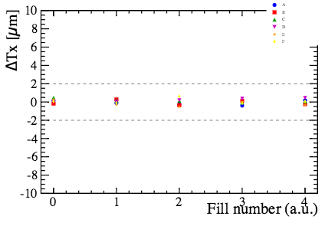
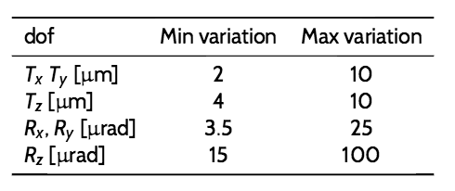
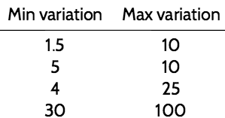
VELO alignment (1/2)
Giulio,
Silvia
Work during WS
Threshold for automatic update of alignment constants:
accuracy and precision used in 2015 taken from 2012 MC and 2012 data
If too small: sensitive to statistical fluctuations If too big: unexpected behaviour
new stability study with data taken in 2015: several alignments made on different events from same fill
New thresholds determined.
Giulio’s talk
2015 for 2016

Slide 5
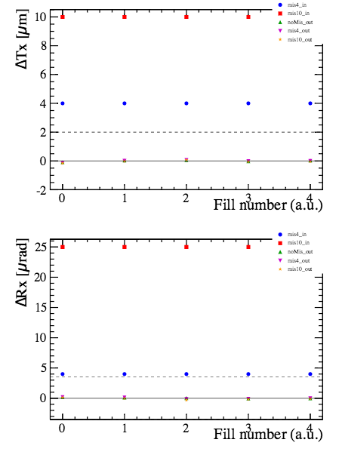
VELO alignment (2/2)
Giulio,
Rosen
Giulio’s talk
Dependence on initial alignment:
stability study with data taken in 2015: several alignments made on same events starting from different alignments (optimal, small misalignment, big misalignment)
➔ New alignment does not significantly depend on the initial alignment.
To be done:
optimization of the rate between collision and beam gas events in the HLT1 line (same HLT1 line as for the luminosity studies) to get more beam gas events
Plans for 2016 data-taking
Apply the new thresholds for automatic update of alignment constants
Adjust the rate of beam-gas events to collision events
Continue running automatically as during the end of 2015
Big initial misalignment
Small initial misalignment
Resulting alignments

Slide 6
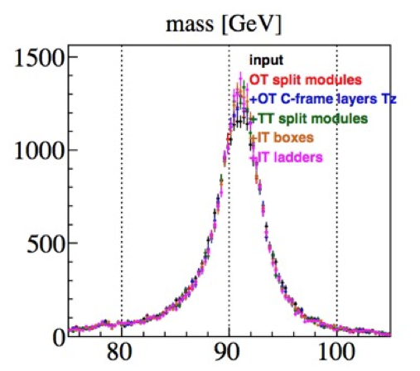
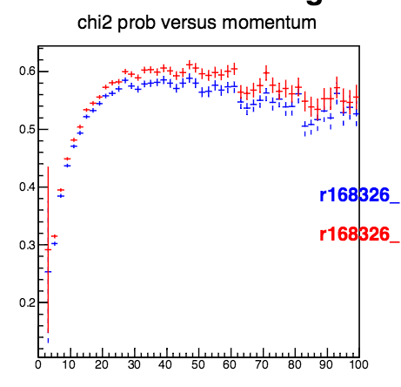
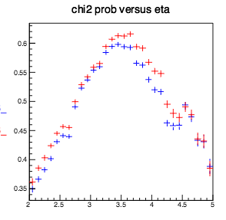
Tracker alignment
Wouter, Maurizio,
Francesca, Lucia
Work during WS
Z→ μμ decays + additional degrees of freedom:
Z→μμ decays collected in 2015
OT modules split above/below the beam pipe, OT C-frames in z, split TT modules, IT boxes, IT layers and ladders
➔ Z peak ~15% narrower, and improved track χ² after alignment
➔ Improved internal IT alignment
D⁰ decays + additional degrees of freedom:
Default D⁰ decays
Same configuration as for Z alignment for OT and IT
Same improvements in track χ² and
overlap-residuals as on Z sample
No improvement in D⁰ mass resolution
Wouter’s talk
Maurizio’s talk
+ No internal alignment
+ Internal alignment

Slide 7
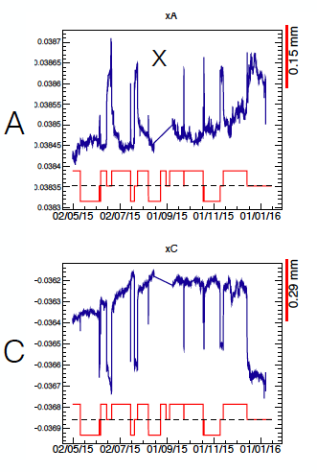
Tracker alignment
To be done:
Evaluation of alignment with high momentum tracks and tracks from J/Ψ events
Study different alignment configurations
Stability study for IT: correlation between movement seen by BCAM (Pavol's talk) and tracker alignment under study
Stability study for OT and TT: stability of alignment constants of the different elements
Plans for 2016 data-taking
Detector was opened and IT2C box was moved (~1mm in x,y) ➔ expect significant misalignment at the start
1st alignment with big data-sample and all degrees of freedom at the beginning of data-taking
Alignment in y with magnet-off data
Use D⁰ events plus high-momentum tracks (and possibly J/Ψ events)
IT1 A side X-coordinate
IT1 C side X-coordinate s

Slide 8
Muon alignment
Silvia,
Stefania
Work during WS
No work necessary, alignment was already stable in 2015.
Plans for 2016 data-taking
Muon system was opened during WS
misalignment in muon system can create asymmetry in L0Muon
➔ initial alignment needed
software alignment
if misalignment is big move the chambers mechanically and perform new alignment
produce new LUT for L0Muon
Run in monitoring mode

Slide 9
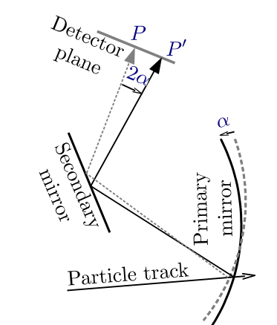
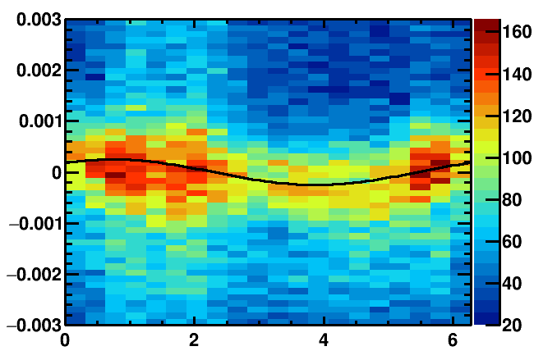
RICH Mirror Alignment (1/3)
Anatoly,
Claire,
Paras
Work during WS
Studies on increase of speed
1. Magnification coefficients:
translate the misalignment-on-the-detector-plane into actual mirror tilts
Previously calculated for every alignment for each iteration on data
Tested using the same set for all alignments and all iterations
No significant difference in resulting mirror tilts and procedure 9 times faster!!!
2. New method for fitting histograms:
use same Gaussian width for each slice in phi
Same resulting mirror-tilts and 3 times faster
3. New method for determining individual mirror misalignments:
No more fixed mirrors + align all mirrors at the same time
Fewer iterations needed obtaining the same Cherenkov angle resolution.
Δθ/ mrads
Φ angle/ rad

Slide 10
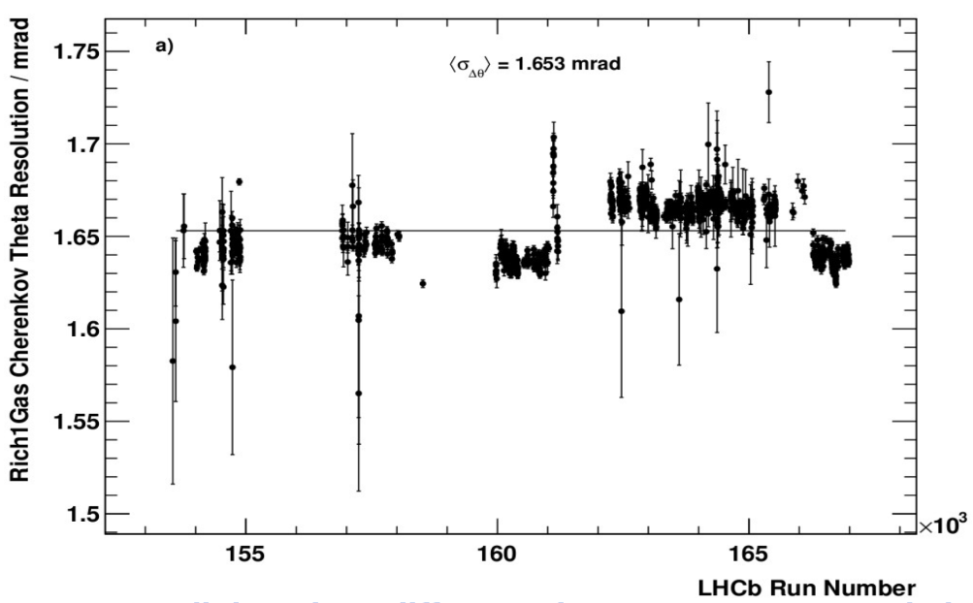
RICH Mirror Alignment (2/2)
Anatoly,
Claire,
Paras
Number of events needed for stable alignment:
several alignments made on different runs from same time-period
1M events for RICH1, 2M events for RICH2
Magnet polarity:
Different Cherenkov angle resolution for different magnet polarities in RICH1
Increase in energy required to pass L0 between Mag Down and Mag Down
See no evidence that the PID suffers if we use the same alignment for both polarities
More studies ongoing
RICH1 Cherenkov angle resolution
up
down
up
Kaon ID vs Pion MissID
Mag Down (162247 – 164189)
Mag Down (164191 – 165528)
MagUp (166277 – 166478)

Slide 11
RICH Mirror Alignment (3/3)
Anatoly,
Claire,
Paras
Plans for 2016 data-taking
Adjust HLT1 prescale for RICH1 to get desired number of events for both RICHs in same amount of time
1st alignment with big data-sample at the beginning of data-taking
Run every fill if possible to have more stability studies
Stability of alignment constants
Stability of Cherenkov angle resolution
Revisit in September if we can run less often

Slide 12
OT global t₀ calibration
Philippe,
Lucia
Work during WS
No conceptual work necessary, calibration already worked well in 2015.
Some work on the monitoring.
Plans for 2016 data-taking
Continue running automatically on ~every run as during 2015.

Slide 13
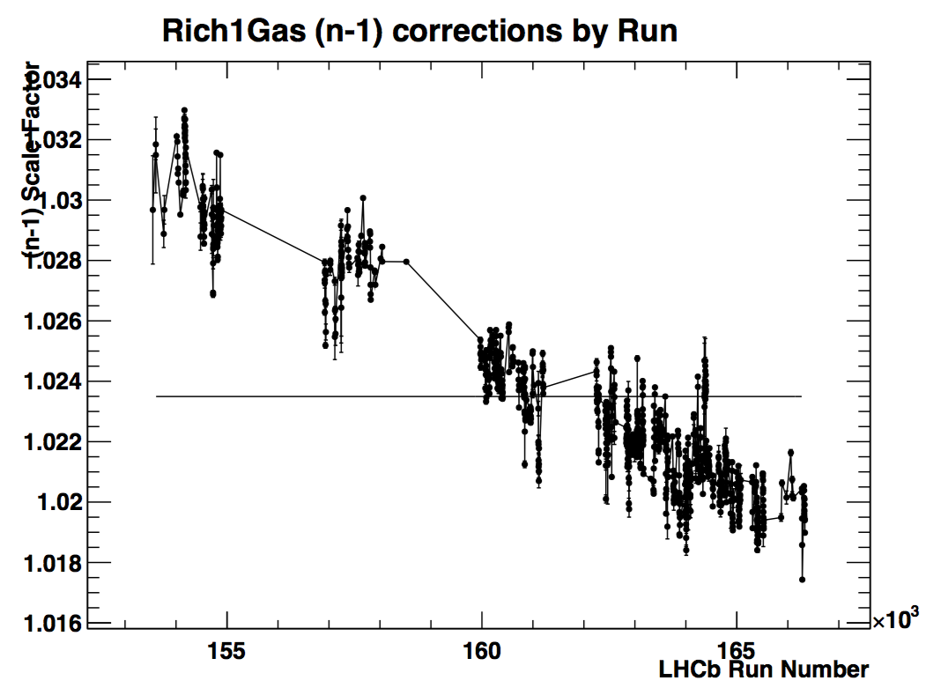
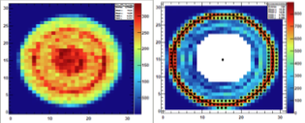
RICH calibrations
Chris,
Jibo
Work during WS
No work conceptual necessary, calibration already worked well in 2015.
Plans for 2016 data-taking
Continue running automatically on ~every run as during 2015.
HPD image w/o and w/ Sobel filter

Slide 14
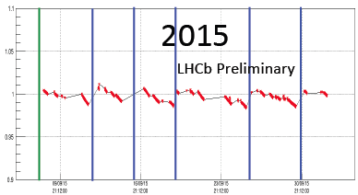
Calorimeter calibrations
Marie-Noelle,
Jean Francois
Work during WS
LED method:
Worked well in 2015
Failing LED were replaced during WS
Occupancy method:
Noticed dependency on the beam conditions
Study still ongoing
Plans for 2016 data-taking
Run LED method for both ECAL and HCAL automatically at the start of each fill
Run occupancy method for each fill (without applying the results) to study the dependency on the beam conditions

Slide 15
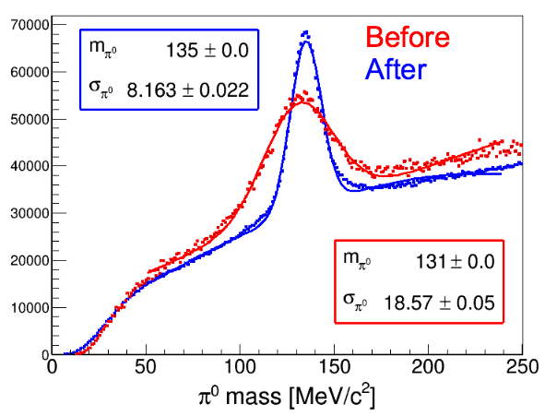
π⁰ calibration
Dasha,
Jean Francois
Work during WS
Dedicated conddb provided for September data that was affected by a π⁰ mass shift (local tag calo-20160104, included into a global tag cond-20160123)
Ongoing work:
Speed up the procedure
Investigate over- and under-calibration of ECAL cells in the central region
➔ Improve event selection
Plans for 2016 data-taking
Before data-taking correct for the over-/under calibration of central cells by using MC
Perform calibrations during the TS

Slide 16
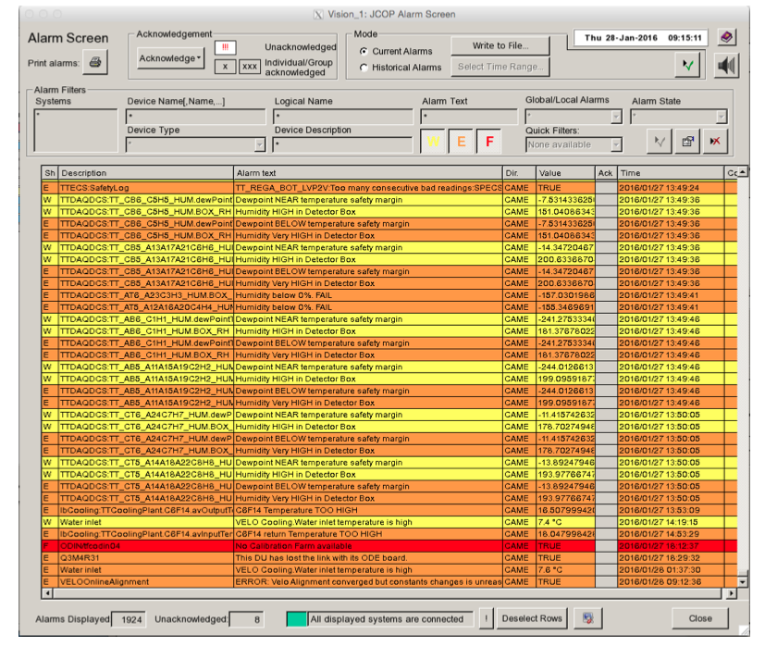
Monitoring and Alarms
Work in progress:
Show development of alignment constants during the alignment procedure in presenter
Show the stability of the alignment constants over time in presenter
Alarm if something goes wrong: change in constants too large, no convergence was reached…
Developing procedure for case of alarms
Thanks, Clara!

Slide 17

Conclusion
Many studies done during WS
Improvements in performance
Improvements in speed
Some small improvements/studies still to be made
Further work on the monitoring required
Getting ready for data-taking!

