Slide 1
Alignment and Calibration report
14/09/2016 Claire Prouve - University of Bristol
on behalf of the Alignment & Calibration group

Slide 2
Overview
Perform alignment and calibration of subdetectors ‘in real-time’
➔ Same constants in trigger and offline reconstruction
➔ Use of PID information in HLT2
➔ Best possible trigger performance
Requirements: fast + evaluated in real-time
Alignments + π⁰ calibration:
Use HLT farm with ~1800 nodes
Collect results on single node and evaluate the alignment constants
Calibrations:
Run on monitoring histograms
Manual, offline, hardware alignments

Slide 3
Alignments

Slide 4
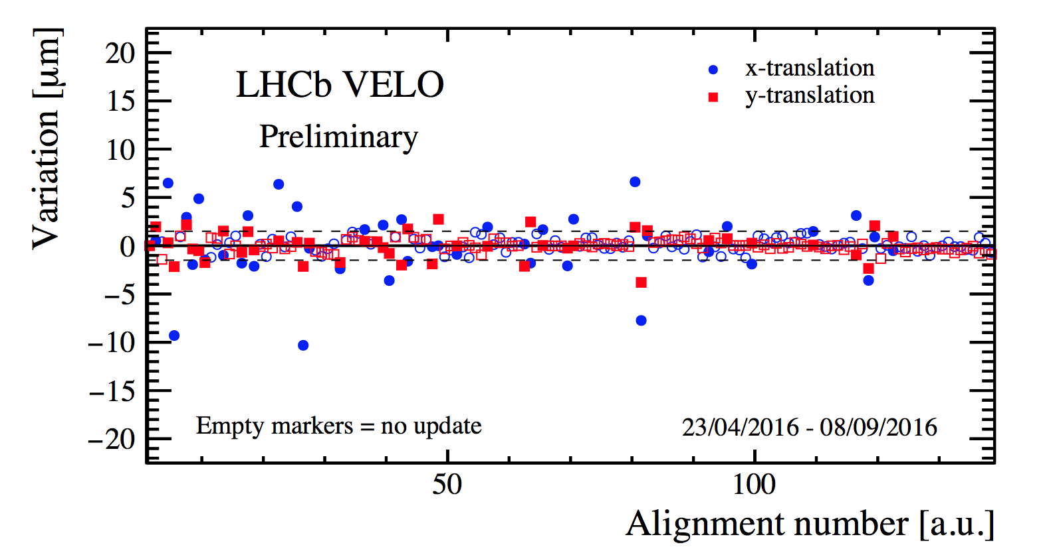
VELO Alignment
Giulio,
Silvia
Alignment of both halves for translations and rotations in x, y and z.
Update of constants | Frequency | Data sample | Time to collect data | Time to run
Automatic | Per fill | Min. bias + beam gas events | < 1 min. | 2 min.
Running since beginning of Run II
Alignment constants updated every 3-8 fills
Stability studies:
Threshold for automatic update of alignment constants
Dependence on initial alignment
[LHCb Week March 2016]

Slide 5
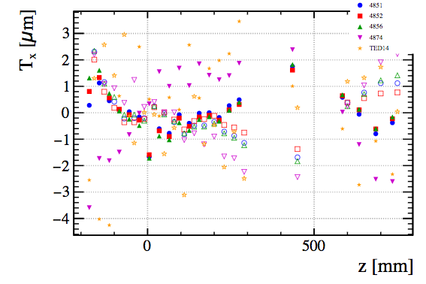
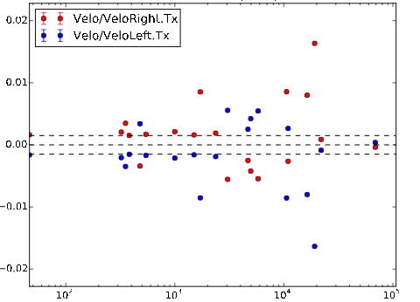
VELO Alignment
Giulio,
Silvia
Study on alignment of individual modules:
Module misalignment degrades alignment
Align modules for main DOF: T_{x}, T_{y} and R_{z}
➔ Compatible with statistical fluctuations, no frequent modular alignment needed.
Study on χ² convergence criteria:
Convergence if χ² /n_{dof} < 2
Update of constants dependent on variation
Plot the variation against χ² /n_{dof}
All triggered updates have χ² /n_{dof} > 200
MC study on the impact of residual mis-alignment on physics ongoing [Matej Roguljic's talk]
T_{x}[mm]
χ² /n_{dof}

Slide 6
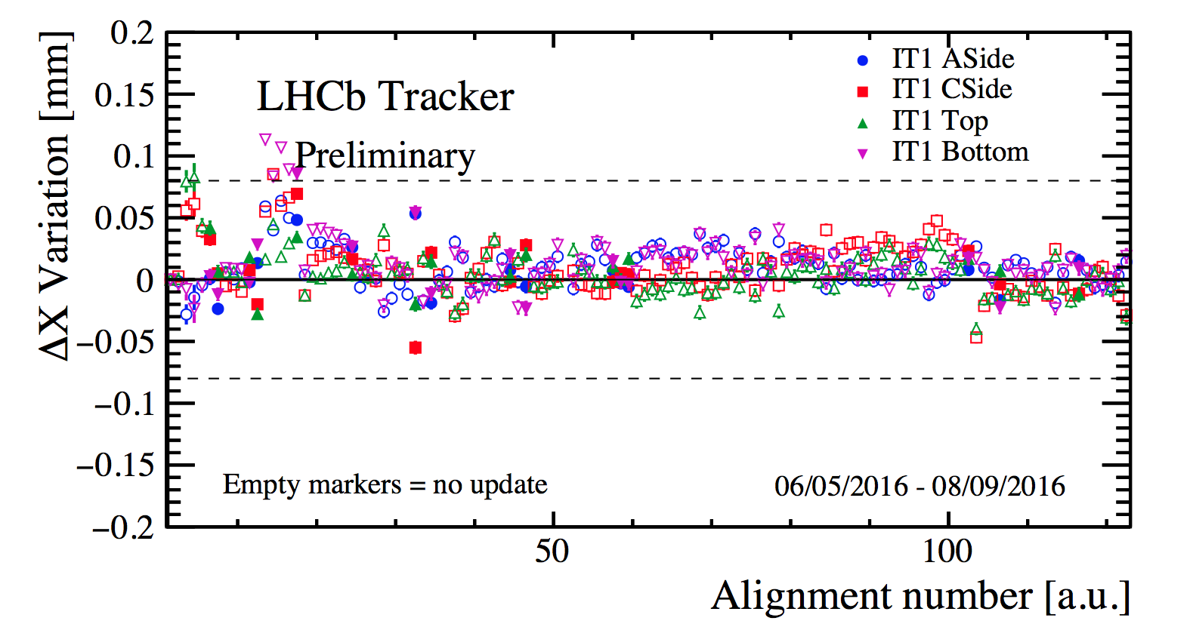
Tracker Alignment
Francesca, Lucia, Maurizio, Wouter
Alignment of each IT box, TT and OT modules for translations in x and z, rotations in x , IT boxes for rotations in z.
Update of constants | Frequency | Data sample | Time to collect data | Time to run
Automatic | Per fill | D⁰ sample | < 1 min. | 7 min
Running since beginning of Run II
Alignment constants updated every 5-12 fills
Studies:
Optimisation of thresholds for automatic update
Optimisation of DOF used online
Offline alignment for T_{y} performed on mag off data at the beginning of the year [LHCb Week June 2016]

Slide 7
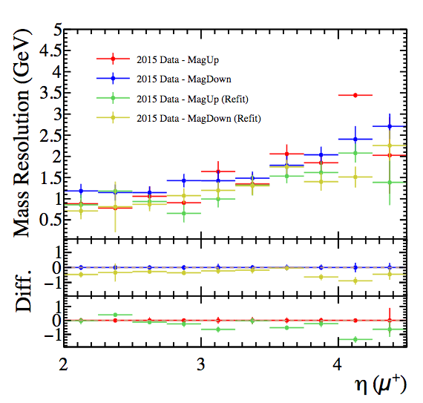
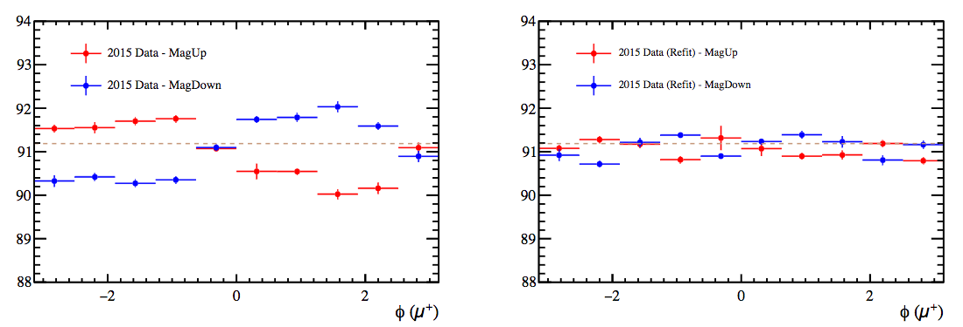
Tracker Alignment
Stephen, Wouter
Study on using Z → μμ for internal alignment:
OT modules split above/below the beam pipe, OT C-frames in z, split TT modules, IT boxes, IT layers and ladders
Performed on full 2015 Z → μμ sample
Using CALIBOFF database (ttitot-20151228) in DaVinci prepared by Wouter [Wouter's talk] on 2015 data [Stephen's talk]
15% improvement in Z mass resolution
Smaller variation of Z mass with Φ(μ)

Slide 8
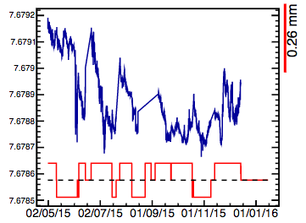
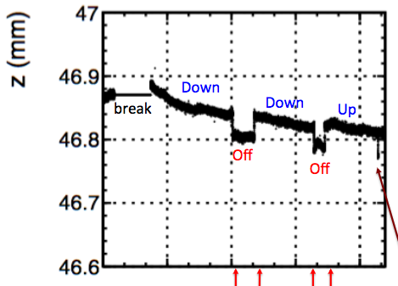
Hardware Tracker Alignment
Fred, Pavol Artur, Niels
Using light + mask/reflector + camera to track points
BCAM: [Pavol's talk]
1 per C-frame of each IT station
every 18 sec
Integrating over 1h ➔ 5μm precision
RASNIK: [Artur's talk]
4 per C-frame of each OT station + 2 on bridge
Precision up to 5μm
Movement seen also by software alignment ➔ real movement of the bridge
Work on relating BCAM with RASNIK with software alignment ongoing
Use BCAM/RASNIK as constraints for software alignment(?)
IT1 C-side in z
Bridge Q13

Slide 9
RICH Mirror Alignment
Anatoly,
Claire,
Paras
Alignment of each mirror for rotations about local y and z axes.
Update of constants | Frequency | Data sample | Time to collect data | Time to run
Monitoring mode only | Per fill | HLT1 line | 5 hours (due to prescale) | 30 min (both RICHs)
Manual running since mid 2015
Automatic running since beginning of 2016
Improvements during Run II:
Increase in speed from 4 hours to 15 min per alignment
Increase in stability [LHCb Week March 2016]
First alignment 2016 into new condDB release

Slide 10
RICH Mirror Alignment
Anatoly,
Claire,
Paras
RICH2 primary mirrors in y
RICH2 primary mirrors in z
Well within required precision!
RICH2 secondary mirrors in y
RICH2 secondary mirrors in z
Run I:
0.68 mrad
Run II:
0.66 mrad

Slide 11
RICH Mirror Alignment
Anatoly,
Claire,
Paras
RICH1 primary mirrors in y
RICH1 primary mirrors in z
RICH1 secondary mirrors in y
RICH1 secondary mirrors in z

Slide 12
RICH Mirror Alignment
Anatoly,
Claire,
Paras
RICH1 primary mirrors in y
RICH1 primary mirrors in z
Small difference due to mag polarity.
➔ No visible impact on overall resolution/performance
More studies following!
RICH1 secondary mirrors in y
RICH1 secondary mirrors in z
DOWN
UP
DOWN
DOWN
UP
DOWN

Slide 13
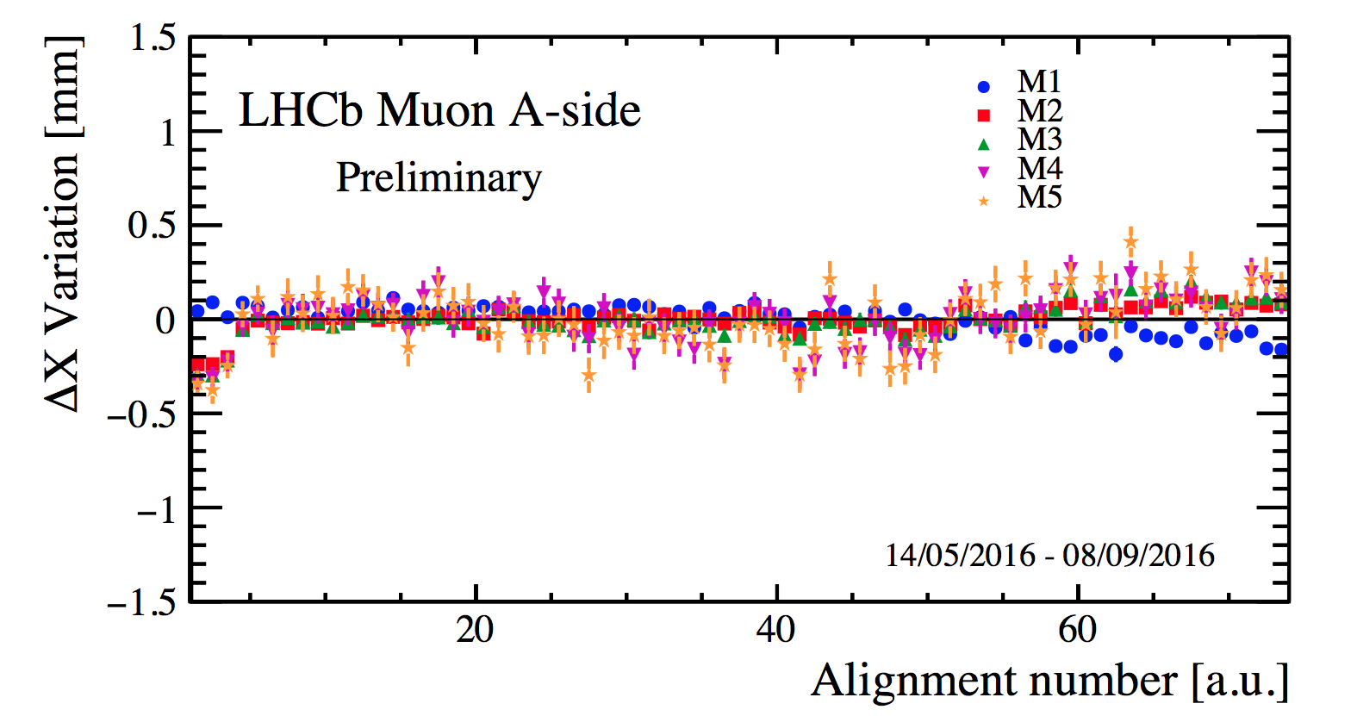
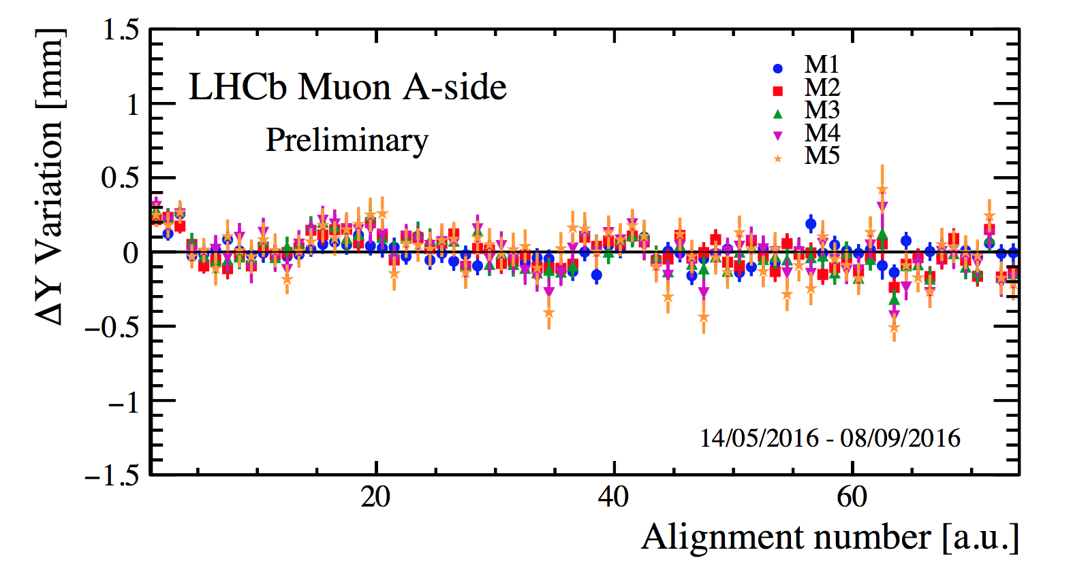
Muon Alignment
Giulio,
Stefania
Alignment of both halves of each station for translations in x and y.
Update of constants | Frequency | Data sample | Time to collect data | Time to run
Monitoring mode only | Per fill | J/ψ sample | 3 hours | 7 min
Running since beginning of Run II
First alignment 2016:
Misalignment of M1 of ~2mm in T_{x} ➔ mechanically moved
New condDB release and LUT for L0 produced
Stable conditions with variations well below required precision of 1mm
[Stefania's talk]

Slide 14
Calibrations

Slide 15
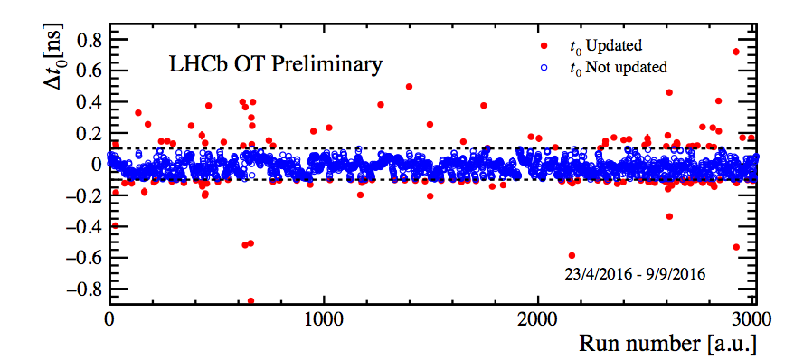
OT Calibration
Philippe,
Lucia
Calibration of global time delay t₀ caused by a difference in collision time and the phase of the LHC clock received at LHCb.
Update of constants | Frequency | Data sample | Time to collect data | Time to run
Automatic | Per run | Mon. histogram | 15 min | O(min)
Running since beginning of Run II
Offline calibration for each t_{OTIS} applied, change only due to hardware interventions ➔ perform ~once a year
Resolution from 3ns in Run I to: 2.43 ns (Monolayer alignment + global t₀ calibration) 2.40 ns (Monolayer alignment + global t₀ calibration + offline t_{OTIS} calibration)
➔ DB update for condDB and simulation with new resolution planned

Slide 16
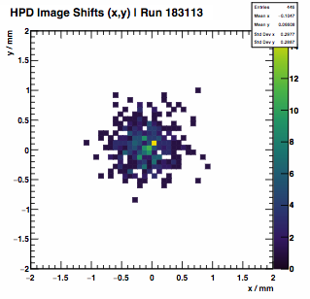
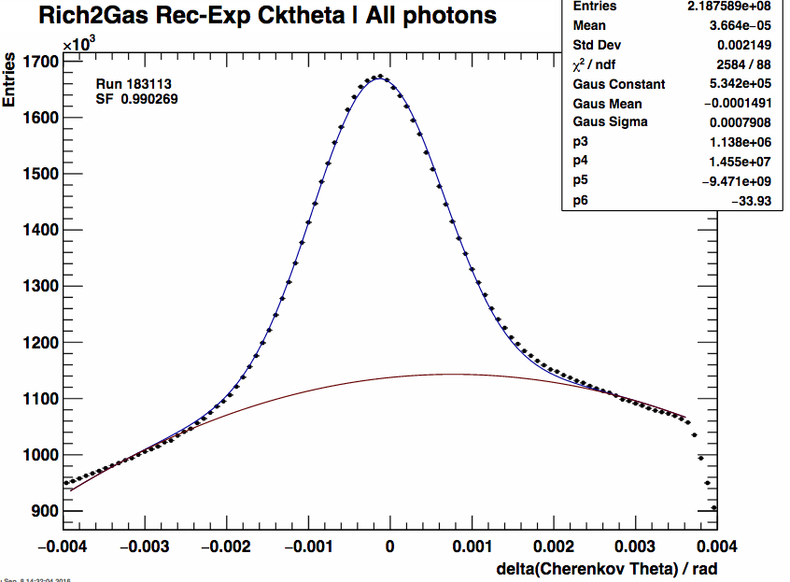
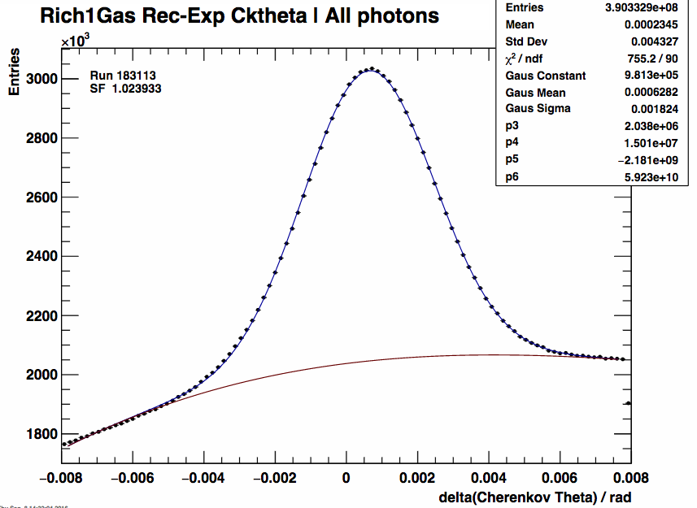
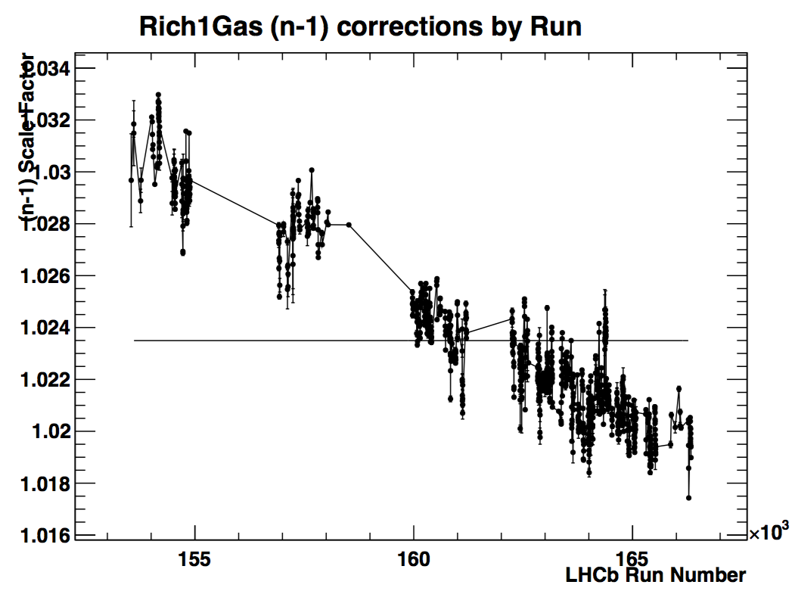
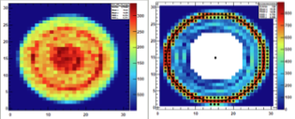
RICH calibrations
Chris,
Jibo, Mike
Calibration of refractive index and HPD image shift.
Update of constants | Frequency | Data sample | Time to collect data | Time to run
Automatic | Per run | Mon. histogram | 15 min | O(min)
Stable running since beginning of Run II
Web resources for easy monitoring: https://lbrich.cern.ch

Slide 17
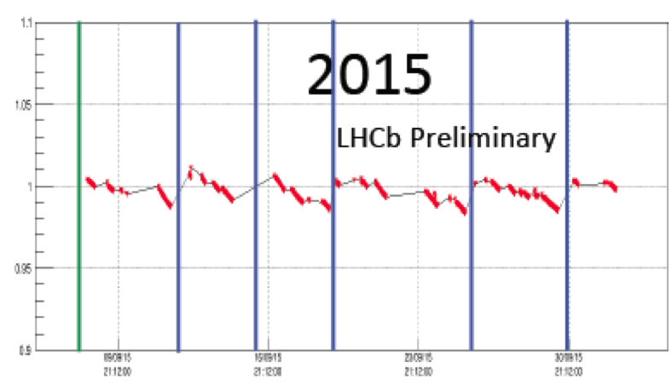
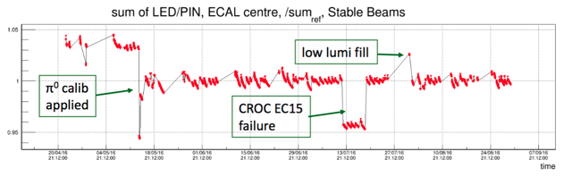
Calorimeter Calibration
Marie-Noelle,
Jean Francois
LED calibration of the gain of the photomultipliers.
Update of constants | Frequency | Data sample | Time to collect data | Time to run
Automatic | Per fill | LED data | O(1h) | O(min)
Running per few fills since beginning of Run II
Running per fill since beginning of 2016 ➔ more stable gain

Slide 18
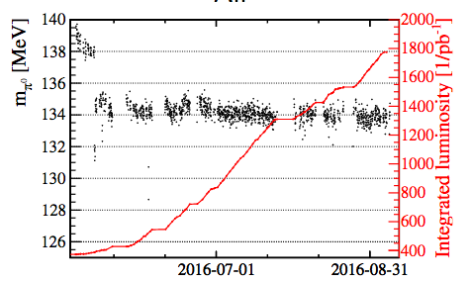
Calorimeter π⁰ Calibration
Dasha,
Jean Francois
Calibration by fitting the π⁰ mass for each calorimeter cell.
Update of constants | Frequency | Data sample | Time to collect data | Time to run
No | ~1 per month | Min. bias | 3-4 days | 5 hours
Last calibration applied in May
Automatisation of online fmDST production
Debugging/ understanding calibration code
Work on PreShower calibration ongoing

Slide 19

Conclusion
Very successful automatic calibration and alignment system!
Additional offline and hardware alignments
Many studies done during the last year
Optimisations in performance and speed
Better understanding of our detector
More things to be studied and understood
Special thanks to the online team!!!

Slide 20
Backup

Slide 21
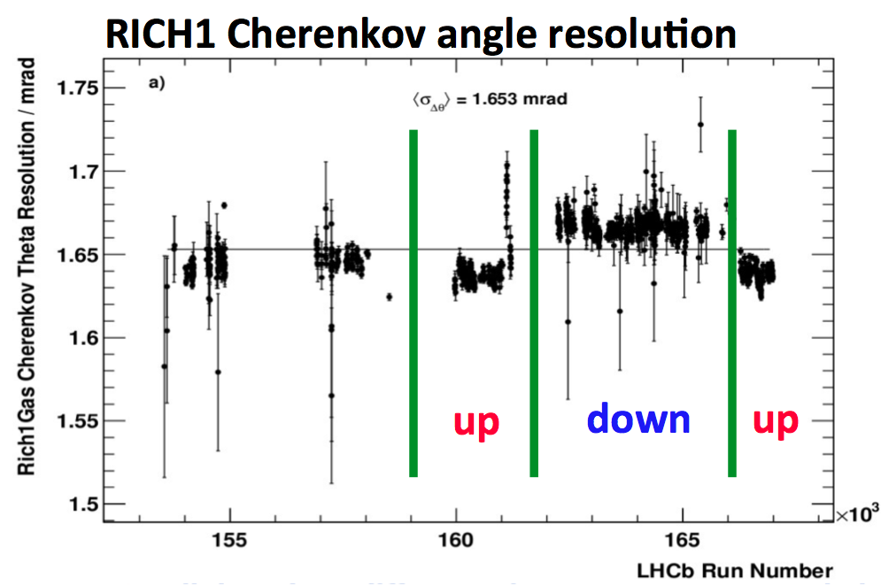
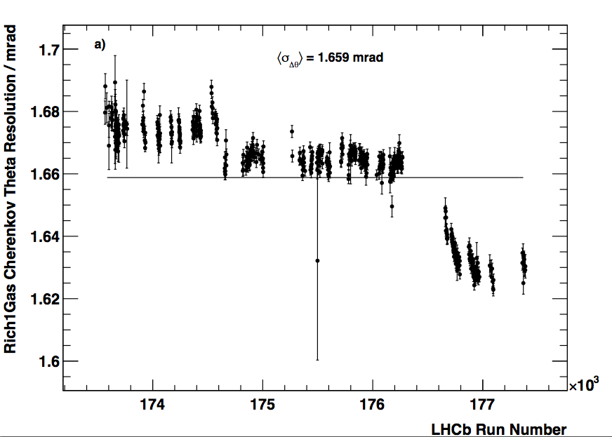
RICH Mirror Alignment
Anatoly,
Claire,
Paras
2015
Early DOWN
DOWN
UP
2015
Still difference in Cherenkov angle resolution between mag. polarities
No difference in overall PID performance in 2015 ➔ waiting for PID samples for 2016
More investigations underway
2016
down
up

