Slide 1
Update on Alignment and Calibration
09/03/2016 Claire Prouve - University of Bristol
on behalf of the Alignment & Calibration group

Slide 2
Overview alignments
Alignments
VELO alignment: Alignment of both halves for translations and rotations in x, y and z.
Tracker alignment: Alignment of TT, IT and OT for translations in x, rotations and translations in z (online) and translations and rotations in y (offline).
RICH mirror alignment: Alignment of all individual mirrors for rotations around x and y.
Muon alignment: Alignment of both halves of each station for translations in x and y.
Run on the HLT-farm at the beginning of every fill in the same order as above.
Automatic update of
alignment constants
Monitoring mode only

Slide 3
Overview calibrations
Calibrations
OT calibration: Global time alignment for all modules, extract the global time delay t₀ caused by a difference in collision time and the phase of the LHC clock received at LHCb.
RICH calibration:
Refractive index calibration: correct the refractive index calculated from hardware sensors.
HPD Image calibration: calibration of the image for each anode element.
Calorimeter calibration: Occupancy method and LED monitoring system, adjust the high voltage to compensate for the aging of the detector
Run on the monitoring histograms for ~every run (OT and RICH) or every fill (Calorimeter).
π⁰ calibration: Calibrate the gain in each cell using the π⁰ mass distribution with π⁰→γγ Run on the alignment farm during TS.

Slide 4
VELO alignment
Giulio,
Silvia
- Runs automatically every fill since beginning of run2
5 minutes to collect data, 2 minutes to run alignment
Updated ~10 fills, ~every week
Align in Txyz, Rxyz
Stability studies, tuning of thresholds for update of alignment
Study on on chi2/ndof
Study on module-alignment => not needed

Slide 5
Tracker alignment
Giulio,
Silvia
Runs automatically every fill since beginning of run2
12 minutes to collect data, 5 minutes to run alignment
Updated ~5 fills, ~twice every week
Align in XXX
Stability studies, tuning of thresholds for update of alignment
Study on which DOF should be used regularly, which once a year
Internal tracker alignment using Z-> mumu tracks offline, Wouter, tested by Stephen on 2015 data, useful once a year

Slide 6
Muon alignment
Giulio,
Silvia
Runs automatically every fill since beginning of run2
XXX minutes to collect data, XXX minutes to run alignment
Monitoring mode
Align in XXX
Stable (as expected)
Updated after moving the muon chamber beginning of the year

Slide 7
RICH Mirror Alignment
Giulio,
Silvia
Runs automatically every fill since beginning of the year
1h to collect data, 20 minutes to run alignment
Monitoring mode
Align each mirror in Ryz
Updated at the beginning of the year
Stable within one magnet polarity
Improved speed
Improved stability

Slide 8
OT global t₀ calibration
Philippe,
Lucia

Slide 9
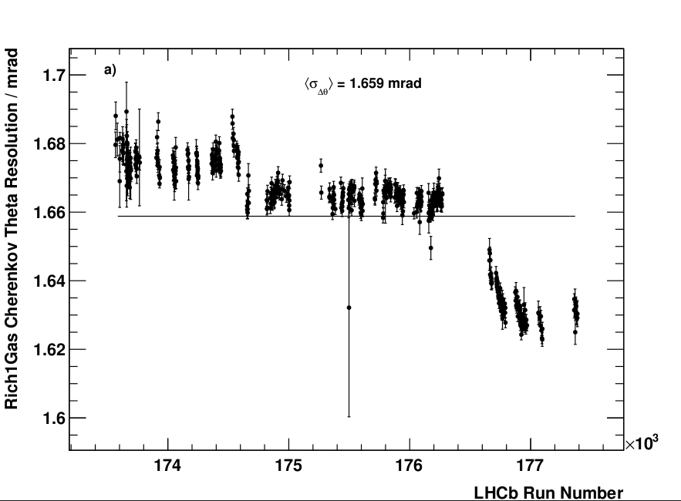
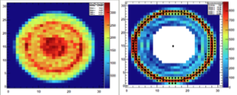
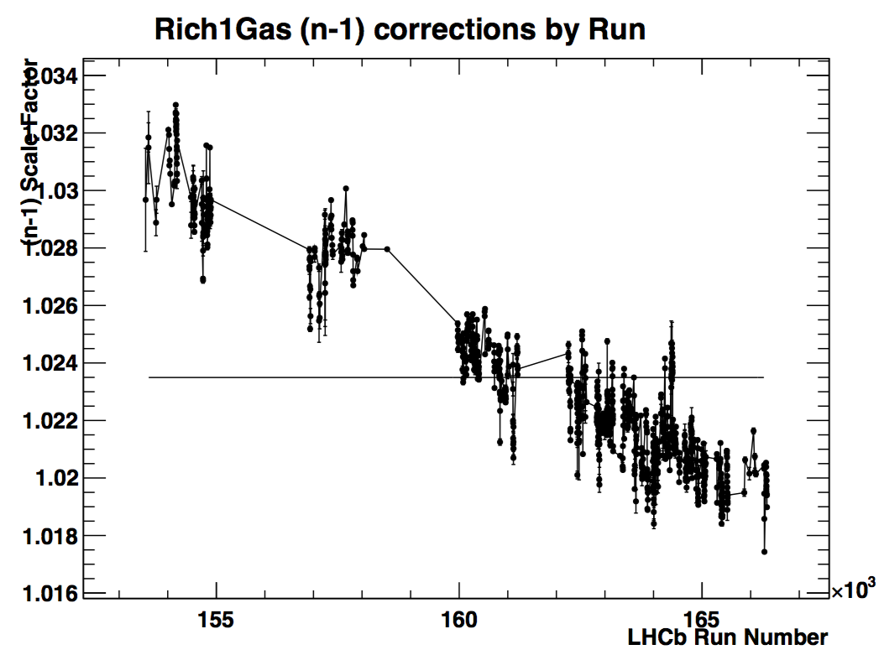
RICH calibrations
Chris,
Jibo
Everything stable and working since beginning of run2
Resolutions now vs run1
HPD image w/o and w/ Sobel filter

Slide 10
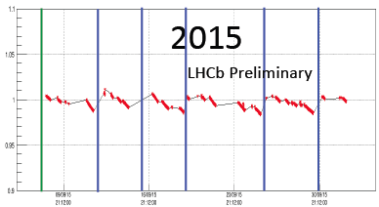
Calorimeter calibrations
Marie-Noelle,
Jean Francois
Work during WS
LED method:
Worked well in 2015
Failing LED were replaced during WS
Occupancy method:
Noticed dependency on the beam conditions
Study still ongoing
Plans for 2016 data-taking
Run LED method for both ECAL and HCAL automatically at the start of each fill
Run occupancy method for each fill (without applying the results) to study the dependency on the beam conditions

Slide 11
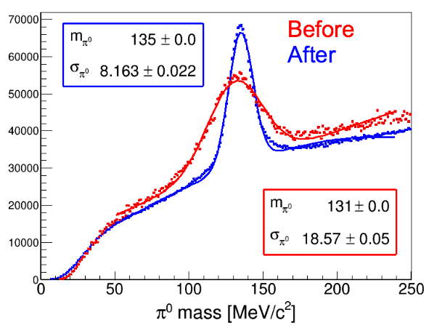
π⁰ calibration
Dasha,
Jean Francois
Work during WS
Dedicated conddb provided for September data that was affected by a π⁰ mass shift (local tag calo-20160104, included into a global tag cond-20160123)
Ongoing work:
Speed up the procedure
Investigate over- and under-calibration of ECAL cells in the central region
➔ Improve event selection
Plans for 2016 data-taking
Before data-taking correct for the over-/under calibration of central cells by using MC
Perform calibrations during the TS

Slide 12
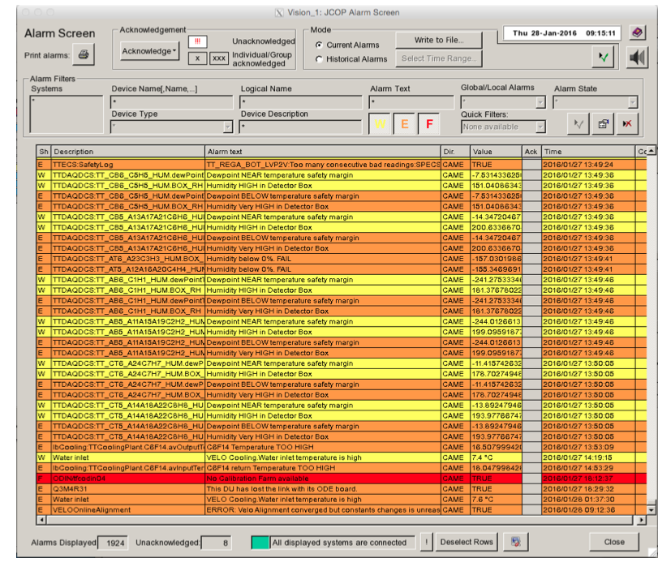
Monitoring and Alarms
Work in progress:
Show development of alignment constants during the alignment procedure in presenter
Show the stability of the alignment constants over time in presenter
Alarm if something goes wrong: change in constants too large, no convergence was reached…
Developing procedure for case of alarms
Thanks, Clara!

Slide 13

Conclusion
Many studies done during WS
Improvements in performance
Improvements in speed
Some small improvements/studies still to be made
Further work on the monitoring required
Getting ready for data-taking!

