Slide 1
Alignment and Calibration report
09/09/2016 Claire Prouve - University of Bristol
on behalf of the Alignment & Calibration group

Slide 2
Overview
Perform alignment and calibration of subdetectors ‘in real-time’
➔ Same constants in the trigger and the offline reconstruction
➔ Use of PID information in HLT2
➔ Best possible trigger performance
Requirements: fast + evaluated in real-time
Buffer events to disk before running HLT2
Alignments + π⁰ calibration:
Use HLT farm with ~1800 nodes
Collect results on single node and evaluate the alignment constants
Calibrations:
Run on monitoring histograms

Slide 3
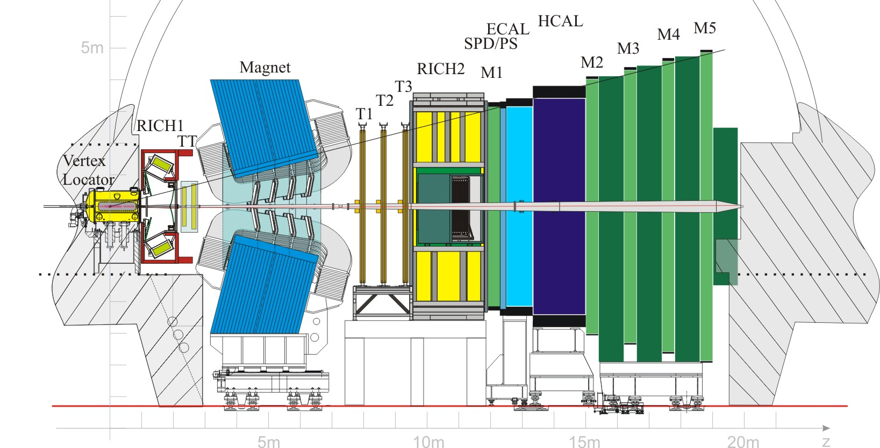
Overview

Slide 4
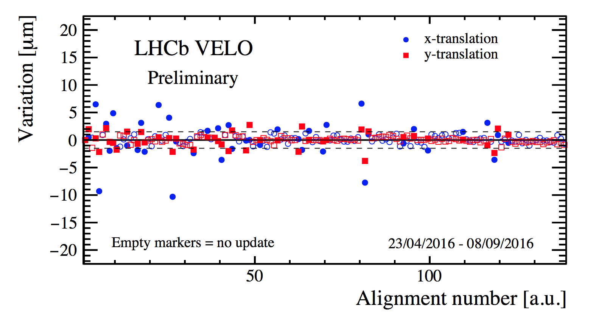
VELO alignment
Giulio,
Silvia
Alignment of both halves for translations and rotations in x, y and z.
Update of constants | Frequency | Data sample | Time to collect data | Time to run
Automatic | Per fill | Min. bias + beam gas events | 5 min. | 2 min
Stable running since beginning of Run II
Alignment constants updated every 2-3 fills

Slide 5
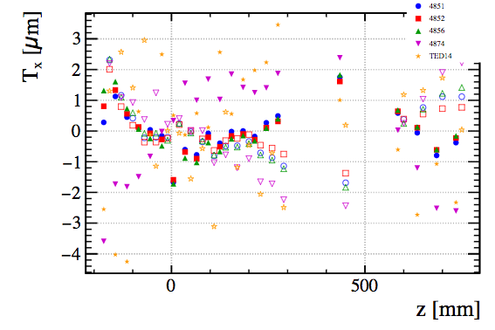
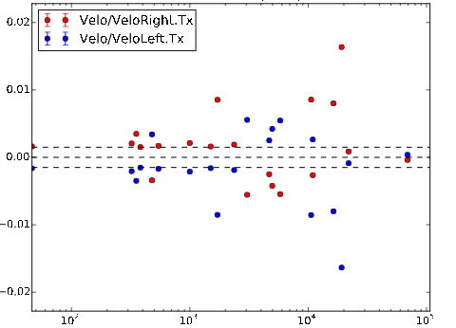
VELO alignment
Giulio,
Silvia
Study on alignment of individual modules:
Module misalignment can degrade alignment if 4 - 8μm in T_{x}, T_{y}
Alignment of modules for main degrees of freedom: T_{x}, T_{y} and R_{z}
4 fills from the beginning of 2016 data taking
➔ Compatible with statistical fluctuations, no frequent modular alignment needed.
Study on χ² convergence criteria:
Convergence reached if χ² /n_{dof} < 2
Update of alignment constants dependent on change in constants
Plot the variation of the alignment constants as a function of χ² /n_{dof}
➔ All triggered updates have χ² /n_{dof} > 200
T_{x}[mm]
χ² /n_{dof}

Slide 6
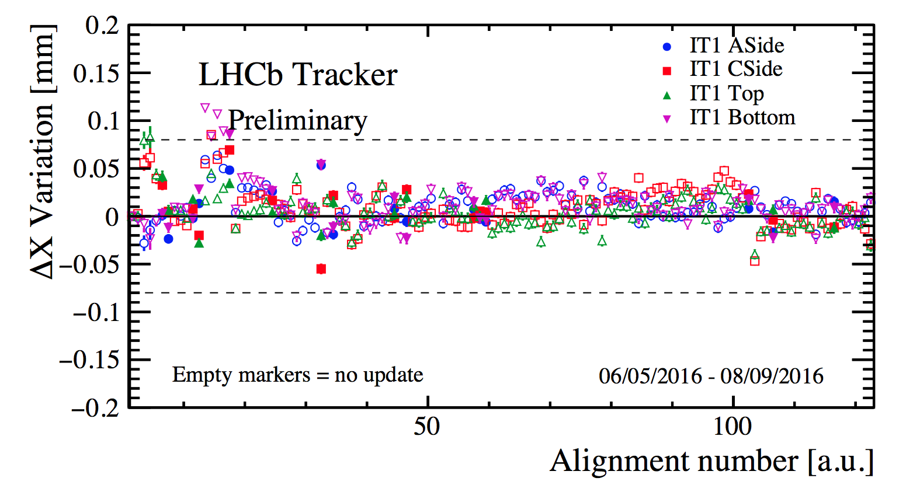
Tracker alignment
Francesca, Lucia, Maurizio, Wouter
Alignment of each IT, TT and OT box for translations in x and z and IT boxes for rotations in z (online) and translations and rotations around y (offline).
Update of constants | Frequency | Data sample | Time to collect data | Time to run
Automatic | Per fill | D⁰ sample | 12 min. | 7 min
Stable running since beginning of Run II
Alignment constants updated every 4-5 fills
Internal alignment performed manually at the start of the year using Z→μμ tracks from 2015 data

Slide 7
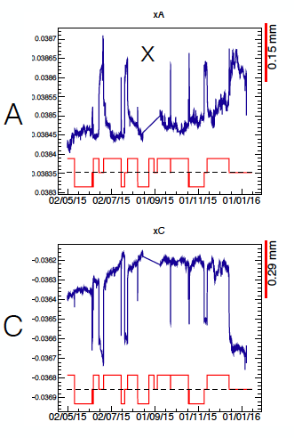
Tracker alignment
To be done:
Evaluation of alignment with high momentum tracks and tracks from J/Ψ events
Study different alignment configurations
Stability study for IT: correlation between movement seen by BCAM (Pavol's talk) and tracker alignment under study
Stability study for OT and TT: stability of alignment constants of the different elements
Plans for 2016 data-taking
Detector was opened and IT2C box was moved (~1mm in x,y) ➔ expect significant misalignment at the start
1st alignment with big data-sample and all degrees of freedom at the beginning of data-taking
Alignment in y with magnet-off data
Use D⁰ events plus high-momentum tracks (and possibly J/Ψ events)
IT1 A side X-coordinate
IT1 C side X-coordinate s

Slide 8
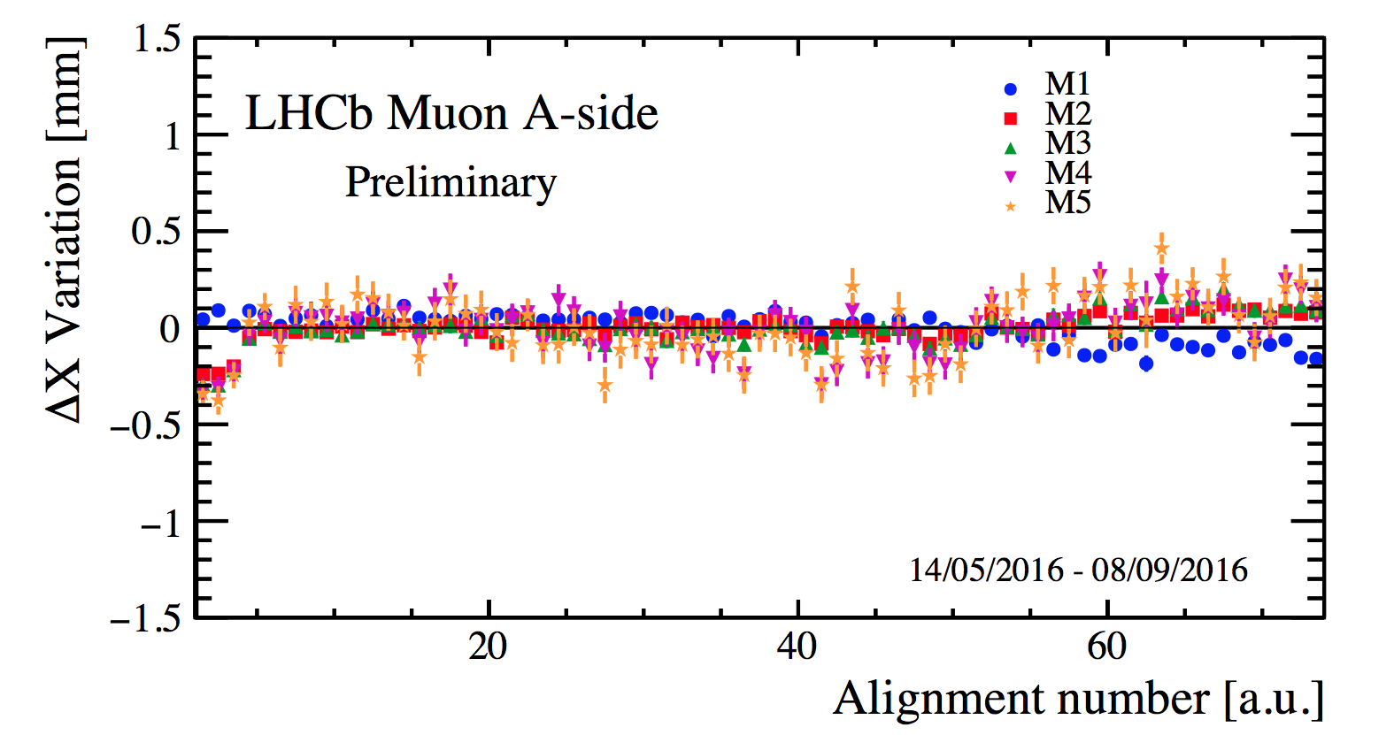
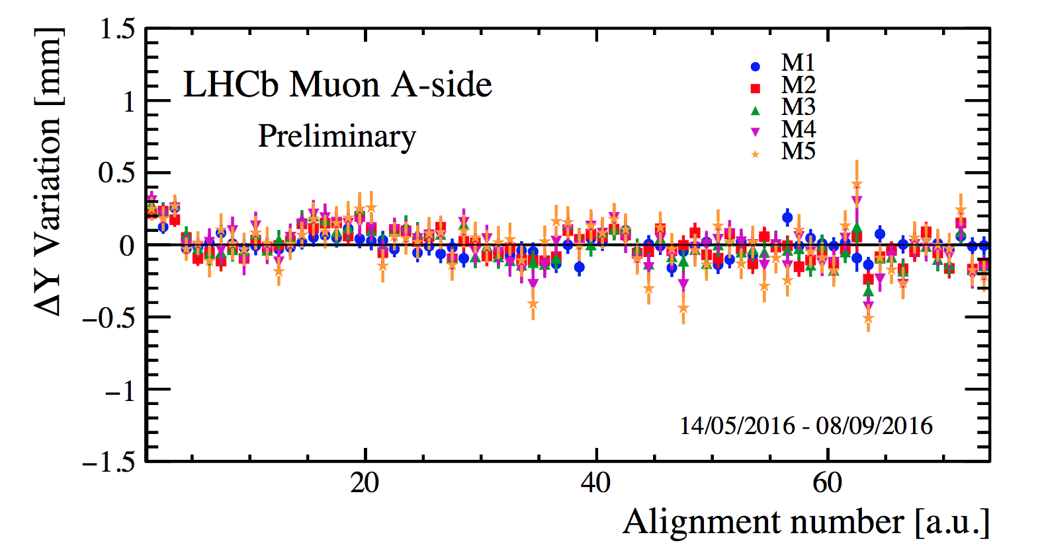
Muon alignment
Silvia,
Stefania
Alignment of both halves of each station for translations in x and y.
Update of constants | Frequency | Data sample | Time to collect data | Time to run
Monitoring mode only | Per fill | J/ψ sample | 3 hours | 7 min
Stable running since beginning of Run II
First alignment 2016:
Misalignment of M1 of ~2mm in T_{x} ➔ mechanically moved
New condDB release and LUT for L0 produced
Stable conditions with variations well below required precision of 1mm

Slide 9
RICH Mirror alignment
Anatoly,
Claire,
Paras
Alignment of each mirror for rotations about local y and z axes.
Update of constants | Frequency | Data sample | Time to collect data | Time to run
Monitoring mode only | Per fill | HLT1 line | 1.5 hours | 30 min (both RICHs)
Automatic running since beginning of 2016
Alignment constants updated at the beginning of data taking this year

Slide 10
OT Calibration
Philippe,
Lucia
Calibration of global time delay caused by a difference in collision time and the phase of the LHC clock received at LHCb t₀ (online) and time differences between different OTIS chips t_{OTIS}(offline).
Update of constants | Frequency | Data sample | Time to collect data | Time to run
Automatic | Per run | Min. bias | O(min) | O(min)
Stable running since beginning of Run II
Offline calibration for each t_{OTIS} applied, only expected to change due to hardware interventions ➔ perform ~once a year
Resolution improved from 3ns in Run I to 2.43 ns (Monolayer alignment + global t₀ calibration) 2.40 ns (Monolayer alignment + global t₀ calibration + offline t_{OTIS} calibration)
➔ DB update for condDB and simulation with new resolution planned

Slide 11
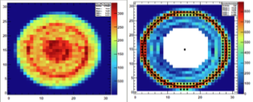
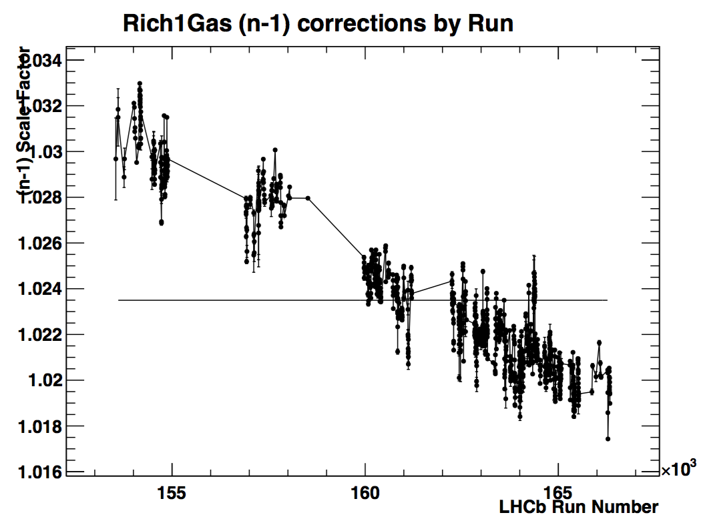
RICH calibrations
Chris,
Jibo
Calibration of refractive index and HPD image shift.
Update of constants | Frequency | Data sample | Time to collect data | Time to run
Automatic | Per run | HLT1 line | 15 min | O(min)
HPD image w/o and w/ Sobel filter

Slide 12
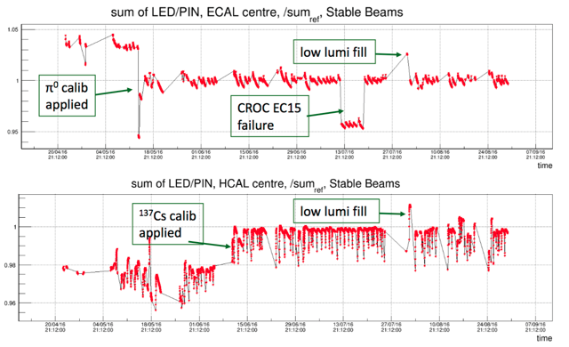
Calorimeter Calibration
Marie-Noelle,
Jean Francois
LED calibration of the gain of the photomultipliers.
Update of constants | Frequency | Data sample | Time to collect data | Time to run
Automatic | Per fill | Min. bias | O(1h) of LED data | O(min)

Slide 13
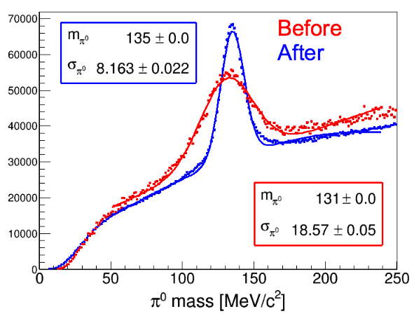
Calorimeter π⁰ Calibration
Dasha,
Jean Francois
Calibration by fitting the Pi0 mass for each calorimeter cell.
Update of constants | Frequency | Data sample | Time to collect data | Time to run
No | ~1 per month | Min. bias | 3-4 days | 5 hours

Slide 14

Conclusion
Many studies done during WS
Improvements in performance
Improvements in speed
Some small improvements/studies still to be made
Further work on the monitoring required
Getting ready for data-taking!

