Slide 1
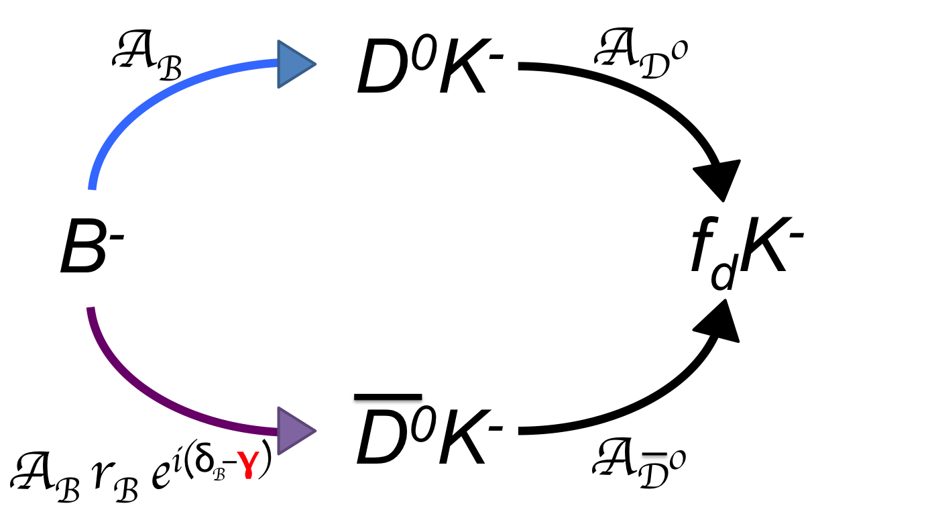
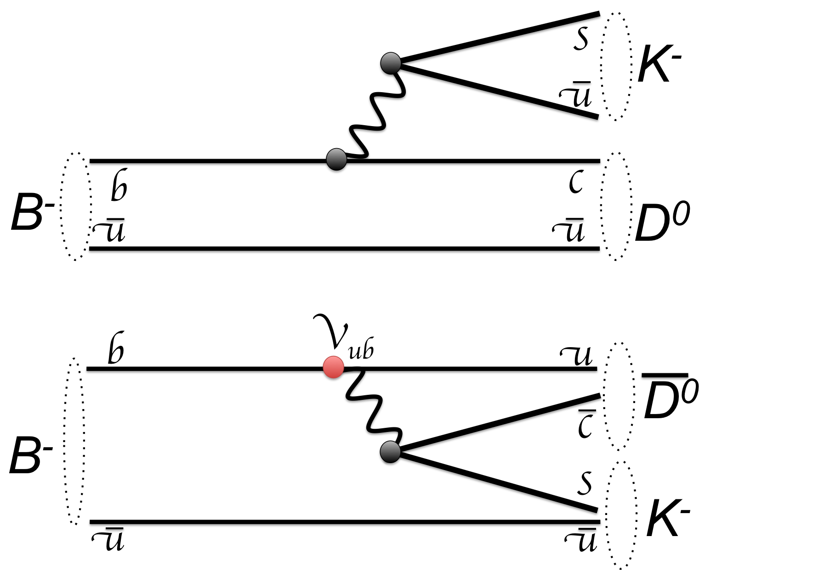
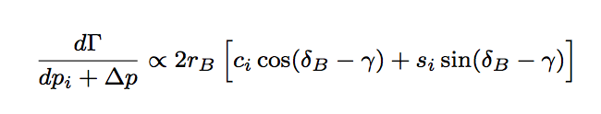


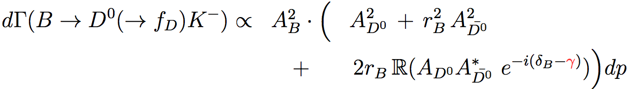
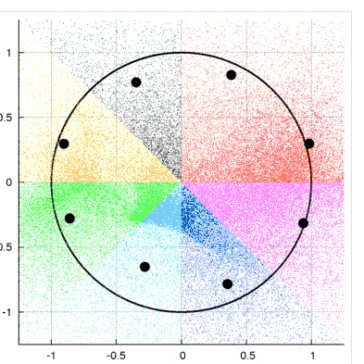

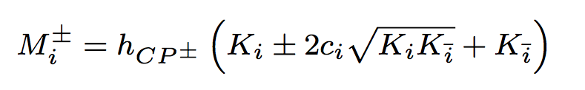
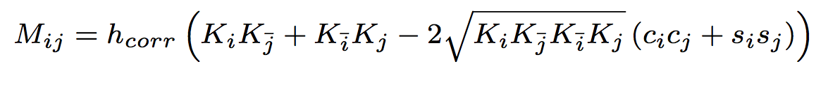
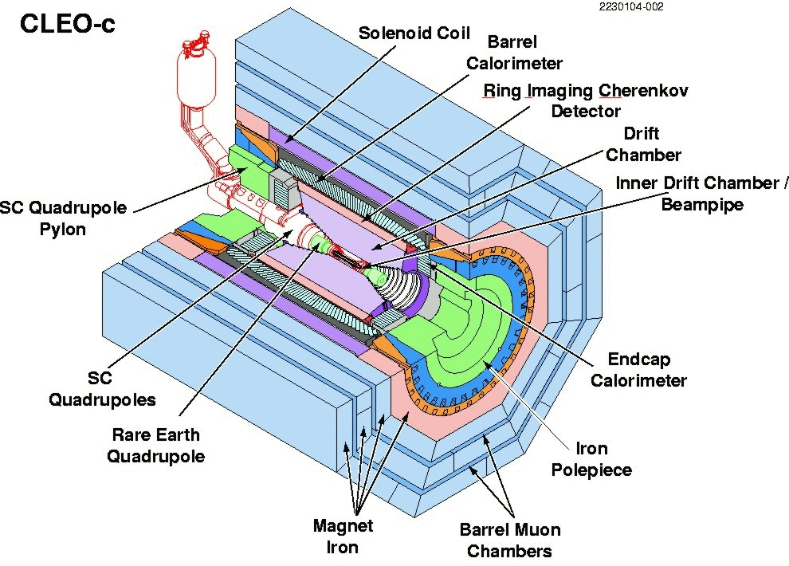
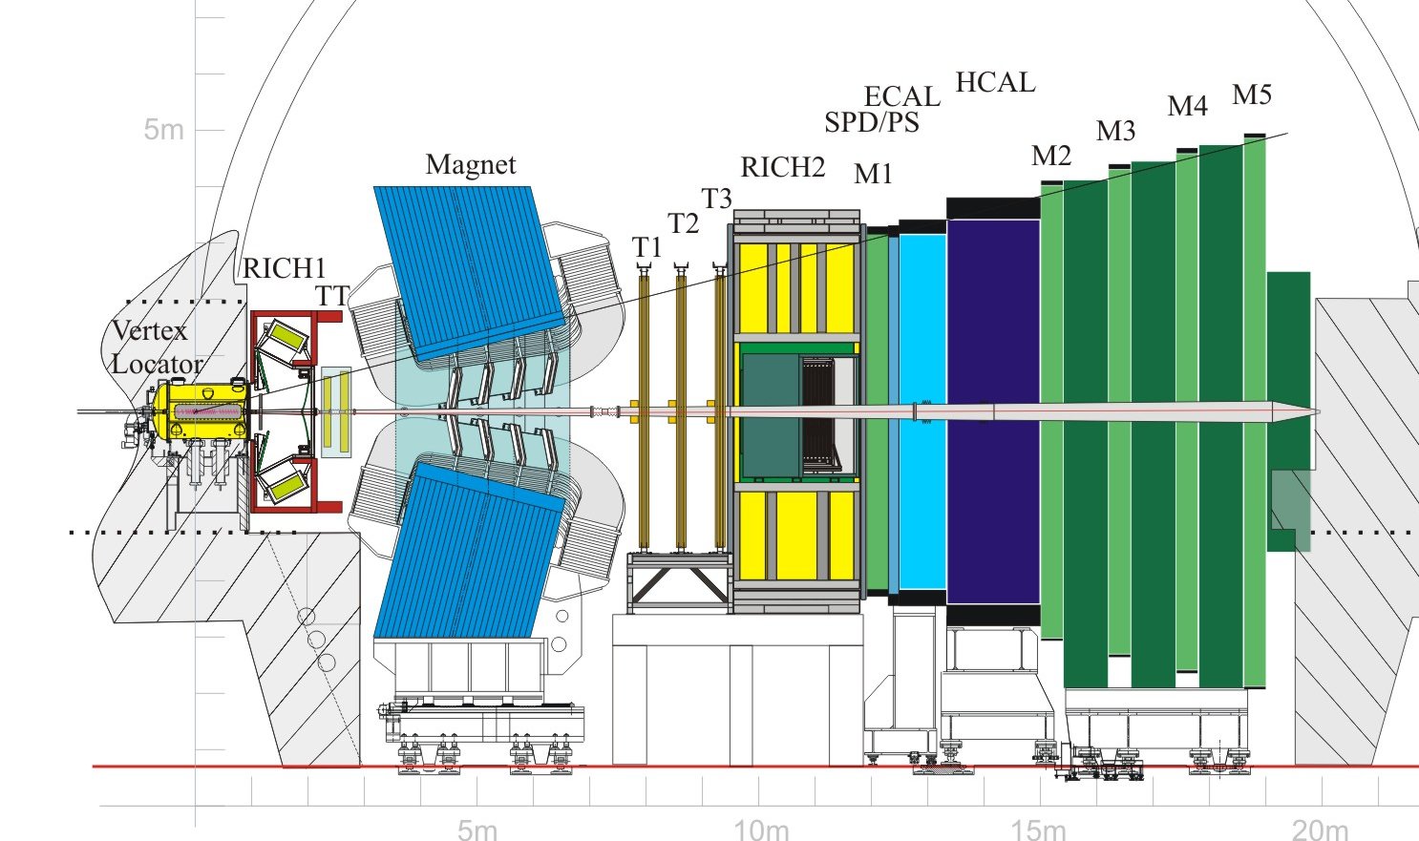
Towards a model independent measurement of γ
through B±→D(→4π)K± decays with LHCb and CLEO-c
Claire Prouve, Jonas Rademaker – University of Bristol
Measurement of CKM angle γ through
interference in B± D( f_{D})K±
Reconstruction of the D mesons in self- conjugate
final state f_{D} = π⁺(p₁) π⁺(p₂) π⁻(p₃) π⁻(p₄)
CP-conjugation*
final state
accessible to
both D⁰ and D⁰
strong phase difference between
A_{D}0 and A_{D}0
All amplitudes and phases depend on the point in phase space
Dalitz plot analysis in 5 dimensions
2D projection
2D projection
2D projection
B⁻ D⁰K⁻ :
Re(A_{D}⁰)
Re(A_{D}⁰)
Im(A_{D}⁰)
m²(π⁺(p₁) π⁺(p₂))
m²(π⁺(p₁) π⁺(p₂))
m²(π⁺(p₁) π⁺(p₂))
m²(π⁺(p₁) π⁻(p₃))
m²(π⁺(p₁) π⁻(p₃))
m²(π⁺(p₁) π⁻(p₃))
B⁻ D⁰K⁻ :
colour
surpressed
In order to extract γ the analysis has to be performed in bins of phase space.
Binned decay width:
Partial decay width
amplitude-weighted average of cos(Δδ)
amplitude-weighted average of sin(Δδ)
γ becomes an observable in the interference term
(*) Assuming no CP-V in the D decays and neglecting 2nd order effects from charm mixing
Model independent determination of c_{i} and s_{i} with CLEO-c using correlated D meson pairsfrom Ψ(3770) DD
Model inspired binning
The highest sensitivity to γ can be obtained by using bins with minimal variation of Δδ.
c_{i} : Reconstruct D 4π as flavour or CP eigenstate by using opposite side tagging and combine information of CP (M±_{i}) and flavour (K_{i}) Dalizt plots
Flavour/ CP
eigenstate
Ψ(3770)
( π⁺(p₁) π⁺(p₂)
π⁻(p₃) π⁻(p₄) )
The more Δδ varies over a bin, the smaller |c_{i}| and |s_{i}|.
<c_{i}> = 0.04 <s_{i}> = -0.01
s_{i}
s_{i} : Reconstruct Ψ(3770) (DD) (4π)(4π’) and use interference between both possible decay paths
Event rate in i^{th} bin of first and j^{th} bin of second Dalitz plot:
Obtain Δδ by applying a model for A_{D}⁰
obtained from CLEO-c.
Ψ(3770)
c_{i}
( π⁺(p’₁) π⁺(p’₂)
π⁻(p’₃) π⁻(p’₄) )
( π⁺(p₁) π⁺(p₂)
π⁻(p₃) π⁻(p₄) )
colours correspond to bins of Δδ
Note: The binning only influences the sensitivity of the γ measurement but not the γ value itself.
Analysis procedure for the future:
2. LHCb
1. CLEO-c
Measurement of c_{i} and s_{i} using
~ 9500 flavour tagged
~ 1000 CP tagged jjj
and performing a 5 dimensional fit for each bin in phase space.
Simultaneous fit of r_{B}, δ_{B} and γ in all bins of phase space using
a few 10³ B± D( 4π)K± events jjj
and the c_{i} and s_{i} extracted from CLEO-c.
D( 4π) events
UK HEP Forum - 14-15 November 2013 - Poster Session

Slide 2
A_{B}
D⁰K⁻
A_{D}⁰
B⁻
f_{d}K⁻
A_{B} r_{B} e^{i(δB–γ)}
D⁰K⁻
A_{D}⁰
s
K⁻
u
u
B⁻
b
c
D⁰
K⁻
u
u
W⁻
s
b
V_{ub}
u
B⁻
b
c
D⁰
B⁻
c
D⁰
u
s
K⁻
u
u
u
u
b
W⁻
c
K⁻
B⁻
s
D⁰
u
u
A_{B}
D⁰K⁻
B⁻
f_{d}K⁻
A_{B} r_{B} e^{i(δB–γ)}
D⁰K⁻

