Slide 1
Plan for measuring c_{i} and s_{i} for 4Pi
15/02/2016 Claire Prouve

Slide 2
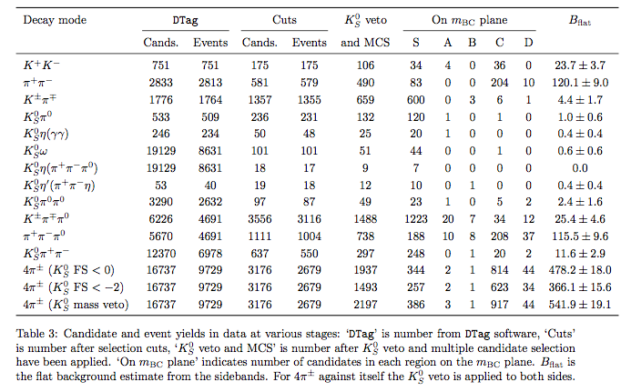
Event selection
Standard event selection for tags: see Chris’ thesis/ F₊ paper
KsPiPi veto for the 4Pi side from F₊ paper (?)

Slide 3
Backgrounds
Peaking backgrounds are those that lie predominantly in the signal region. They often have the same final-state particle content as the signal decay.
Flat backgrounds are distributed across the signal region and sidebands without any significant peaking structures. The quantity of flat background in the signal region can be estimated using the sideband populations in data.
--------------------------------------------
Phase-space backgrounds: evenly distributed in phase-space, meaning each bin ‘gets’ the a number of events proportional to its area in the Dalitz-plot.
Resonant background: ‘unevenly’ distributed in phase-space, meaning distribution of events over the bins has to be found differently
The categories peaking bkg/flat bkg are used to find the total number of events while the phase-space/resonant category is used to find the distribution over the bins.
Find peaking/resonant bkgs! (KsPiPi reconstructed as 4Pi is one)
How to define and determine the ‘area of a bin in phase-space’?

Slide 4
Backgrounds
We consider the following phase-space backgrounds:
• Signal-side background to KS0K+K,
The following backgrounds are assumed to be resonant:
• KS0,LK+K against opposite-side background,
We use a signal MC sample of KS0,LK+K tagged with KPi to estimate the bin-by-bin yield of resonant backgrounds…
➔ Not sure this is optimal (but the errors are probably so big that it doesn’t matter?)
KsPiPi reconstructed as 4Pi: find distribution from data with reversed Ks-Veto

Slide 5
Kinematic fitting
The final state tracks are refitted to the D⁰ mass.
Chris validates this technique on MC, do we need to do that too?
Treating of events that leave the signal region due to the fit: Occasionally an event is reconstructed outside the physical region. A vector from this point to the Dalitz plane boundary is determined such that the vector is perpendicular to the tangent to the boundary at the point of intersection between the vector and the boundary. There is one unique vector that satisfies this condition, denoted the vector of closest approach.
➔ How to do that for 4Pi?

Slide 6

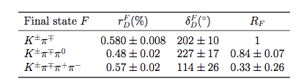
Flavour tag correction factors
Correction factor to be multiplied to the number of flavour tagged events:

Slide 7
To do
Finish getting K3Pi and Kenu events (data, genMC, continuum MC, Signal MC)
What bkgs would we expect here?
Include Chris’ BkgCat
Apply selection and make table like Chris to compare
Handle events that the kinematic fit kicked out the physical region
Peaking and flat bkgs for total signal region
Get “area” of bins in phasespace
Flavour-tag correction factors
Bin migration
Selection and reconstruction efficiencies
Amplitude model MC from CLEO? (for bin migration and efficiencies)
Model predictions for number of signal events in bins (both flavour and CP tags)
Model predictions for c_{i}, s_{i}
How many bins do we want to try?

