Slide 1
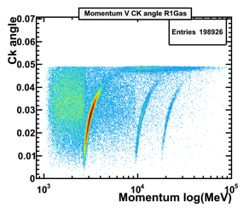
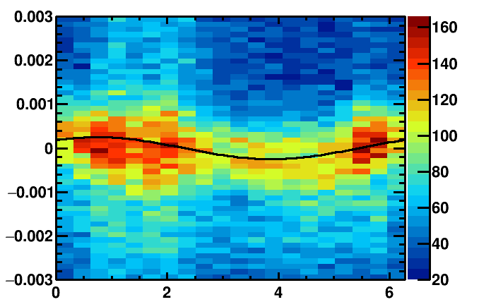

High energy tracks + reconstruct under pion- hypothesis
Fill histograms with (Δθ vs. Φ) of unambiguous photons for each mirror- pair
Events
Unambiguous photons will be reflected by the same mirror-pair no matter where along the track they were emitted.
database
Replace database + do next iteration.
YES
Alignment converged!!!
NO
Any mirror moved > 0.1 mrad?
Calculate mirror misalignments for each individual mirror + Update database
Determine misalignment on detector plane
new database

