Slide 1
Note to Parallel
Aaron

Slide 2
OpenMP: Critical
Only one thread can excute the following structured block at a time.
Be careful ablout deadlock.
1
critical
block
global_result = 0.0;
# pragma omp parallel num threads(thread count)
{
# pragma omp critical
global result += Local_trap(double a, double b, int n);
}
2
3
critical
block
Local_trap will be excute sequentially
1
2
global result = 0.0;
# pragma omp parallel num threads(thread count)
{
double my result = 0.0; /∗ private ∗/
my result += Local trap(double a, double b, int n);
# pragma omp critical
global result += my result;
}
3
critical
block
1
2
3
Parallel excute Local_trap & correct result

Slide 3
OpenMP: atomic & lock
atomic
lock
Same effect as critical does.
Can only be used when the critical section has the form x <op>= <expression>, x++, ++x, x-- or --x.
Only the load and store of x are protected.
Exploit special hardware instructions.
Much faster than an ordinary critical section.
Lock is used for data structure.
Only one thread can fetch the data at a time.
1
data
locked data
1
2
2
3
3
data
locked data
1
1
2
2
3
3

Slide 4

Loop-carried dependences
A numerical approximation to π
A serial implementation can be
A wrong parrallel implementationwith loop-carried dependence in line 7
The right one should be
1 double factor = 1.0;
2 double sum = 0.0;
3 # pragma omp parallel for num threads(thread count) \
4 reduction(+:sum)
5 for (k = 0; k < n; k++) {
6 sum += factor/(2∗k+1);
7 factor = −factor;
8 }
9 pi_approx = 4.0∗sum;
1 double factor = 1.0;
2 double sum = 0.0;
3 for (k = 0; k < n; k++) {
4 sum += factor/(2∗k+1);
5 factor = −factor;
6 }
7 pi_approx = 4.0∗sum;
1 double factor = 1.0;
2 double sum = 0.0;
3 # pragma omp parallel for num threads(thread count) \
4 reduction(+:sum)
5 for (k = 0; k < n; k++) {
6 factor = (k % 2 == 0) ? 1.0 : -1.0;
6 sum += factor/(2∗k+1);
8 }
9 pi_approx = 4.0∗sum;

Slide 5
Scope: default, private, shared & reduction
default(none): specific scopeby hand.
private: private copies created.
shared: all threads share the data.
reduction: private at each thread, and reduction to one at the end.
sum = 0.0, n
Thread 0
Thread 1
Thread 2
k_0
factor_0
sum_0
k_1
factor_1
sum_1
k_2
factor_2
sum_2
reduction(<operator>: <variable list>)
Our code for approximating π could be
sum += sum_0
double sum = 0.0;
# pragma omp parallel for num threads(thread count) \
default(none) reduction(+:sum) private(k, factor) \
shared(n)
for (k = 0; k < n; k++) {
factor = (k % 2 == 0) ? 1.0 : -1.0;
sum += factor/(2∗k+1);
}
sum += sum_1
sum += sum_2
End

Slide 6
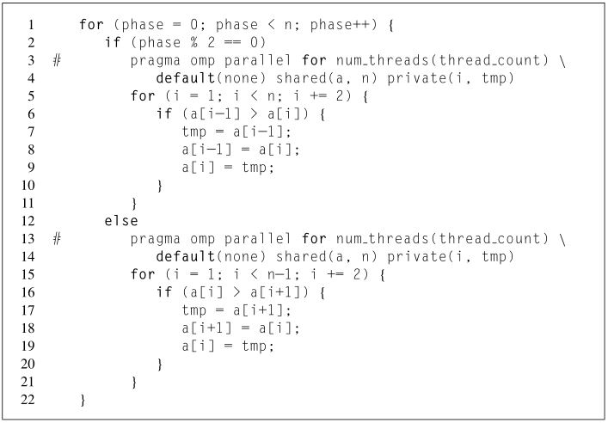
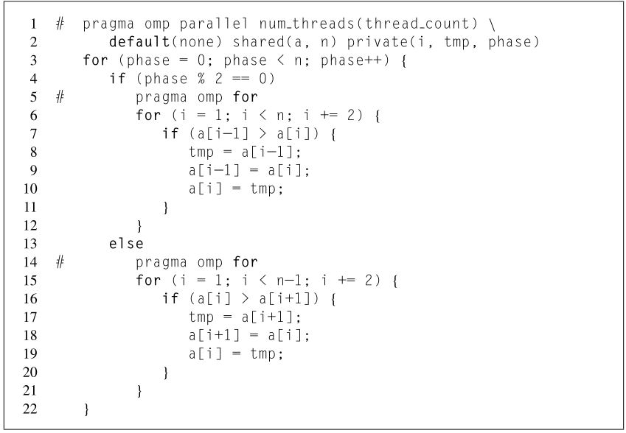
OpenMP: forking & joining overhead
the odd-even sort
May fork and join thread_count threads n times.
Only fork and join thread_count threads once.

Slide 7
OpenMP: schedule
To get a cyclic schedule
the schedule clause has the form
Use 3 threads, for 12 loops with chunksize 2, iterations devided into 12/2=6 chunks
sum = 0.0;
# pragma omp parallel for num threads ( thread count ) \
reduction (+: sum ) schedule (static,1)
for ( i = 0; i <= n ; i ++)
sum += f ( i );
static, 2
0 | 0 | 1 | 1 | 2 | 2 | 0 | 0 | 1 | 1 | 2 | 2
dynamic, 2
schedule (< type > [, < chunksize >])
0 | 0 | 1 | 1 | 2 | 2 | 1 | 1 | 0 | 0 | 2 | 2
Type | Effect
static | Iterations assigned before loop.
dynamic | Each thread excutes a chunk. Requsts another one when finishes a chunk.
guided | Each thread excutes a chunk. Requsts another one when finishes a chunk. Chunk size decreases.
runtime | uses the schedule specified by OMP_SCHEDULE environment variable, such as static, dynamic or guided.
Thread 1 finishes its first chunk before thread 0
guided, 2
0 | 0 | 0 | 0 | 1 | 1 | 1 | 2 | 2 | 2 | 2 | 1
chunk_size ≈ remaining_iterations / thread_num
chunk_size ≥ chunksize

Slide 8
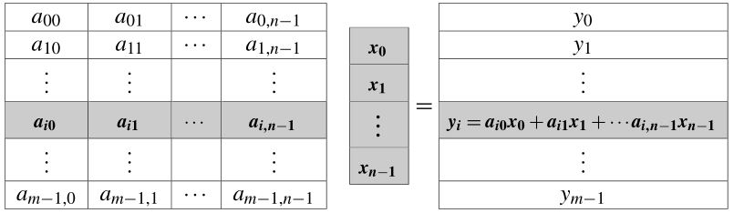
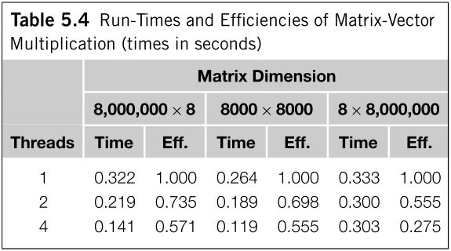
OpenMP：false sharing
Look at a matrix-vector multiplication
1 # pragma omp parallel for num threads(thread count) \
2 default(none) private(i, j) shared(A, x, y, m, n)
3 for (i = 0; i < m; i++) {
4 y[i] = 0.0;
5 for (j = 0; j < n; j++)
6 y[i] += A[i][j]∗x[j];
7 }
For single thread
of 8,000,000 x 8 inputs, far more write-miss of y[i] occurs, since y is too large and y[i] may not in cache. (line 4)
of 8 x 8,000,000 inputs, far more read-miss of x[j] occurs, since x is too large and x[j] may not in cache. (line 6)
2. For parallel efficiency
At four threads case with 8 x 8,000,000 inputs, each thread is assigned only 2 components of y .
A cache line is 64 bytes on the system, it will store 8 doubles. Thus all components of y will be stored in each cache.
Cache coherence is enforced at the “cache-line level”, any writting to y will invalid other cache, forces the assigned y to update again.
The system has two dual-core processors, then each thread will update its assigned compnents of y a total of 16,000,000 times.
This is called false sharing.

Slide 9
OpenMP: barrier
When a thread encounters the barrier, it blocks until all the threads in the team have reached the barrier.
1
barrier
1
barrier
2
2
3
3
1
barrier
barrier
1
2
2
3
3
# pragma omp barrier
Several OpenMP directives provide implicit barriers when they are completed, such as reduction, for, etc.

