Slide 1
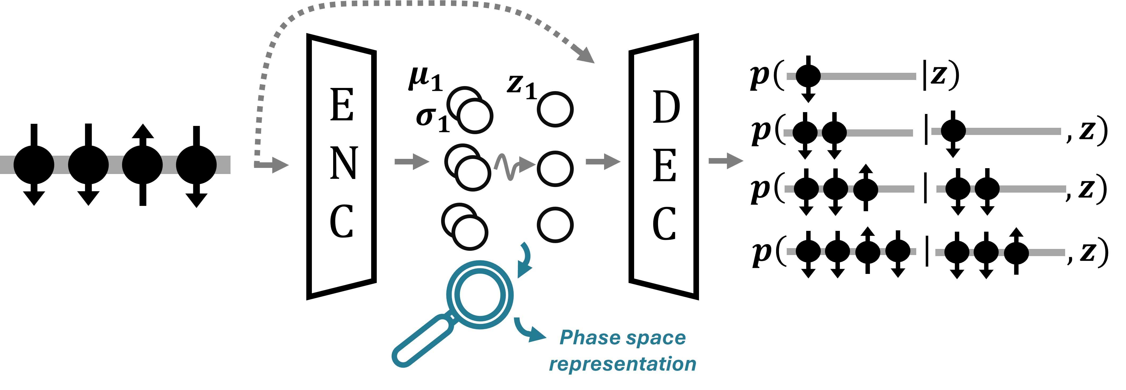
VAEs basic
Generative model – Decoder pθ(x)
Aim: optimize parameter θ to well approximate the true probabilistic distribution p(x)~pθ(x), namely maximize the logarithmic evidence log[pθ(x)]
Latent variable z
To represent more complex distribution, we introduce the latent variable z
However, this integral is in general intractable.
Schoulepnikoff2025
Interference model – Encoder qφ(x)
Aim: optimize parameter φ to approximate the posterior probability pθ(z|x) (how to map data into latent space), qφ(x)~pθ(z|x)

Slide 2

VAEs basic
Optimizing parameters
Using Jensen's inequality, the logarithmic evidence can be written as follow,
Schoulepnikoff2025
As the KL divergence takes non-negative values, the logarithmic evidence (l.h.s) is greater than the first term of r.h.s. This term is called the evidence lower bound (ELBO), and we can use the ELBO as the target function to maximize, instead of the evidence itself, which is intractable. Therefore, the cost function of VAE reads,
First term: Reconstruction error
Second term: The distance between the posterior distribution predicted by encoder and priori distribution. Regularization term to make the resulting distribution into the desired form.
Reparametrization trick
To optimize the parameters, we calculate the gradient of ELBO with the parameters θ and φ. However, random sampling itself depends on the parameter φ, and the back propagation won’t reach encoder as the gradient is not differentiable.
Reparameterization trick enables to avoid this issue by rewriting random sampling as the deterministic calculation for a fixed distribution. Namely, let μ and σ^2 as predicted mean and variance, and denote the standard normal distribution as ε, the random sampling can be written as

Slide 3

VAEs basic
β-VAE
One can introduce the additional coefficient β for KL divergence term to adjust how strongly enforce the regularization. The ELBO reads,
Schoulepnikoff2025
TC-VAE (Total Correlation VAE)
In the βVAE, the reconstruction error and the regularization terms are trading off, either increasing the generality and losing the reconstruction precision, or keep the precision and lose the generality.
To evade this drawback, Chen introduced the so-called the total correlation (TC) VAE in 2018, enabling to separate the regularization term into three terms and optimize each weight.
The KL divergence term can be decomposed as follow:
MI: Index-core mutual information
Mutual information between latent variable z and the data x. Indicates how much information regarding the specific input x the latent variable z has. Important for recovering information.
TC: Total correlation
The distance between the entire latent variable distribution and the distribution under the assumption of the independence of each latent variable z. The larger value indicates the latent variables are strongly entangles each other. Imposing the big penalty leads disentangle of latent variables.
dwKL: dimension-wise KL
How close the joint distribution of each latent variable to priori distribution. Important to enforcing the distribution form (to normal distribution in general).

Slide 4

cpVAE
Conditional Probabilistic Decoder
Schoulepnikoff2025 proposed to enable the decoder to generate the spin distribution with the conditional probability. To this end, they embed the autoregressive neural network (ARNN) into the decider part, which generate the spin configuration with the conditional probability,
Schoulepnikoff2025
ELBO for the cpVAE
Assuming outcome x can be -1 or 1, the probabilistic mass function can be rewritten using the Bernoulli distribution,
Therefore, the ELBO for the cpVAE reads,
They demonstrate the cpVAE with the models which consider only two states for each lattice site. To use cpVAE, one needs to extend this formula to the categorical distribution.

Slide 5

cpVAE
Conditional Probabilistic Decoder
Schoulepnikoff2025 proposed to enable the decoder to generate the spin distribution with the conditional probability. To this end, they embed the autoregressive neural network (ARNN) into the decoder part, which generate the spin configuration with the conditional probability,
Schoulepnikoff2025
ELBO for the cpVAE with more than three local Hilbert space
Assume outcome x can be K categories, the probabilistic mass function can be rewritten using the categorical distribution in the one-hot encoding manner.
x1 | x2 | ... | xK
1 | 0 | ... | 0
0 | 1 | ... | 0
0 | 0 | ... | 1
In this case, the probabilistic mass function is given as:
Therefore, the reconstruction loss is given as:
Maximizing the log likelihood is equivalent to minimizing the cross-entropy (CE). Therefore, we use the CE as the reconstruction error.

Slide 6
cpVAE
Code for generalized reconstruction error
Consider $N=4$ system and the spin configuration is $s = [-1,1,-1,1]$. For encoding, one needs to map the spin configuration in to positive indices, such as $-1\rightarrow 0$ and $+1\rightarrow 1$. The mapped configuration is $s_{\text{map}} = [0,1,0,1]$. Using one_hot() function, it will return $N\times K$ array, which contains
one_hot($s_{\text{map}}$, $K=2$)
$$\rightarrow [[x_{i=1,k=1}, x_{i=1,k=2}], [x_{i=2,k=1}, x_{i=2,k=2}], [x_{i=3,k=1}, x_{i=3,k=2}], [x_{i=4,k=1}, x_{i=4,k=2}]] = [[1,0],[0.1],[1,0],[0,1]]$$
Obtraining the same array structure of logrithmic probability, such as,
$\log p$
$$\rightarrow [[\log p(x_{i=1,k=1}), \log p(x_{i=1,k=2})], [\log p(x_{i=2,k=1}), \log p(x_{i=2,k=2})], [\log p(x_{i=3,k=1}), \log p(x_{i=3,k=2})], [\log p(x_{i=4,k=1}), \log p(x_{i=4,k=2})]]$$
we can calculate the reconstruction error simply one_hot($s_{\text{map}}$, $K=2$)*$\log p$
Benchmark for generalized reconstruction error
Compare the reconstruction error in the previous paper (Schoulepnikoff2025) and the generalized code.
Condition:
Model: NNN-TFIM (N=20)
Input data: 1 sample generated from wave function obtained through ED
Models (different reconstruction error):
- Schoulepnikoff2025
- generalized

Slide 7
dVAE for Spin-1 system
Code from previous paper (for spin-1/2)
Input: sampling from wave function (Nsample, N)
Encoder → μ, σ → (reparameterization trick) z
z → decoder → probabilities (Nsample, N), which shows the probability 0 to 1 (1→ +1, 0→ -1)
Jax.random.Bernoulli() → get samples generated from the probability predicted by the decoder
This architecture works for only the system with 2 states as the state is either +1 (p=1) or -1 (p=0)
For K>2 cases, we need to output from decoder the probability for each z-axis spin.
Code for spin-1
Input: sampling from wave function (Nsample, N)
Encoder → μ, σ → (reparameterization trick) z
change:
Output from decoder: Instead of output all the probabilities for Nsample*N, we output probability of each state at each site. Namely, decoder outputs N*(K=3) probability p_i^k corresponds to z-axis spin at site i,
-1 → p_i^1, 0 → p_i^2, +1 → p_i^3
so that p_i^1+p_i^2+p_i^3 = 1. (We can do this by using softmax function as an activate function to the output layer)
Loss function: Instead of MSE as in the previous paper, we calculate the cross-entropy for reconstruction error.
Samples from decoder: We use jax.random.categorical() for generating samples
MPS perfect sampling
References:
tensornetwork.org
Ferris and Vidal, Phys. Rev. B 85, 165146 (2012), “Perfect sampling with unitary tensor networks”
Each sample is taken from the probabilistic distribution ‘directly’, not relying on Marcov chain, namely, each new sample does not depend on the previous samples. The computational cost scales if the MPS is right-orthogonal.

Slide 8
BENCHMARK: β-dVAE, cpVAE for Spin-1 system
Product state
We prepare the simple product state where there are no correlations between sites, and all the sites are in a same state (+1, 0, or -1). We feed the samples to dVAE for each θ to benchmark the code for spin-1 systems.
Benchmark
We benchmark the code by feeding the samples and train dVAE, and reconstruct the samples from the trained model. We check following quantities:
Loss function during the training (reconstruction loss, KL divergence)
Logarithm variance during the training
Reconstruction error of input samples and reconstructed samples.
We simply calculate the Root Mean Squared Error (RMSE).
Compare z-axis spin (for each site) and the string correlation function calculated with the input samples and the reconstructed samples
Mean values predicted by the trained encoder for each θ (which is uniform)
Latent space scan
Instead of input the samples to the encoder, we change the values of latent variable directly and see the difference in the decoder output.

Slide 9
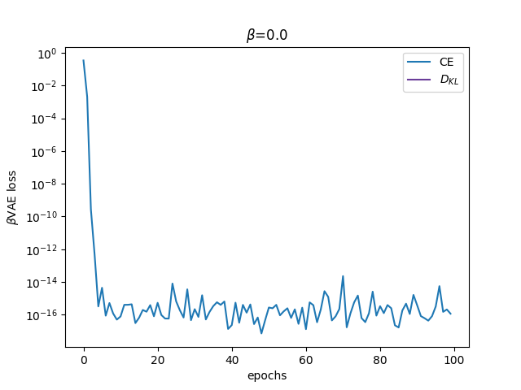
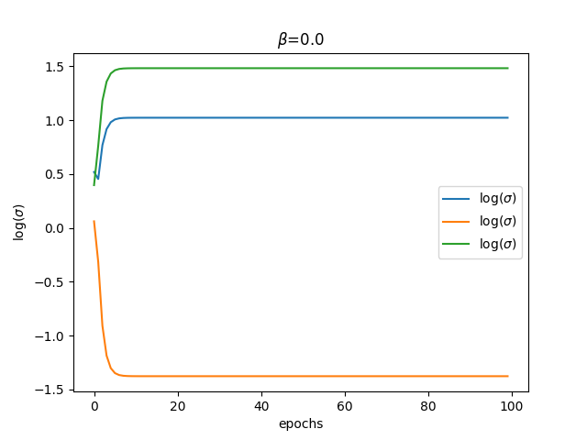
BENCHMARK: dVAE for Spin-1 system
Conditions
N=50
Nsample=100
Sz=1 for all lattice sites and all θ
Learning rate: 0.001
# of epochs: 10
Latent dimension: 3
β: 0.0
All Sz = 1: All the sites in all the samples have 1 z-spin for all θ.
These results are consistent for Sz=-1 and Sz=0
During training
Loss function during the training
As β=0, only the cross-entropy term is non-zero. The loss function decreases as the epoch increases
Log variance during the training
As β=0, all the neurons are active. As the epoch increases, the variance in the three different neurons saturates to the specific values.

Slide 10
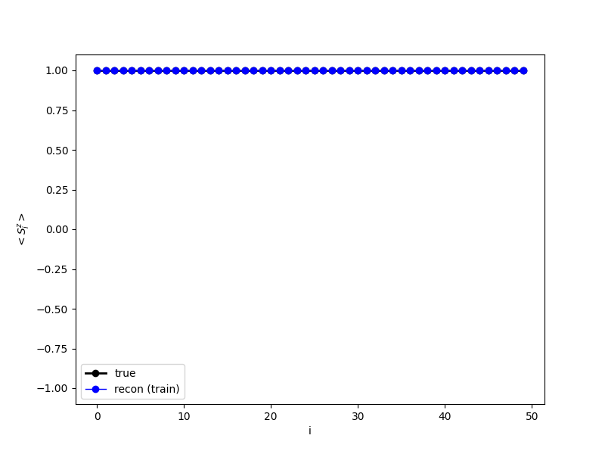
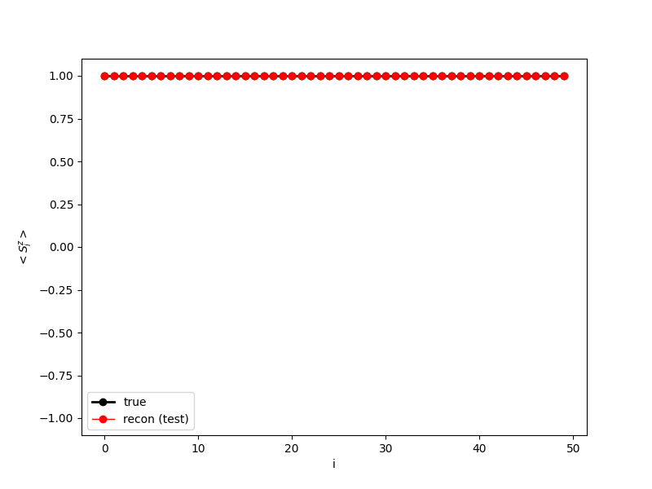
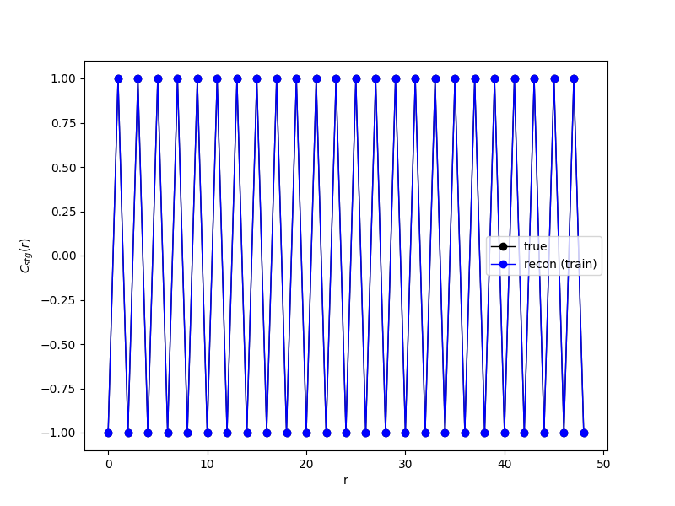
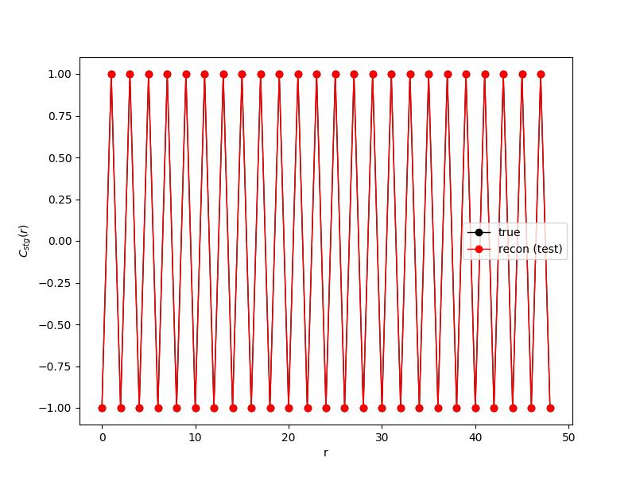
BENCHMARK: dVAE for Spin-1 system
Conditions
N=50
Nsample=100
Sz=1 for all lattice sites and all θ
Learning rate: 0.001
# of epochs: 10
Latent dimension: 3
β: 0.0
All Sz = 1: All the sites in all the samples have 1 z-spin for all θ.
These results are consistent for Sz=-1 and Sz=0
Reconstruction error after training
Compare the physical quantities calculated by the input samples and the samples reconstructed from the trained decoder.
Root mean square error (RMSE) over each sample: 0.0
Sz for each lattice site
For the train dataset (blue) and the test dataset (red), the decoder can produce the same results as the input (black)
String correlator
For the train dataset (blue) and the test dataset (red), the decoder can produce the same results as the input (black)

Slide 11
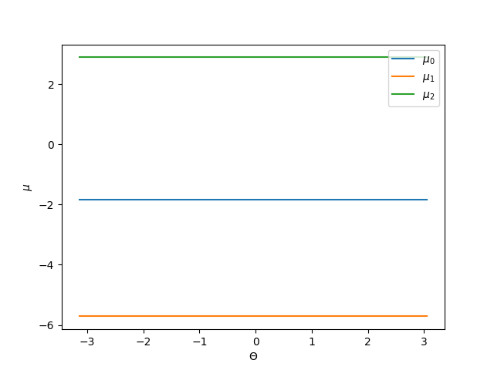
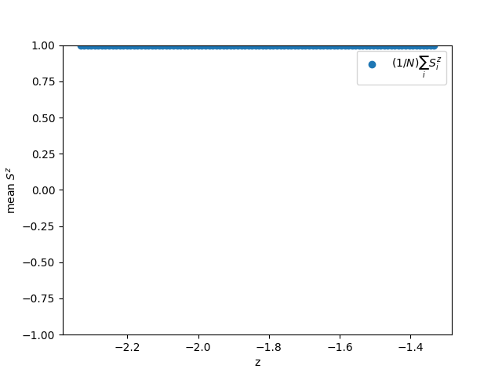
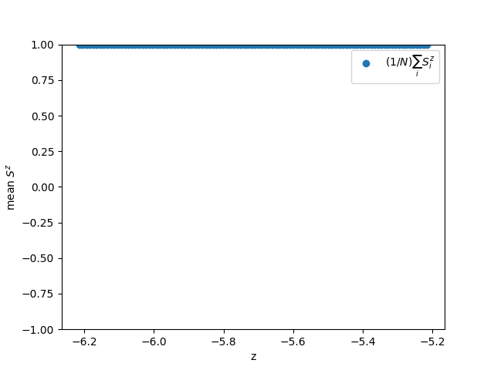
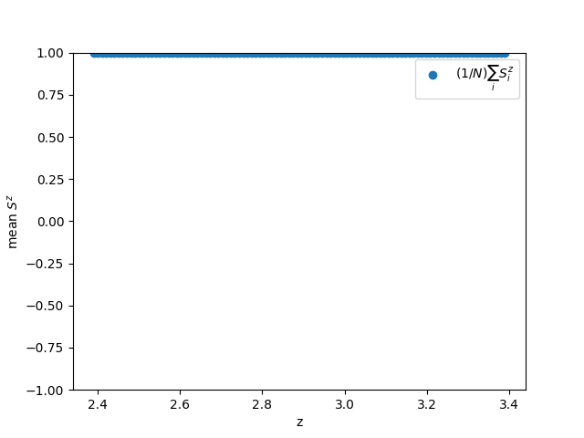
BENCHMARK: dVAE for Spin-1 system
Conditions
N=50
Nsample=100
Sz=1 for all lattice sites and all θ
Learning rate: 0.001
# of epochs: 10
Latent dimension: 3
β: 0.0
All Sz = 1: All the sites in all the samples have 1 z-spin for all θ.
These results are consistent for Sz=-1 and Sz=0
Mean values predicted by the trained encoder
As all the θ has the same samples, there is no dependence on θ
Latent scan
Latent variable No. 1
Latent variable No. 2
Latent variable No. 3
Quantities do not depends on latent variable

Slide 12
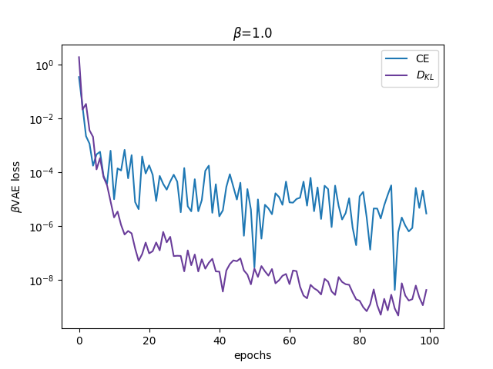
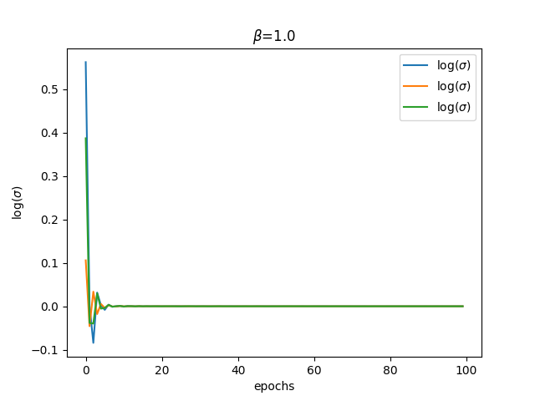
BENCHMARK: dVAE for Spin-1 system
Conditions
N=50
Nsample=100
Sz=1 for all lattice sites and all θ
Learning rate: 0.001
# of epochs: 10
Latent dimension: 3
β: 1.0
All Sz = 1: All the sites in all the samples have 1 z-spin for all θ.
These results are consistent for Sz=-1 and Sz=0
During training
Loss function during the training
As β is finite, all the KL divergence term has non-zero value. Both term decreases as the epoch increases.
Log variance during the training
As β is finite, only the one neuron is active and the other two are washed out. The invariance converge to zero.

Slide 13
BENCHMARK: dVAE for Spin-1 system
Conditions
N=50
Nsample=100
Sz=1 for all lattice sites and all θ
Learning rate: 0.001
# of epochs: 10
Latent dimension: 3
β: 1.0
All Sz = 1: All the sites in all the samples have 1 z-spin for all θ.
These results are consistent for Sz=-1 and Sz=0
Reconstruction error after training
Compare the physical quantities calculated by the input samples and the samples reconstructed from the trained decoder.
Root mean square error (RMSE) over each sample: 0.0
Sz for each lattice site
For the train dataset (blue) and the test dataset (red), the decoder can produce the same results as the input (black)
String correlator
For the train dataset (blue) and the test dataset (red), the decoder can produce the same results as the input (black)

Slide 14
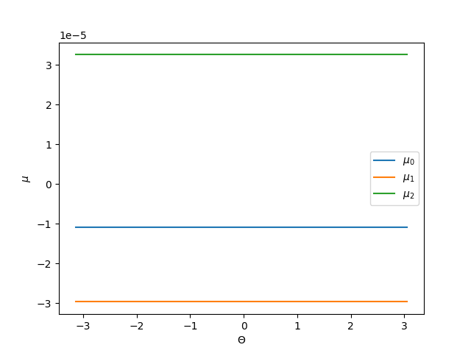
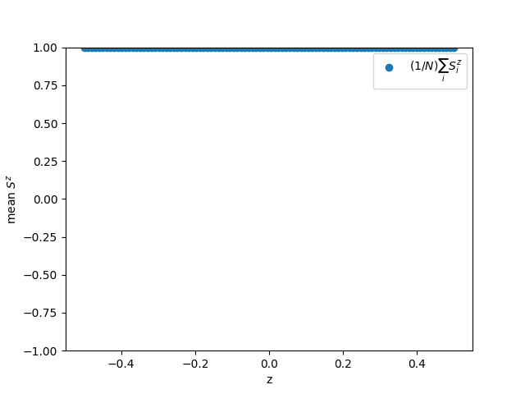
BENCHMARK: dVAE for Spin-1 system
Conditions
N=50
Nsample=100
Sz=1 for all lattice sites and all θ
Learning rate: 0.001
# of epochs: 10
Latent dimension: 3
β: 1.0
All Sz = 1: All the sites in all the samples have 1 z-spin for all θ.
These results are consistent for Sz=-1 and Sz=0
Mean values predicted by the trained encoder
1E-5
As all the θ has the same samples, there is no dependence on θ
Latent scan
Latent variable No. 1
Latent variable No. 2
Latent variable No. 3

Slide 15
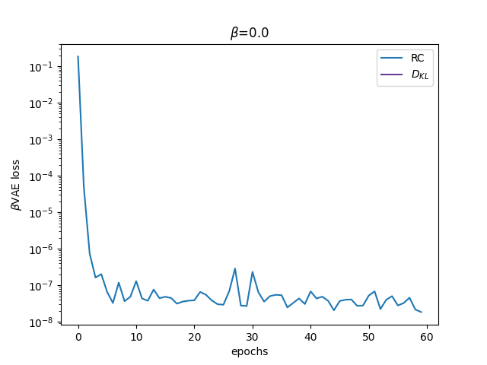
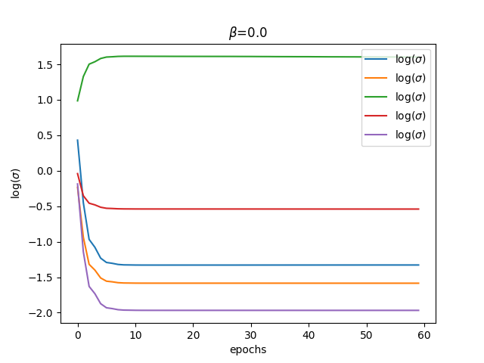
BENCHMARK: cpVAE for Spin-1 system
Conditions
N=10
Nsample=100
Sz=1 for all lattice sites and all θ
Learning rate: 0.001
# of epochs: 20
Latent dimension: 5
(!To change # of latent dim, we need to modify the ARNN code file!)
β: 0.0
All Sz = 1: All the sites in all the samples have 1 z-spin for all θ.
These results are consistent for Sz=-1 and Sz=0
During training
Loss function during the training
As β=0, only the cross-entropy term is non-zero. The loss function decreases as the epoch increases
Log variance during the training
As β=0, all the neurons are active. As the epoch increases, the variance in the three different neurons saturates to the specific values.

Slide 16
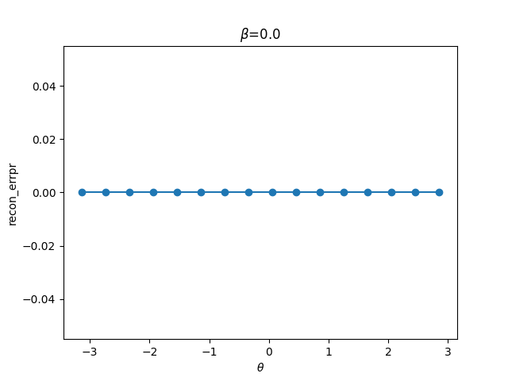
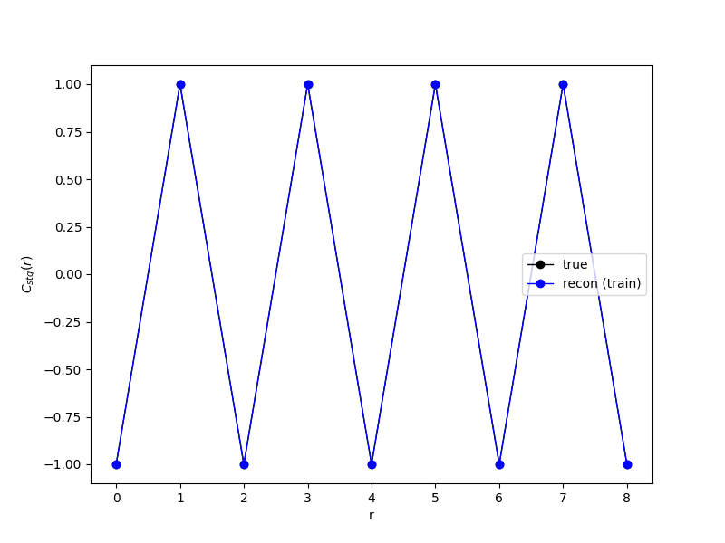
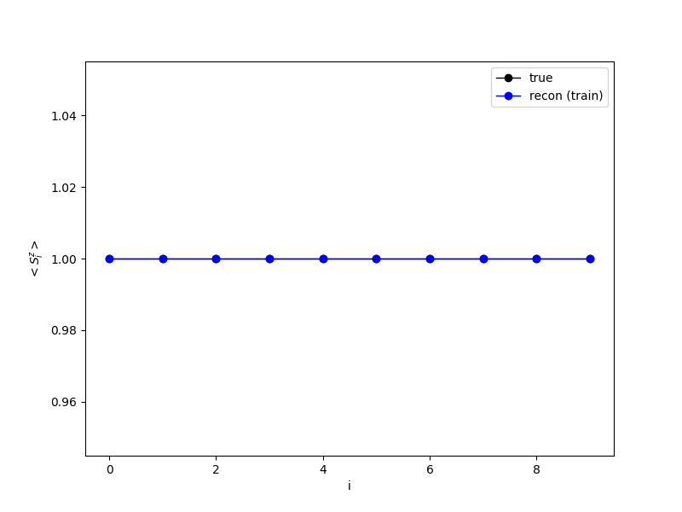
BENCHMARK: cpVAE for Spin-1 system
Conditions
N=10
Nsample=100
Sz=1 for all lattice sites and all θ
Learning rate: 0.001
# of epochs: 20
Latent dimension: 5
(!To change # of latent dim, we need to modify the ARNN code file!)
β: 0.0
All Sz = 1: All the sites in all the samples have 1 z-spin for all θ.
These results are consistent for Sz=-1 and Sz=0
Reconstruction error after training
Compare the physical quantities calculated by the input samples and the samples reconstructed from the trained decoder.
Reconstruction error
0.0
String correlator
For the train dataset (blue) and the test dataset (red), the decoder can produce the same results as the input (black)
Sz for each lattice site
For the train dataset (blue) and the test dataset (red), the decoder can produce the same results as the input (black)

Slide 17
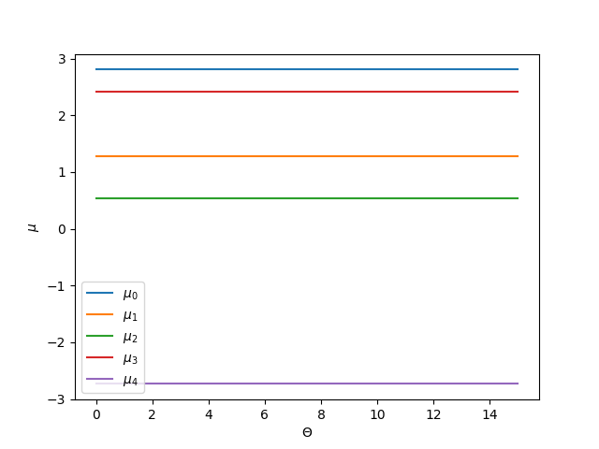
BENCHMARK: cpVAE for Spin-1 system
Conditions
N=10
Nsample=100
Sz=1 for all lattice sites and all θ
Learning rate: 0.001
# of epochs: 20
Latent dimension: 5
(!To change # of latent dim, we need to modify the ARNN code file!)
β: 0.0
All Sz = 1: All the sites in all the samples have 1 z-spin for all θ.
These results are consistent for Sz=-1 and Sz=0
Mean values predicted by the trained encoder
As all the θ has the same samples, there is no dependence on θ
Latent variable No. 1
Latent variable No. 2
Latent variable No. 3

Slide 18
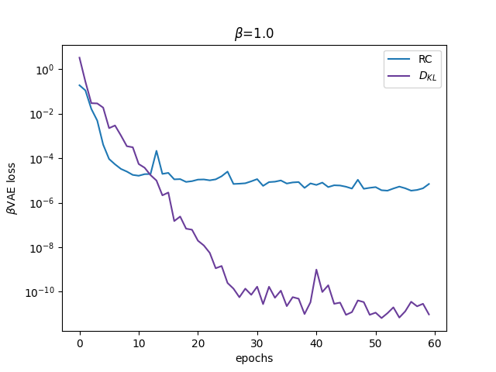
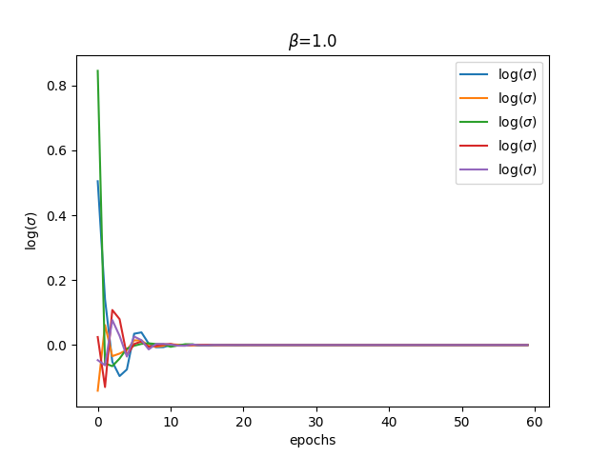
BENCHMARK: cpVAE for Spin-1 system
Conditions
N=10
Nsample=100
Sz=1 for all lattice sites and all θ
Learning rate: 0.001
# of epochs: 20
Latent dimension: 5
(!To change # of latent dim, we need to modify the ARNN code file!)
β: 1.0
All Sz = 1: All the sites in all the samples have 1 z-spin for all θ.
These results are consistent for Sz=-1 and Sz=0
During training
Loss function during the training
As β is finite, all the KL divergence term has non-zero value. Both term decreases as the epoch increases.
Log variance during the training
As β is finite, only the one neuron is active and the other two are washed out. The invariance converge to zero.

Slide 19
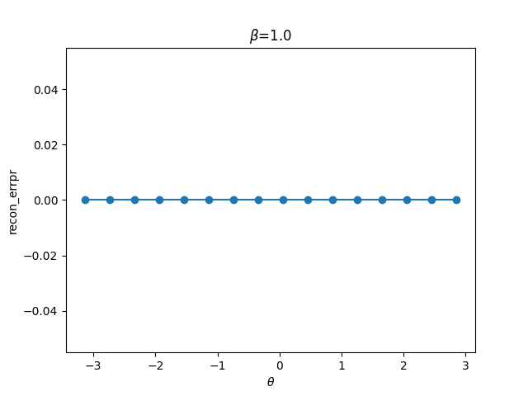
BENCHMARK: cpVAE for Spin-1 system
Conditions
N=10
Nsample=100
Sz=1 for all lattice sites and all θ
Learning rate: 0.001
# of epochs: 20
Latent dimension: 5
(!To change # of latent dim, we need to modify the ARNN code file!)
β: 1.0
All Sz = 1: All the sites in all the samples have 1 z-spin for all θ.
These results are consistent for Sz=-1 and Sz=0
Reconstruction error after training
Compare the physical quantities calculated by the input samples and the samples reconstructed from the trained decoder.
Reconstruction error
0.0
String correlator
For the train dataset (blue) and the test dataset (red), the decoder can produce the same results as the input (black)
Sz for each lattice site
For the train dataset (blue) and the test dataset (red), the decoder can produce the same results as the input (black)

Slide 20
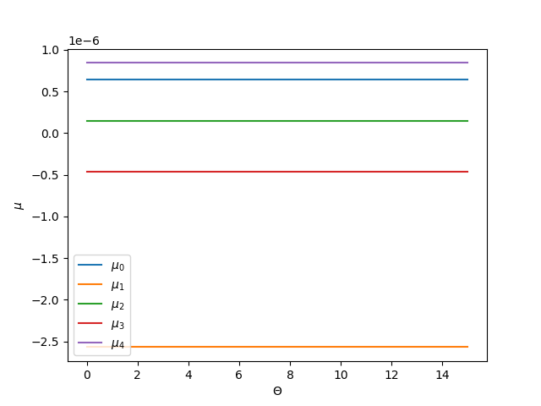
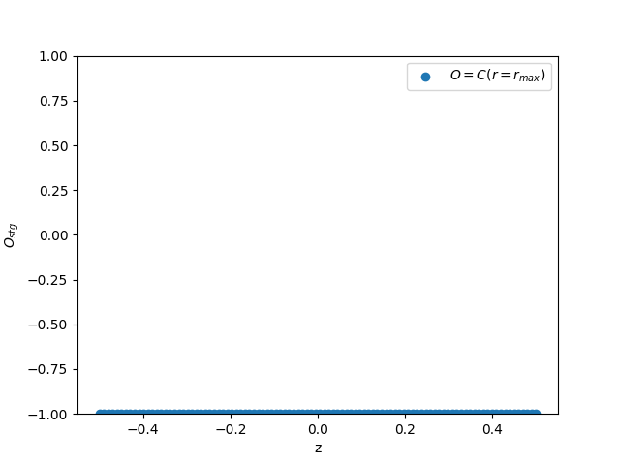
BENCHMARK: cpVAE for Spin-1 system
Conditions
N=10
Nsample=100
Sz=1 for all lattice sites and all θ
Learning rate: 0.001
# of epochs: 20
Latent dimension: 5
(!To change # of latent dim, we need to modify the ARNN code file!)
β: 1.0
All Sz = 1: All the sites in all the samples have 1 z-spin for all θ.
These results are consistent for Sz=-1 and Sz=0
Mean values predicted by the trained encoder
1E-6
As all the θ has the same samples, there is no dependence on θ
Latent variable No. 1
Latent scan
Quantities do not depends on latent variable

Slide 21
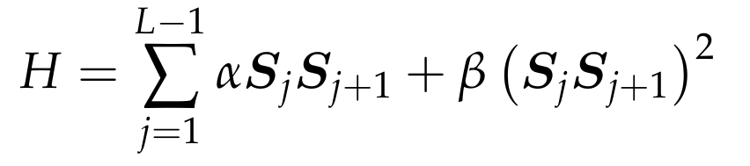
Experiments with cpVAE on string order in spin models
Generating data
The general spin-1 model. We use α=cos(θ) and β=sin(θ).
θ=0.0: Heisenberg model
arctan(θ)=1/3: AKLT model

Slide 22
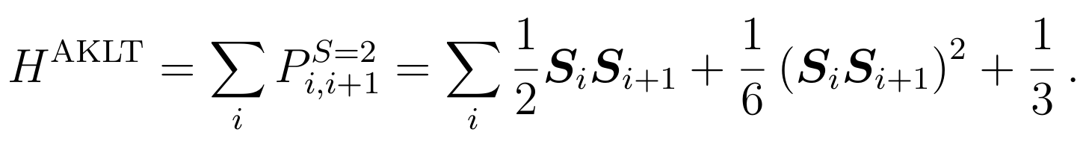
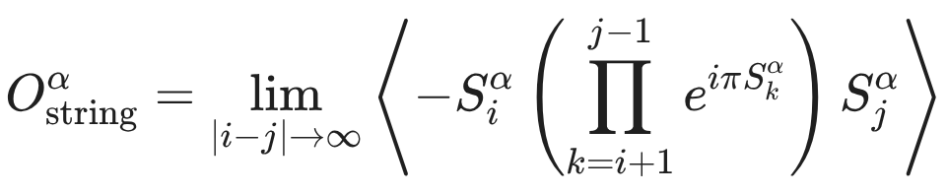
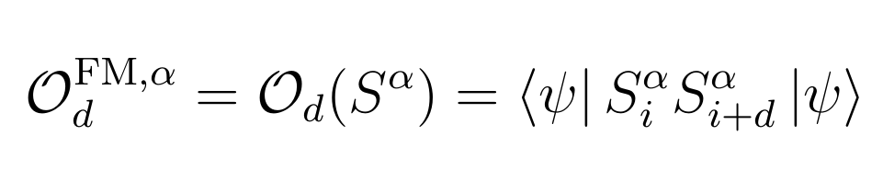
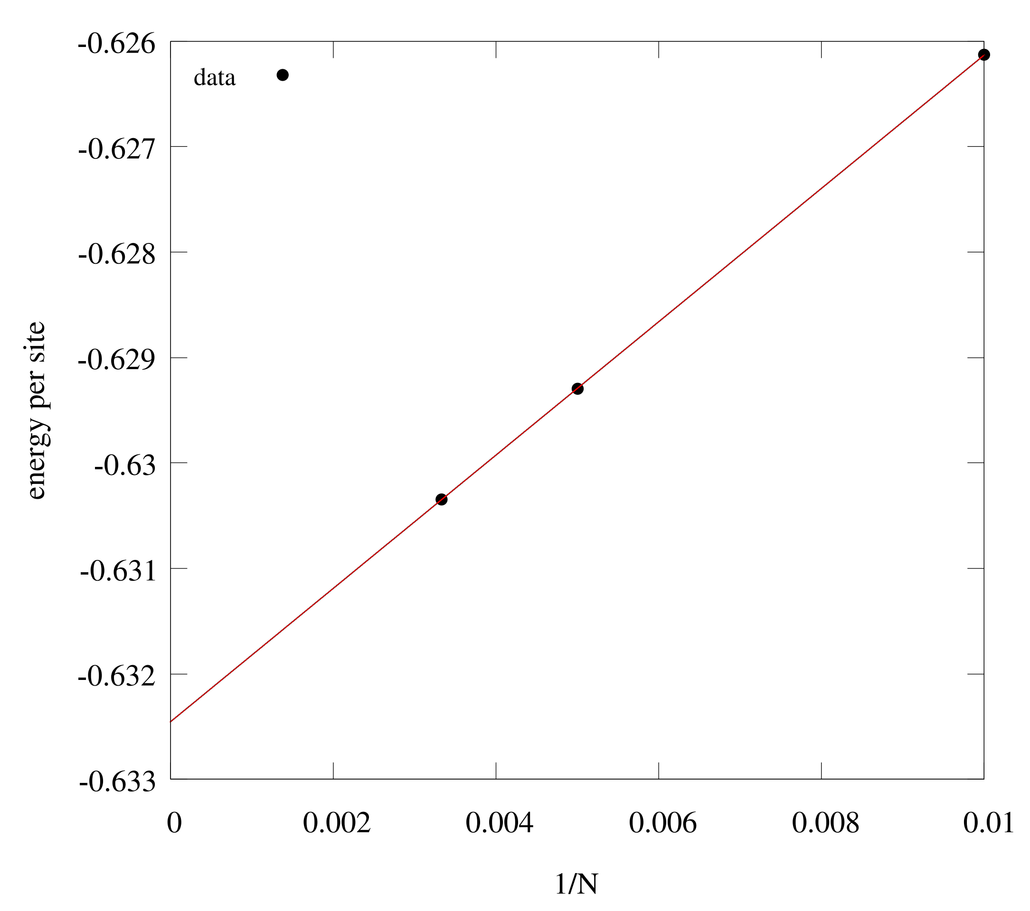
Experiments with cpVAE on string order in spin models
Generating data
Benchmark of the code for generating data
Exactly-solvable AKLT model
Computational conditions:
N = 200 (number of spin), OBC
but N = 100,200,300 is used for scaling
Correlation functions: Let i0 is the centering site (i0=N/2) and calculate until i0+r=N
String order correlation function (α=z)
Correlation function (α=x,y,z)
 | Exact | Code
Ground energy per site* | 0.0 (-0.6324555) | -0.632456 (scaled)
Entropy | log 2 ~ 0.69 | 0.693147
String order | 4/9 ~ 0.44 | 0.444444
Correlation | Exponential decay | Exponential decay
Ground energy
Due to the constant difference of the exact-solvable form (where the ground energy is 0.0) and coded AKLT Hamiltonian, the true ground energy (per site) is
-2/3*cos(θ), θ=arctan(1/3) = -0.6324555
System size scaling of ground energy per site

Slide 23
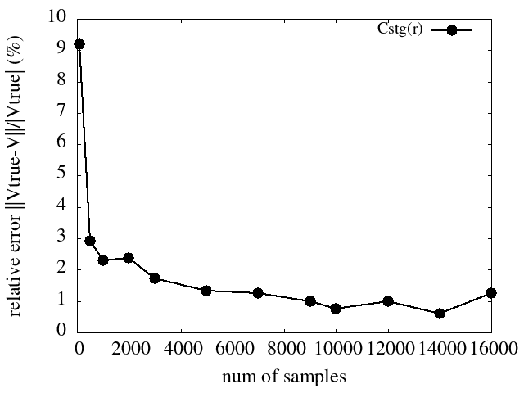
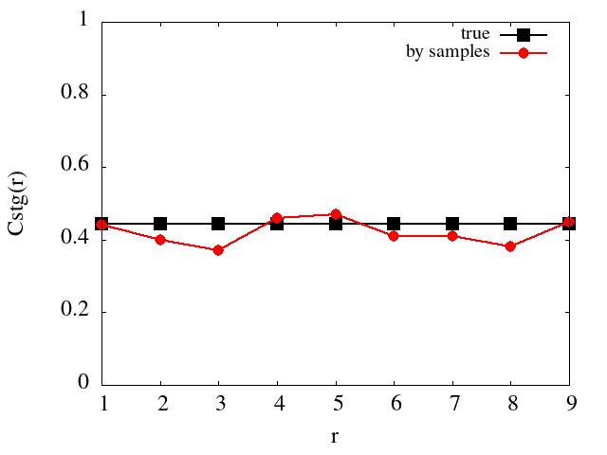
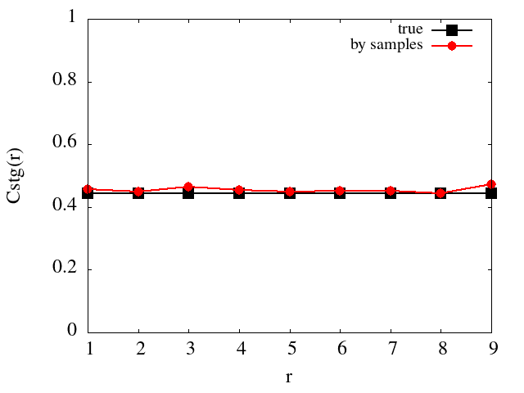
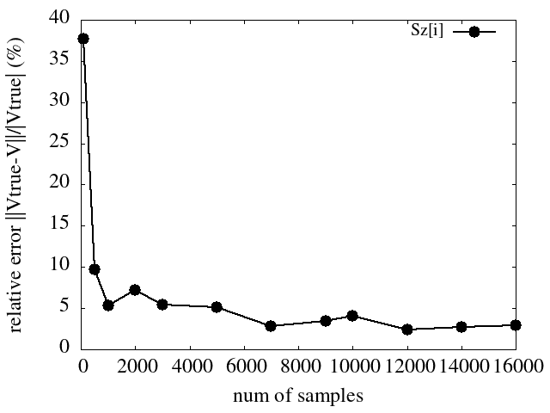
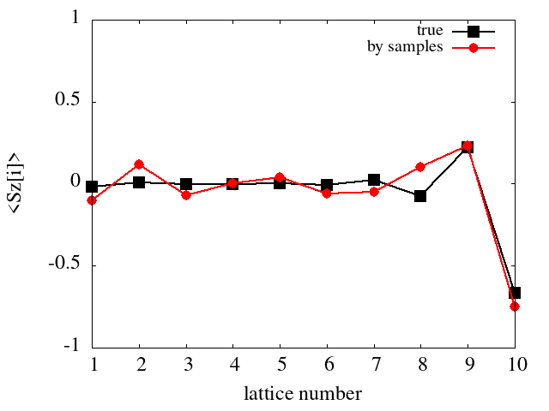
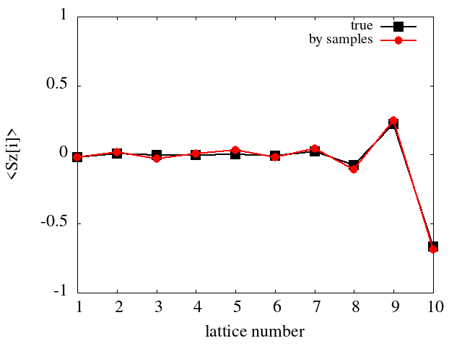
Experiments with cpVAE on string order in spin models
Generating data
Benchmark of the code for generating data
Sampling
We calculate the expectation values using sampling generated from the resulting MPS through DMRG, to know how big samples is enough to recover the true expectation value.
We calculate the z-axis spin and the string correlator, and compare the results from the normally calculated value in MPS term (true) and the samplings (relative error).
For simplicity, we use the AKLT for comparison.
Computational conditions:
N = 10 (number of spin), θ=arctan(1/3) [equivalent to AKLT]
String order correlation function (α=z)
Correlation function (α=z)
# of sample: 100
# of sample: 500
# of sample: 100
# of sample: 500

Slide 24
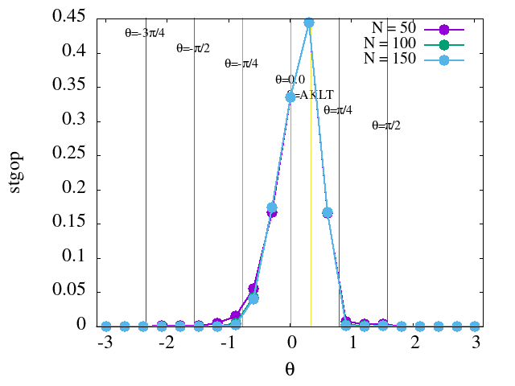
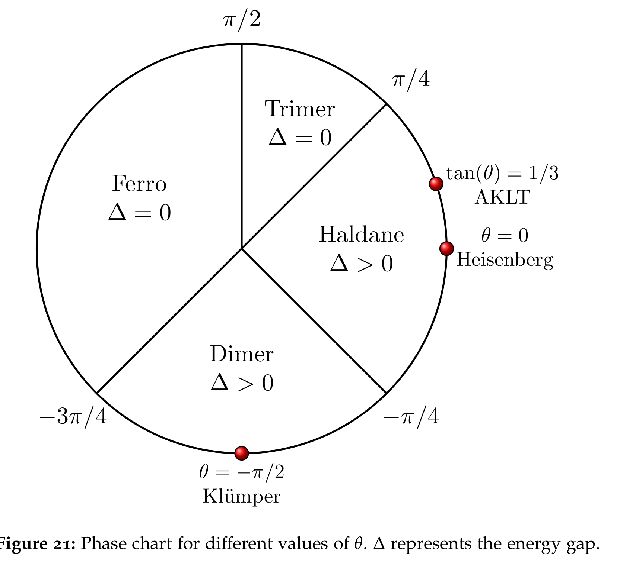
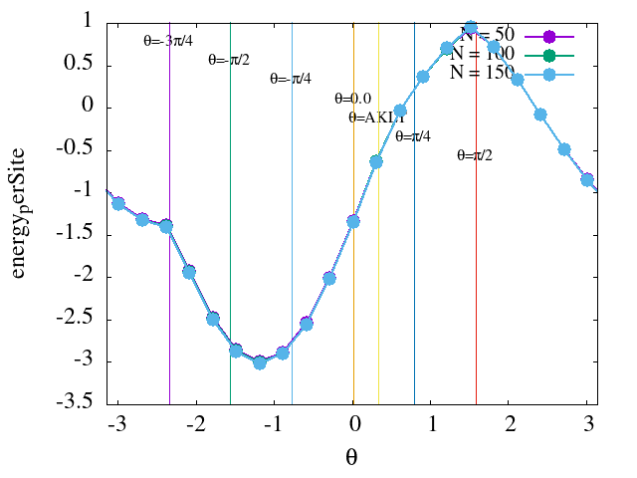
Experiments with cpVAE on string order in spin models
Generating data
Varying θ
Computational conditions:
N = 50,100,150 (number of spin)
OBC
Maxbonddim = 100
max_sweep = 50 (stop before if energy_tol=1e-8)
Ref. Bachelor Thesis
Johannes Gutenberg University Mainz

Slide 25
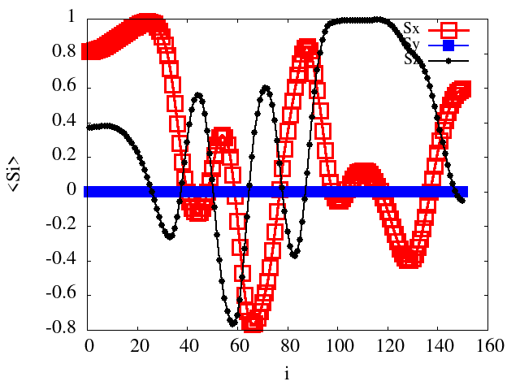
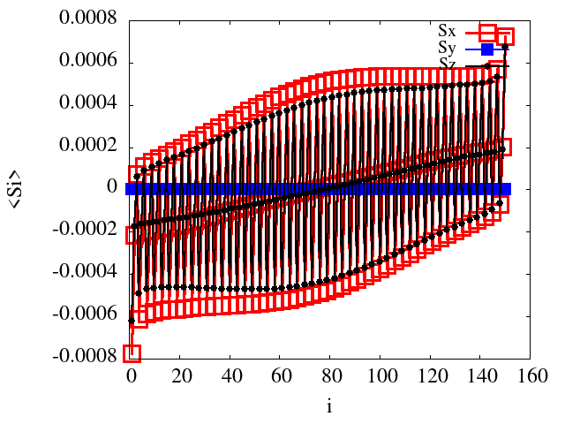
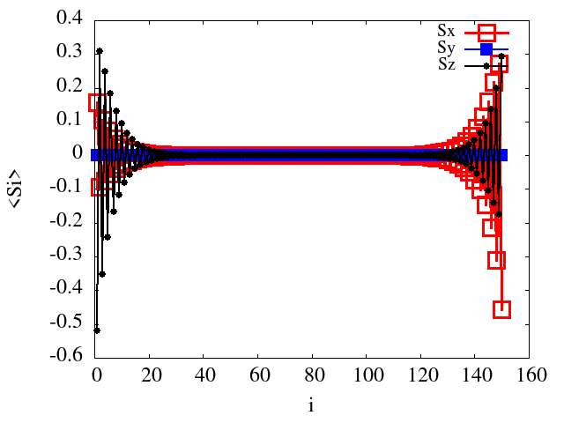
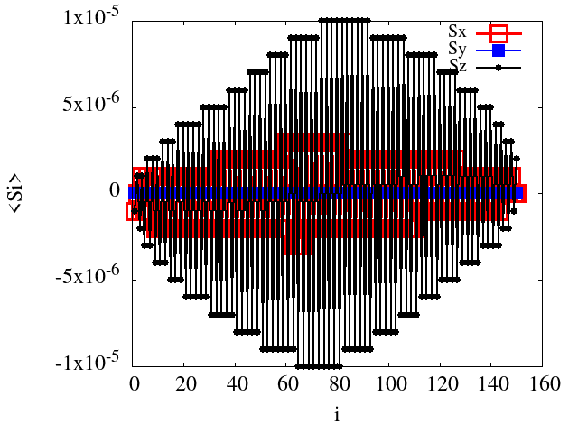
Experiments with cpVAE on string order in spin models
Generating data
Varying θ, N = 150
Computational conditions:
N = 150 (number of spin)
OBC
Maxbonddim = 100
max_sweep = 50 (stop before if energy_tol=1e-8)
Ref. Bachelor Thesis
Johannes Gutenberg University Mainz

Slide 26
Experiments with βVAE on string order in spin models
dVAE
Samples from DMRG
N = 50, Nsamples=500
OBC
Maxbonddim = 100
max_sweep = 50
(stop before if energy_tol=1e-8)
dVAE Conditions
Learning rate: 0.001
# of epochs: 10
Latent dimension: 5
Batch size: 50
Structure:
Encoder
(input) → [CNN 32 kerne ls of size 3]+(ReLU) → [CNN 32 kernels of size 3]+(ReLU) → [mean over N]
mean: [DENSE layer to 64 output]+(ReLU) → [DENSE to latent_dim output]
var(log): [DENSE layer to 64 output]+(ReLU) → [DENSE to latent_dim output]
Decoder
(latent z) → [DENSE layer to α*N output]+(ReLU) → [DENSE layer to α*N output]+(ReLU)
→ [DENSE layer to K*N output]+(softmax)
→ (K*N output) = prob for each K-states at each site

