Slide 1
Effective Troubleshooting with Differential Heap Analysis
AT&T Software Symposium, 4/13/2016, Middletown NJ, AT&T Labs
Mining the Memory
Kenny Yu
Performance Engineer
Notes:
Here is a story of changes in a JVM heap from the end to the beginning.

Slide 2
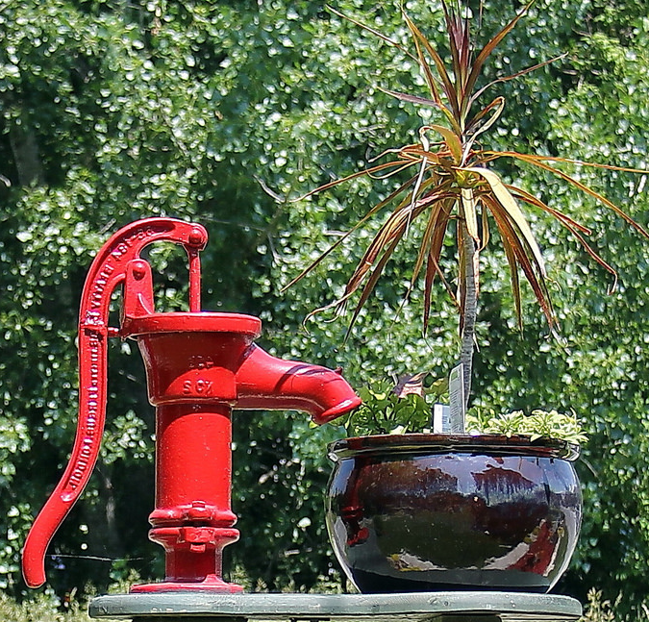

Code uses memory – can you troubleshoot backwards from heap?
Heap
Stack
service()
Request data
DOM
parse()
fetch()
Profile data
send()
Response
Database
Notes:
The end result of running software is growth of objects in the heap. Can you trace back from them to what’s going wrong?

Slide 3


Common mysteries with memory
Stuck
OutOfMemory Error
High latency
Busy GC
High Usage
Notes:
Problems arise outside the heap. But since everything leaves a trace in it, if anything’s wrong, something must stand out in the heap.

Slide 4
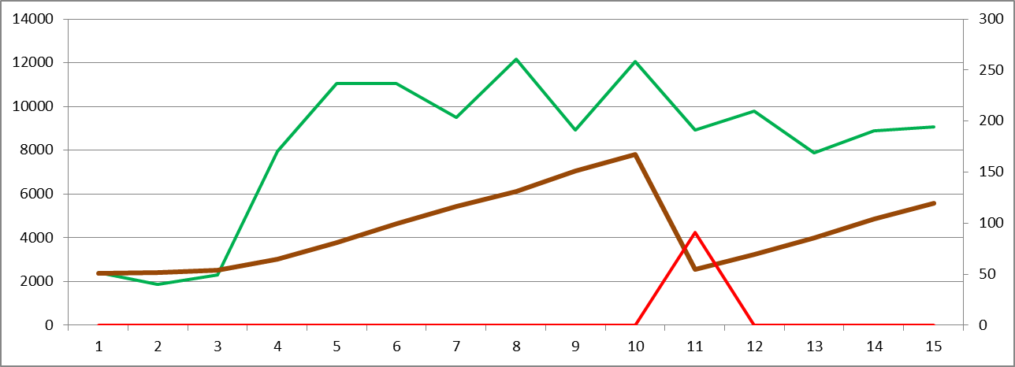
A dynamic view of memory usage driven by CPU
CPU activity from workload pushes the memory usage up, until GC pulls it down.
CPU Burn
Garbage Collection
Heap Usage
Notes:
Running software burns CPU, pushes the heap usage up, until a garbage collection pulls it down.

Slide 5
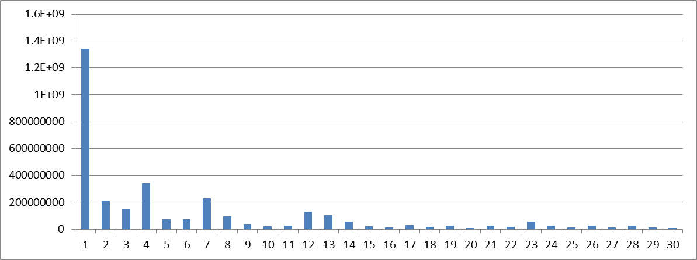
A compositional view of memory usage
Top memory users by class – sample from 40K classes.
# Bytes
Class
Notes:
An application puts 10’s of millions of objects in its heap. When problems show up in memory, you wonder: what’s taking up the heap?
?

Slide 6
Compositions raise questions, but can’t answer them
Class name | # bytes | # instances
java.util.concurrent. ConcurrentHashMap$HashEntry | 7980896 | 249403
com.pega.pegarules.session.internal.mgmt. PRThreadImpl | 5632 | 176
Notes:
A heap dump tells you what’s in the heap. It tells you the counts and sizes of the objects. The data, however, is overwhelming.

Slide 7
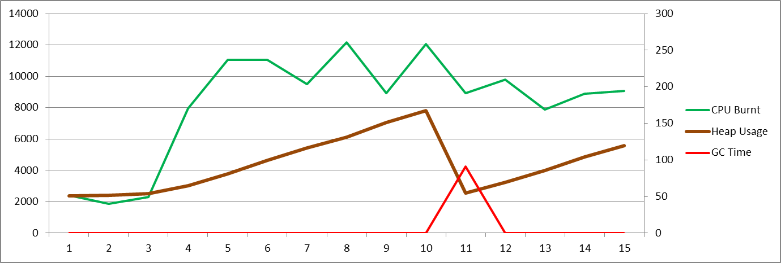
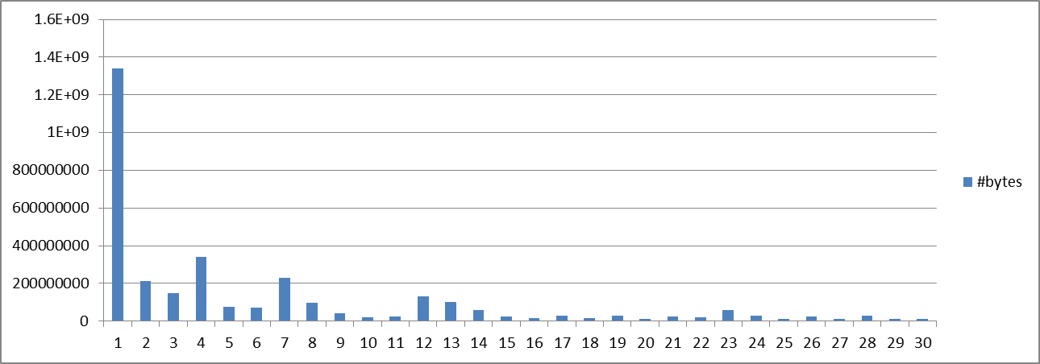
View of Heap | Usefulness
 | Changes over time; Garbage collector tuning; Not for functional anomalies
 | Snapshot of composition; Not useful in isolation
Need to put them in contexts and correlations.
Notes:
The heap usage and composition don’t tell you what class is in trouble. You need some context.

Slide 8
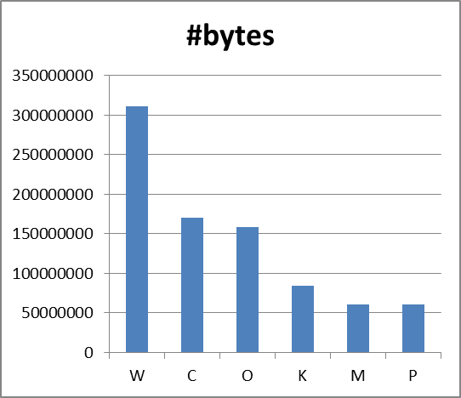
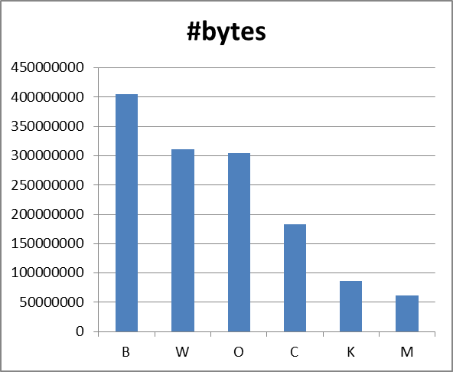
Context 1: Compare against a baseline
Notes:
One context of a heap map is another heap map. Through the comparison, you can see what’s increased, and what’s decreased.

Slide 9

Context 2: Link memory usage to workload
For each class and each source of allocation:
Population ∝ Workload * LifeSpan
Little’s Law applies to each step as well as to sums
Notes:
The second context is the workload. The heavier the load, the more objects staying around at each step.

Slide 10
Context 3: Population growths in a sequence
Any blockage distorts object population distribution.
Notes:
The third context is the sequence of object life and death. The earlier ones feed the later ones.

Slide 11
Heap behavior in 3 contexts: conditions, classes, parts vs. whole
ClassB
ClassB
ClassA
ClassA
∑classes
∑classes
Notes:
So you have three kinds of comparisons: between runtime conditions, between classes, and between parts and the whole.

Slide 12
The new approach: Correlate heap composition with load conditions
∆(Composition)
∆(Time) , ∆(Conditions)
∆(Composition)
∆(Time) , ∆(Conditions)
Notes:
You take a few heap maps, measure their differences over the differences in time and condition.

Slide 13
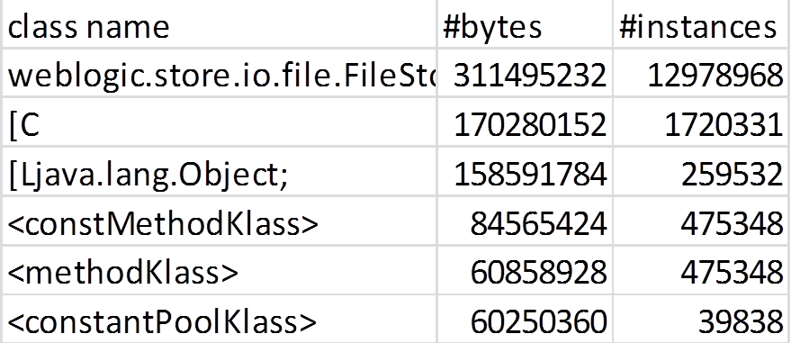
Suspect vs. baseline
Good baseline memory map
Problematic memory map with poor performance
Notes:
Here you see two heap maps: one good, the other bad. What do you do with them?

Slide 14
This approach: normalized difference per class
For each class’s memory size
Difference from a good baseline
Divided by the sum of the two
M - Mbase
M + Mbase
Notes:
You measure the growth from the good to the bad, and divide it by their sum.

Slide 15
This approach: normalized difference per class
For each class’s memory size
Difference from a good baseline
Divided by the sum of the two
M - Mbase
M + Mbase
Notes:
You get the growth from the baseline, and it’s normalized between -1 and 1.

Slide 16
Normalized difference: Contrast in context
Contrast in context
M + Mbase
M - Mbase
Mbase
∆
Time or Condition
∑
Notes:
The baseline is in blue. The growth is in red. The sum is in yellow.

Slide 17
Normalized difference: Contrast in context
Contrast in context
M + Mbase
M - Mbase
Mbase
∆
Time or Condition
∑
Notes:
You get the delta over the sigma, the growth over the base for each type of objects.

Slide 18
An interpretation of ∆/∑
The relative growth of objects of a class:
Zero for structural objects
Workload-driven
Environment-dependent
Internal blockage
Population Growth
A Base Population
class
= Relative Growth
Notes:
For each class, you have the growth over a base. That’s a relative growth.

Slide 19
An interpretation of ∆/∑
The relative growth of objects of a class:
Zero for structural objects
Workload-driven
Environment-dependent
Internal blockage-sensitive
Population Growth
A Base Population
class
= Relative Growth
Notes:
Objects grow at a certain rate. For some, that’s 0%; for others, it should be 20% because the workload is 20% higher.

Slide 20
Relative growth of objects
Notes:
If you sort the classes by the growth rate, where do you find a blockage? On the high end, intuitively?

Slide 21
Corollaries of Little’s Law
Blockage propagates upstream.
Execution Flow
Notes:
A blockage causes objects to over-grow upstream. Downstream from it, there should be under-growth.

Slide 22
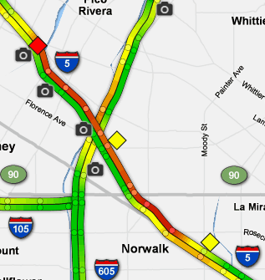
Time-sequence interpretation of relative growth
Like freeway traffic, a blockage is located at the front of a queue-up.
Object queue-up is revealed by relative growth of populations.
Blockage divides density and sparsity.
Direction of move
Notes:
Just like a traffic congestion: the troublemaker is located at the leading front of a backup.

Slide 23
Application code uses memory
Heap
Stack
service()
Request data
DOM
parse()
Sequence of events
fetch()
Profile data
send()
Response
Database
Order of accumulation
Notes:
Running software grows objects in the heap – in certain order. Over- growth follows that order.

Slide 24
Growth cascade reveals object queue-up
Suspects on the front of descent
Order of events
Blocked threads accumulated.
Notes:
If you sort the classes by the growth rate, the blockage is on the descending front.

Slide 25
Growth cascade reveals object queue-up
Suspects on the front of descent
Order of events
Blocked threads accumulated.
Notes:
In this case, the thread objectss are blocked, because the thread pool is configured to be too small.

Slide 26
Introducing a ready-to-use heap analysis application
HeapDiff
∆/∑
Notes:
The analysis has been coded into an application. You prepare the data, run the app and check the results.

Slide 27
Heap analysis made easy with a ready-to-use application introduced here
Execute:
$ java -jar heapdiff.jar heap.HeapDiff
Examine results to identify bottlenecks
Simple Configuration:
Provide baseline heap maps
Identify a suspect heap map
Set up filters
Specify output destination
Notes:
The application needs some simple configuration. You specify the input and the output.

Slide 28

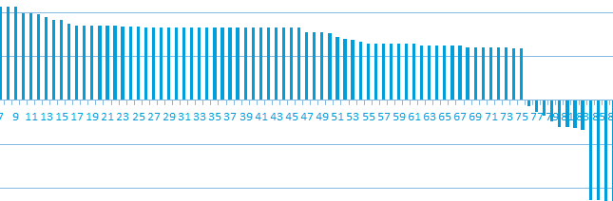
Differential heap analysis
The technique in review:
Action | Result
Collect heap maps, suspect vs. baseline jmap -histo:live
Compute relative population growth | ∆m/∑m
Sort classes by growth
Identify blockage on descending front | Narrow in from 10,000’s to a few classes
Notes:
In summary, you measure the growth of each class, and find the class in trouble on the descending front of the growth.

Slide 29

Built into a ready-for-use tool
Download the Differential Heap Analyzer executable, source code and documentation:
http://link.att.com/HeapAnalysis
Notes:
What you need to analyze your heap this way is here for download.

Slide 30
Notes:
Thank you and enjoy the story of growth your heap is telling you.

