Slide 1
Week5 Tasks
Yumi Verma

Slide 2
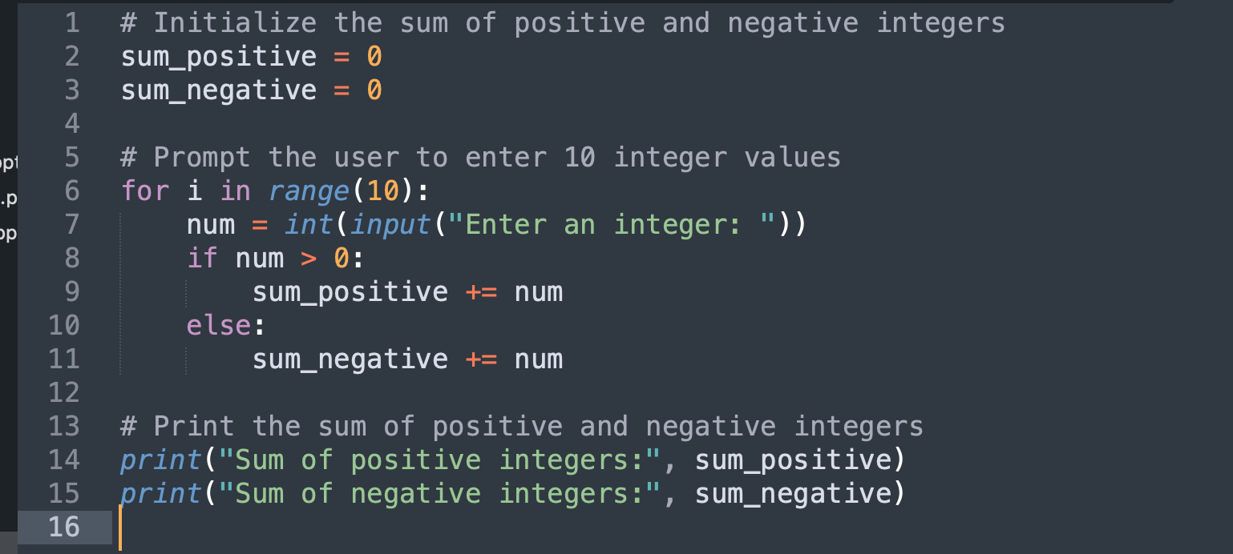
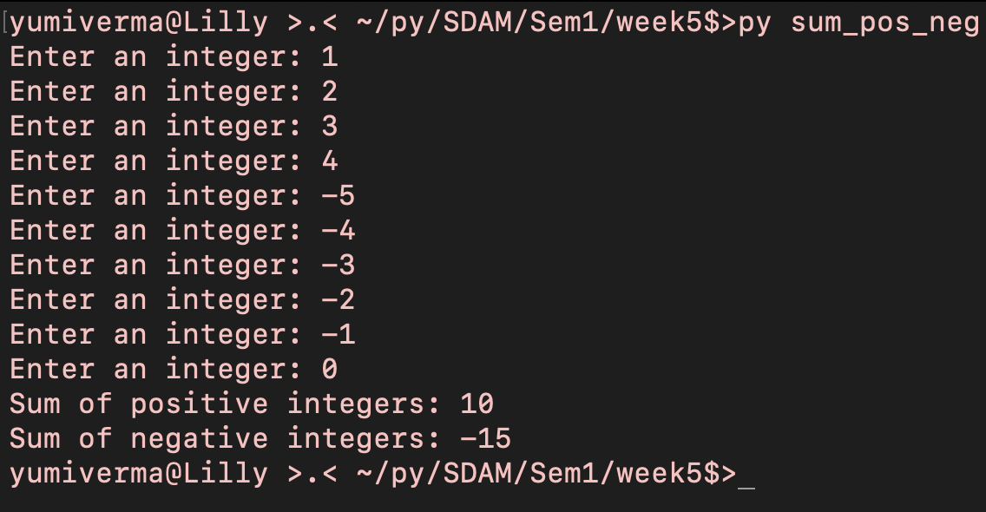
Task 1
# Initialize the sum of positive and negative integers
sum_positive = 0
sum_negative = 0
# Prompt the user to enter 10 integer values
for i in range(10):
num = int(input("Enter an integer: "))
if num > 0:
sum_positive += num
else:
sum_negative += num
# Print the sum of positive and negative integers
print("Sum of positive integers:", sum_positive)
print("Sum of negative integers:", sum_negative)

Slide 3
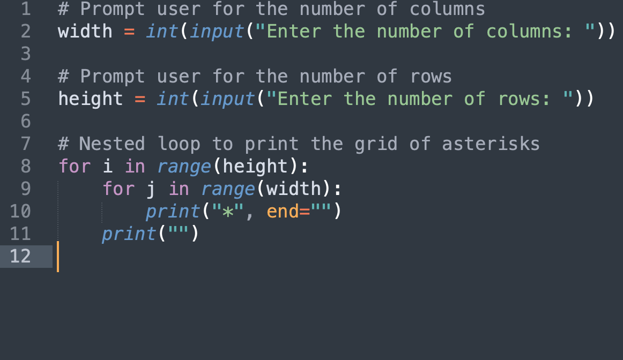
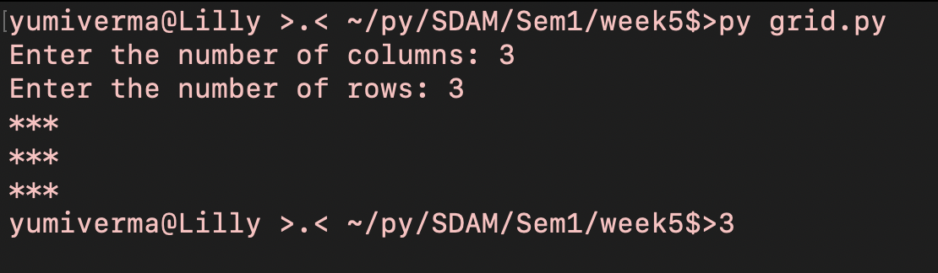
Task 2
# Prompt user for the number of columns
width = int(input("Enter the number of columns: "))
# Prompt user for the number of rows
height = int(input("Enter the number of rows: "))
# Nested loop to print the grid of asterisks
for i in range(height):
for j in range(width):
print("*", end="")
print("")

Slide 4
Task 3
Just a Word document is required for this task.
State whether each of the following is deterministic, non-deterministic or either (ie could be solved deterministically or non-deterministically) and justify your choice:
a) writing Christmas cards to family – Deterministic repetitive task that can be done in a specific order and is not subject to randomness.
b) washing up - Deterministic repetitive, done in a specific order and is not random
c) reading a book – both as you can read a book start to end or can skip pages making it non-derterministic
d) waiting for someone to answer the phone – Non-Deterministic with a lot of external factors e.g. busy?
e) counting to 10 in French – Deterministic, you either know 1 – 10 in French or you dont
f) playing a game of 501 in darts - do not know
g) laying the table for a dinner party – Deterministic as task with a set of steps that can be done in a specific order
h) answering this question - Deterministic as task with a set of steps that can be done in a specific order

