Slide 1
Week1 Work
Yumi Verma

Slide 2
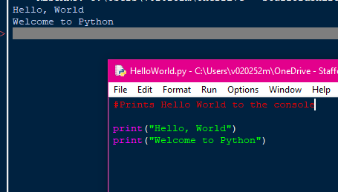
Task 1
#Prints Hello World to the console
#prints Welcome to Python to the console
print("Hello, World")
print("Welcome to Python")

Slide 3
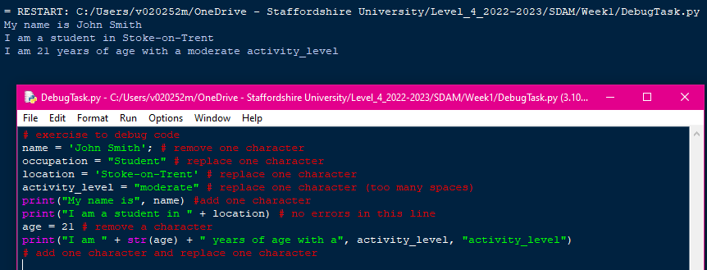
Task 2
# exercise to debug code
name = 'John Smith'; # remove one character
occupation = "Student" # replace one character
location = 'Stoke-on-Trent' # replace one character
activity_level = "moderate" # replace one character (too many spaces)
print("My name is", name) #add one character
print("I am a student in " + location) # no errors in this line
age = 21 # remove a character
print("I am " + str(age) + " years of age with a", activity_level, "activity_level")
# add one character and replace one character

Slide 4
Task 3
a. A company’s profit | This would be a Float as the profit would have decimal numbers.
b. A person’s weight | This would be an Integer
c. A book title | This would be a String as it is a name of a book
d. Average rainfall in September | This would be an Integer as rainfall is measured in
e. Number of runs scored by a cricketer | This would be an Integer
f. A telephone number, including area code | This would be an Integer
g. A dress size | This would be an Integer

Slide 5
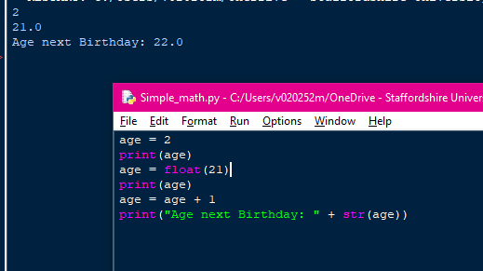
Task 4
age = 2
print(age)
age = float(21)
print(age)
age = age + 1
print("Age next Birthday: " + str(age))

Slide 6
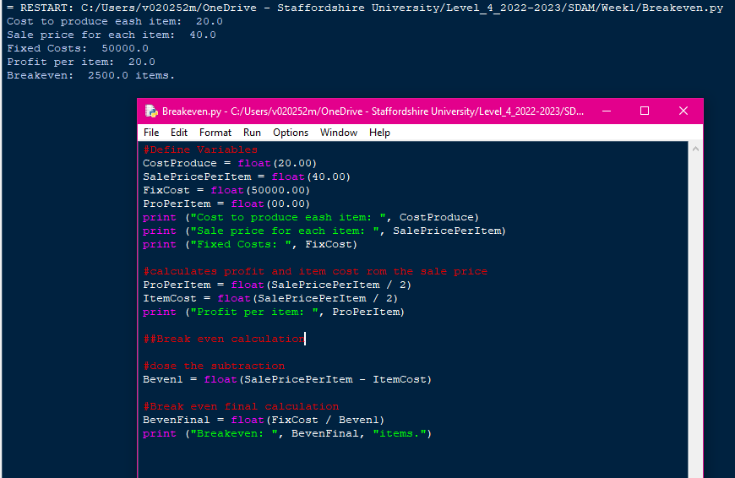
Task 5
#Define Variables
CostProduce = float(20.00)
SalePricePerItem = float(40.00)
FixCost = float(50000.00)
ProPerItem = float(00.00)
print ("Cost to produce eash item: ", CostProduce)
print ("Sale price for each item: ", SalePricePerItem)
print ("Fixed Costs: ", FixCost)
#calculates profit and item cost rom the sale price
ProPerItem = float(SalePricePerItem / 2)
ItemCost = float(SalePricePerItem / 2)
print ("Profit per item: ", ProPerItem)
##Break even calculation
#dose the subtraction
Beven1 = float(SalePricePerItem - ItemCost)
#Break even final calculation
BevenFinal = float(FixCost / Beven1)
print ("Breakeven: ", BevenFinal, "items.")

Slide 7
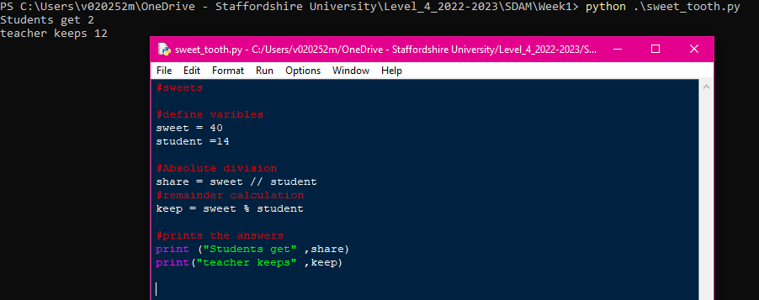
Task 6
#sweets
#define varibles
sweet = 40
student =14
#Absolute division
share = sweet // student
#remainder calculation
keep = sweet % student
#prints the answers
print ("Students get" ,share)
print("teacher keeps" ,keep)

Slide 8
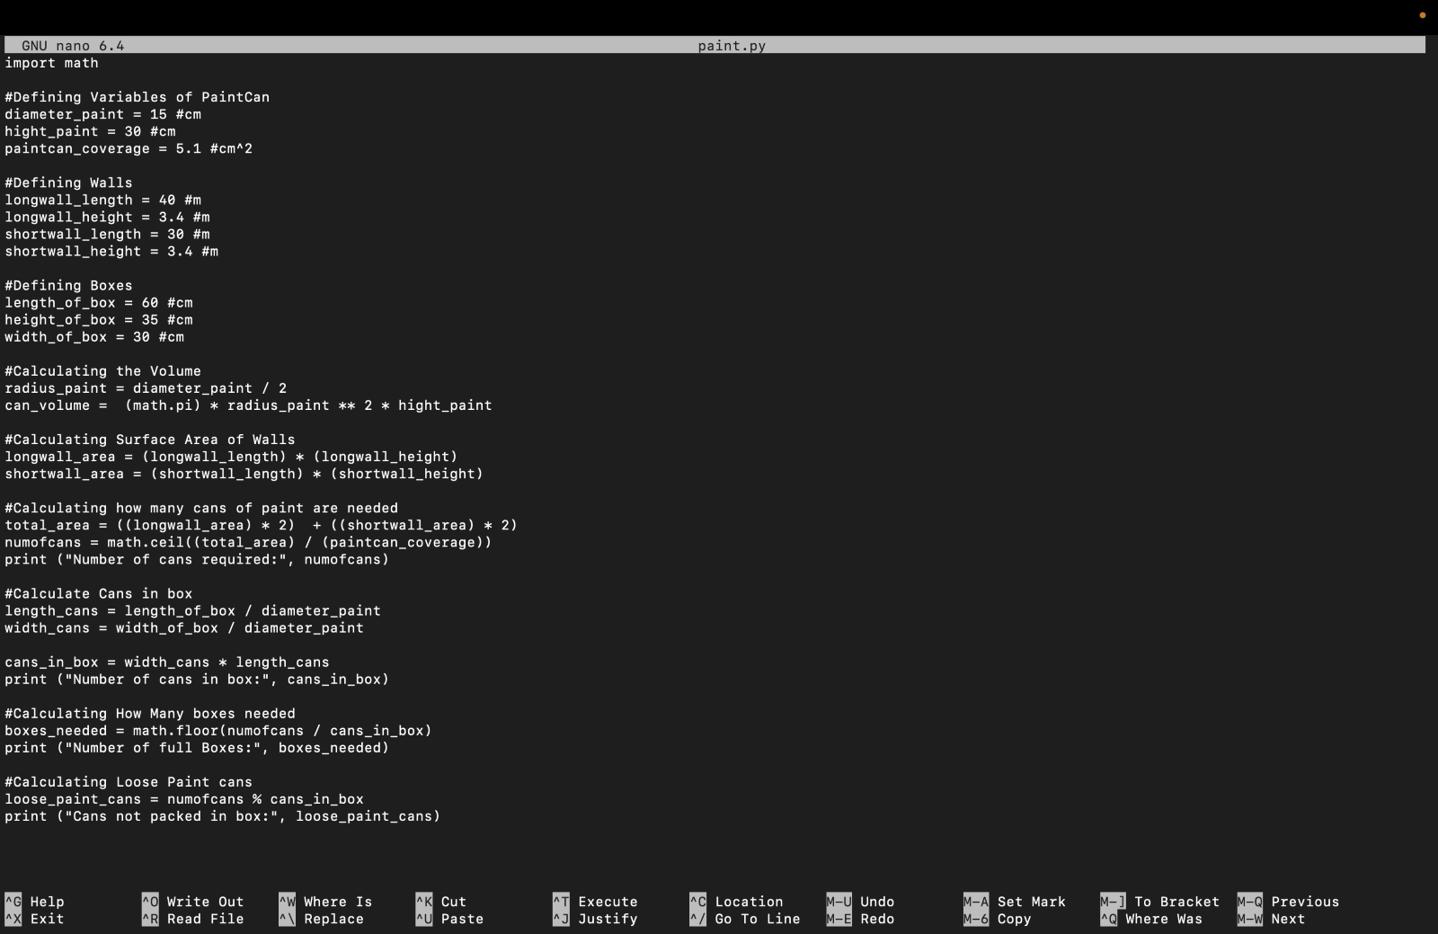
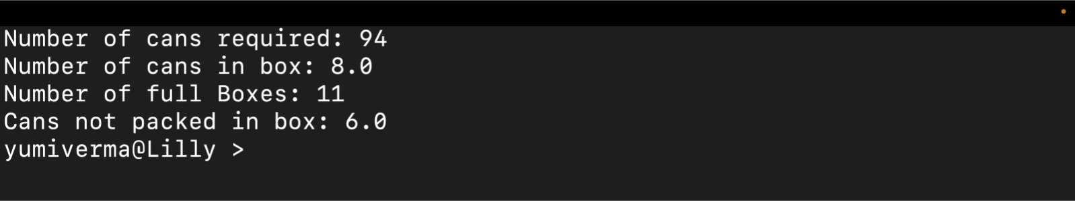
Task 7
import math
#Defining Variables of PaintCan
diameter_paint = 15 #cm
hight_paint = 30 #cm
paintcan_coverage = 5.1 #cm^2
#Defining Walls
longwall_length = 40 #m
longwall_height = 3.4 #m
shortwall_length = 30 #m
shortwall_height = 3.4 #m
#Defining Boxes
length_of_box = 60 #cm
height_of_box = 35 #cm
width_of_box = 30 #cm
#Calculating the Volume
radius_paint = diameter_paint / 2
can_volume = (math.pi) * radius_paint ** 2 * hight_paint
#Calculating Surface Area of Walls
longwall_area = (longwall_length) * (longwall_height)
shortwall_area = (shortwall_length) * (shortwall_height)
#Calculating how many cans of paint are needed
total_area = ((longwall_area) * 2) + ((shortwall_area) * 2)
numofcans = math.ceil((total_area) / (paintcan_coverage))
print ("Number of cans required:", numofcans)
#Calculate Cans in box
length_cans = length_of_box / diameter_paint
width_cans = width_of_box / diameter_paint
cans_in_box = width_cans * length_cans
print ("Number of cans in box:", cans_in_box)
#Calculating How Many boxes needed
boxes_needed = math.floor(numofcans / cans_in_box)
print ("Number of full Boxes:", boxes_needed)
#Calculating Loose Paint cans
loose_paint_cans = numofcans % cans_in_box
print ("Cans not packed in box:", loose_paint_cans)

