Slide 1
Week2Tasks
Yumi Verma

Slide 2
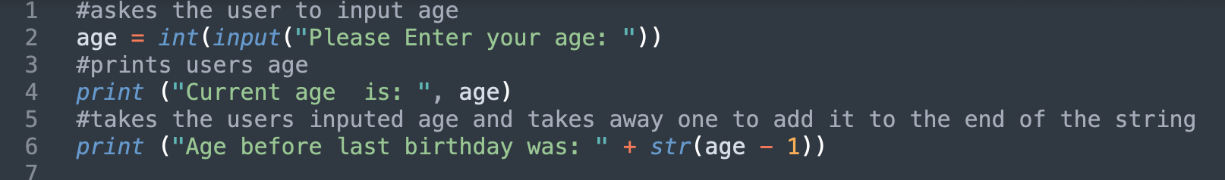
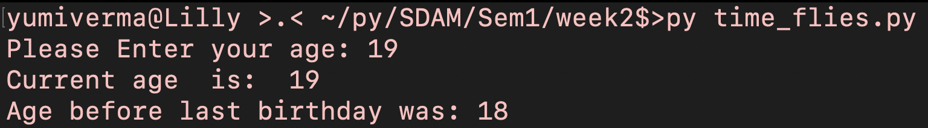
Task 1
#askes the user to input age
age = int(input("Please Enter your age: "))
#prints users age
print ("Current age is: ", age)
#takes the users inputed age and takes away one to add it to the end of the string
print ("Age before last birthday was: " + str(age - 1))

Slide 3
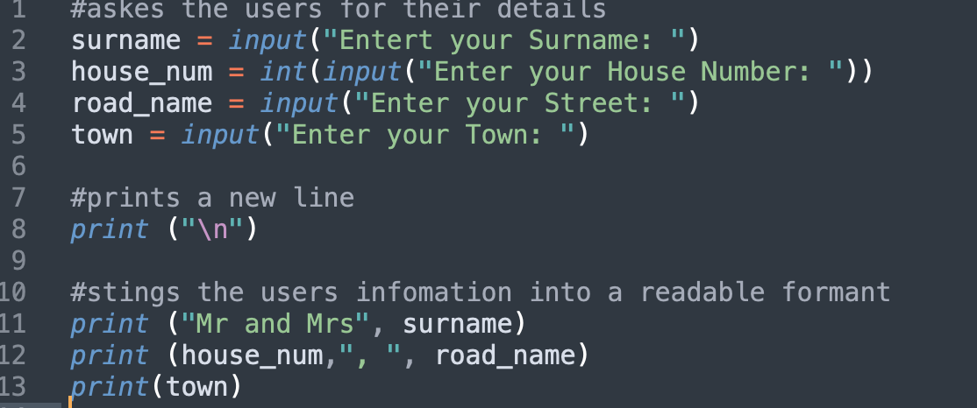
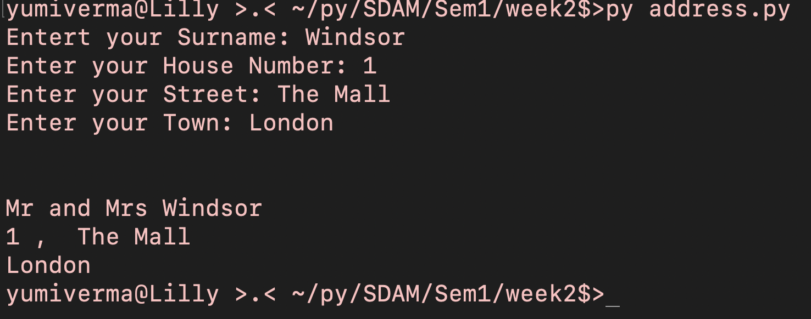
Task 2
#askes the users for their details
surname = input("Entert your Surname: ")
house_num = int(input("Enter your House Number: "))
road_name = input("Enter your Street: ")
town = input("Enter your Town: ")
#prints a new line
print ("\n")
#stings the users infomation into a readable formant
print ("Mr and Mrs", surname)
print (house_num,", ", road_name)
print(town)

Slide 4
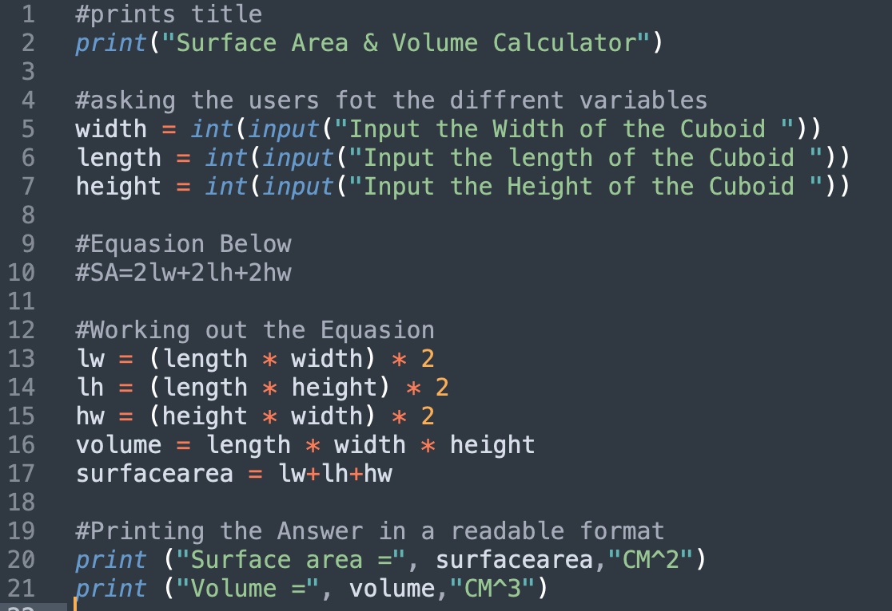
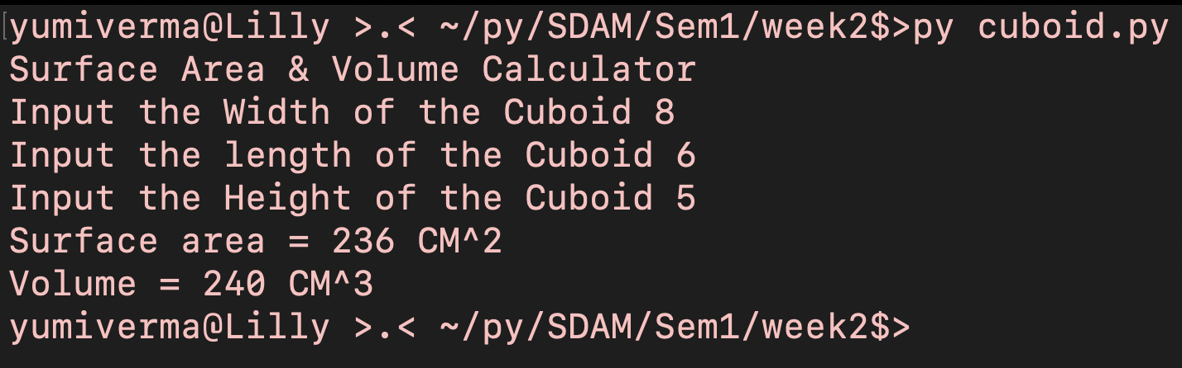
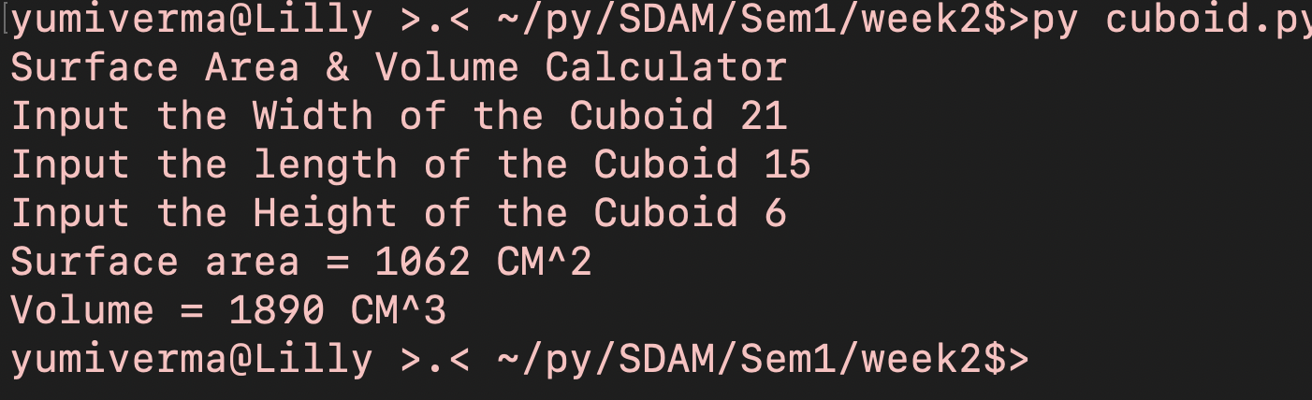
Task 3
#prints title
print("Surface Area & Volume Calculator")
#asking the users fot the diffrent variables
width = int(input("Input the Width of the Cuboid "))
length = int(input("Input the length of the Cuboid "))
height = int(input("Input the Height of the Cuboid "))
#Equasion Below
#SA=2lw+2lh+2hw
#Working out the Equasion
lw = (length * width) * 2
lh = (length * height) * 2
hw = (height * width) * 2
volume = length * width * height
surfacearea = lw+lh+hw
#Printing the Answer in a readable format
print ("Surface area =", surfacearea,"CM^2")
print ("Volume =", volume,"CM^3")
Part 1
Part 2

Slide 5
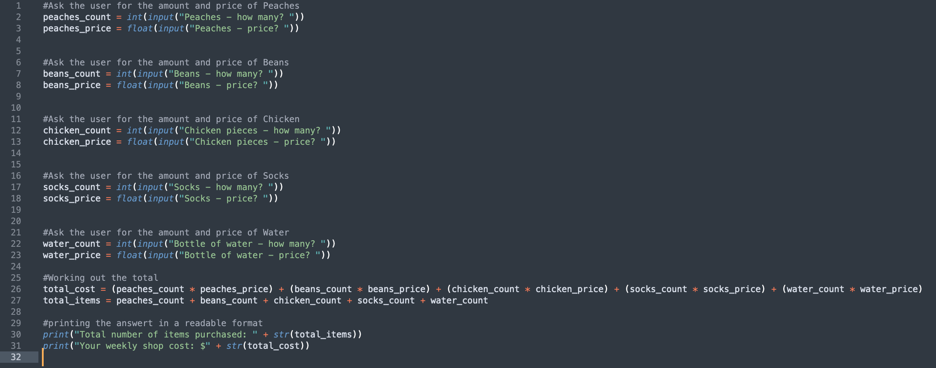
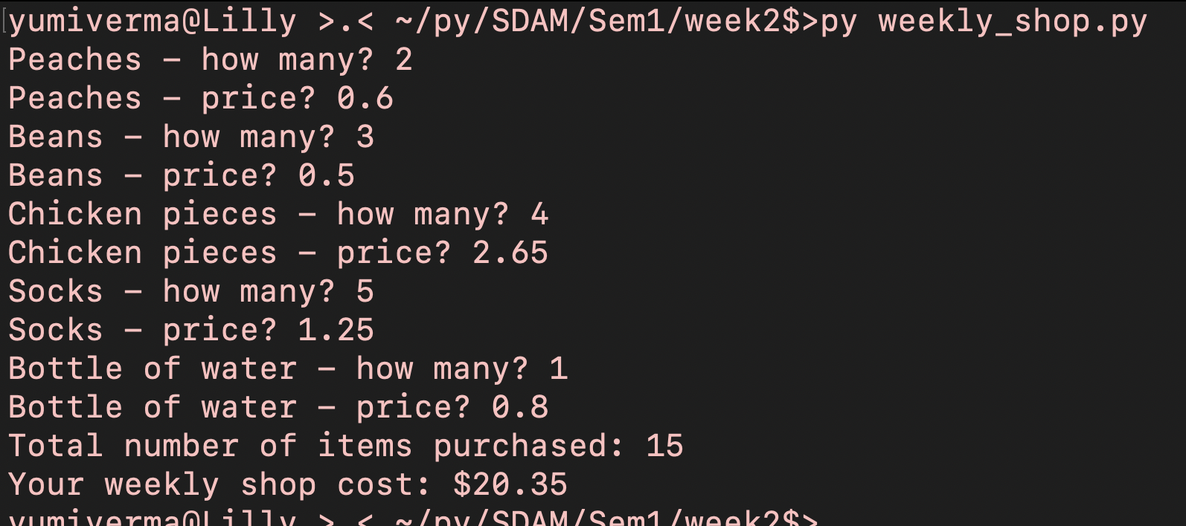
Task 4
#Ask the user for the amount and price of Peaches
peaches_count = int(input("Peaches - how many? "))
peaches_price = float(input("Peaches - price? "))
#Ask the user for the amount and price of Beans
beans_count = int(input("Beans - how many? "))
beans_price = float(input("Beans - price? "))
#Ask the user for the amount and price of Chicken
chicken_count = int(input("Chicken pieces - how many? "))
chicken_price = float(input("Chicken pieces - price? "))
#Ask the user for the amount and price of Socks
socks_count = int(input("Socks - how many? "))
socks_price = float(input("Socks - price? "))
#Ask the user for the amount and price of Water
water_count = int(input("Bottle of water - how many? "))
water_price = float(input("Bottle of water - price? "))
#Working out the total
total_cost = (peaches_count * peaches_price) + (beans_count * beans_price) + (chicken_count * chicken_price) + (socks_count * socks_price) + (water_count * water_price)
total_items = peaches_count + beans_count + chicken_count + socks_count + water_count
#printing the answert in a readable format
print("Total number of items purchased: " + str(total_items))
print("Your weekly shop cost: $" + str(total_cost))

Slide 6
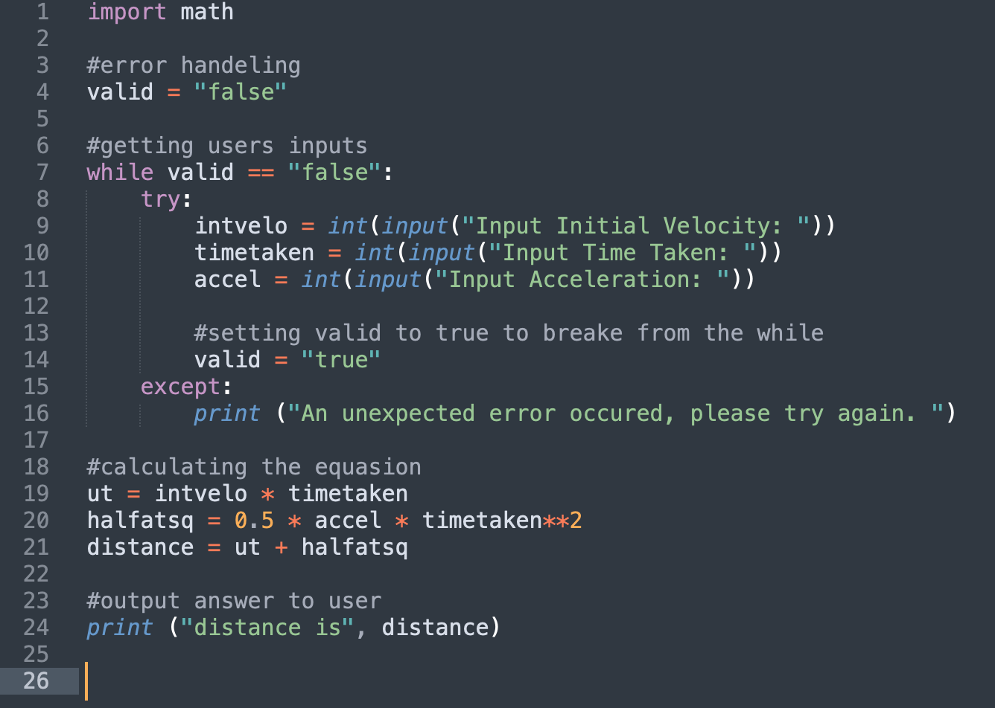
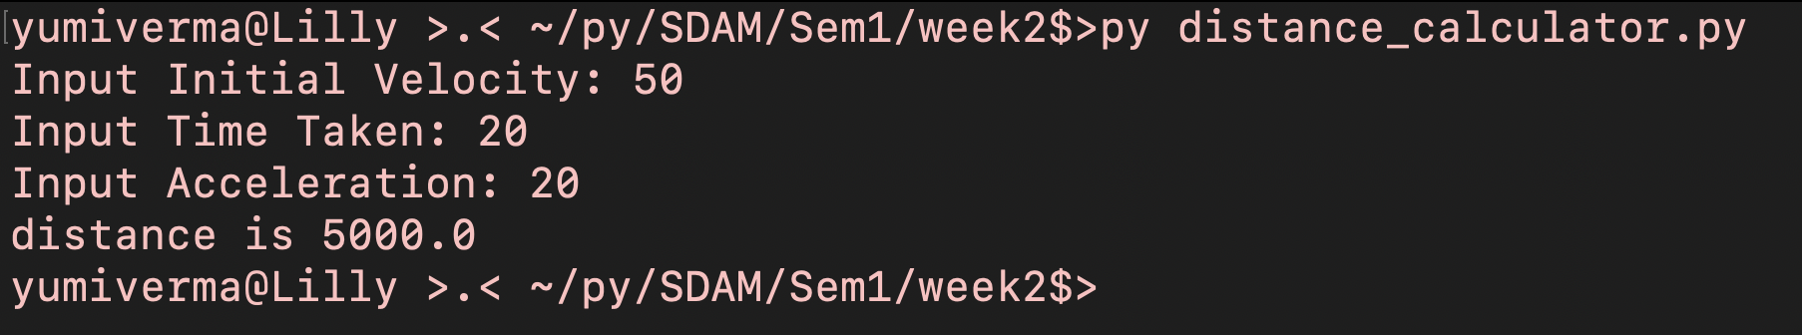
Task 5
import math
#error handeling
valid = "false"
#getting users inputs
while valid == "false":
try:
intvelo = int(input("Input Initial Velocity: "))
timetaken = int(input("Input Time Taken: "))
accel = int(input("Input Acceleration: "))
#setting valid to true to breake from the while
valid = "true"
except:
print ("An unexpected error occured, please try again. ")
#calculating the equasion
ut = intvelo * timetaken
halfatsq = 0.5 * accel * timetaken**2
distance = ut + halfatsq
#output answer to user
print ("distance is", distance)

Slide 7
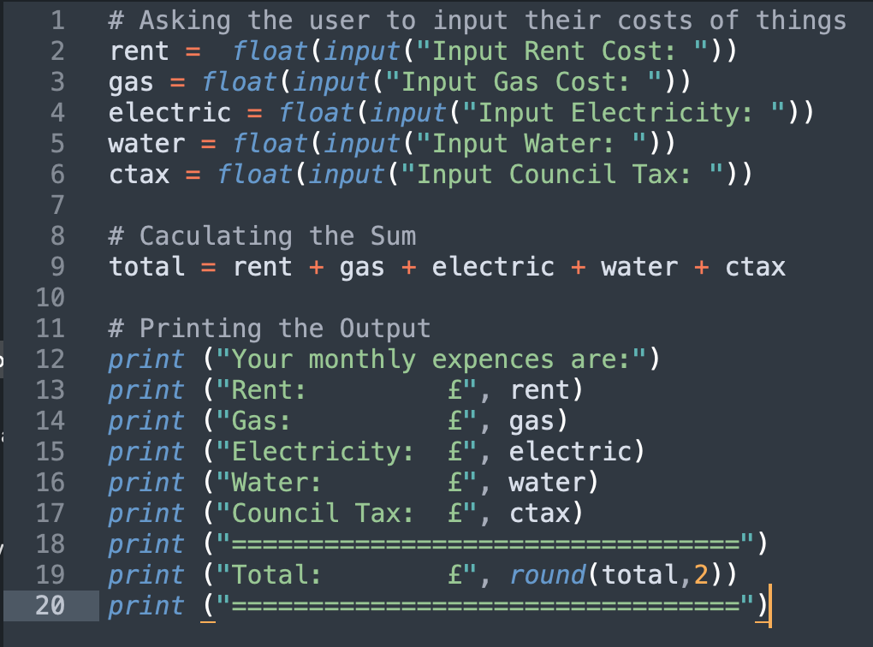
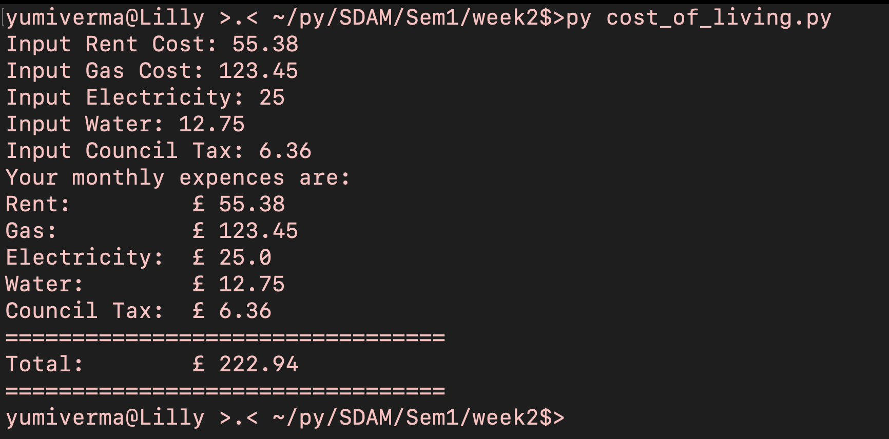
Task 6
# Asking the user to input their costs of things
rent = float(input("Input Rent Cost: "))
gas = float(input("Input Gas Cost: "))
electric = float(input("Input Electricity: "))
water = float(input("Input Water: "))
ctax = float(input("Input Council Tax: "))
# Caculating the Sum
total = rent + gas + electric + water + ctax
# Printing the Output
print ("Your monthly expences are:")
print ("Rent: £", rent)
print ("Gas: £", gas)
print ("Electricity: £", electric)
print ("Water: £", water)
print ("Council Tax: £", ctax)
print ("=================================")
print ("Total: £", round(total,2))
print ("=================================")

Slide 8
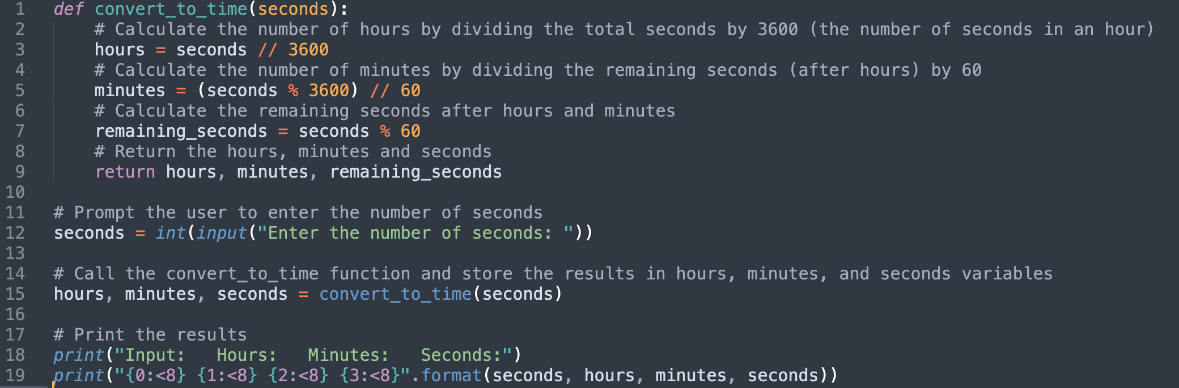
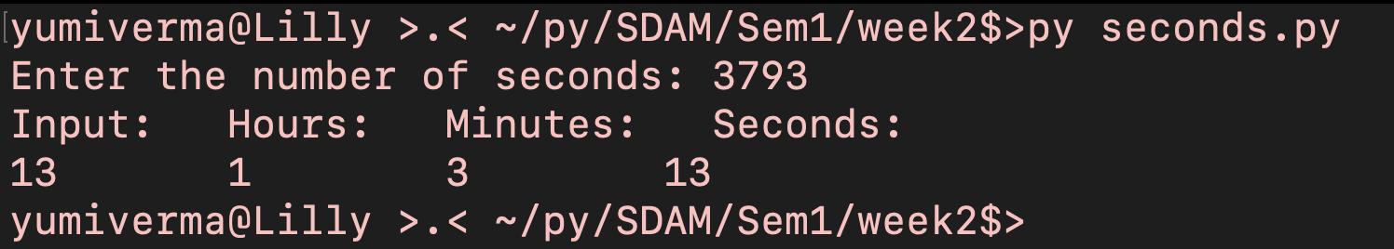
Task 7
def convert_to_time(seconds):
# Calculate the number of hours by dividing the total seconds by 3600 (the number of seconds in an hour)
hours = seconds // 3600
# Calculate the number of minutes by dividing the remaining seconds (after hours) by 60
minutes = (seconds % 3600) // 60
# Calculate the remaining seconds after hours and minutes
remaining_seconds = seconds % 60
# Return the hours, minutes and seconds
return hours, minutes, remaining_seconds
# Prompt the user to enter the number of seconds
seconds = int(input("Enter the number of seconds: "))
# Call the convert_to_time function and store the results in hours, minutes, and seconds variables
hours, minutes, seconds = convert_to_time(seconds)
# Print the results
print("Input: Hours: Minutes: Seconds:")
print("{0:<8} {1:<8} {2:<8} {3:<8}".format(seconds, hours, minutes, seconds))

