Slide 1
Week3 Tasks
Yumi Verma

Slide 2
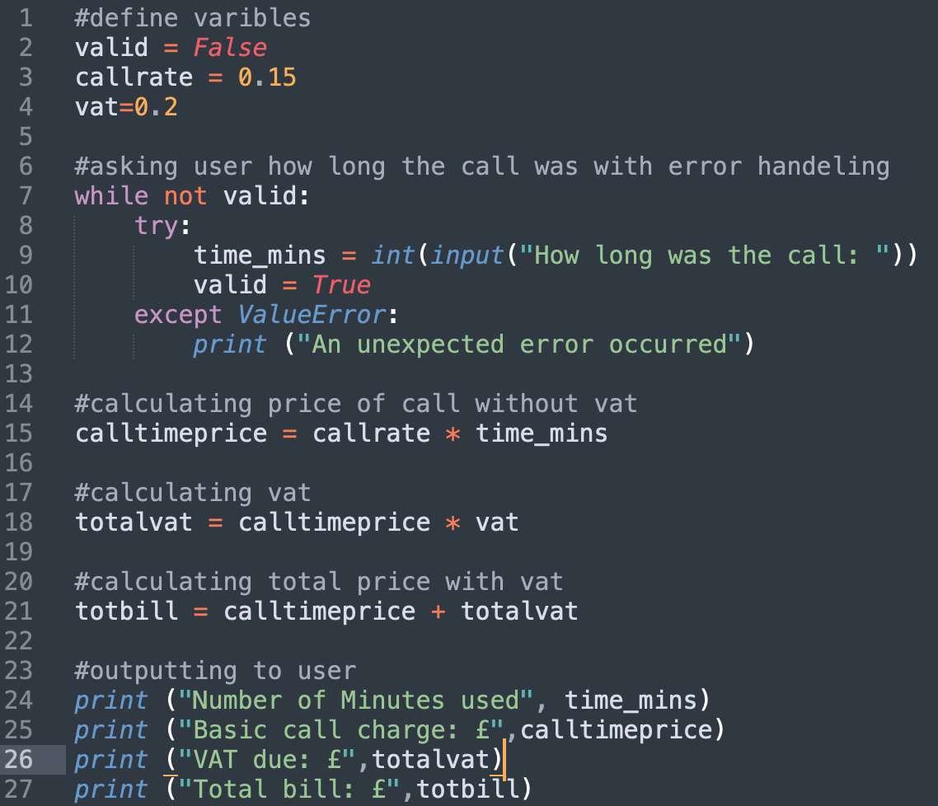
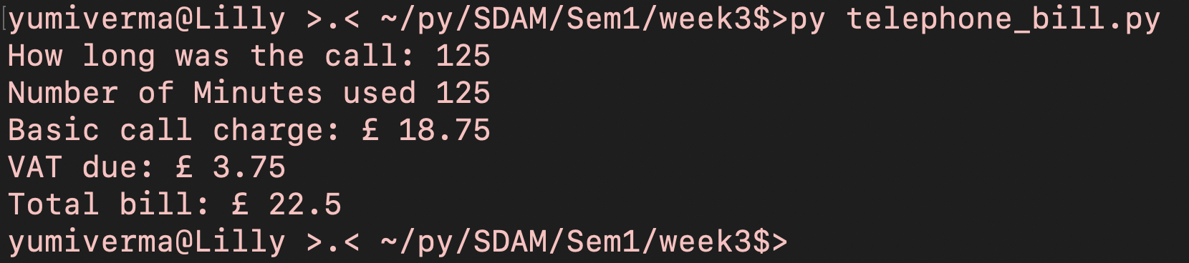
Task 1
#define varibles
valid = False
callrate = 0.15
vat=0.2
#asking user how long the call was with error handeling
while not valid:
try:
time_mins = int(input("How long was the call: "))
valid = True
except ValueError:
print ("An unexpected error occurred")
#calculating price of call without vat
calltimeprice = callrate * time_mins
#calculating vat
totalvat = calltimeprice * vat
#calculating total price with vat
totbill = calltimeprice + totalvat
#outputting to user
print ("Number of Minutes used", time_mins)
print ("Basic call charge: £",calltimeprice)
print ("VAT due: £",totalvat)
print ("Total bill: £",totbill)

Slide 3
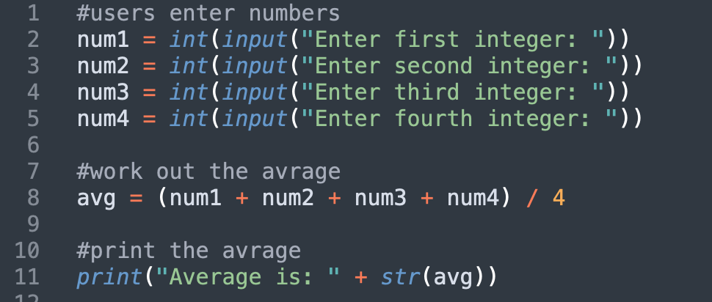
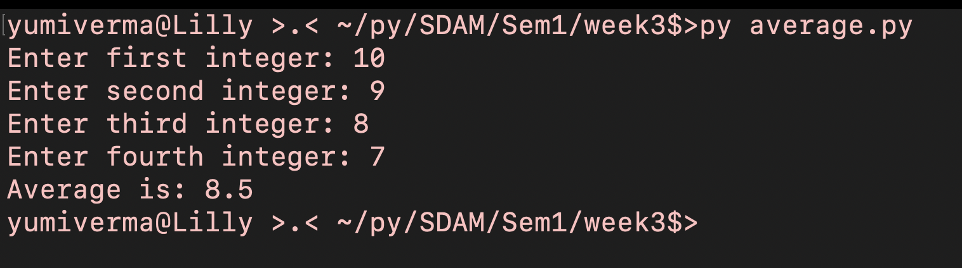
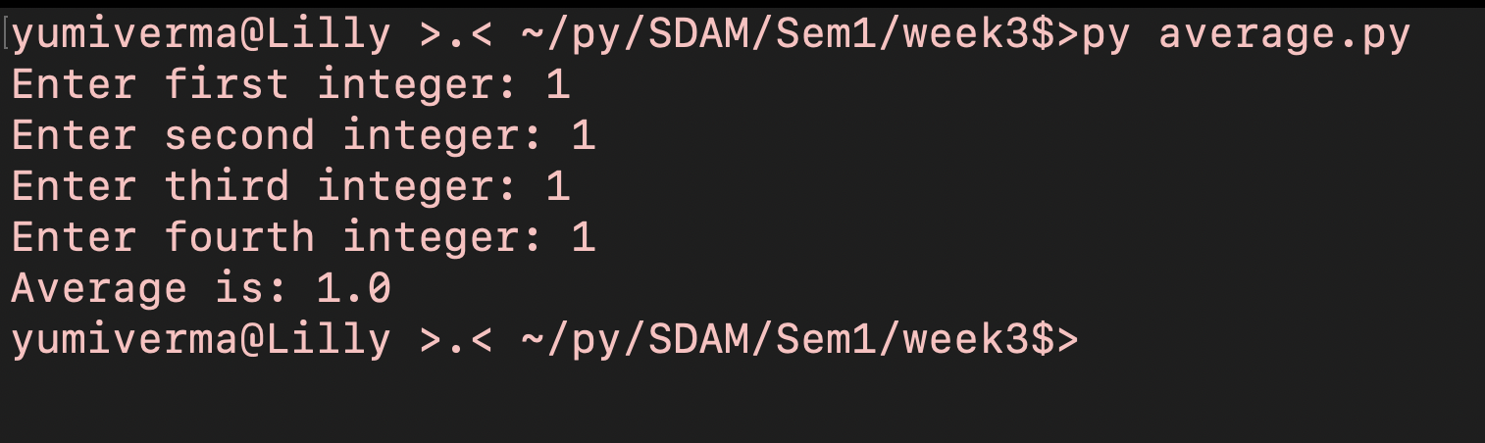
Task 2
Part 1
#users enter numbers
num1 = int(input("Enter first integer: "))
num2 = int(input("Enter second integer: "))
num3 = int(input("Enter third integer: "))
num4 = int(input("Enter fourth integer: "))
#work out the avrage
avg = (num1 + num2 + num3 + num4) / 4
#print the avrage
print("Average is: " + str(avg))
Part 2

Slide 4
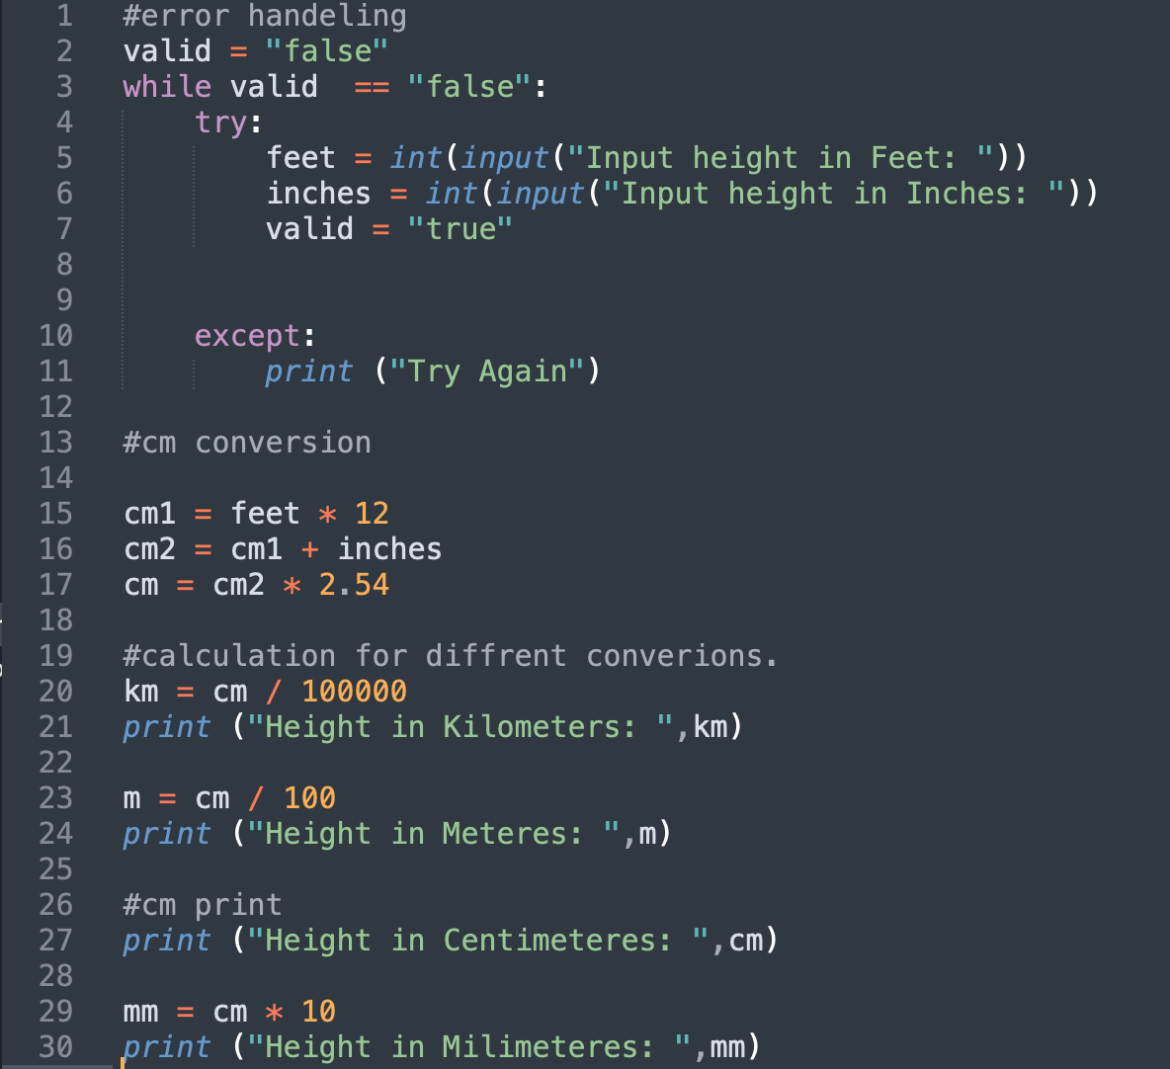
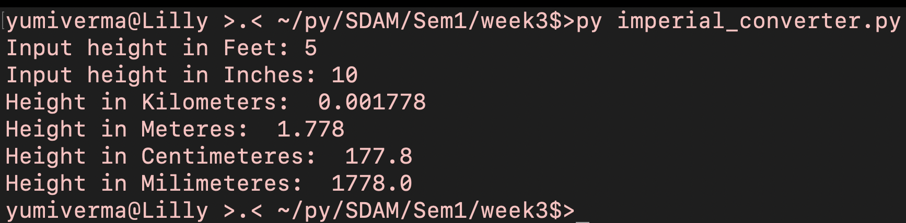
Task 3
#error handeling
valid = "false"
while valid == "false":
try:
feet = int(input("Input height in Feet: "))
inches = int(input("Input height in Inches: "))
valid = "true"
except:
print ("Try Again")
#cm conversion
cm1 = feet * 12
cm2 = cm1 + inches
cm = cm2 * 2.54
#calculation for diffrent converions.
km = cm / 100000
print ("Height in Kilometers: ",km)
m = cm / 100
print ("Height in Meteres: ",m)
#cm print
print ("Height in Centimeteres: ",cm)
mm = cm * 10
print ("Height in Milimeteres: ",mm)

