Slide 1

Comparative Research on Predictive Models Based on MOBA Game Data Set
Yumin Xu, Michael Vigil, Logan Decker

Slide 2


Contents
Part 1
Background
Part 2
Training & Evaluating
Part 3
Performance Comparison
Part 4
Conclusion

Slide 3
Part 1
Background

Slide 4
Part 1.1 Research Background
Human Activity Recognition
Vision-based methods
Provide better recognition rates
Very vulnerable to the effects of lighting, environmental occlusion, and background changes
People pay more and more attention to privacy
Wearable sensor-based methods
● Wearable devices, especially smartphones, are increasingly used for human activity recognition
Wearable Sensor-based Methods
K-nearest neighbor algorithm by Kaghyan et al.
A robust recognition system in terms of orientation, placement and subject variations through the support vector machine (SVM) by Chen et al.
A hardware-Friendly algorithm which takes energy and computing power into account by Davide
Disadvantage of those Wearable Sensor-based Methods
Vector-based processing mode and feature alignment are inevitable to lose the latent relationship
between different smartphone sensors and various orientations

Slide 5
Part 1.2 Research Steps
The features from different sensors and various orientations were presented as a higher-order tensor
The latent relationship between different sensors and the inherent difference of signal properties for different orientations can be exploited in a tensor-based mode for feature representation and interpretation
Proposed Weighted Support Tensor Machines (WSTM) for human activity recognition
WSTM can avoid the sensitivity of outliers in the standard STM and improve the accuracy
Constructed tensor-based human activity recognition framework
The framework realized the analysis and classification of human activities in tensor space

Slide 6
Part 2
From SVM to WSTM

Slide 7

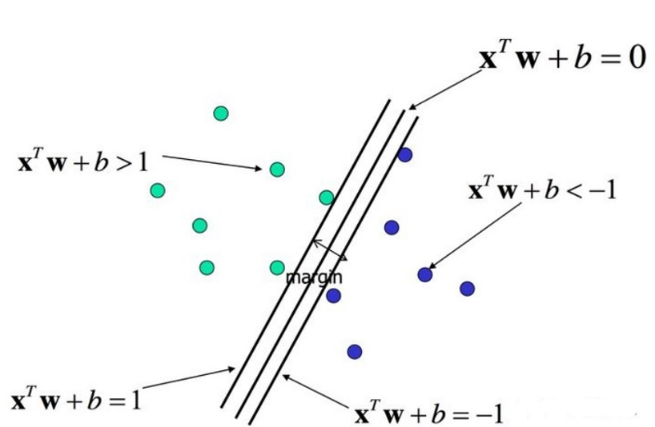


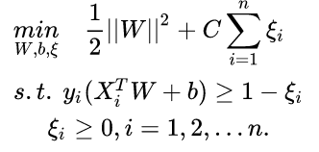
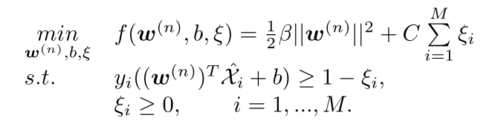

Part 2.1 From SVM to STM
Input: Vector
Core Technologies of SVM
Input: Tensor
Core Technologies of STM
A tensor of Nth-order is expressed as
Soft Margin SVM: Use Relaxation Factor
Soft Margin STM: Use Relaxation Factor
Formula of the SVM algorithm
Formula of the STM algorithm
Use relaxation factor
Use relaxation factor
Use idea of iteration to solve $w_{n}$
Optimization goal & primal problem
The nth optimization goal & primal problem

Slide 8
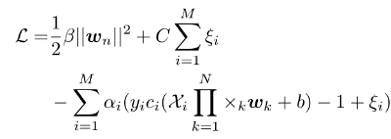
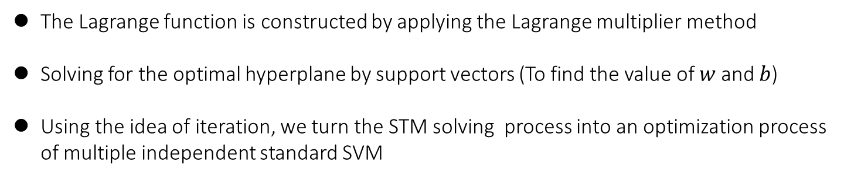
Part 2.1 From SVM to STM
Lagrangian function
SVM
Lagrangian function
STM
Adding positive Lagrange multipliers to each constraint
Adding positive Lagrange multipliers to each constraint
The Lagrange function is constructed by applying the Lagrange multiplier method
Solving for the optimal hyperplane by support vectors (To find the value of $w$and $b$)
Using the idea of iteration, we turn the STM solving process into an optimization process of multiple independent standard SVM

Slide 9

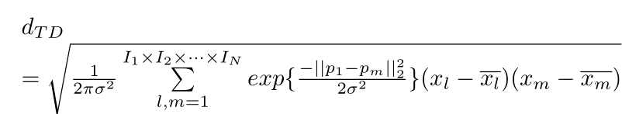
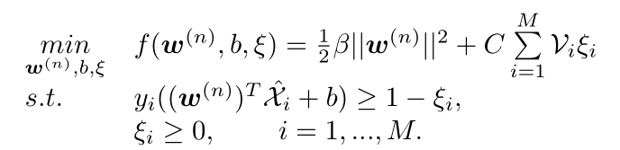
Part 2.2 From STM to WSTM
Use weight
Core Technologies of WSTM
Without weight
Core Technologies of STM
A tensor of Nth-order is expressed as
Where r is the ratio that can be set during initialization
Soft Margin STM: Use Relaxation Factor
Formula of the STM algorithm
The constrained optimization problem is formulated as
Use relaxation factor
Use idea of iteration to solve $w_{n}$
The nth optimization goal & primal problem

Slide 10
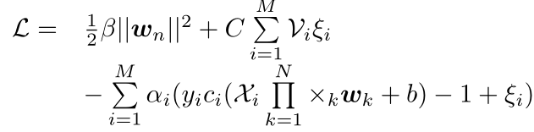
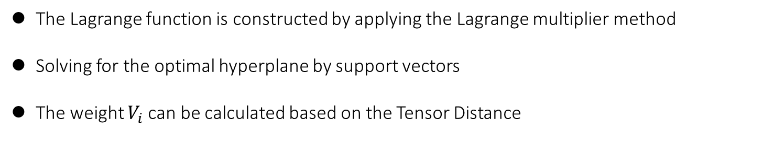
Part 2.2 From STM to WSTM
Lagrangian function
WSTM
Lagrangian function
STM
Adding positive Lagrange multipliers to each constraint
Adding positive Lagrange multipliers to each constraint
The Lagrange function is constructed by applying the Lagrange multiplier method
Solving for the optimal hyperplane by support vectors
The weight $V_{i}$can be calculated based on the Tensor Distance

Slide 11
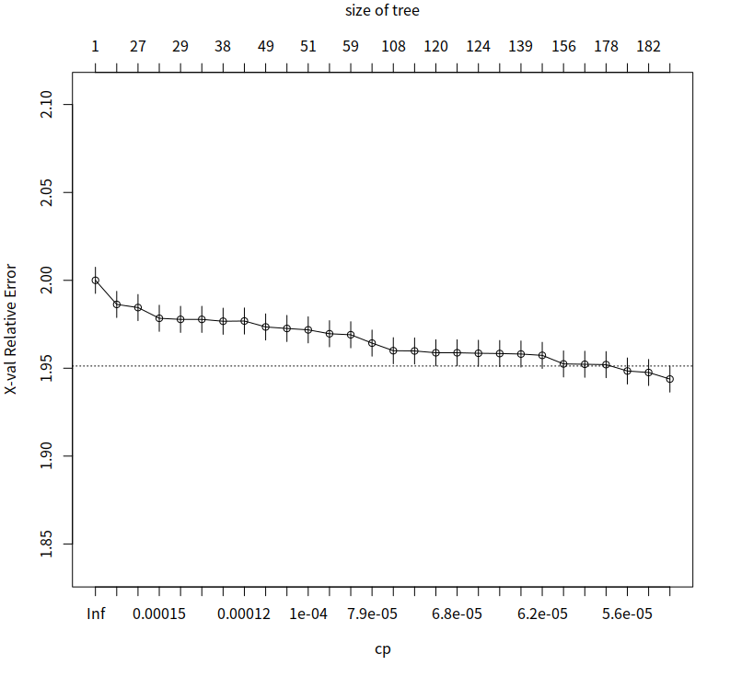
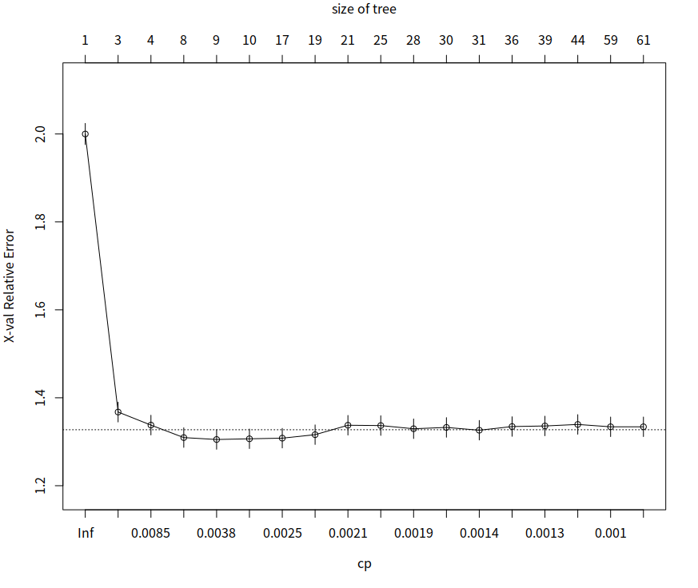
Part 2.3 Training Methods and Decision Trees
Training and Testing Set
Training and Testing Set
Dota2
LoL
Dota2 relative error (xerror±xstd) of the cross-validation plot.
LoL relative error (xerror±xstd) of the cross-validation plot.
We randomly selected 70% of the data for the training set and the remaining as the testing set.
Built a CART (Classification And Regression Tree) model
RPART package provided a pruning method for complexity loss pruning
Helpful for telling us how much cp(complexity parameter) and the aver. Error when the model is split to each layer.
In our model we chose the method of cp with the smallest xerror.

Slide 12
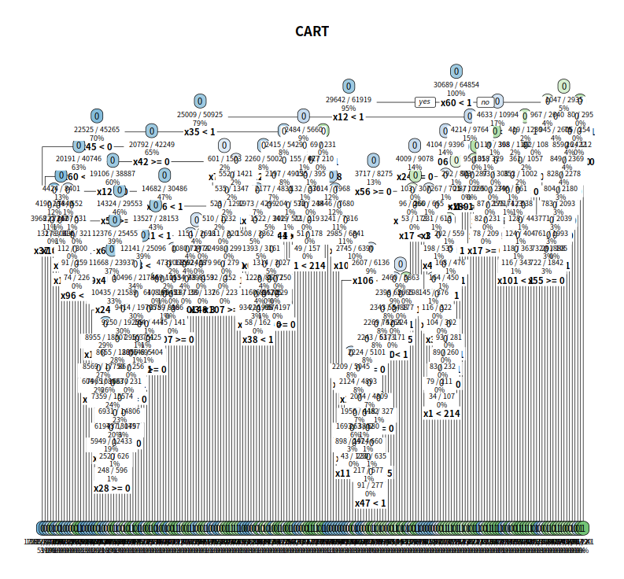
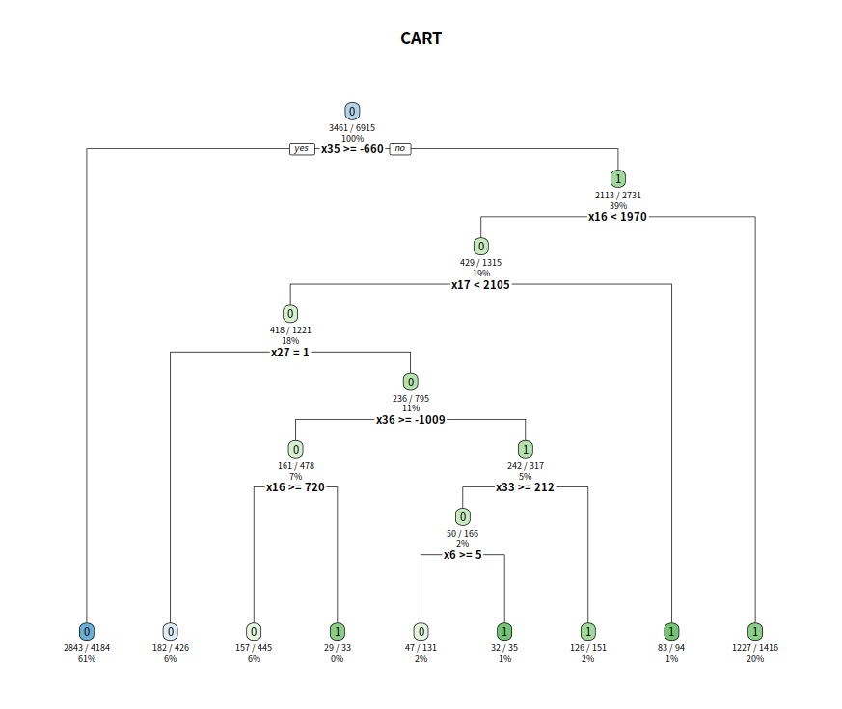
Part 2.3 Training Methods and Decision Trees
Dota2
LoL
The decision tree model based on the Dota2 dataset.
The decision tree model based on the LoL dataset.
Use of rpart.plot function to draw the final decision trees.

Slide 13
Part 3
Experimental Result & Discussion

Slide 14
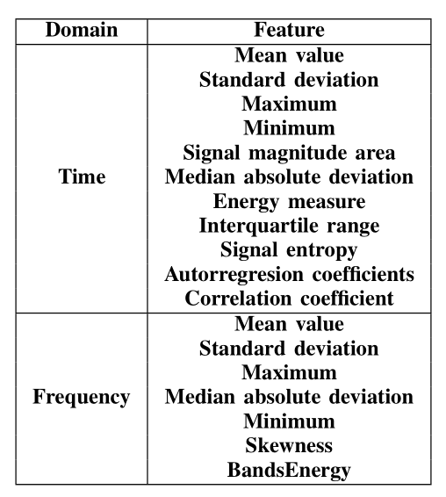
Part 3.1 Methodology
Feature Selection
Feature selection is to select those features with low coupling and high fractional variability, in preparation for the later behavior recognition
By computing the variables, 11 features from the time domain and 7 features from the frequency domain were obtained from each window. Table below lists the features we selected in the dataset

Slide 15
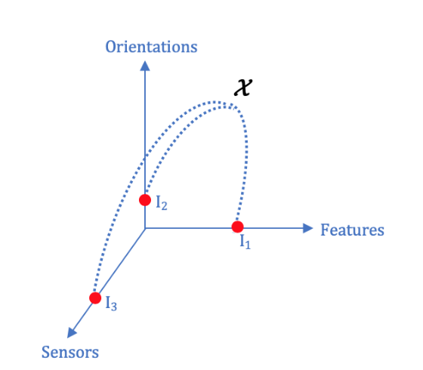

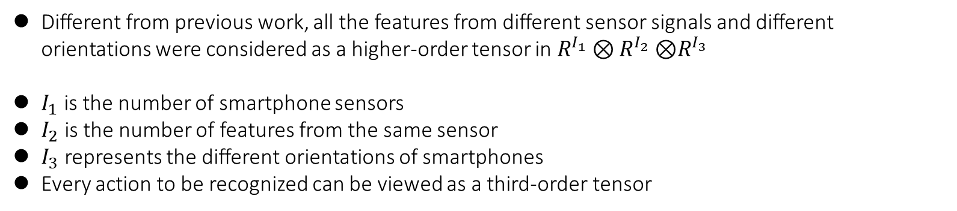
Part 3.1 Methodology
Tensor-based Feature Representation Model
Different from previous work, all the features from different sensor signals and different orientations were considered as a higher-order tensor in $R^{I_{1}}⊗R^{I_{2}}$ ⊗$R^{I_{3}}$
$I_{1}$ is the number of smartphone sensors
$I_{2}$ is the number of features from the same sensor
$I_{3}$ represents the different orientations of smartphones
Every action to be recognized can be viewed as a third-order tensor

Slide 16
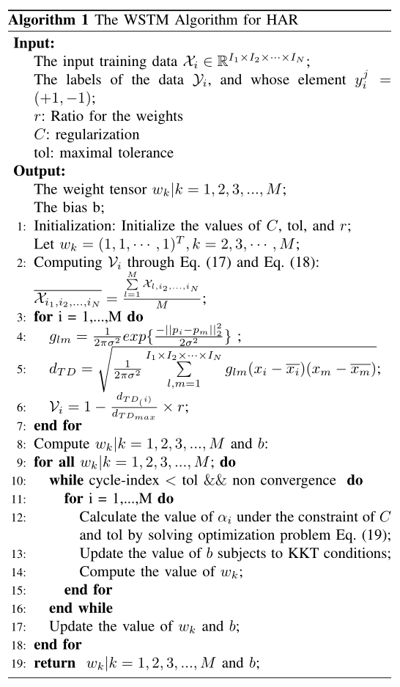

Part 3.1 Methodology
Weighted Support Tensor Machine Model
The standard STM treats all data points indiscriminately, but in the space, some data points are far from the data center, while others end up in the support tensor, and they have completely different impacts
The basic idea of our algorithm is to assign corresponding weights to different data points according to their distances from the center. We derive the standard STM and thus the WSTM containing the weights, which uses the data points containing the weights as the basis for hyperplane selection
The WSTM algorithm mainly includes two episodes, the weights $V_{i}$ generation and the training for $w$ and $b$

Slide 17
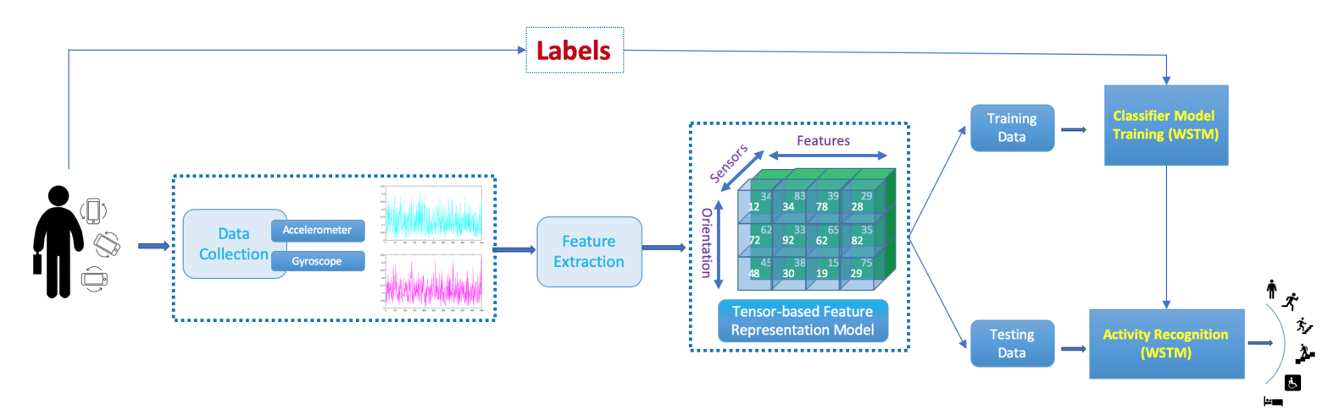
Part 3.1 Methodology
Tensor-based human activity recognition framework
The weighted support tensor machine, which assigns different weights to different point according to the relative importance of each data collected by the smartphone sensor, is used to divide human activities into 6 classes
From the picture, we can find that the labeled human activity data will be used for training the classifier model, weighted support tensor machine

Slide 18
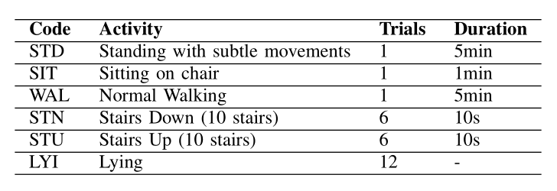
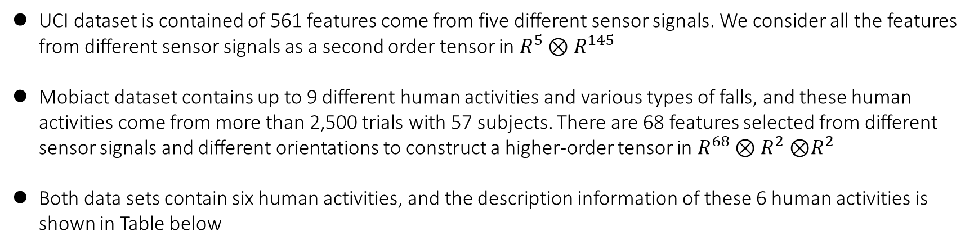
Part 3.2 Experimental Results and Discussions
Data sets
UCI dataset is contained of 561 features come from five different sensor signals. We consider all the features from different sensor signals as a second order tensor in $R^{5}⊗R^{145}$
Mobiact dataset contains up to 9 different human activities and various types of falls, and these human activities come from more than 2,500 trials with 57 subjects. There are 68 features selected from different sensor signals and different orientations to construct a higher-order tensor in $R^{68}⊗R^{2}$ ⊗$R^{2}$
Both data sets contain six human activities, and the description information of these 6 human activities is shown in Table below

Slide 19
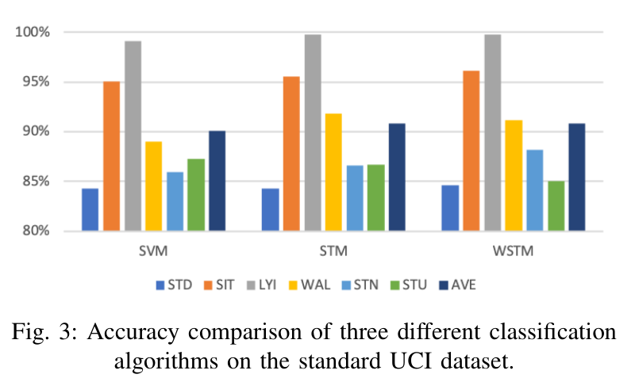
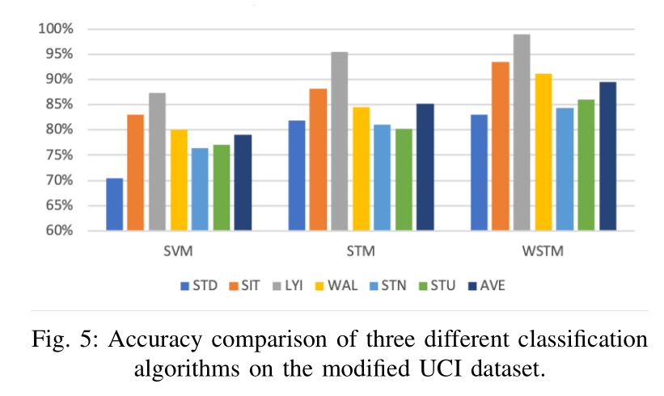
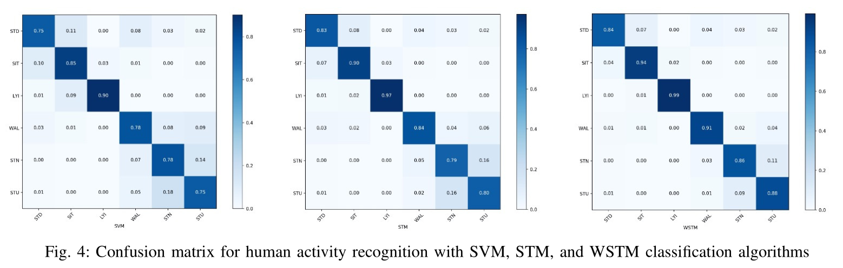
Part 3.2 Experimental Results and Discussions
Experiments on UCI dataset

Slide 20
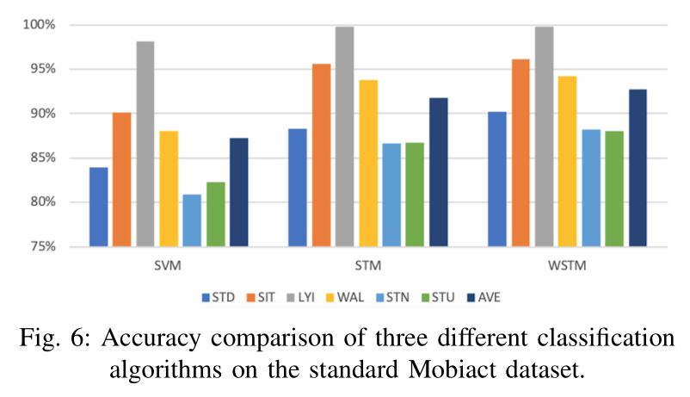
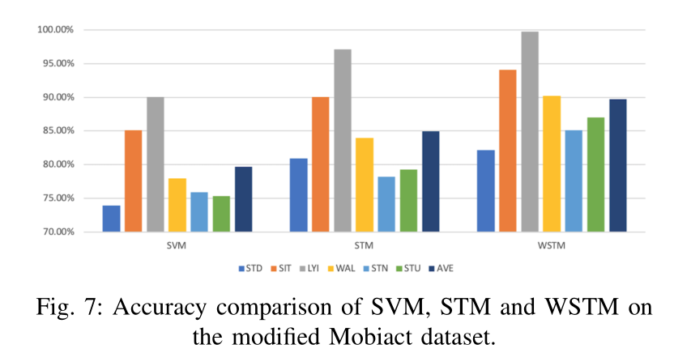
Part 3.2 Experimental Results and Discussions
Experiments on Mobiact dataset

Slide 21
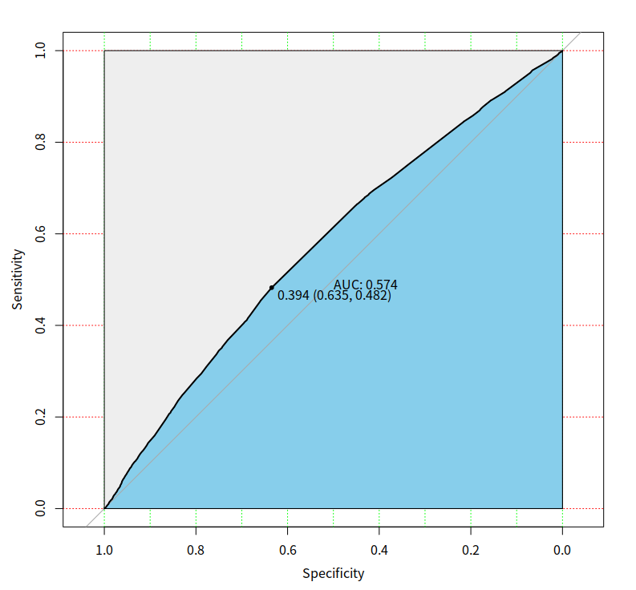
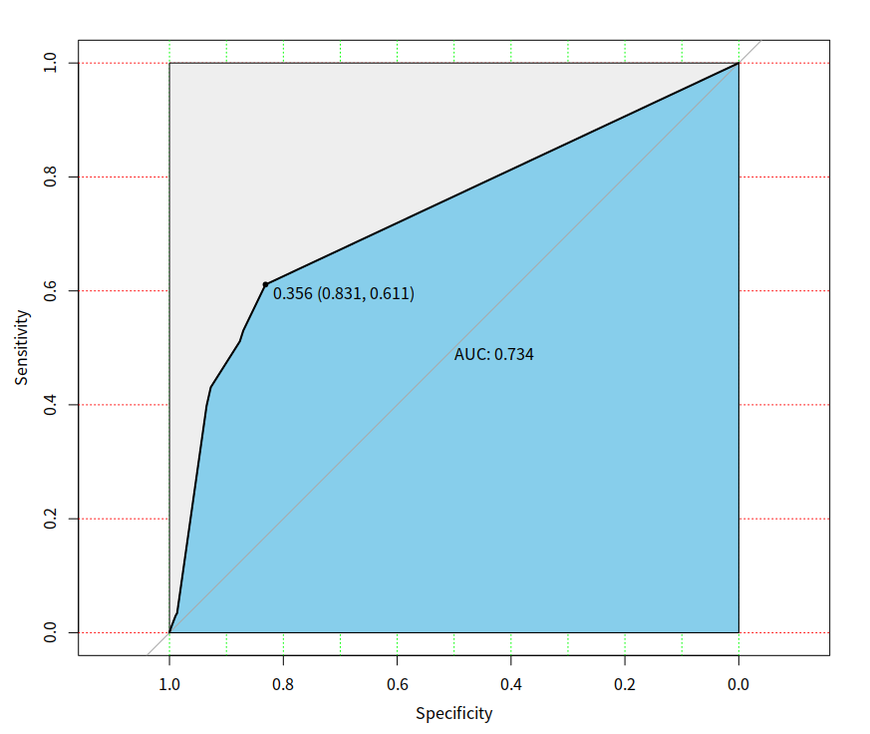
Part 3.2 Experimental Results and Discussions
Evaluation Results
Dota2
LoL
AUC=0.574, the classifier from our modeling only slightly outperforms the random guessing.
AUC=0.734, the classifier of our modeling outperforms random guessing.

Slide 22
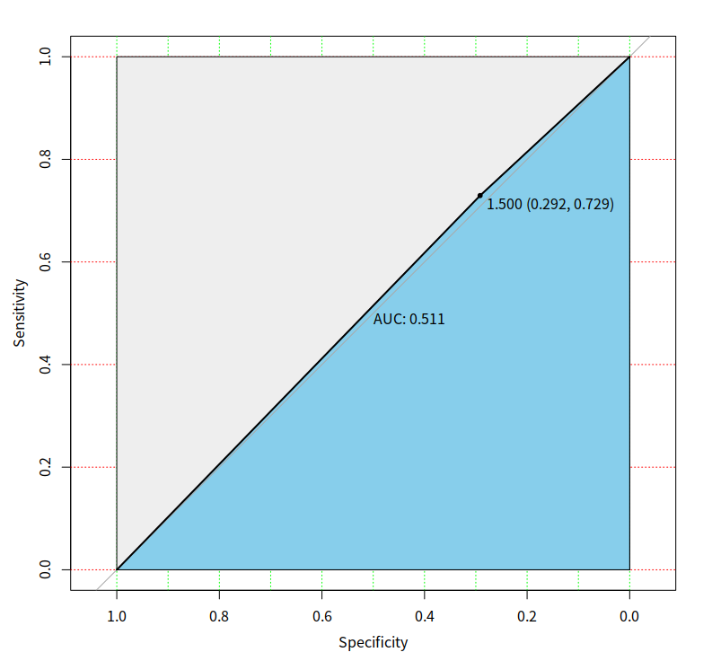
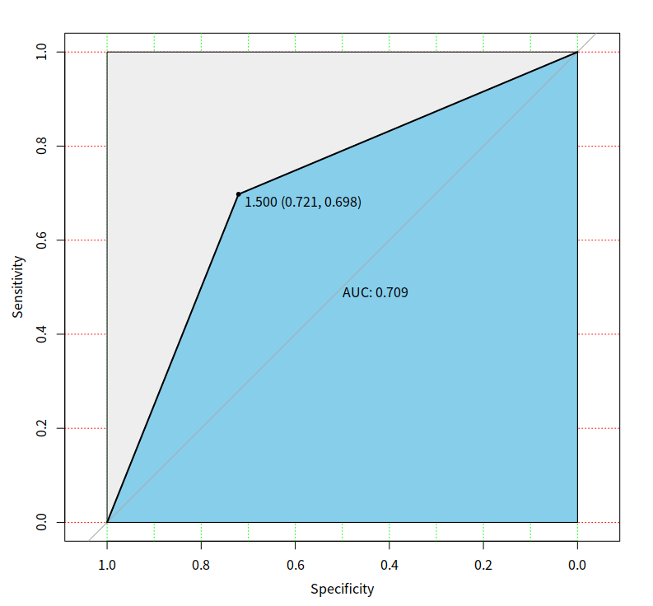
Part 3.2 Experimental Results and Discussions
K-NN Evaluation Results
Dota2
LoL

Slide 23
Part 4
Conclusion

Slide 24
Part 4 Conclusion
We represent the features from different sensors as a higher-order tensor. The latent relationship between different sensors and the inherent difference of signal properties for different orientations can be exploited in a tensor-based mode for feature representation and interpretation. Furthermore, a weighted support tensor machine was proposed for human activity recognition while avoiding the outlier sensitivity problem
Many experiments have been done to verify the effectiveness of STM and WSTM algorithms in human activity recognition. Experimental data show that the tensor-based STM algorithm can more accurately identify human activity than the SVM algorithm. In addition, the WSTM algorithm we proposed can effectively avoid the problem of abnormal sensitivity of the standard STM algorithm, and can achieve a better recognition rate in practice. The experimental results prove the huge potential of our proposed WSTM algorithm in human activity recognition
The main drawback of this study is its low efficiency of calculating the weight Vi and iterative algorithm

Slide 25
Q & A

