Slide 1

Melissa Jenkins
Cassidy Lamm
Nico Wood

Slide 2
Yummy Crummy
Provides convenient, user-friendly mobile application for users to keep track of their family’s dish preferences at different restaurants
Records restaurant, dish, rating, and additional notes for each profile
Can be used by people of all ages, backgrounds, ethnicities, and education levels

Slide 3

What’s Changed
Internal vs External Data Storage
Account and Profile Organization
Yelp Integration

Slide 4
Please turn your attention to the application demonstration

Slide 5
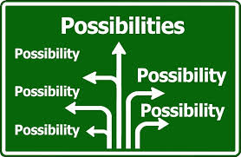
Lessons Learned
Don’t Underestimate the Learning Curve
Android development process
Android Studio
Git/GitHub
SQLite Database
HTML
Genymotion
Visual Paradigm
Phone Developer Options
Computers
Share the Wealth
Don’t Be a ‘Jack of All Trades’
Think Twice Before You Jump
Question Everything

Slide 6

Future Goals
Store Data on a Server
Allow for aggregation of user ratings and reviews
Eliminates need for internal storage
Will increase scalability
Optimize User Interface and Design Flow
Enhance user experience
Add Facebook login
Increase ease of use

Slide 7
Any questions?

