Slide 1
Important notes about the slideshow:
While presenting, don’t read from the slide, each script is in the speaker notes below ↓ for each person’s designated slide.
Every text on each slide is only used as a visual, not a reference for reading, only read from the script in the speaker notes when we present

Slide 2

AURUM
CORN YIELD ML PREDICTION MODEL
USDA HACKATHON 2026
00
ENGIN GEDIK, IAN BARRIE, RAGHAV AGARWAL, SASHA NAUSHAD
Notes:
Liam: Welcome to our Time Use Gender and Time Poverty presentation for Econ 211. My name is Liam and I will present alongside Alex, Diego, Sasha, and Westen.

Slide 3
THE SIGNIFICANCE OF CROP YIELD FORECASTING
WHO ARE THE STAKEHOLDERS OF CROP YIELD?
WHAT ARE THE LIMITATIONS OF CURRENT ESTIMATION METHODS?
HOW CAN PREDICTION BE REVOLUTIONIZED?
PROBLEM
WHAT IS THE ISSUE AT HAND?
02
SPEAKER: SASHA NAUSHAD
PROBLEM
Notes:
LIAM: Our project examines how people spend their time and whether time use differs by gender. We also look at how our sample compares to national U.S. averages and whether any of our participants experience time poverty. Time poverty refers to having too little discretionary time after necessary and committed activities. Understanding time use is important because it impacts stress levels, health, education, disparities, and overall well-being.

Slide 4
THE POWER OF AI
TIME CONSTRAINTS AND EFFICIENCY
04
SPEAKER: SASHA NAUSHAD
AI-USE STATEMENT

Slide 5
SOLUTION
HIGH LEVEL MULTI-MODEL SYSTEM
INITIAL APPROACH
WORKING APPROACH
HLS SATELLITE DATA, CDL MASKS, NDVI (NORMALIZED DIFFERENCE VEGETATION INDEX)
MORE ACCURATE - COST OF TIME
NEED FOR INCREASED DATA IMPLEMENTATION
INCREASE IN PIPELINES, TWO PIPELINES IN DEVELOPMENT
CHECKING FOR REDUNDANCY
OUTPUT COMPARISON AND VARIATION IN TRAINING DATA
03
SPEAKER: ENGIN GEDIK
COLLECTION AND METHOD
Notes:
Script – Alex (Methodology):
“Our sample was made up of students who completed 24-hour time diaries. Each participant recorded how many minutes they spent sleeping, studying, working, doing personal care, and having free time. We then converted those minutes into hours and percentages so we could compare time use across categories and by gender. We also grouped activities into necessary, committed, and discretionary time so we could evaluate time poverty using Kalenkoski’s definition.”

Slide 6
DATA + MODELING
THE TECHNICAL CORE OF THE MODEL
04
SPEAKER: ENGIN GEDIK, IAN BARRIE, RAGHAV AGARWAL
DATA + MODELING

Slide 7
SATELLITE IMAGERY
TABULAR DATA
HLS (HARMONIZED LANDSAT SENTINEL):
NDVI
EVI
CDL (CROPLAND DATA LAYER):
CROP MASKS
PRISM:
TEMPERATURE MEAN
PRECIPITATION LEVEL
PRITHVI
USDA NASS:
CROP YIELD HISTORICAL ANALOG PER COUNTY
GRIDMET:
CLIMATE VARIABLES
US DROUGHT MONITOR:
DROUGHT SEVERITY
INSIGHT
WHY THESE DATA
SETS?
DATA POINTS THAT DRIVE CROP YIELD
06
SPEAKER: RAGHAV AGARWAL
DATA + MODELING
Notes:
Script – Sasha (Graph Results):
This graph shows that men spent about 34.95% of their day in free time, compared to 27.43% for women, showing a noticeable gap in leisure. In contrast, women devoted a larger share of their day to both studying and paid work, with 21.18% of their time spent studying and 5.90% in paid work, compared to 18.40% and 3.47% for men. Women also spent a slightly higher percentage of their day sleeping. Together, these patterns highlight that while both groups balance similar activities, the way their time is allocated across the day is different.

Slide 8
XGBoost
KNN
MAIN YIELD PREDICTOR, TRAINED SEPARATELY PER FORECAST DATE
ENSEMBLE MODEL THAT HANDLES MISSING VALUES, MIXED FEATURES, AND PROVIDES INTERPRETABLE FEATURE IMPORTANCE
ANALOG YEAR FINDER FOR CONE OF UNCERTAINTY
FOUND MOST SIMILAR HISTORICAL SEASONS TO 2025 TO BUILD THE UNCERTAINTY RANGE
MODELS
INITIAL MODEL APPROACH?
06
SPEAKER: RAGHAV AGARWAL
DATA + MODELING
Notes:
Script – Sasha (Graph Results):
This graph shows that men spent about 34.95% of their day in free time, compared to 27.43% for women, showing a noticeable gap in leisure. In contrast, women devoted a larger share of their day to both studying and paid work, with 21.18% of their time spent studying and 5.90% in paid work, compared to 18.40% and 3.47% for men. Women also spent a slightly higher percentage of their day sleeping. Together, these patterns highlight that while both groups balance similar activities, the way their time is allocated across the day is different.

Slide 9
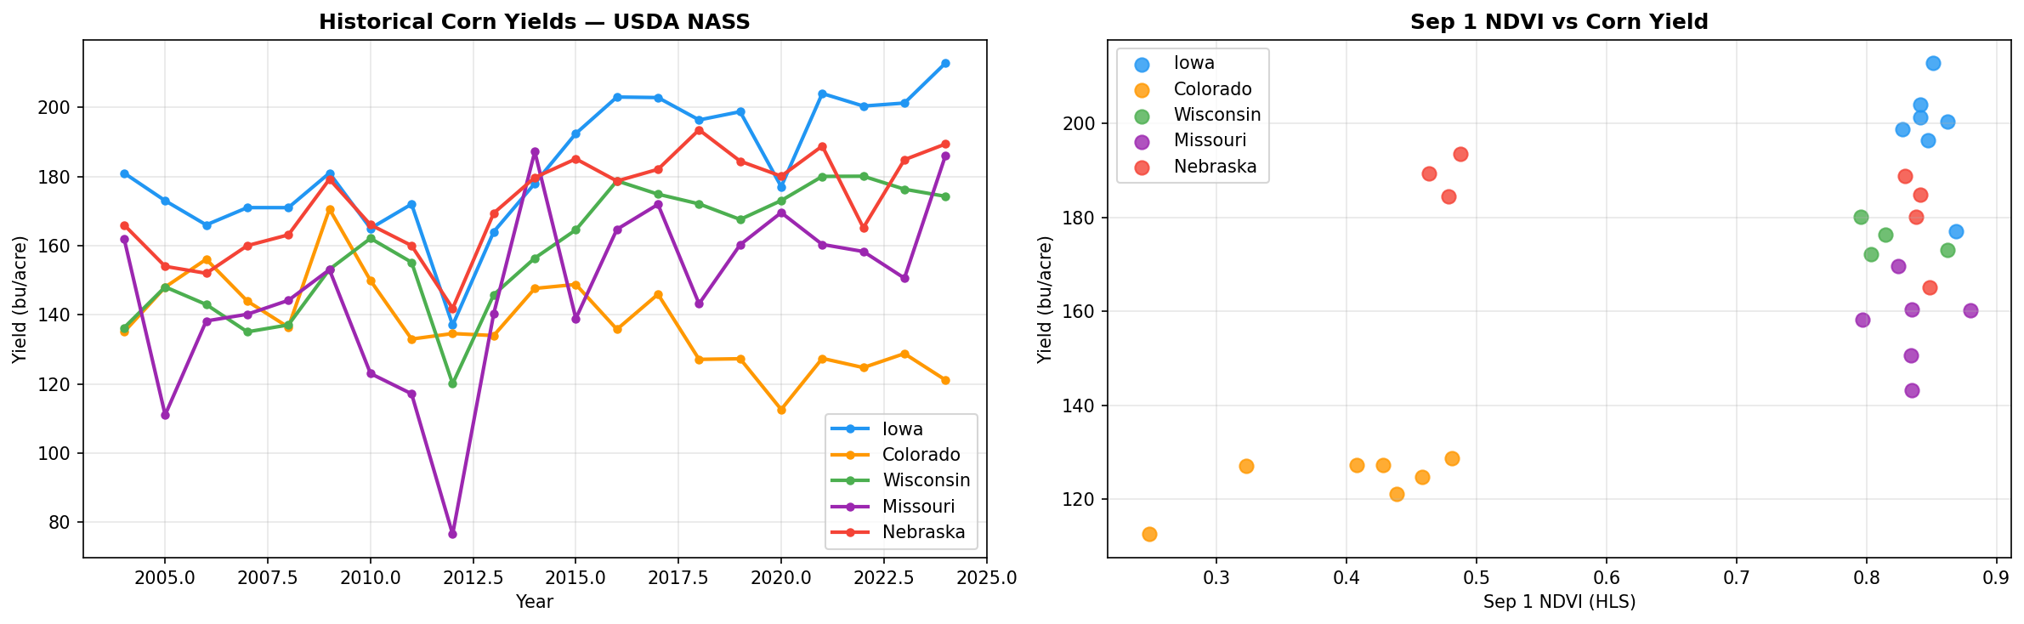
DATA VISUAL
HISTORICAL CORN YIELDS AND NDVI COMPARISON
07
SPEAKER: IAN BARRIE
DATA + MODELING
Notes:
Script – Sasha (Time Poverty Results):
“Using the Kalenkoski definition of time poverty, we classified discretionary time as anything left after necessary and committed activities. In our sample, most participants had 9-15 hours of discretionary time per day. However, two of our participants fell below the time poverty threshold of 8.9 hours of discretionary time for 2 adults with no children, which aligns with the average number of adults and children in each household. The two participants are male and female, and spent below the average amount of time on free time and study, while spending a significant amount of time on sleep and personal care.

Slide 10
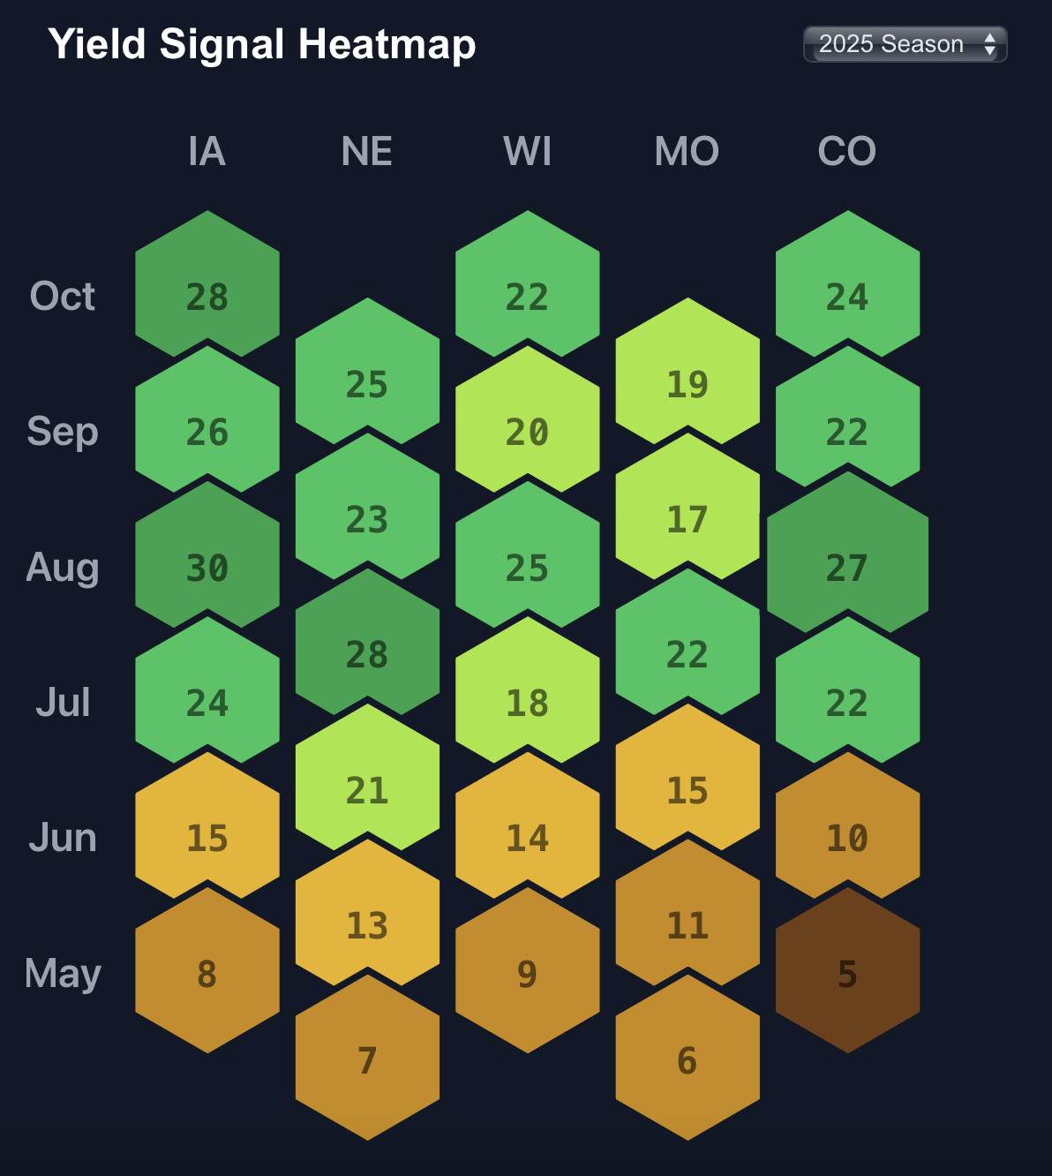
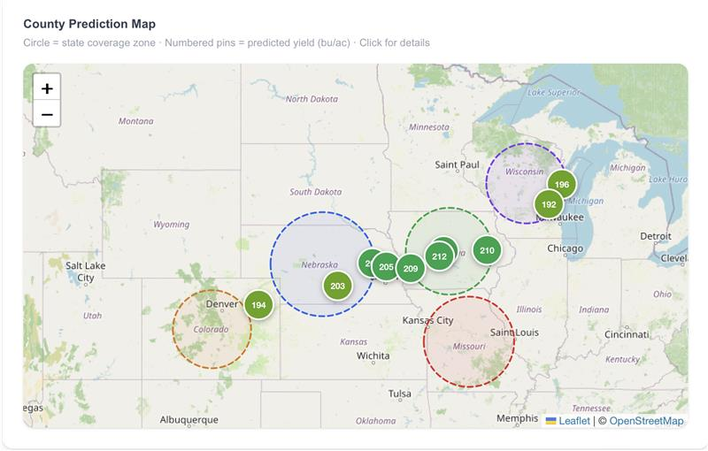
DATA VISUAL
YIELD SIGNAL HEAT MAP AND COUNTY PREDICTION
05
SPEAKER: IAN BARRIE
DATA + MODELING
Notes:
Script – Sasha (Table Results):
This table shows our average time use in hours per day. On average, participants spent about 9.45 hours sleeping, 0.95 hours on personal care, 0.27 hours on domestic work, 0.85 hours on paid work, 7.79 hours in free time, and 4.59 hours studying. When looking at gender differences, women in our sample spent slightly more time sleeping, studying, and in paid work compared to men, while men spent more time in domestic work and free time.
We also observe a noticeable difference in free time, with men having nearly two more hours of free time per day than women. This difference may be related to the fact that, on average, women spent more time engaged in studying, paid work, and sleep. The graph further highlights that men dedicated more time to domestic work in this sample.

Slide 11
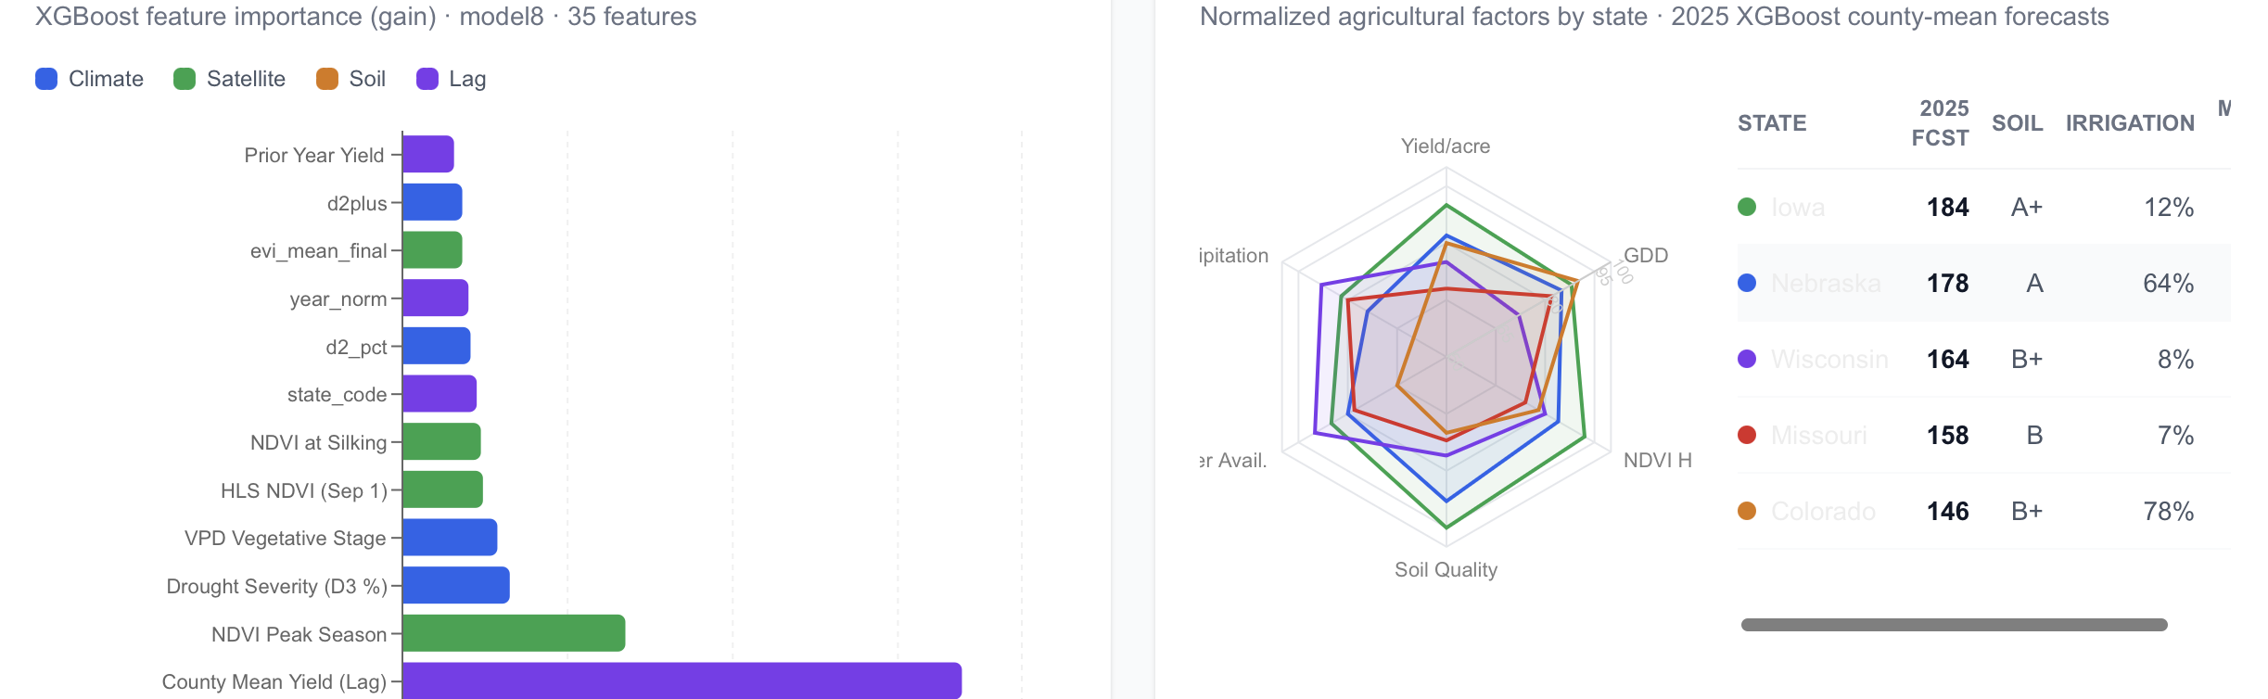
DATA VISUAL
FEATURE IMPORTANCE AND STATE PERFORMANCE
07
SPEAKER: IAN BARRIE
DATA + MODELING
Notes:
Script – Sasha (Time Poverty Results):
“Using the Kalenkoski definition of time poverty, we classified discretionary time as anything left after necessary and committed activities. In our sample, most participants had 9-15 hours of discretionary time per day. However, two of our participants fell below the time poverty threshold of 8.9 hours of discretionary time for 2 adults with no children, which aligns with the average number of adults and children in each household. The two participants are male and female, and spent below the average amount of time on free time and study, while spending a significant amount of time on sleep and personal care.

Slide 12
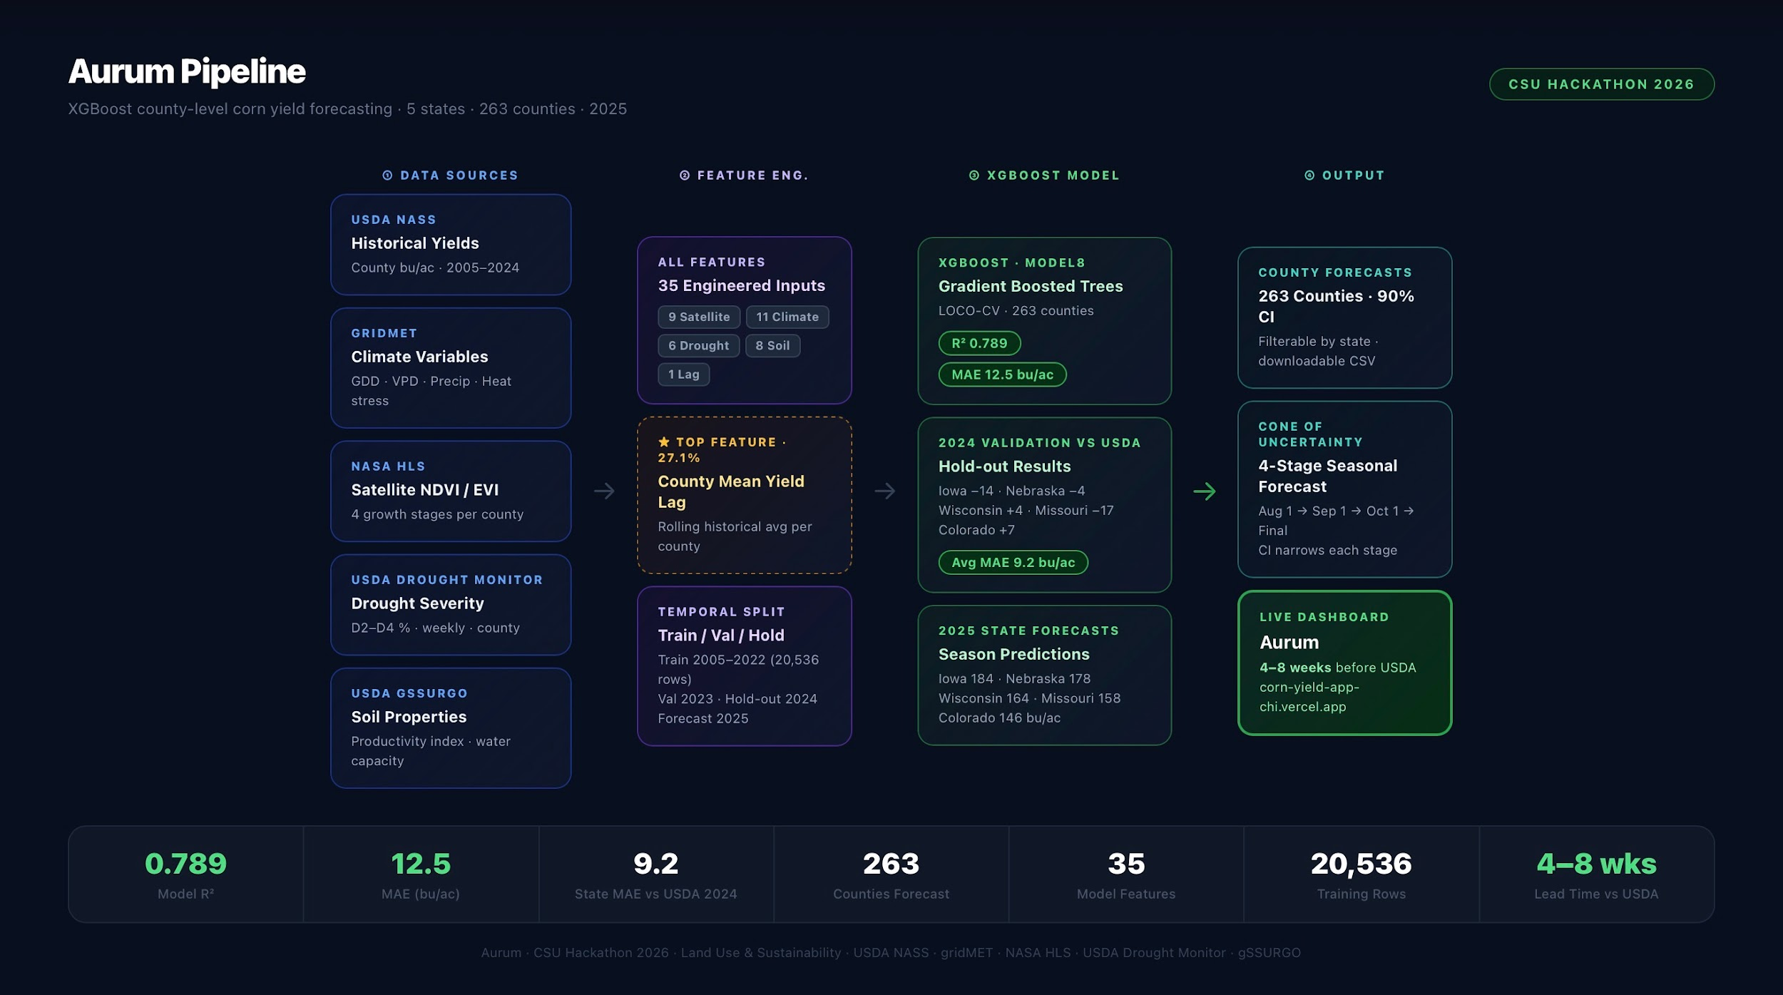
MODELING
MODEL DIAGRAM: PIPELINE ONE
05
SPEAKER: IAN BARRIE
DATA + MODELING
Notes:
Script – Sasha (Table Results):
This table shows our average time use in hours per day. On average, participants spent about 9.45 hours sleeping, 0.95 hours on personal care, 0.27 hours on domestic work, 0.85 hours on paid work, 7.79 hours in free time, and 4.59 hours studying. When looking at gender differences, women in our sample spent slightly more time sleeping, studying, and in paid work compared to men, while men spent more time in domestic work and free time.
We also observe a noticeable difference in free time, with men having nearly two more hours of free time per day than women. This difference may be related to the fact that, on average, women spent more time engaged in studying, paid work, and sleep. The graph further highlights that men dedicated more time to domestic work in this sample.

Slide 13
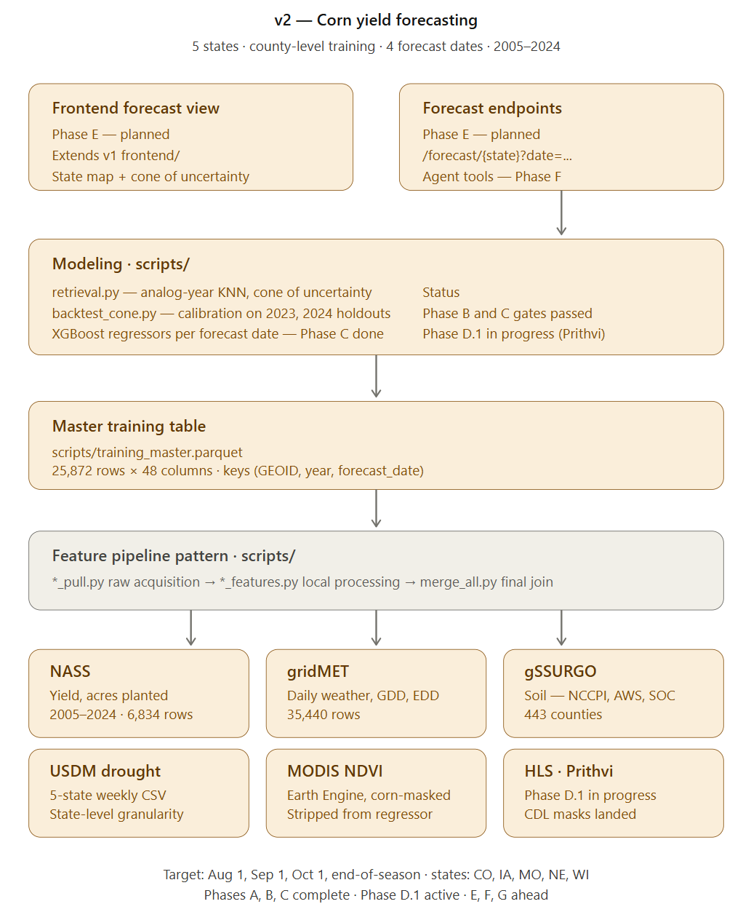
MODELING
MODEL DIAGRAM: PIPELINE TWO
05
SPEAKER: ENGIN GEDIK
DATA + MODELING
Notes:
Script – Sasha (Table Results):
This table shows our average time use in hours per day. On average, participants spent about 9.45 hours sleeping, 0.95 hours on personal care, 0.27 hours on domestic work, 0.85 hours on paid work, 7.79 hours in free time, and 4.59 hours studying. When looking at gender differences, women in our sample spent slightly more time sleeping, studying, and in paid work compared to men, while men spent more time in domestic work and free time.
We also observe a noticeable difference in free time, with men having nearly two more hours of free time per day than women. This difference may be related to the fact that, on average, women spent more time engaged in studying, paid work, and sleep. The graph further highlights that men dedicated more time to domestic work in this sample.

Slide 14
RESULTS
OUR 2025 CORN YIELD DATA PREDICTION
AUG 1
SEP 1
OCT 1
EOS
COLORADO
IOWA
MISSOURI
NEBRASKA
WISCONSIN
128.8 BU/AC
140.3 BU/AC
134.6 BU/AC
133.9 BU/AC
193.0 BU/AC
196.5 BU/AC
196.7 BU/AC
200.6 BU/AC
157.9 BU/AC
158.4 BU/AC
159.3 BU/AC
155.8 BU/AC
180.0 BU/AC
180.7 BU/AC
181.9 BU/AC
182.0 BU/AC
170.5 BU/AC
176.2 BU/AC
179.8 BU/AC
179.8 BU/AC
07
RESULTS
Notes:
Script – Sasha (Time Poverty Results):
“Using the Kalenkoski definition of time poverty, we classified discretionary time as anything left after necessary and committed activities. In our sample, most participants had 9-15 hours of discretionary time per day. However, two of our participants fell below the time poverty threshold of 8.9 hours of discretionary time for 2 adults with no children, which aligns with the average number of adults and children in each household. The two participants are male and female, and spent below the average amount of time on free time and study, while spending a significant amount of time on sleep and personal care.

Slide 15
CHALLENGES
OBSTACLES DURING THE PROJECT
08
SPEAKER: RAGHAV AGARWAL
CHALLENGES

Slide 16
DATA ORGANIZATION COLLECTION.
HARDWARE LIMITATIONS.
UNFAMILIARITY WITH THE DATA BEING HANDLED.
LEARNING EXPERIENCE WITH AWS ENVIRONMENT
CHALLENGES
DURING DEVELOPMENT
09
SPEAKER: RAGHAV AGARWAL
CHALLENGES
Notes:
Script – Westen (Gender Differences):
The main gender differences in our time analysis show that women in our sample spent more time sleeping, studying, and in paid work, while men spent more time in free time and domestic work. The most noticeable difference was in free time, where men had nearly two more hours per day than women. Women also spent on average about 40 more minutes per day studying than men, showing a stronger emphasis on academic work. Paid work was slightly higher for women as well, while men spent a bit more time on domestic tasks. But cannot conclude accurately without more data.

Slide 17
NEXT STEPS
ANY CHANGES?
APPLY CDL CORN MASK DIRECTLY TO HLS PIXELS BEFORE COMPUTING NDVI/EVI
INCREASING SCOPE: MORE EXTERNAL DATA SETS, INCLUSION OF OTHER STATES’ DATA.
HOW AND WHY WILL THIS CREATE AN IMPACT? WHAT DO THESE MODELS MEAN FOR THE FUTURE?
07
SPEAKER: IAN BARRIE
NEXT STEPS / IMPROVISATION / IMPACT
Notes:
Script – Sasha (Time Poverty Results):
“Using the Kalenkoski definition of time poverty, we classified discretionary time as anything left after necessary and committed activities. In our sample, most participants had 9-15 hours of discretionary time per day. However, two of our participants fell below the time poverty threshold of 8.9 hours of discretionary time for 2 adults with no children, which aligns with the average number of adults and children in each household. The two participants are male and female, and spent below the average amount of time on free time and study, while spending a significant amount of time on sleep and personal care.

Slide 18
FRONTEND DEMO
EXPLORING THE VISUALIZED MODELS
04
FRONTEND DEMO

