Slide 1
OPTICYCLE
01
PROOF
BEFORE CAPITAL
Proof-carrying SPY options agent
Payload-bound authorization with Alpaca MCP reconciliation
PAPER ACCOUNT PA3V84C40PJQ
Notes:
Project overview. Source: repository README and committed Alpaca paper-account evidence.

Slide 2
THE COMPLETE MODEL OUTPUT SPACE
02
BULLISH
BEARISH
NO_TRADE
Order fields stay in deterministic code
Notes:
AI logic boundary. The ThesisAgent can return BULLISH, BEARISH or NO_TRADE. It cannot emit OCC symbols, quantity or limit price.

Slide 3
ONE BROKER-VERIFIED CYCLE
03
OBSERVE
THESIS
CANDIDATE
CERTIFY
MCP
GET
MATCH
Fresh evidence enters once. Broker state decides the final outcome.
Notes:
Lifecycle source: src/opticycle and src/trade. Execution uses the official Alpaca MCP server, followed by broker GET reconciliation.

Slide 4
EXACT PAYLOAD CERTIFICATE
04
712c
9332
...
SHA-256 of the exact MLEG payload
SPY 740P / 724P
QTY 1
LIMIT -2.26
Any changed field invalidates authorization
Notes:
Golden payload hash: 712c6feb6a8b0d6b4879a59892a1217a079057bc390cf91d4c8a80e842df9332. Source: artifacts/evidence/sanitized_fills/oc-63db2a85298b4ecabefab59076a6397e.json.

Slide 5
AMBIGUOUS RESPONSE POLICY
05
1
0
GET THE SAME CLIENT ORDER ID
oc-63db2a85298b4ecabefab59076a6397e
SUBMIT
RESUBMITS
Unknown broker state halts the agent
Notes:
Credential-free zero-resubmit assertion and live golden episode both record mcp_submit_count=1 and second_submit=false. Source: artifacts/evidence and scripts/assert-zero-resubmit.py.

Slide 6
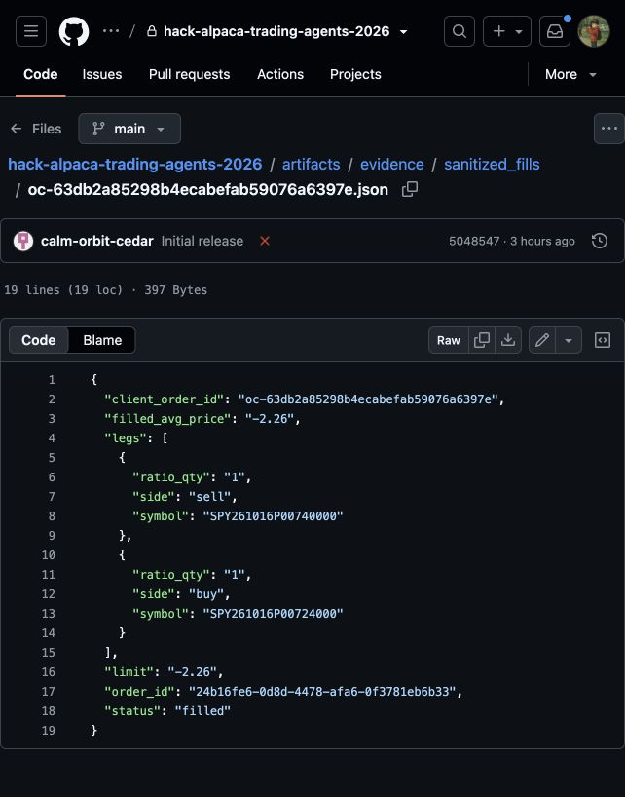
ALPACA BROKER GET
06
EXECUTION PROOF - BEFORE 3-10 DTE / $5 POLICY
MATCHED
LIMIT
FILL
-2.26
-2.26
24b16fe6-0d8d-4478-afa6-0f3781eb6b33
Broker order ID
Notes:
Live paper order ID and signed credit fill. This receipt predates the current 3-10 DTE / $5 selector and proves execution plus broker reconciliation. Source: artifacts/evidence/broker_lookup.json and artifacts/evidence/sanitized_fills/oc-63db2a85298b4ecabefab59076a6397e.json.

Slide 7
BROKER RESULT
07
+$55.67
CLOSED-SPREAD REALIZED P&L
+$77.00
$100,132.45
OPEN UNREALIZED
ACCOUNT EQUITY
SEP 3, 19:43 PDT PAPER ACCOUNT PA3V84C40PJQ
Notes:
Committed broker snapshot at 2026-09-04T02:43:50Z. Source: artifacts/evidence/alpaca_cli_snapshot.json. Values are paper trading results before fees.

Slide 8
08
2
1
FILLED
MATCHED
positive credit sign
signed credit limit -2.26
The third fill proves the corrected invariant
WATCH DEMO EVIDENCE LEDGER SLIDE PDF
Notes:
Honesty note: two historical positive-limit credit fills remain FILLED only. The third signed-credit fill is price-bound MATCHED. Source: artifacts/evidence/index.html.

