Slide 1

School of
Engineering and Computer Science
Te Kura Mātai Pūkaha, Pūrorohiko
Secure Programming CYBR 271 T2 2020
Ian Welch, Harith Al-Sahaf

Slide 2
Safety briefing
https://www.youtube.com/watch?v=OYglUBo7kIQ
CYBR 271: Secure Programming
Slide 2

Slide 3
Course prescription
This course addresses the concepts, techniques and tools required for developing software that reliably preserves the security properties of the information and systems they protect.
The course covers common software vulnerabilities, specifying security requirements, secure design principles and techniques for evaluating software security.
Practical work will involve developing and evaluating the security of C and Java programs.
CYBR 271: Secure Programming
Slide 3

Slide 4
Course learning objectives
Students who pass this course will be able to:
Describe the role of, and develop security requirements and abuse scenarios based upon, an understanding of the differences between the methodologies used by attacker and a testers to discover security vulnerabilities that could lead to security risks.
Apply knowledge of threats, vulnerabilities and how these may interact to choosing and implementing client-side and server-side software security controls to mitigate software security risks.
Evaluate the security of software using a range of security techniques including vulnerability assessment, fuzzing and code review.
CYBR 271: Secure Programming
Slide 4

Slide 5
Course Organisation
Lectures:
two each week (tues 11-11.50 – MC LT103, thurs 11-11.50 – TTR LT1)
recorded and available via the vstream link
aim to get lecture notes up beforehand
Tutorial (from week 2):
fri 11-11.50 – TTR LT1
recorded webcast and available via the vstream link
Helpdesk w/tutors:
mon, tues and weds 14-17, in person/zoom
no signup, starts from week 4
CYBR 271: Secure Programming
Slide 5

Slide 6
Workload (approx.)
Two lectures per week = 2 hours
Helpdesk = 1 hour
Revising notes and reading = 3 hours
Working on assignment = 5 hours
15 weeks @ 10 hours per week = 150 hours
CYBR 271: Secure Programming
Slide 6

Slide 7


Staff
Ian Welch, course coordinator ian.welch@ecs.vuw.ac.nz
https://people.wgtn.ac.nz/Ian.Welch
Office hour: Tuesday 4-5pm, email
Harith Al-Sahaf, lecturer
harith.al-sahaf@ecs.vuw.ac.nz
https://people.wgtn.ac.nz/Harith.Al-Sahaf Office hour: TBA, email
CYBR 271: Secure Programming
Slide 7

Slide 8

Emailing us
A fairly accurate depiction of my inbox.
Put “CYBR271” in the subject line.
Outlook will label it for me and tell me there is new mail regaring the course!
"The Suitcase Letters" by whistlepunch is licensed under CC BY-NC-SA 2.0. To view a copy of this license, visit https://creativecommons.org/licenses/by-nc-sa/2.0/
CYBR 271: Secure Programming
Slide 8

Slide 9
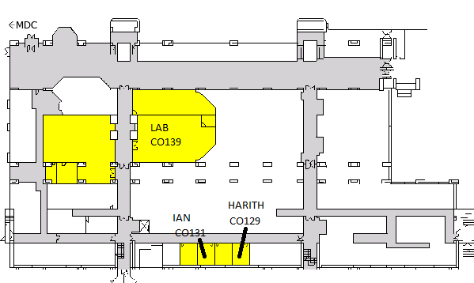
Finding us (and the lab)
Science Faculty Office
Cotton corridor
Hub
Rec Centre
CYBR 271: Secure Programming
Slide 9

Slide 10
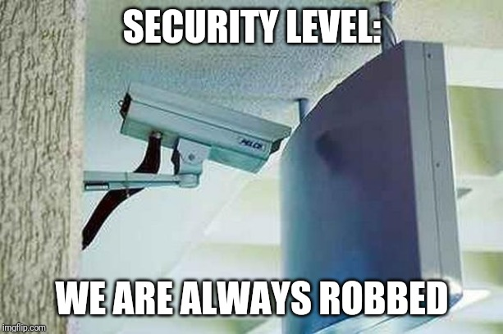
What is this course about?
Avoid security problems in the first place.
A lot cheaper:
security principles
threat and risk modeling
security testing
CYBR 271: Secure Programming
Slide 10

Slide 11

What is this course about?
Stack buffer overflow attack.
Web server written in C.
Allowed remote code execution.
Affected 79 device models shipped to home and office users.
https://threatpost.com/netgear-zero-day-takeover-routers/156744/
CYBR 271: Secure Programming
Slide 11
Notes:
Netgear Zero-day is example of stack-overflow on the webserver that ships with the

Slide 12
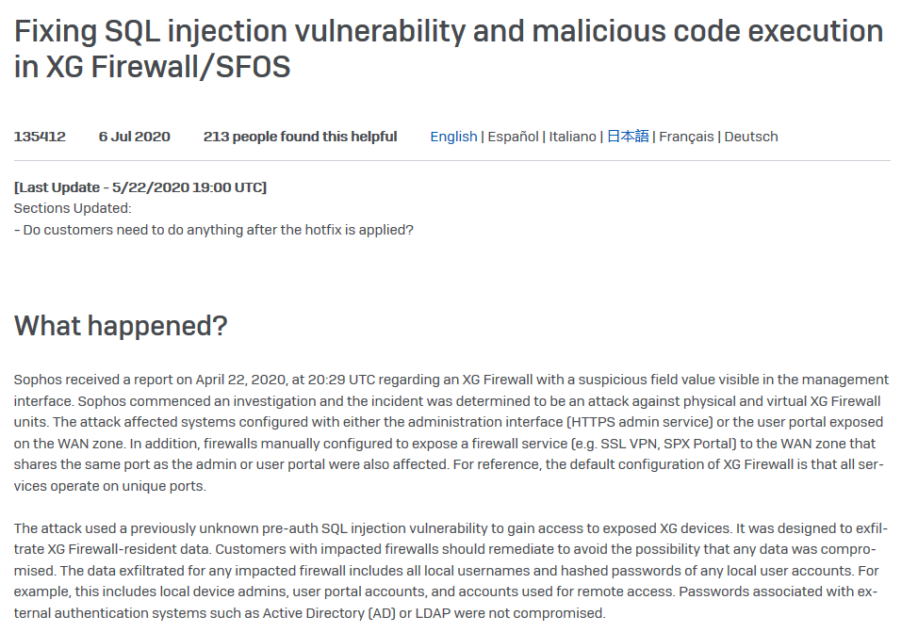
What is this course about?
SQL injection attack.
Data exfiltration.
Local usernames and hashed passwords.
Local device admis, user portal accounts and accounts used for remote access.
https://community.sophos.com/kb/en-us/135412/
CYBR 271: Secure Programming
Slide 12
Notes:
Netgear Zero-day is example of stack-overflow on the webserver that ships with the

Slide 13
Required reading
Assignments and take home test are based upon content taught in the lectures themselves.
There are no required readings but there are some recommended books to help understand the lectures and assignments.
CYBR 271: Secure Programming
Slide 13

Slide 14


Recommended e-books
Library ebook access varies between books. It is not always possible to get unlimited access. The Library gets the best access it can for you.
Be aware that all students and staff share ebook access, similar to sharing a print format library book.
Limited numbers of simultaneous views may be enforced by the publisher. Remember to close your browser window when you have finished. A browser window open in the background on your device counts as one of those views.
If you’ve failed to get access because of the restricted number of simultaneous views, consider trying again at a time of day when other students are less likely to be reading online.
CYBR 271: Secure Programming
Slide 14

Slide 15
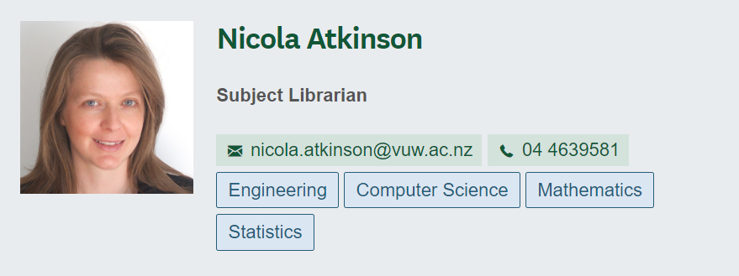
Recommended e-books
Download PDF files of chapters or sections to read offline, where this is allowed. Download limits often refresh after 24 hours. Return to the ebook one day later to download another chapter or section. You’ll need to plan ahead if you have a deadline.
Contact your Subject Librarian if you have technical difficulties accessing a library ebook.
Inform your Course Coordinator if access restrictions are negatively impacting your work.
CYBR 271: Secure Programming
Slide 15

Slide 16

Recommended dead tree book
Available from Amazon: https://www.amazon.com/Wenliang-Du/e/B07R86172C
Standard shipping July 30-Aug 5
$NZ 137.00
Weeks 4 onwards & assignment 2.
Excellent resource for going deeper into what we are covering in class.
https://www.amazon.com/Wenliang-Du/e/B07R86172C
CYBR 271: Secure Programming
Slide 16

Slide 17

Recommended dead tree book
Chinese version.
See: https://www.handsonsecurity.net/chinese/index.html
Weeks 5 onwards & assignment 2.
Excellent resource for going deeper into what we are covering in class.
https://www.handsonsecurity.net/chinese/index.html
CYBR 271: Secure Programming
Slide 17

Slide 18
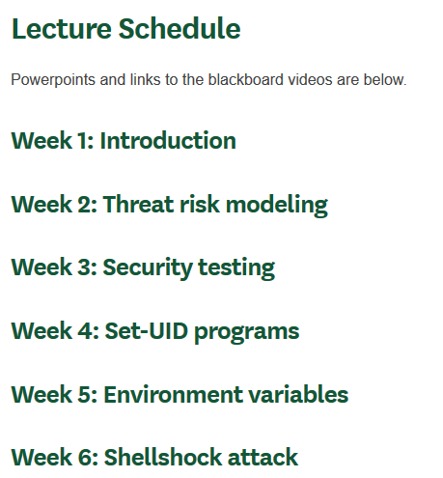
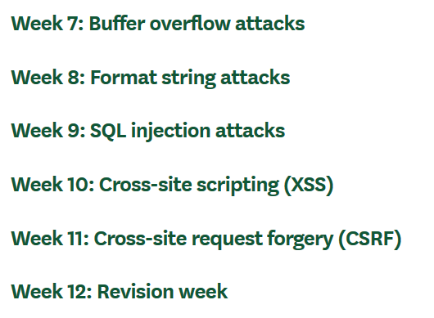
https://ecs.wgtn.ac.nz/Courses/CYBR271_2020T2/LectureSchedule
CYBR 271: Secure Programming
Slide 18

Slide 19

Communicating with you
Lectures and links to videos posted via ECS website.
Submit work via ECS website.
Announcements are made via Blackboard (& emailed to your myvuw address).
Vstream for webcasts.
Zoom links for helpdesks announced later.
https://pixabay.com/
CYBR372: Applications of Cryptography
Slide 19

Slide 20
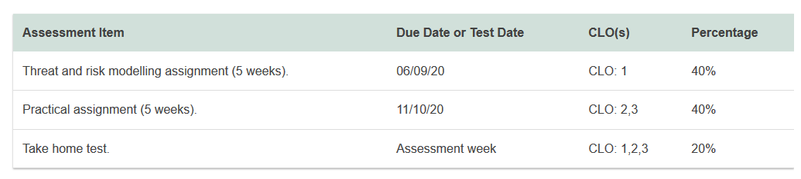
Assessment
CYBR 271: Secure Programming
Slide 20

Slide 21
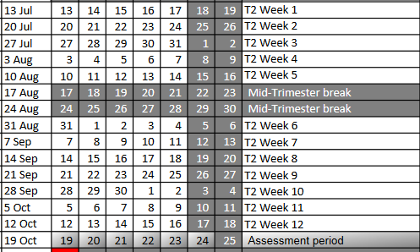
Assessment
, including working the break
Given a specification, implement a program for encryption & decryption supporting individual and group keys.
Assignment one
Conduct a security review of a product or system.
Assignment two
Mix of MCQ and short answer questions via Blackboard.
Take home test (tba)
CYBR 271: Secure Programming
Slide 21

Slide 22
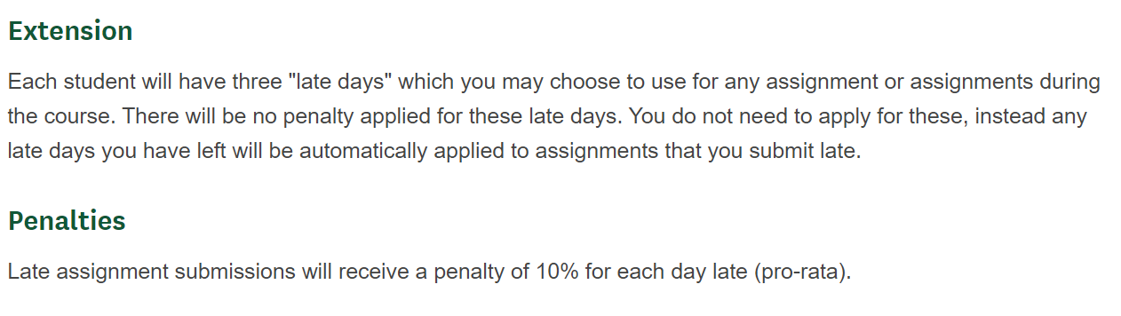
Extensions and Penalties
CYBR 271: Secure Programming
Slide 22

Slide 23
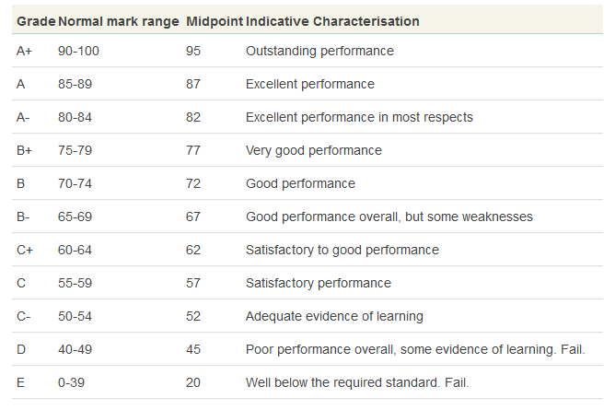
Your final grade
assignment 1 (40%) +
assignment 2 (40%) +
test (20%) +
[moderation]
CYBR 271: Secure Programming
Slide 23

Slide 24
Withdrawal Dates
Withdrawal with refund
- up to and including 24th July - no consequences
Withdrawal without refund
- after 18th September
- Withdrawal Recorded
- No grade recorded on transcript
- Withdrawal counts as a fail for demonstrating "Satisfactory Academic Progress"
Late withdrawal with Dean’s permission:
- after 18th September.
- Requires permission of Associate Dean (Pondy).
- Given – only for medical or exceptional circumstances.
CYBR 271: Secure Programming
Slide 24

Slide 25
Class Representative(s)
https://www.vuwsa.org.nz/class-representatives
Representing your class has many benefits; VicPlus points, Class Rep certificates, professional and personal growth, and links to other representation opportunities.
Who is interested?
CYBR 271: Secure Programming
Slide 25

Slide 26
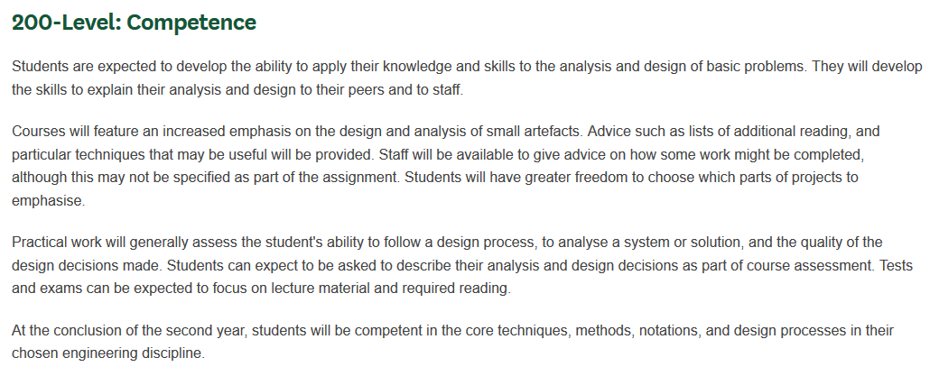
Expectations of ECS Students
CYBR 271: Secure Programming
Slide 26

Slide 27
What’s on this week
Security principles on Thursday.
Investigate the dead wood book and whether to buy it or not.
No Friday tutorial this week.
No helpdesk until we have handed out the assignment itself (around week 4).
CYBR 271: Secure Programming
Slide 27

