Slide 1

School of
Engineering and Computer Science
Te Kura Mātai Pūkaha, Pūrorohiko
Security Principles II CYBR 271 T2 2020
Ian Welch, Harith Al-Sahaf
Slides based upon these ones: https://www.cs.montana.edu/courses/csci476/topics/secure_coding_principles.pdf

Slide 2
Learning objectives
List the security principles of secure design and implementation:
Secure by design
Secure by default
Secure by implementation
Describe why each principle is important to security.
Identify the needed design principle.
CYBR 271: Secure Programming
Slide 2

Slide 3
Secure by design
Security principles
Establish trust boundaries
Don’t reinvent the wheel
Economy of mechanism
Separation of duty
Open design
Minimize the attack surface
Secure the weakest link
Last lecture
CYBR 271: Secure Programming
Slide 3

Slide 4
Secure by design
Security principles
Establish trust boundaries
Don’t reinvent the wheel
Economy of mechanism
Separation of duty
Open design
Minimize the attack surface
Secure the weakest link
CYBR 271: Secure Programming
Slide 4

Slide 5
Open design
Principle: The security of a component or system should not depend on the secrecy of the design or implementation
– Kerckhoff's Principle: Crypto-systems should remain secure even when the attacker knows all the internal details (stated in 1883)
Keys: the secret data that must be protected
Also known as avoiding "Security by Obscurity"
It is highly unlikely that any algorithm or method can be kept secret
– Many people know
– Attackers can guess and probe the application
– Your own documentation may reveal the secrets
CYBR 271: Secure Programming
Slide 5

Slide 6
Open design
Openness applies to algorithms and implementation details, but not to data like encryption keys and passwords (the Keys)
The more review and testing of security code, the more secure it becomes (assuming some skill!)
The security of a system should depend on the possession of easy to protect passwords and keys, not on the ignorance of the attacker
CYBR 271: Secure Programming
Slide 6

Slide 7
Open design
You should not depend on obscurity for protection
But using obscurity as camouflage is fine
– Port knocking
– Changing the name of the Admin user
– Changing cgi-bin to demos
– Changing the name of system administration executables
But making it more difficult, is never the wrong thing to do
CYBR 271: Secure Programming
Slide 7

Slide 8
Open design
Design security features as though only the keys are private
–The point of open design is that secrets usually are not secret
–If your software has proprietary algorithms, processes and procedures, assume they are public when you design
–Without proprietary algorithms, you need to be especially careful with keys
Areas where data is commonly assumed to be safe when it is not
–Registry keys
–Hard-coded passwords or encryption keys
–Data or code in HTML pages
–Anything stored on a client host
–Anything sent over an unencrypted communication channel
CYBR 271: Secure Programming
Slide 8

Slide 9
Open design
Obscure or customized security algorithms are seldom reliable which increases risk
- Encryption
- Randomization
- Session management
Any security mechanism that depends on no one noticing is doomed to failure
Keys are safe only if you make them so
– Inside of your Trust Boundaries
– Security features designed to protect them even if everyone knows how they work
CYBR 271: Secure Programming
Slide 9

Slide 10
Secure by design
Establish trust boundaries
Don’t reinvent the wheel
Economy of mechanism
Separation of duty
Open design
Minimize the attack surface
Secure the weakest link
CYBR 271: Secure Programming
Slide 10

Slide 11
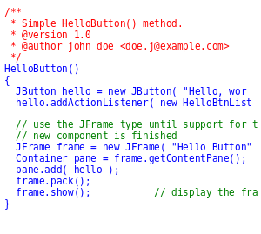
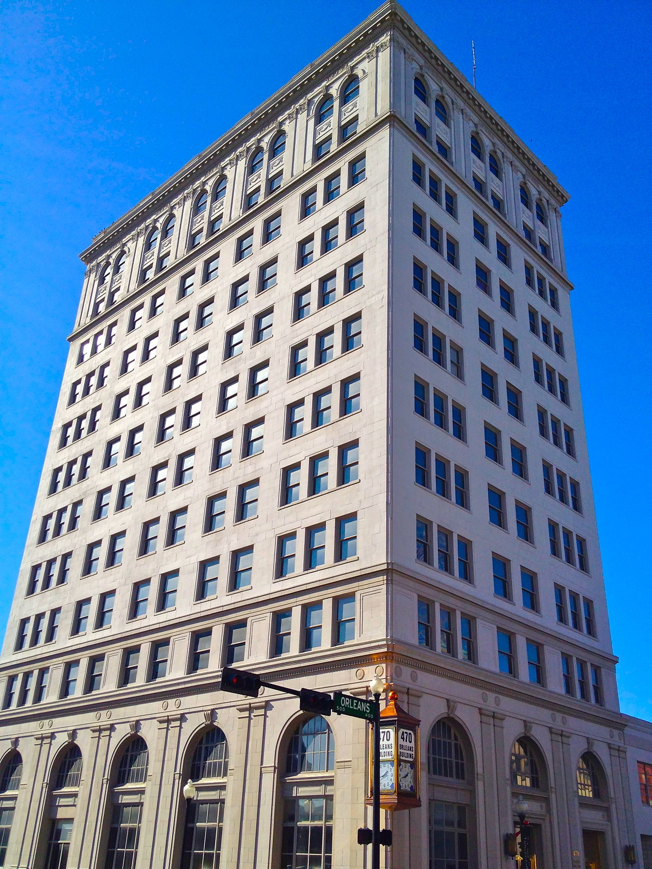
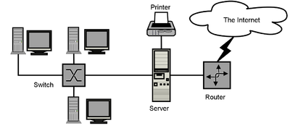
Minimize the attack surface
Attack surface describes all the different points where an attacker could get into a system and where they can get data out.
Smaller an attack surface the better.
Allows comparison of relative vulnerability of different systems, for example a building, program or network.
Compare effect of changes to a system after adding new features.
Leads to a tendency for a system to become less secure over time. https://www.wired.com/2017/03/hacker-lexicon-attack-surface/
This Photo by Unknown Author is licensed under CC BY-SA
CYBR 271: Secure Programming
Slide 11

Slide 12
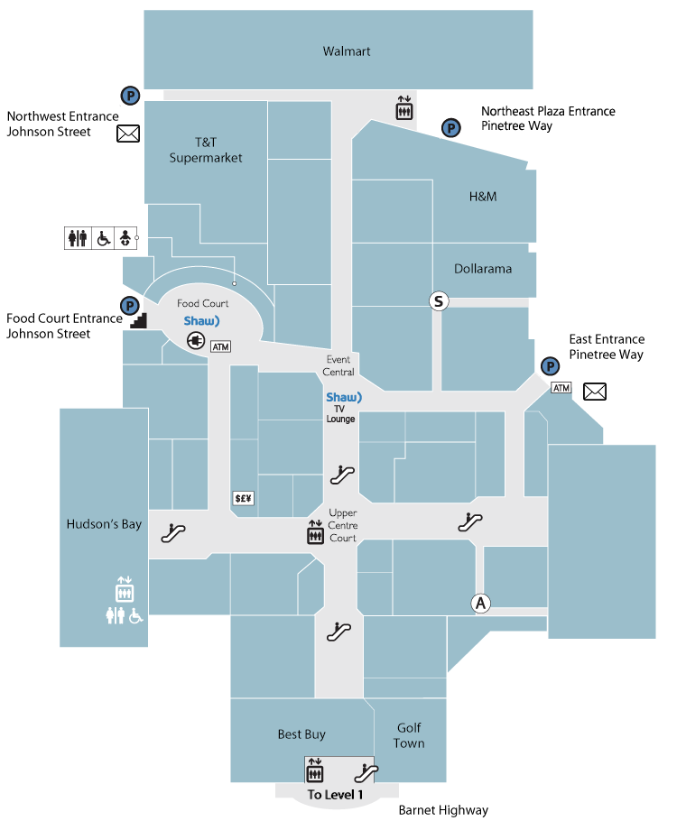
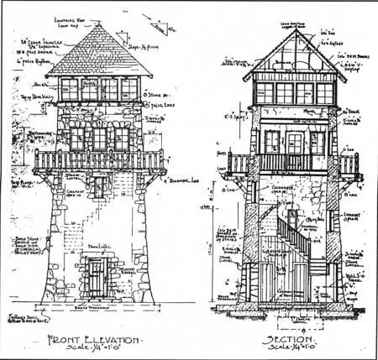
Attack surface - example
Consider a place to wait out the Zombie apocalypse. Which of these has the smaller attack surface?
Shopping mall
Tower house
CYBR 271: Secure Programming
Slide 12

Slide 13
Attack surface - software
The Attack Surface of an application is:
The sum of all paths for data/commands into and out of the application, and
The code that protects these paths (including resource connection and authentication, authorization, activity logging, data validation and encoding)
all valuable data used in the application, including secrets and keys, intellectual property, critical business data, personal data and PII, and
the code that protects these data (including encryption and checksums, access auditing, and data integrity and operational security controls).
https://cheatsheetseries.owasp.org/cheatsheets/Attack_Surface_Analysis_Cheat_Sheet.html
CYBR 271: Secure Programming
Slide 13

Slide 14
Secure by design
Establish trust boundaries
Don’t reinvent the wheel
Economy of mechanism
Separation of duty
Open design
Minimize the attack surface
Secure the weakest link
CYBR 271: Secure Programming
Slide 14

Slide 15
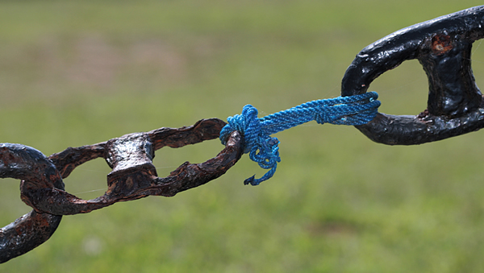
Secure the weakest link
Principle: Attackers will attack the weakest security point in the application
– Corollary: One valid secure coding outcome is encouraging the attacker to go after someone else
– Corollary: A chain is as strong as its weakest link
Adversaries will expend the least amount of effort possible to penetrate a system
–They will work no harder than necessary
–If they have to work too hard, they may move on to another target (depending on how attractive the asset is)
http://www.businessearth.com/wp-content/uploads/supply_chain_sustainability.jpg
CYBR 271: Secure Programming
Slide 15

Slide 16
Secure the weakest link
Threat Models will lead you to the weakest areas
–Invest in remediating weakest security defenses
–There will always be a new weakest link
–Attackers will go after weakest links simply because they are easy
They are looking for a foothold or information to use
Factor in the four sources of threats
–Social: People
–Operational: Processes (and People)
–Technological: The application and network
–Environmental: Facilities
Which threat sources are more likely to be weak?
CYBR 271: Secure Programming
Slide 16

Slide 17
Secure the weakest link - example
HP Printers using Jetdirect firmware include an embedded web server
–Allows for remote administration of the device
–Due to an undisclosed design flaw, the server handles passwords in an insecure manner
–Attacker can gain unauthorized access to the device and also create a denial of service.
Networked printers, in general, are poorly secured.
Example of the Netgear routers with the vulnerable web server.
CYBR 271: Secure Programming
Slide 17

Slide 18
Secure the weakest link – tips
Use Threat Models to understand your attack surface
Make sure you don't ignore operational and social threats
Test your application thoroughly
–Have a test plan
–Use Red Teaming and/or third-party audits
–Test for all of the obvious vulnerabilities
- SQL Injection
- XSS
- Authentication Bypass
CYBR 271: Secure Programming
Slide 18

Slide 19
Secure by default
Secure by design was a set of principles that lead to less vulnerable systems.
Secure by default is a set of principles with respect to configuration of the system that lead to less vulnerable systems.
Least privilege
Default deny
Fail securely
CYBR 271: Secure Programming
Slide 19

Slide 20
Secure by default
Least privilege
Default deny
Fail securely
CYBR 271: Secure Programming
Slide 20

Slide 21
Least privilege
Principle: A subject should only be granted only the privileges needed for an operation
Corollary: Privileges should be associated with the function being performed, not with the identity
Least Privilege is a concept that means that at any given application state, the user will operate at the lowest level of access rights possible
A program should be given only those privileges it needs in order to satisfy its requirements:
no more, no less
if a program doesn’t need an access right, it should not be granted that right
think of it as “need to know”rule
thus if the program is compromised, damage is limited
CYBR 271: Secure Programming
Slide 21

Slide 22
Least privilege - example
Do you run your local desktop as an Administrator user?
You are not applying the Least Privilege Principle
The damage from executing malicious code will be much greater than if you didn’t
On Linux, running services as root or with setuid permission bit set has the same effect
Running the Apache web server as root
That gives every executable that Apache runs root privileges on your system
If a program runs as root, many of it's normal defects become security defects
CYBR 271: Secure Programming
Slide 22

Slide 23
Summary
Security principles
Establish trust boundaries
Don’t reinvent the wheel
Economy of mechanism
Separation of duty
Open design
Minimize the attack surface
Secure the weakest link
Least privilege
Default deny
Fail securely
CYBR 271: Secure Programming
Slide 23

