Slide 1

School of
Engineering and Computer Science
Te Kura Mātai Pūkaha, Pūrorohiko
Security Principles III CYBR 271 T2 2020
Ian Welch, Harith Al-Sahaf
Slides based upon these ones: https://www.cs.montana.edu/courses/csci476/topics/secure_coding_principles.pdf

Slide 2
Learning objectives
List the security principles of secure design and implementation:
Secure by design
Secure by default
Secure by implementation
Describe why each principle is important to security.
Identify the needed design principle.
CYBR 271: Secure Programming
Slide 2

Slide 3
Secure by default
Least privilege
Default deny
Fail securely
CYBR 271: Secure Programming
Slide 3

Slide 4
Use default deny
Principle: Anything not specifically allowed must be denied
– Corollary: Default configurations should be the most secure setting
Assume that access is denied, and find conditions that allow access
– The converse, finding reasons to deny access leads to errors
– If there is a defect in your system, you will deny access, not grant it
The access control system should default to no access
– Unless it is specifically allowed
In the event of an access check failure, do nothing.
CYBR 271: Secure Programming
Slide 4

Slide 5

Use default deny - example
Consider controlling entry to a building.
You can either –
(a) Default allow unless person on is on banned list.
(b) Default deny unless person is on allowed list.
What happens if you forget to add someone to the banned list?
What happens if you forget to add someone to the allowed list?
Default deny (also known as basing access on permission rather than exclusion) is the safer option because inevitably a mistake is made.
CYBR 271: Secure Programming
Slide 5

Slide 6
Fail securely
Principle: Handle all failures securely and return the system to a proper state
Problem:
– Error messages can disclose information valuable to an attacker
– Failure can lead to an unhandled state, which can lead to denial of service
– Unhandled failures can lead to malicious behaviour being unnoticed
Tips:
– All error conditions are handled and logged
– There are no verbose error messages
– The failure of a component doesn't result in systemic failure
– A failure does not result in a secure data breach
CYBR 271: Secure Programming
Slide 6
Notes:
Any sufficiently complex system will have failure modes. Failure is unavoidable and should be planned for. What is avoidable are security problems related to failure. The problem is that when many systems fail in any way, they exhibit insecure behavior. In such systems, attackers only need to cause the right kind of failure or wait for the right kind of failure to happen. Then they can go to town.
https://us-cert.cisa.gov/bsi/articles/knowledge/principles/failing-securely

Slide 7
Fail securely - example
isAdmin = true;
try {
codeWhichMayFail();
isAdmin = isUserInRole( “Administrator” );
}
catch (Exception ex)
{
log.write(ex.toString());
}
Should codeWhichMayFail have an error the program branches to the catch and exits the code block with isAdmin = true.
CYBR 271: Secure Programming
Slide 7

Slide 8
Fail securely - example
isAdmin = false;
try {
codeWhichMayFail();
isAdmin = isUserInRole( “Administrator” );
}
catch (Exception ex)
{
log.write(ex.toString());
}
Should codeWhichMayFail have an error the program branches to the catch and exits the code block with isAdmin = true.
CYBR 271: Secure Programming
Slide 8

Slide 9
Fail securely - example
Imagine a login screen.
USERNAME: ******
PASSWORD: ******
Wrong username – display “wrong username”
Wrong password – display “wrong password”
Is there anything wrong with the current error messages?
CYBR 271: Secure Programming
Slide 9

Slide 10
Fail securely - example
Imagine a login screen.
USERNAME: ******
PASSWORD: ******
Wrong username – display “wrong username”
Wrong password – display “wrong password”
Gives away too much information to the attacker, try instead “wrong username or password”
CYBR 271: Secure Programming
Slide 10

Slide 11
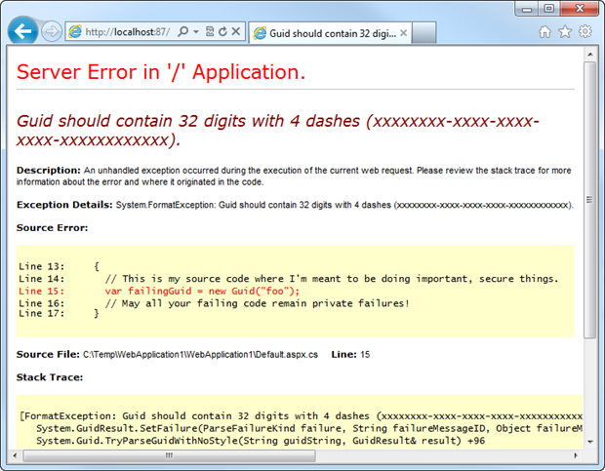
Fail securely - example
When debugging you might display a stack trace after a failure.
Leave it on after you put the system live in production and you just shared internal code to the outside world.
Excellent for our attacker, maybe can cause other errors to display other parts of the code.
Log to a debug file instead.
CYBR 271: Secure Programming
Slide 11

Slide 12
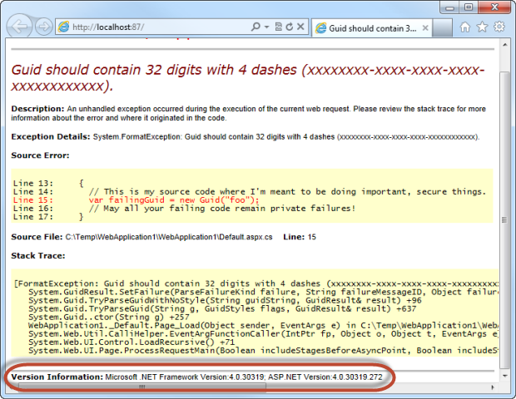
Fail securely - example
What is highlighted in RED?
Leaking information about the version of software running on the web server.
Attack can go look this up in a vulnerability database such as NVD to find out other attacks.
CYBR 271: Secure Programming
Slide 12

Slide 13
Secure by default
Use least privilege
User default deny
Fail securely
Secure by implementation
Psychological acceptability
Validate inputs
Secre data at rest
Prevent bypass attacks
Defense in depth
CYBR 271: Secure Programming
Slide 13

Slide 14
Psychological acceptability
Principle: Security mechanisms should not make the resource more difficult to access than if the security mechanism were not present
– Corollary: In many cases, you will only get a close approximation
Problem is that users might choose not to enable it
Security and user-friendliness are often contradictory
Security mechanisms should seek to be as unobtrusive as possible while still meeting security goals
CYBR 271: Secure Programming
Slide 14

Slide 15
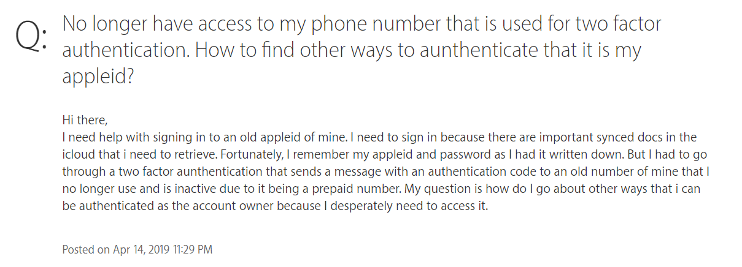
Psychological acceptability - example
CYBR 271: Secure Programming
Slide 15
Notes:
What if lose your phone number?
How do you know that the person is legitmate?
What if an attacker?

Slide 16
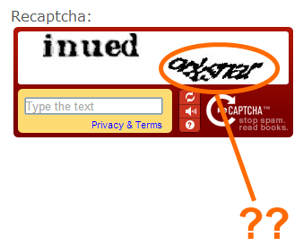
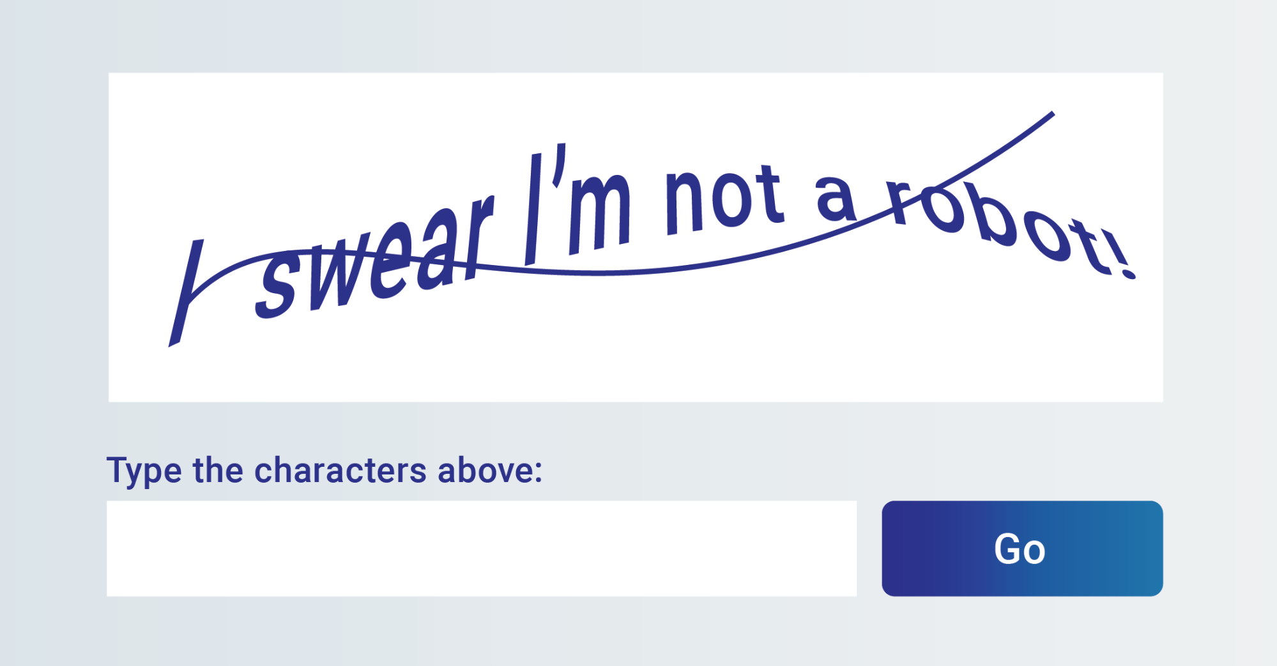
Psychological acceptability - example
https://www.theverge.com/2019/2/1/18205610/google-captcha-ai-robot-human-difficult-artificial-intelligence
CYBR 271: Secure Programming
Slide 16
Notes:
What is captcha?
“A computer program or system intended to distinguish human from machine input, typically as a way of thwarting spam and automated extraction of data from websites.”

Slide 17
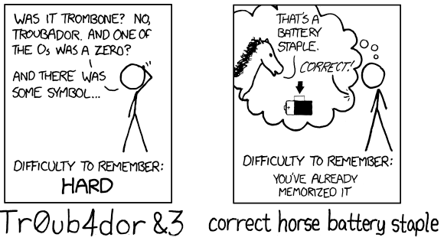
Psychological acceptability - example
Compare two password schemes.
Random numbers.
vs
Passphrases.
Humans are bad at memorizing random strings.
CYBR 271: Secure Programming
Slide 17
Notes:
• Your company mandates two-factor login for google mail
– Is having to get an authentication code from your cell phone when you login
psychologically acceptable?
– If you only have to do so every 30 days for any given host?
• A college campus decides that usernames should be less "guessable" and
replaces them with 8 random characters
– Psychologically acceptable?
• A system requires that all personal files be passworded, so each access
requires a password to be typed
– Psychologically acceptable?

Slide 18
Validate Inputs
Principle: All inputs should be treated as untrustworthy
– Corollary: Anything coming from outside of your application may not agree with your expected input requirements
Inputs that don't meet expectations can lead to program states that are undefined
– Undefined states are problematical for security because there is no sure way to predict how the application will respond
CYBR 271: Secure Programming
Slide 18

Slide 19
Validate Inputs
There are many vulnerabilities that are created or worsened by using unvalidated inputs in code constructs
– All of the injection vulnerabilities (SQL injection, XSS, command Injection, etc)
– Open Redirect
– Buffer Overflow, Uncontrolled Format String, …
– Parameter Tampering
– …
In addition, if you allow inputs that are incorrect for any reason into your system, you risk its integrity
CYBR 271: Secure Programming
Slide 19
Notes:
https://www.trustwave.com/en-us/resources/blogs/spiderlabs-blog/understanding-and-discovering-open-redirect-vulnerabilities/

Slide 20

Validate Inputs - Example
CYBR 271: Secure Programming
Slide 20

Slide 21
Validate Inputs - Difficulties
What filtering rule would use to prevent this attack?
CYBR 271: Secure Programming
Slide 21

Slide 22
Validate Inputs - Difficulties
You need to consider all the different representations of the same command or object being referenced.
Example from Windows:
C:\windows\system32\cmd.exe
C:\windows\system32/cmd.exe
%windir%\system32\cmd.exe
C:\windows\.\system32\cmd.exe
\\127.0.0.1\c$\ windows\system32\cmd.exe
Blacklisting is less reliable than whitelisting – similar to an earlier principle.
CYBR 271: Secure Programming
Slide 22
Notes:
https://www.trustwave.com/en-us/resources/blogs/spiderlabs-blog/understanding-and-discovering-open-redirect-vulnerabilities/

Slide 23
Secure Data at Rest
Principle: Data at rest must be protected to meet security requirements
Data stored as part of an application has needs for:
– Security, which determines if access granted or not granted for a data set
– Privacy, determines what the access means to a given user; what form is the data in what operations are allowed
Example: doctors in a have full access to patient records; but not to extract information of prurient interest
As you can see, this can be a difficult problem
CYBR 271: Secure Programming
Slide 23

Slide 24
Secure Data at Rest - Example
An application manages data for an online sales organization
– Sales consultants need to access the personal information of the customer on
the phone or chat including credit card information to complete purchases
– But, those consultants should not be able to see credit card numbers
Solution:
– The sales consultants have access to the credit card data
– But they see the credit card masked: **** **** **** 9999
– They can press a button to make the purchase, but not see the credit card data
– Since CVV (card verification number) cannot be stored, they will have to ask the customer
– The server logs operations to create an audit trail; it also cannot contain the credit card number
The Payment Card Industry Data Security Standard (PCI DSS) is a set of security standards designed to ensure that ALL companies that accept, process, store or transmit credit card information maintain a secure environment.
CYBR 271: Secure Programming
Slide 24
Notes:
https://www.pcicomplianceguide.org/faq/#:~:text=A%3A%20The%20Payment%20Card%20Industry,information%20maintain%20a%20secure%20environment.

Slide 25
Secure Data at Rest - Example
A client application handles authentication for an application by fetching the user name and password on the first attempt
– If additional attempts are required, they can be handled without communicating with the server
– The problem is that the username and password are stored on the client
– They are vulnerable to client-side attacks
- Memory dumps
- Dynamic debuggers
Solution:
– Encrypt the credentials while stored in memory
– When authentication is complete, overwrite all memory locations used
– The encryption keys also have to be protected
CYBR 271: Secure Programming
Slide 25

Slide 26
Avoid Bypass Attacks
Principle: Attacks that bypass authentication or authorization gates are among the most dangerous
– Corollary: Bypass attacks are favourites among the evil-doers
In a bypass attack, an attacker:
– Is able to act as an authenticated user without providing valid credentials
– Is able to access resources by evading the authorization checks
Many vulnerabilities can result in a bypass, but the focus here is on the authentication and authorization system
CYBR 271: Secure Programming
Slide 26

Slide 27
Avoid Bypass Attacks - Example
Consider “Forgot my password” as a way to bypass authentication.
The login/password/forgotten_password system must be designed carefully
– Prevent information leakage
– Strong configurable passwords
– Strong encryption
– No bypass opportunities
CYBR 271: Secure Programming
Slide 27

Slide 28
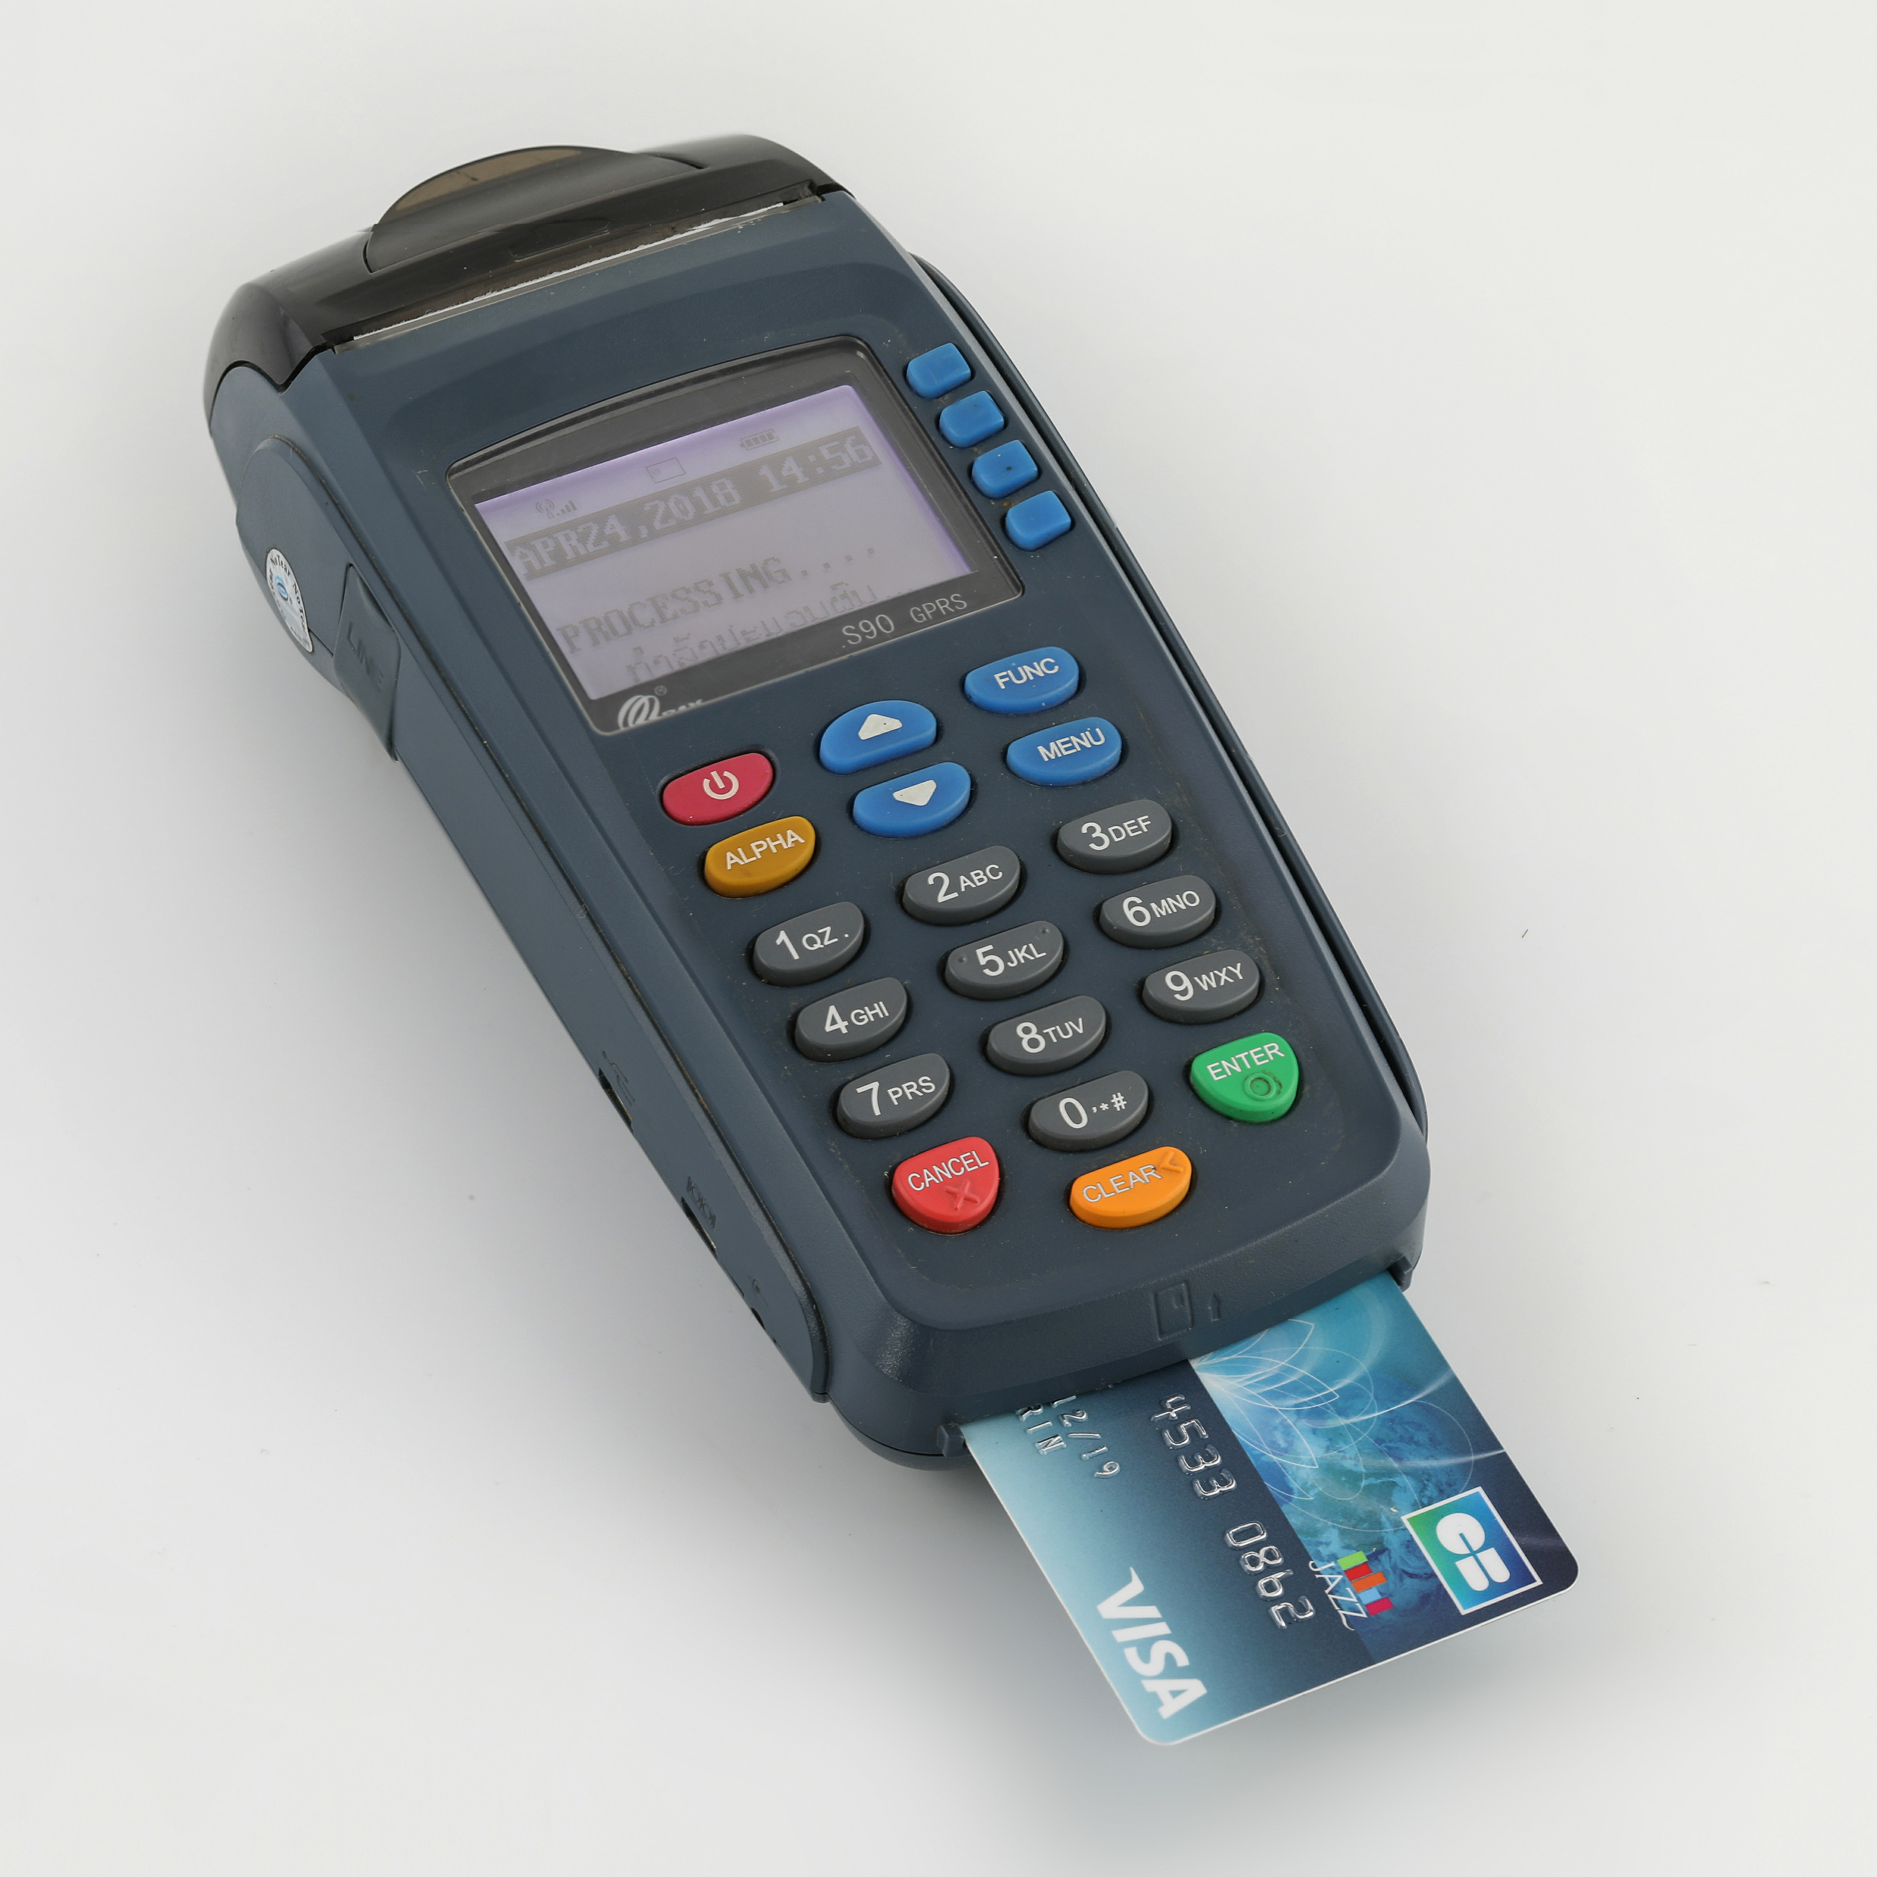
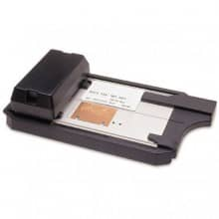
Avoid Bypass Attacks - Example
CYBR 271: Secure Programming
Slide 28
Notes:
How does Paywave affect this?
All the background checking applies – number of withdrawals, limits on the amounts
These don’t apply to the manual system.

Slide 29
Defense in Depth
Principle: Use layered security defenses
– Corollary: Defense in Depth is not just opportunism
There many ways to defend your application
– A given defense may fail if:
o You make any kind of an error
o Someone else is negligent or malicious
o Circumstances change
o New attack methods are developed
– So it is better to have more than one layer of defense for every possible threat
– Many defense strategies protect for multiple threats
CYBR 271: Secure Programming
Slide 29

Slide 30
Defense in Depth - difficulties
– Timelines and laziness can lead developers to ignore defense in depth
– There is substantial evidence that security is very difficult to get right
– Changing conditions can result in expensive patches to restore a secure situation
– Negligence is responsible for up to a third of exploits
CYBR 271: Secure Programming
Slide 30

Slide 31
Secure by default
Use least privilege
User default deny
Fail securely
Secure by implementation
Psychological acceptability
Validate inputs
Secre data at rest
Prevent bypass attacks
Defense in depth
CYBR 271: Secure Programming
Slide 31

