Slide 1

School of
Engineering and Computer Science
Te Kura Mātai Pūkaha, Pūrorohiko
Threat Modelling and Risk Assessment I CYBR 271 T2 2020
Ian Welch, Harith Al-Sahaf
Slides based upon number of sources: Threat Modelling and Risk Assessment (Chloe Ashford, security consultant, quantum security)

Slide 2
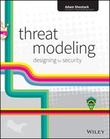
Book
Threat Modeling: Designing for Security
by Adam Shostack
Publisher: Wiley
Release Date: February 2014
https://learning.oreilly.com/library/view/threat-modeling-designing/9781118810057/

Slide 3
Secure by design:
Establish trust boundaries
Don’t reinvent the wheel
Economy of mechanism
Separation of duty
Open design
Minimize the attack surface
Secure the weakest link
Secure by default
Use least privilege
User default deny
Fail securely
Secure by implementation
Psychological acceptability
Validate inputs
Secre data at rest
Prevent bypass attacks
Defense in depth
CYBR 271: Secure Programming
Slide

Slide 4
Goal
Start thinking about the threats that might impact the applications or systems that you build and how you might protect against them.
开始考虑可能影响您所构建的应用程序或系统的威胁，以及如何防范这些威胁。
CYBR 271: Secure Programming
Slide
Notes:
This is a great place to start when approaching security in a structured way
We want a structured way because we only have so much resource to throw at the problem of securing our systems
2 parts here: let’s talk practically about how threat modelling works and then add context based on how businesses manage risks.
At the end of the day, security, to businesses, is risk management.

Slide 5
Definitions IMPORTANT
安全控制又称“缓解”
保护免受威胁，减少脆弱性
Security Controls aka “mitigations”
Protect against threats, reduce vulnerability
财产Asset
Something that should be protected
Vulnerability
Weakness or lack of protections
Threat
Something that could negatively impact an asset
Risk
The possibility that a threat will exploit a vulnerability to harm an asset
Risk = Threat * Vulnerability
More detail at: https://csrc.nist.gov/glossary/
CYBR 271: Secure Programming
Slide
Notes:
Asset - is anything within an environment that should be protected. This could be a computer file, a piece of software or hardware, a service, or some sensitive data within your database. If the asset was damaged or stolen, then there may be a negative impact on the owner’s productivity, profits or reputation, perhaps.
Vulnerability – is a weakness in an asset or the lack of an appropriate protection to safeguard the asset. If a vulnerability is exploited, then this may harm the asset. For example, this could be a flaw in an application code, an error made by an administrator, or a limitation of the technology used.
Threat – a threat a potential occurrence that causes harm to an asset. This could be an action or inaction, intentional or unintentional, and could originate from a person, a company, hardware, or nature. The easiest example here is a person might attack a system, but it also could be a hardware fault that might cause an outage or a natural disaster that floods a datacentre.
Risk - the possibility that a threat will exploit a vulnerability to harm an asset. It adds an assessment of likelihood, possibility or chance.
For example:
In IT, the risk may be that data in our database is disclosed (risk) because a hacker (threat) is able to use an injection attack in our web application because we aren’t sanitizing inputs.
Security Controls – anything that removes or reduces a vulnerability or protects against a specific threat. In the examples we used above, the controls may be: For our web application, we might do some sanitisation of inputs, disallow users to provide inputs or whatever other activities that are effective in mitigating that threat by removing the vulnerability.
If you want more detailed definitions checkout: https://csrc.nist.gov/glossary
Note that people will define these more than one way

Slide 6

Why?
Non-compliance
Data Loss
Monetary Cost
Reputation
Weight/Cost of
Risk Realisation
Weight/Cost of
Countermeasures
CYBR 271: Secure Programming
Slide
Notes:
To a business, IT security exists only in the context of risk. And businesses are driven by risk management concerns to implement protections.
Risks to a business may be: non-compliance with the law or standards (PCI), data loss (personal, proprietary, financial), financial loss (associated with resolving incidents, system downtime, decreased profits), and impacts to reputation (customers are less likely to use their services).
Being aware of the threats to our systems help us to select appropriate controls to protect against them.
However, most companies will not tell their IT managers to spend all of their money on protecting their systems. It is a balancing act between the cost of threat realisation. How much will it cost us if our assets are breached?
Versus how much will it cost to implement adequate security controls to reduce the likelihood of a threat being able to exploit a vulnerability or the impact to us if this did happen.

Slide 7
Question
Do you know any examples of standards or laws that you need to comply with?
CYBR 271: Secure Programming
Slide
Notes:
Could be:
New attack tools developed
New vulnerabilities discovered
Maintenance of the system introduces new vulnerabilities
System is deployed into a different environment changing assumptions about potential threats (for example, in front of a firewall)

Slide 8
Question
Do you know any examples of standards or laws that you need to comply with?
NZ Information Security Manual (NZISM) https://www.gcsb.govt.nz/publications/the-nz-information-security-manual/)
NZ Privacy Act https://www.privacy.org.nz/the-privacy-act-and-codes/privacy-act-and-codes-introduction/
EU General Data Protection Regulation (GDPR) https://gdpr-info.eu/
US Health Information Portability and Accountability Act HIPAA https://www.hhs.gov/hipaa/index.html
Payment Card Industry Data Security Standard PCI DSS https://www.pcisecuritystandards.org/pci_security/
CYBR 271: Secure Programming
Slide

Slide 9
When?
After Implementation
During Development
High cost to fix issues
Consider security during system design and development to reduce vulnerabilities
Ongoing
More vulnerabilities = more risk
CYBR 271: Secure Programming
Slide
Notes:
Unfortunately security is an afterthought for many companies. And these threats are identified after the implementation of a system.
The impact of this is two-fold: the cost and difficulty of fixing an issue is more expensive than preventing it. AND the more vulnerabilities that are present within a system, the more opportunities there are for a threat agent to exploit a vulnerability.
These issues dictate best practice for software security risks (which is applicable to how a business might manage risk:
Considering security throughout the software development lifecycle, design and development of the system or application
Realistically good practice looks like ongoing identification of threats and ongoing risk management
Why might new risks appear that weren’t there before?
Example – new tools

Slide 10
Question
Why is it ideal for the application of the process to be ongoing?
New attack tools developed
New vulnerabilities discovered
Maintenance of the system introduces new vulnerabilities
System is deployed into a different environment changing assumptions about potential threats
CYBR 271: Secure Programming
Slide
Notes:
Could be:
New attack tools developed
New vulnerabilities discovered
Maintenance of the system introduces new vulnerabilities
System is deployed into a different environment changing assumptions about potential threats (for example, in front of a firewall)

Slide 11
How? Threat Modelling
Analysing the Application/System
What does the system do?
Determining Threats
What could go wrong?
Addressing Threats
What can you do?
CYBR 271: Secure Programming
Slide
Notes:
First, understand the application – the purpose, the users, the information, the features, the CIA.
Determining threat – this is the difficult part. We can use a threat model (which we will talk about shortly) to identify the high-level threats.
Lastly, deciding how the threats will be managed.

Slide 12
Question
Why is it ideal for the application of the process to be ongoing?
New attack tools developed
New vulnerabilities discovered
Maintenance of the system introduces new vulnerabilities
System is deployed into a different environment changing assumptions about potential threats
CYBR 271: Secure Programming
Slide
Notes:
Could be:
New attack tools developed
New vulnerabilities discovered
Maintenance of the system introduces new vulnerabilities
System is deployed into a different environment changing assumptions about potential threats (for example, in front of a firewall)

Slide 13
Threat Modelling techniques
Unstructured
Persona non Grata
Misuse cases
Security cards
Privilege escalation game
Structured
STRIDE
DREAD
Attack trees
Attack libraries
PASTA
VAST
Trike
OCTAVE
NIST
SOME TECHNIQUES CAN BE COMBINED TOGETHER
CYBR 271: Secure Programming
Slide
Notes:
Many threat-modeling methods have been developed. They can be combined to create a more robust and well-rounded view of potential threats. Not all of them are comprehensive; some are abstract and others are people-centric. Some methods focus specifically on risk or privacy concerns.
The varying structured approaches for threat modeling are usually called frameworks or methodologies (the two terms can basically be used interchangeably in this context).
Some are just called techniques.

Slide 14
Threat Modelling techniques
Unstructured
Persona non Grata
Misuse cases
Security cards
Privilege escalation game
Structured
STRIDE
DREAD
Attack trees
Attack libraries
PASTA
VAST
Trike
OCTAVE
NIST
CYBR 271: Secure Programming
Slide
Notes:
We are going to cover these ones.
We are going to try out some techniques in tutorials.
We will have an assignment on STRIDE & DREAD which are quite popular ones.

Slide 15
Why follow a particular technique?
Key benefit is it makes developers and implementer’s answer the question: what is your threat model?
Clarifies assumptions.
Security always costs in terms of time, $$$ or performance.
Avoid wasting effort on necessary defences.
Focuses effort on actual defences.
CYBR 271: Secure Programming
Slide
Notes:
Key benefit is it makes developers and implementer’s answer the question: what is your threat model?
Clarifies assumptions.
Avoid wasting effort on necessary defences.
Focuses effort on actual defences.

Slide 16
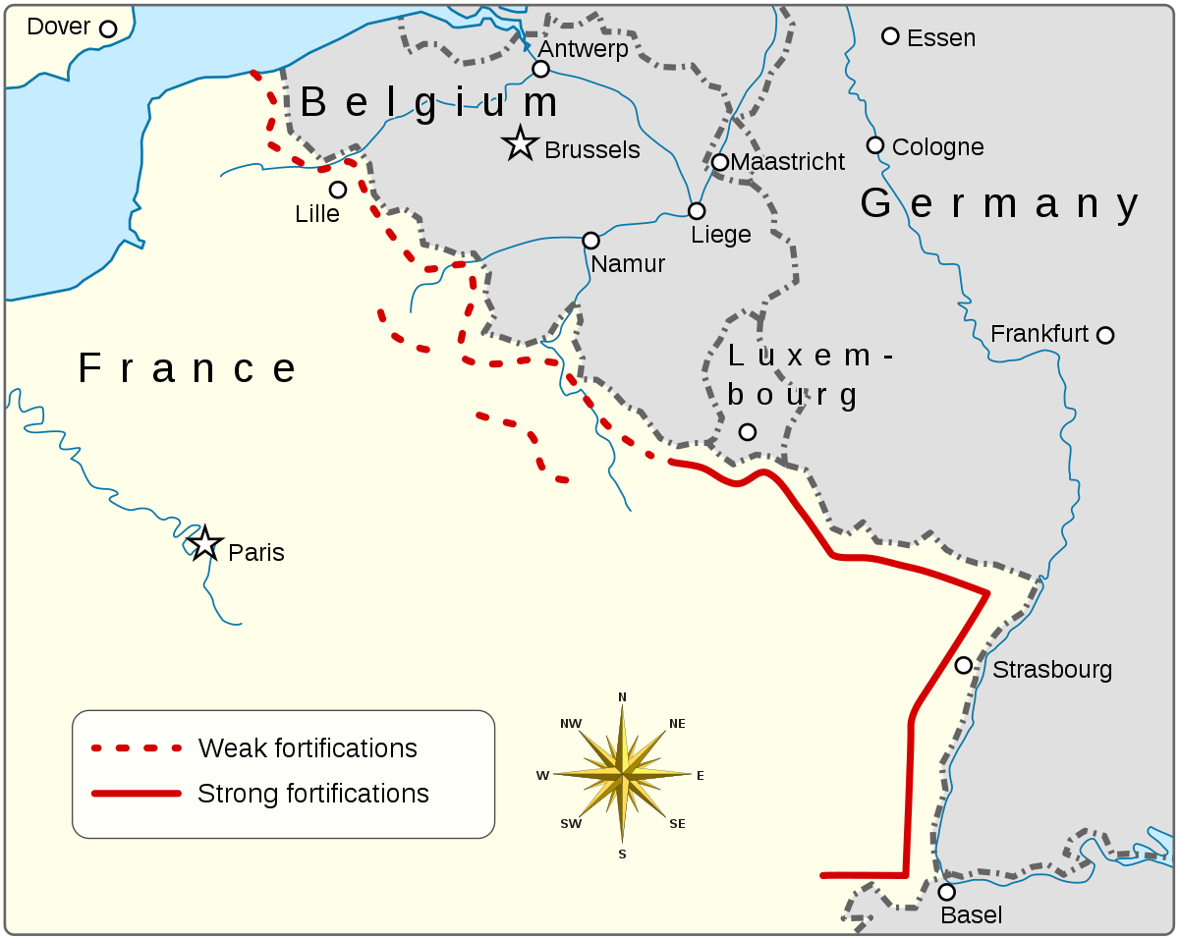
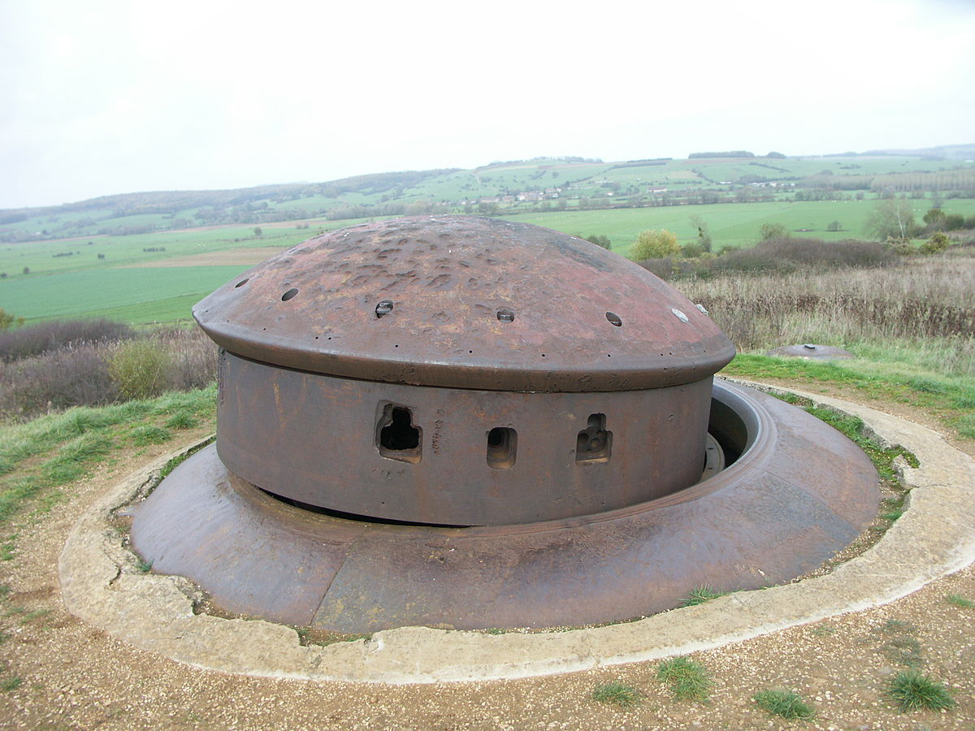
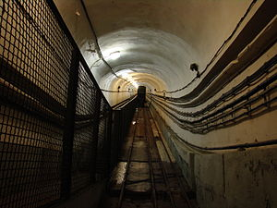
Example – getting it wrong
https://en.wikipedia.org/wiki/Maginot_Line
450 km
CYBR 271: Secure Programming
Slide
Notes:
The Maginot Line (French: Ligne Maginot, IPA: [liɲ maʒino]), named after the French Minister of War André Maginot, is a line of concrete fortifications, obstacles, and weapon installations built by France in the 1930s to deter invasion by Germany and force them to move around the fortifications.
Purposes:
- To prevent a German surprise attack.
- To deter a cross-border assault.[
- To protect Alsace and Lorraine (returned to France in 1918) and their industrial basin.
- To save manpower (France counted 39 million inhabitants, Germany 70 million)
- To cover the mobilisation of the French Army (which took between two and three weeks)
- To push Germany into an effort to circumvent via Switzerland or Belgium, and allow France to fight the next war off French soil to avoid a repeat of 1914–1918.
- To be used as a basis for a counter-offensive.

Slide 17
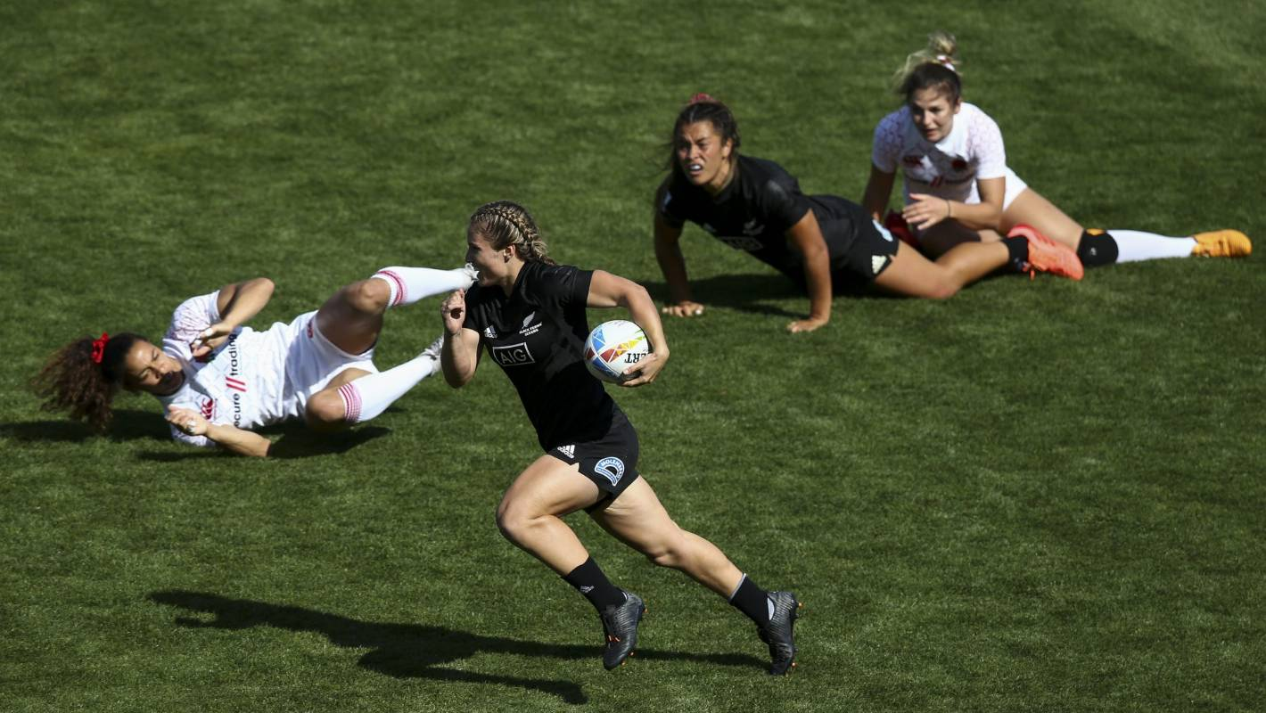
Example – getting it wrong
CYBR 271: Secure Programming
Slide
Notes:
Side stepped the opposition.

Slide 18
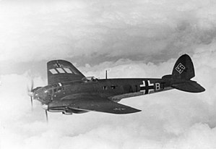
Example – getting it wrong
CYBR 271: Secure Programming
Slide
Notes:
Side stepped the opposition.

Slide 19
Why follow a particular technique?
Key benefit is it makes developers and implementer’s answer the question: what is your threat model?
CYBR 271: Secure Programming
Slide
Notes:
We are going to cover these ones.
We are going to try out some techniques in tutorials.
We will have an assignment on STRIDE & DREAD which are quite popular ones.

Slide 20
System Analysis
Functions?
Users?
Interfaces?
User requirements?
Non-functional requirements?
Data? CIA?
Technology used?
Connected systems?
Notes:
The aim of the analysis step is to understand the application. This isn’t a definitive list, but some questions you might ask
Ask the right questions to understand the purpose of the application or system, the functions, who are the users?

Slide 21
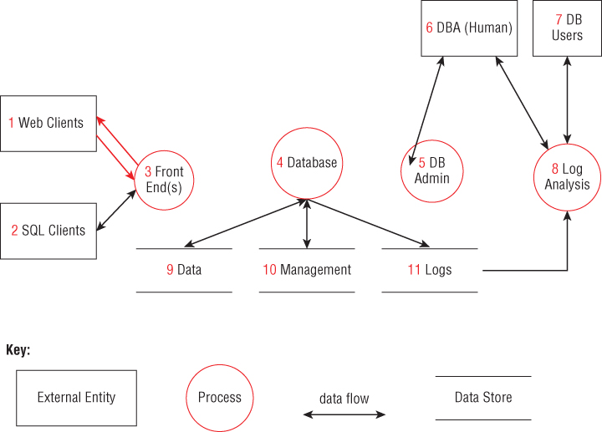
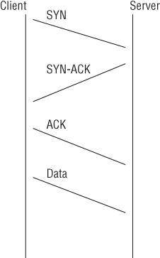
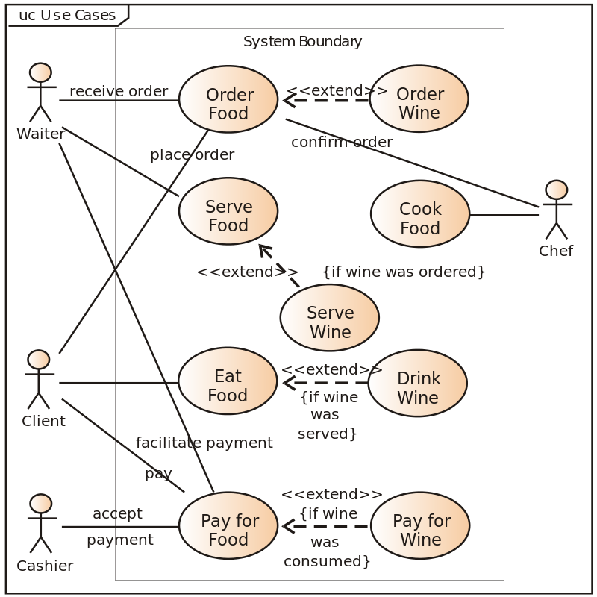
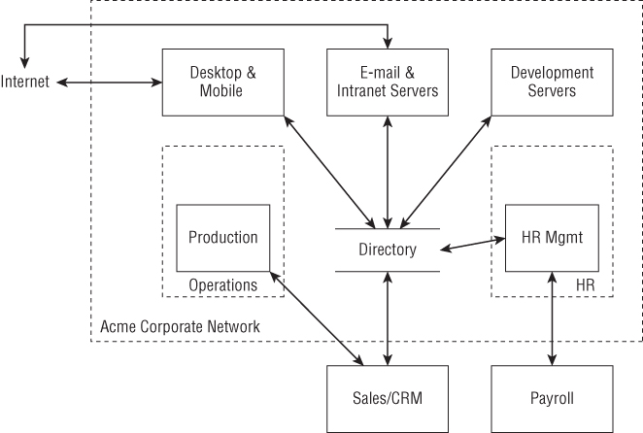
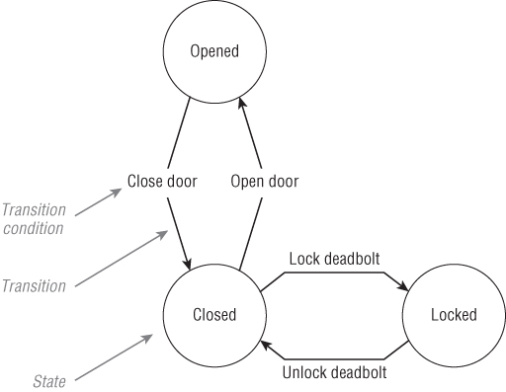
System Models
UML – Swimlanes
UML – Use cases
State machines
Data flow diagrams (1970s)
Notes:
Use diagrams to model the application once you understand it.

Slide 22
Brainstorming
Experienced experts in a room.
Whiteboard, papers ….
Quality bounded by experience of brainstormers and amount of time spent brainstorming.
Techniques:
Persona non grata
Use cases
Security cards
Notes:
Use diagrams to model the application once you understand it.

