Slide 1

School of
Engineering and Computer Science
Te Kura Mātai Pūkaha, Pūrorohiko
Threat Modelling and Risk Assessment III CYBR 271 T2 2020
Ian Welch, Harith Al-Sahaf
Includes material from “Introduction to threat modelling” by Microsoft

Slide 2
After the last lecture you should be able to …
Describe the concept of misuse cases, persona non grata and security cards to support brainstorming approach to threat modelling.
Discuss the pro’s and con’s of these concepts.
Explain who persona non grata can help with the development of misuse cases.
Apply security cards to develop a threat model and rank these threats relative to each other.
CYBR 271: Secure Programming
Slide

Slide 3
The STRIDE per Element Approach to Threat Modeling

Slide 4
How to Create Diagrams
Go to the whiteboard
Start with an overview which has:
A few external interactors
One or two processes
One or two data stores (maybe)
Data flows to connect them
Check your work
Can you tell a story without edits?
Does it match reality?
转到白板
从概述开始：
一些外部交互器
一两个过程
一两个数据存储（也许）
数据流连接它们
检查你的工作
您可以不编辑就能讲一个故事吗？
它与现实相符吗？

Slide 5
Diagramming
Use DFDs (Data Flow Diagrams)
Include processes, data stores, data flows
Include trust boundaries
Diagrams per scenario may be helpful
Update diagrams as product changes
Enumerate assumptions, dependencies
Number everything (if manual)

Slide 6
Diagram Elements: Examples
External Entity
Data
Flow
Process
Data Store
People
Other systems
Microsoft.com
DLLs
EXEs
.CLASS
.JSSe
Manual procedures
Function call
Network traffic
Method calls
Physical items
Phone calls
Texts
Database
File
Registry
Shared Memory
Queue / Stack
Physical records
Trust Boundary
Process boundary
File system

Slide 7
Diagrams: Trust Boundaries
Add trust boundaries that intersect data flows
Points/surfaces where an attacker can interject
Machine boundaries, privilege boundaries, integrity boundaries are examples of trust boundaries
Threads in a native process are often inside a trust boundary, because they share the same privs, rights, identifiers and access
Processes talking across a network always have a trust boundary
They make may create a secure channel, but they’re still distinct entities
Encrypting network traffic is an ‘instinctive’ mitigation
But doesn’t address tampering or spoofing

Slide 8
Diagram Iteration
Iterate over processes, data stores, and see where they need to be broken down
How to know it “needs to be broken down?”
More detail is needed to explain security impact of the design
Object crosses a trust boundary
Words like “sometimes” and “also” indicate you have a combination of things that can be broken out
“Sometimes this datastore is used for X”…probably add a second datastore to the diagram

Slide 9
Diagram Iteration
Iterate over processes, data stores, and see where they need to be broken down
How to know it “needs to be broken down?”
More detail is needed to explain security impact of the design
Object crosses a trust boundary
Words like “sometimes” and “also” indicate you have a combination of things that can be broken out
“Sometimes this datastore is used for X”…probably add a second datastore to the diagram

Slide 10
Context Diagram
Resource integrity information
iNTegrity App
Administrator
Analysis Instructions
Notes:
Now to put this all together, we’re going to look at a simple system for change detection in an enterprise.

Slide 11
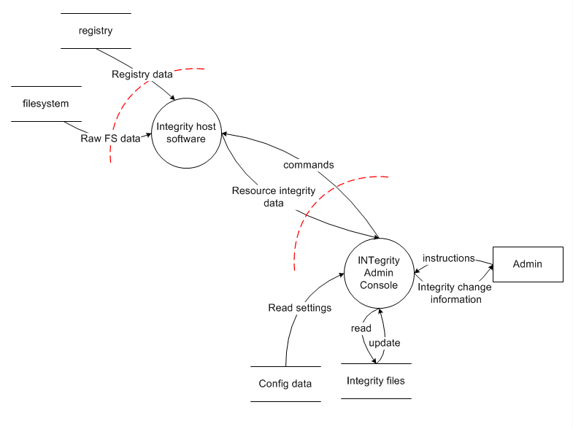
Level 1 Diagram
Notes:
We have an admin console that gathers filesystem & registry data from one or more monitored hosts in the field.

Slide 12
Diagram layers
Context Diagram
Very high-level; entire component / product / system
Level 1 Diagram
High level; single feature / scenario
Level 2 Diagram
Low level; detailed sub-components of features
Level 3 Diagram
More detailed
Rare to need more layers, except in huge projects or when you’re drawing more trust boundaries

Slide 13
Creating Diagrams: analysis or synthesis?
Top down
Gives you the “context” in context diagram
Focuses on the system as a whole
More work at the start
Bottom up
Feature crews know their features
Approach not designed for synthesis
More work overall
Notes:
FINDME: If your team has made a call on this, you can eliminate this slide

Slide 14
Diagram Validation Rules of Thumb
Notes:
These rules of thumb are derived from Microsoft’s analysis of threat models and are designed to make it easier to know if you’re doing the right thing. Even if you’re using the tool—which automates these– its important to know where they come from.

Slide 15
Diagram Validation Rules of Thumb
Does data magically appear?
Data comes from external entities or data stores
Order
Customer
Web Server
SQL Database
Confirmation

Slide 16
Diagram Validation Rules of Thumb
Are there data sinks?
You write to a store for a reason: Someone uses it.
Transaction
Analytics
Web Server
SQL Server Database

Slide 17
Diagram Validation Rules of Thumb
Data doesn’t flow magically
Order Database
Returns Database

Slide 18
Diagram Validation Rules of Thumb
It goes through a process
Order Database
RMA
Returns Database

Slide 19
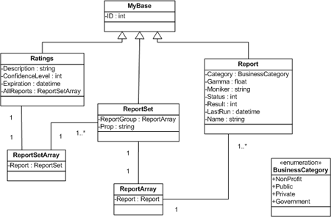
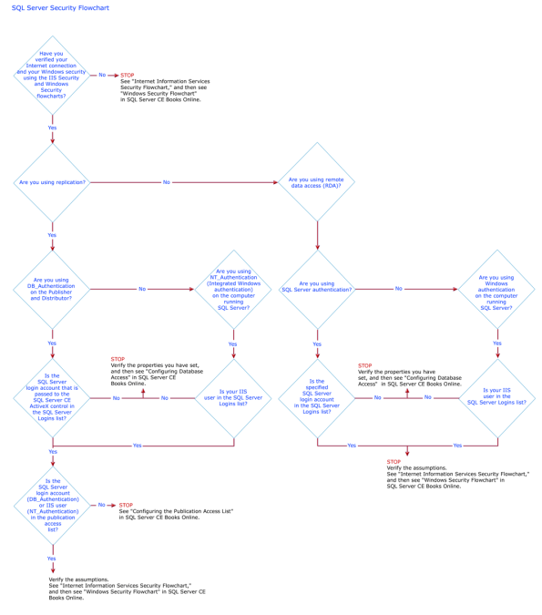
Diagrams Should Not Resemble
Flow charts
Class diagrams
Call graphs

Slide 20
Real Context Diagram (“Castle”)
Castle Config
Feedback

Slide 21
Castle Level 1 Diagram
SSDP
8
SSDP
10
Get version
info
Cache Castle
info
Set version
info
Query other
Castle info
Read
Castle info
Publish this
Castle info
Local User
1
Manage
Castle
Explorer
(or rundl132)
2
Manage
Castle
Feedback
Castle
Service
8
Join, leave,
Set users props
Remote
Castle
Service
9
Feedback
Query users props
Set acct info
Get acct info
Get machine
password
Set psswd
Shacct
4
Set acct
Info
Get acct info
Notes:
I usually ask people in the class to improve this diagram. Where should there be trust boundaries? What’s the wrong shape? What happens in what order?
Do point out that none of the data flows are labeled “read” or “write,” and that’s a good thing. You get read/write from the direction of the arrow.

Slide 22
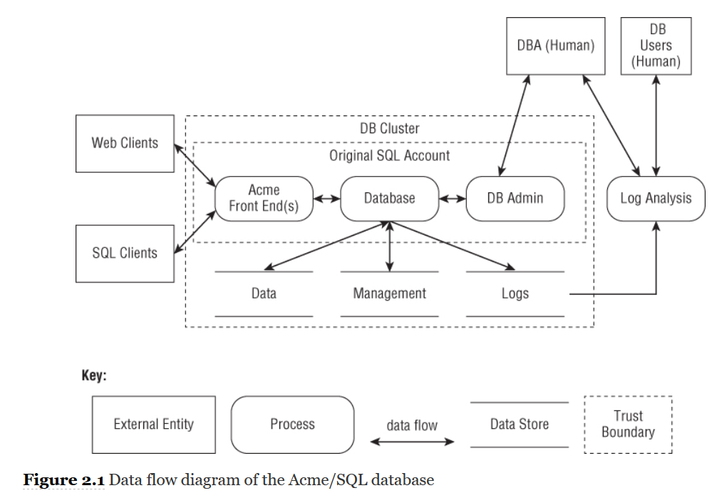
Level 0
Notes:
The next phase of the process is to identify threats. How do you do this without being an expert?

Slide 23
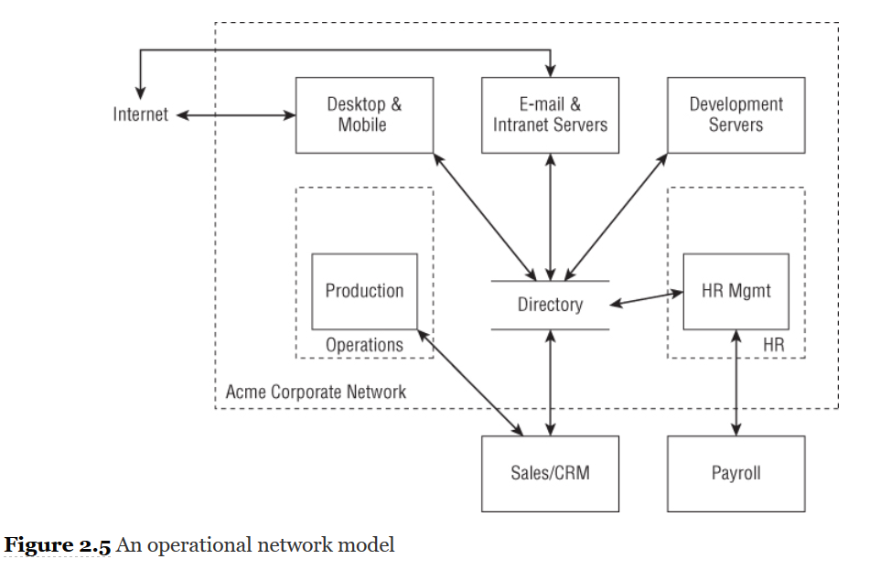
Level 0
Notes:
The next phase of the process is to identify threats. How do you do this without being an expert?

Slide 24
Identify Threats
Experts can brainstorm专家可以集思广益
How to do this without being an expert?没有专家怎么做？
Use STRIDE to step through the diagram elements使用STRIDE逐步浏览图表元素
Get specific about threat manifestation详细了解威胁表现
Threat Property we want
Spoofing | Authentication
Tampering | Integrity
Repudiation | Nonrepudiation
Information Disclosure | Confidentiality
Denial of Service | Availability
Elevation of Privilege | Authorization
Notes:
Self explanatory. The next slides go into more detail, with examples

Slide 25
Threat: Spoofing
Threat | Spoofing
Property | Authentication
Definition | Impersonating something or someone else
Example | Pretending to be any of billg microsoft.com, or ntdll.dll

Slide 26
Threat: Tampering
Threat | Tampering
Property | Integrity
Definition | Modifying data or code
Example | Modifying a DLL on disk or DVD, or a packet as it traverses the LAN

Slide 27
Threat: Repudiation
Threat | Repudiation
Property | Non-Repudiation
Definition | Claiming to have not performed an action
Example | “I didn’t send that email,” “I didn’t modify that file,” “I certainly didn’t visit that Web site!”

Slide 28
Threat: Information Disclosure
Threat | Information Disclosure
Property | Confidentiality
Definition | Exposing information to someone not authorized to see it
Example | Allowing someone to read the Windows source code; publishing a list of customers to a Web site
威胁：信息泄露
财产：保密
定义：向未经授权的人公开信息
示例：允许某人阅读Windows源代码； 将客户列表发布到网站

Slide 29
Threat: Denial of Service
Threat | Denial of Service
Property | Availability
Definition | Deny or degrade service to users
Example | Crashing Windows or a Web site, sending a packet and absorbing seconds of CPU time, or routing packets into a black hole
威胁：拒绝服务
属性：可用性
定义：拒绝或降低对用户的服务
示例：崩溃Windows或网站，发送数据包并占用几秒钟的CPU时间，或将数据包路由到黑洞中

Slide 30
Threat: Elevation of Privilege
Threat | Elevation of Privilege (EoP)
Property | Authorization
Definition | Gain capabilities without proper authorization
Example | Allowing a remote Internet user to run commands is the classic example, but going from a “Limited User” to “Admin” is also EoP
威胁：特权提升（EoP）
财产：授权
定义：未经适当授权即可获得功能
示例：经典示例是允许远程Internet用户运行命令，但从“受限用户”到“管理员”也是EoP

Slide 31
Different Threats Affect Each Element Type
ELEMENT
S T R I D E


External Entity






Process

?


Data Store



Data Flow
Notes:
These are the threats which affect each type of element. For example, data flows are subject to tampering, information disclosure and denial of service.
Data stores are subject to tampering, information disclosure and denial of service, and if they’re logs, impact repudiation:
Data stores which are logs come under special attack because they’re logs.
Logs can act as a pass through—lots of security software looks at logs. Be careful about what you write.
If a system has no logs, repudiation is easy.

Slide 32
Apply STRIDE Threats to Each Element
For each item on the diagram:
Apply relevant parts of STRIDE
Process: STRIDE
Data store, data flow: TID
Data stores that are logs: TID+R
External entity: SR
Data flow inside a process:
Don’t worry about T, I, or D
This is why you number things

Slide 33
Apply STRIDE Threats to Each Element
Each element is a victim.
Can be confusing to decide which threat to identify.
Consider where threat arising from another threat.
For example, consider a data flow representing flow of email:
Tamper with the network to change the email FROM: field
Is this “tampering” or “spoofing” of the data flow?
Notes:
Each element is the victim, not the perpetrator. Therefore, if you're tampering with a data store, the threat is to the data store and the data within. If you're spoofing in a way that affects a process, then the process is the victim. So, spoofing by tampering with the network is really a spoof of the endpoint, regardless of the technical details. In other words, the other endpoint (or endpoints) are confused about what's at the other end of the connection. The chart focuses on spoofing of a process, not spoofing of the data flow.

Slide 34
Apply STRIDE Threats to Each Element
Each element is a victim.
Can be confusing to decide which threat to identify.
Consider where threat arising from another threat.
For example, consider a data flow representing flow of email:
Tamper with the network to change the email FROM: field
Is this “tampering” or “spoofing” of the data flow?
Who is the victim here?
Endpoint (process, entity or data flow) – confused by what is other end so spoofing
Data flow – tampered with (leading to spoofing of endpoint)
Notes:
Each element is the victim, not the perpetrator. Therefore, if you're tampering with a data store, the threat is to the data store and the data within. If you're spoofing in a way that affects a process, then the process is the victim. So, spoofing by tampering with the network is really a spoof of the endpoint, regardless of the technical details. In other words, the other endpoint (or endpoints) are confused about what's at the other end of the connection. The chart focuses on spoofing of a process, not spoofing of the data flow.

Slide 35
Threats and Distractions
Don’t worry about these threats
The computer is infected with malware
Someone removed the hard drive and tampers
Admin is attacking user
A user is attacking himself
You can’t address any of these (unless you’re the OS)
There are some threats you will never be able to mitigate so ignore
You may document your assumptions:
Computer has up to date anti-virus
Attacker does not have physical access to server
Admin is trustworthy
Users act in their own best interests

Slide 36
Threats and Distractions
Don’t worry about these threats
The computer is infected with malware
Someone removed the hard drive and tampers
Admin is attacking user
A user is attacking himself
You can’t address any of these (unless you’re the OS)
There are some threats you will never be able to mitigate so ignore
You may document your assumptions:
Computer has up to date anti-virus
Attacker does not have physical access to server
Admin is trustworthy
Users act in their own best interests
Any danger here?
Notes:
Your assumption might be too strong.
But at least you have documented it and other people know your thinking.

Slide 37
Validating Threat Models
Validate the whole threat model
Does diagram match final code?
Are threats enumerated?
Minimum: STRIDE per element touching a trust boundary
Maximum: Within trust boundaries to make explicit the reliance upon protection provided
Example: vending machine
Minimum: ignore elements inside machine protected by lock
Maximum: include elements so understand whether have defence-in-depth, exploitability depends upon lock

Slide 38
Attack trees
Notes:
As Bruce Schneier wrote in his introduction to the subject, “Attack trees provide a formal, methodical way of describing the security of systems, based on varying attacks. Basically, you represent attacks against a system in a tree structure, with the goal as the root node and different ways of achieving that goal as leaf nodes” (Schneier, 1999).

Slide 39
Attack Trees
Alternative to STRIDE.
Explicity shows the relationships between threats compared to STRIDE that the description might show the relationship (“Spoofing email sender by tampering with header when sent via network to carry out phishing attack”).
Bruce Schneier (1999) “Attack trees provide a formal, methodical way of describing the security of systems, based on varying attacks. Basically, you represent attacks against a system in a tree structure, with the goal as the root node and different ways of achieving that goal as leaf nodes”
Three ways to use attack trees:
Use attack tree from someone else.
Create a new attack tree for your project.
Create an attack for someone else to use them (this is hard!)
Take the DFD and iterate through elements using attack tree to identify threats.
Notes:
There are three ways you can use attack trees to enumerate threats: You can use an attack tree someone else created to help you find threats. You can create a tree to help you think through threats for a project you're working on. Or you can create trees with the intent that others will use them. Creating new trees for general use is challenging, even for security experts.

Slide 40
Creating Attack Trees
The basic steps to create an attack tree are as follows:
Decide on a representation.
Create a root node.
Create subnodes.
Consider completeness.
Prune the tree.
Check the presentation.

Slide 41
Decide on a representation
Either:
AND
OR
AND – all of the subnodes must be true for the goal to be achieved
OR – any one of the subnodes must be true for the goal to be achieved

Slide 42
Create a root node
Either:
Goal
High-impact action
Advice:
Create a root node with an attacker goal or high-impact action.
Use OR trees.
Draw them into a grid that the eye can track linearly.

Slide 43
Create subnodes
Use brainstorming or rely upon checklists or similar of threats.
Nodes can be linked by AND or OR.
Example:
Attacking a system:
physical access
subvert software
subvert a person
More examples:
Attacking a system via:
People
Process
Technology
Attacking a product during:
Design
Production
Distribution
Usage
Discard
Notes:
You can create subnodes by brainstorming, or you can look for a structured way to find more nodes. The relation between your nodes can be AND or OR, and you'll have to make a choice and communicate it to those who are using your tree. Some possible structures for first-level subnodes include:
Attacking a system:
physical access
subvert software
subvert a person
Attacking a system via:
People
Process
Technology
Attacking a product during:
Design
Production
Distribution
Usage
Discard
You can use these as a starting point, and make them more specific to your system. Iterate on the trees, adding subnodes as appropriate.

Slide 44
Consider completeness
Might need trees for each component.
Ask “is another way that could happen?”
Consider additional attackers or motivations, or
Consider other threats
Can draw upon other techniques:
Apply STRIDE
Attacker models persona non grata here.
Notes:
For this step, you want to determine whether your set of attack trees is complete enough. For example, if you are using components, you might need to add additional trees for additional components. You can also look at each node and ask “is there another way that could happen?” If you're using attacker motivations, consider additional attackers or motivations. The lists of attackers in Appendix C “Attacker Lists” can be used as a basis.
An attack tree can be checked for quality by iterating over the nodes, looking for additional ways to reach the goal. It may be helpful to use STRIDE, one of the attack libraries in the next chapter, or a literature review to help you check the quality.

Slide 45
Prune the tree
Is each action preventable?
Are there duplicate?
Are the threats mitigated, mark them on the tree so it is clear about the assumptions.
Notes:
Prune the Tree
In this step, go through each node in the tree and consider whether the action in each subnode is prevented or duplicative. (An attack that's worth putting in a tree will generally only be prevented in the context of a project.) If an attack is prevented, by some mitigation you can mark those nodes to indicate that they don't need to be analyzed. (For example, you can use the test case ID, an “I” for impossible, put a slash through the node, or shade it gray.) Marking the nodes (rather than deleting them) helps people see that the attacks were considered. You might choose to test the assumption that a given node is impossible. See the “Test Process Integration” section in Chapter 10 “Validating That Threats Are Addressed” for more details.

Slide 46
Check the presentation
Present each tree on a single page.
Each top level subnode can be the root of a new tree.
Use active terms, show equivalent level subnodes.
Notes:
Regardless of graphical form, you should aim to present each tree or subtree in no more than a page. If your tree is hard to see on a page, it may be helpful to break it into smaller trees. Each top level subnode can be the root of a new tree, with a “context” tree that shows the overall relations. You may also be able to adjust presentation details such as font size, within the constraints of usability.
The node labels should be of the same form, focusing on active terms. Finally, draw the tree on a grid to make it easy to track. Ideally, the equivalent level subnodes will show on a single line. That becomes more challenging as you go deeper into a tree.

Slide 47
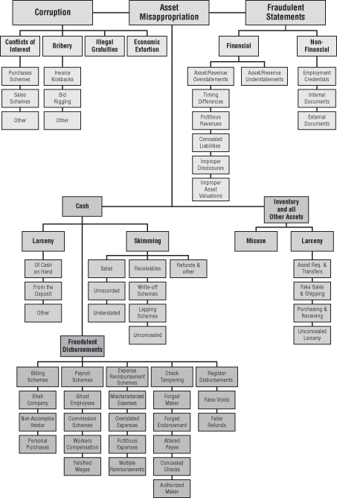
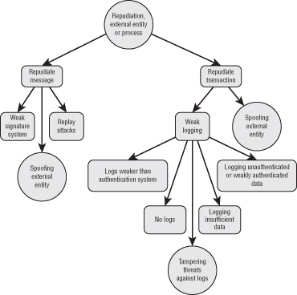
Example
Notes:
The ques.
Attack trees can be a useful way to convey information about threats. They can be helpful even to security experts as a way to quickly consider possible attack types. However, despite their surface appeal, it is very hard to create attack trees. I hope that we'll see experimentation and perhaps progress in the quality of advice. There are also a set of issues that can make trees hard to use, including completeness, scoping, and meaning:
Completeness: Without the right set of root nodes, you could miss entire attack groupings. For example, if your threat model for a safe doesn't include “pour liquid nitrogen on the metal, then hit with a hammer,” then your safe is unlikely to resist this attack. Drawing a tree encourages specific questions, such as “how could I open the safe without the combination?” It may or may not bring you to the specific threat. Because there's no way of knowing how many nodes a branch should have, you may never reach that point. A close variant of the this is how do you know that you're done? (Schneier's attack tree article alludes to these problems.)
Scoping: It may be unreasonable to consider what happens when the computer's main memory is rapidly cooled and removed from the motherboard. If you write commercial software for word processing, this may seem like an operating system issue. If you create commercial operating systems, it may seem like a hardware issue. The nature of attack trees means many of the issues discovered will fall under the category of “there's no way for us to fix that.”
Meaning: There is no consistency around AND/OR, or around sequence, which means that understanding a new tree takes longer.
tion of how to effectively represent AND/OR is not simple. Some representations leave them out, others include an indicator either before or after a line.

Slide 48
That’s it

