Slide 1

School of
Engineering and Computer Science
Te Kura Mātai Pūkaha, Pūrorohiko
Threat Modelling and Risk Assessment IV CYBR 271 T2 2020
Ian Welch, Harith Al-Sahaf
Includes material from “Introduction to threat modelling” by Microsoft

Slide 2
After the last lecture you should be able to …
Identify the main elements of a dataflow diagram (DFD) and be able to interpret the semantics of a DFD
Describe each of the different STRIDE threats
Apply STRIDE to a DFD to identify threats to security
Explain the main purposes of an attack tree
Use attack trees to show the relationship between different threats
CYBR 271: Secure Programming
Slide

Slide 3

Attack libraries
Argument against STRIDE is that is too abstract.
Useful to have a detailed list of common problems.
Look at checklists and some examples of libraries.
Dimensions:
Audience – who is being targeted
Detail versus abstraction – specific detail versus abstract ideas
Scope – what’s the focus of the library
CYBR 271: Secure Programming
Slide
Notes:
Possible focuses: Application security, Web application security and Network defense

Slide 4
“Checklist security”
Detailed list of questions or steps related to security threats.
Focuses on a particular domain, e.g. network security, particular application or working from home.
Examples:
https://itservices.uncc.edu/one-it/information-security-checklist
https://docs.oracle.com/cd/B19306_01/network.102/b14266/checklis.htm#i1011179
Many security professionals are sceptical of “checklist security”
Encourages people to believe they are secure when they are not
Pro’s - Checklists can be used to avoid common classes of problems.
Con’s –Only avoid the threats associated with the problems on the checklist i.e. won’t find threats that are not on the checklist.
CYBR 271: Secure Programming
Slide
Notes:
A checklist developed by security experts using questions dealing with a number of security issues. ... If computers are outside the firewall (bastion hosts), how securely are they separated from computers on the inside?

Slide 5

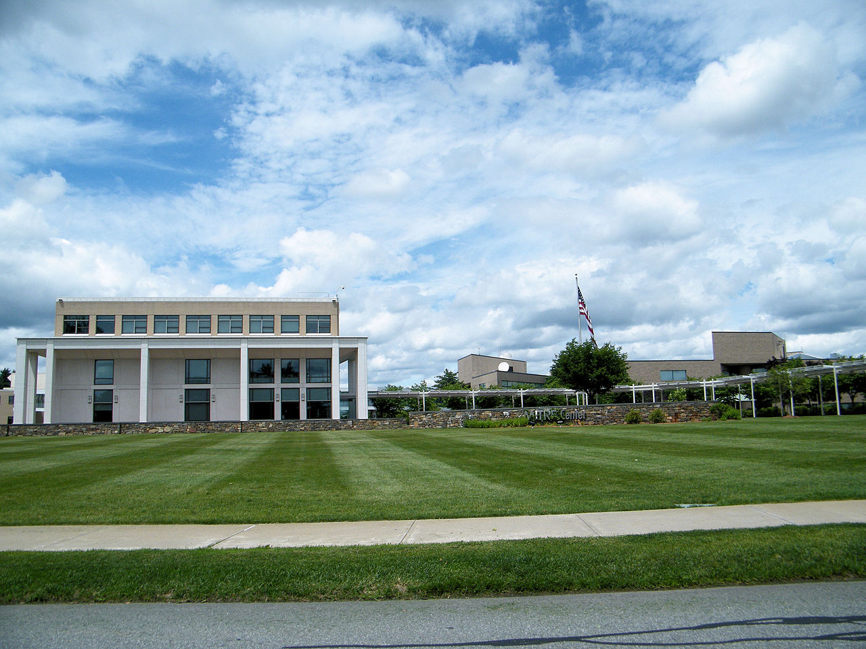
CAPEC – Common Attack Pattern Enumeration and Classification
Developed by MITRE corporation.
Who is MITRE?
Founded 1952
Not-for-profit research for US government agencies
$US 1.7 billion (2017)
Library of 500+ attack patterns
More abstract than a checklist
CYBR 271: Secure Programming
Slide

Slide 6
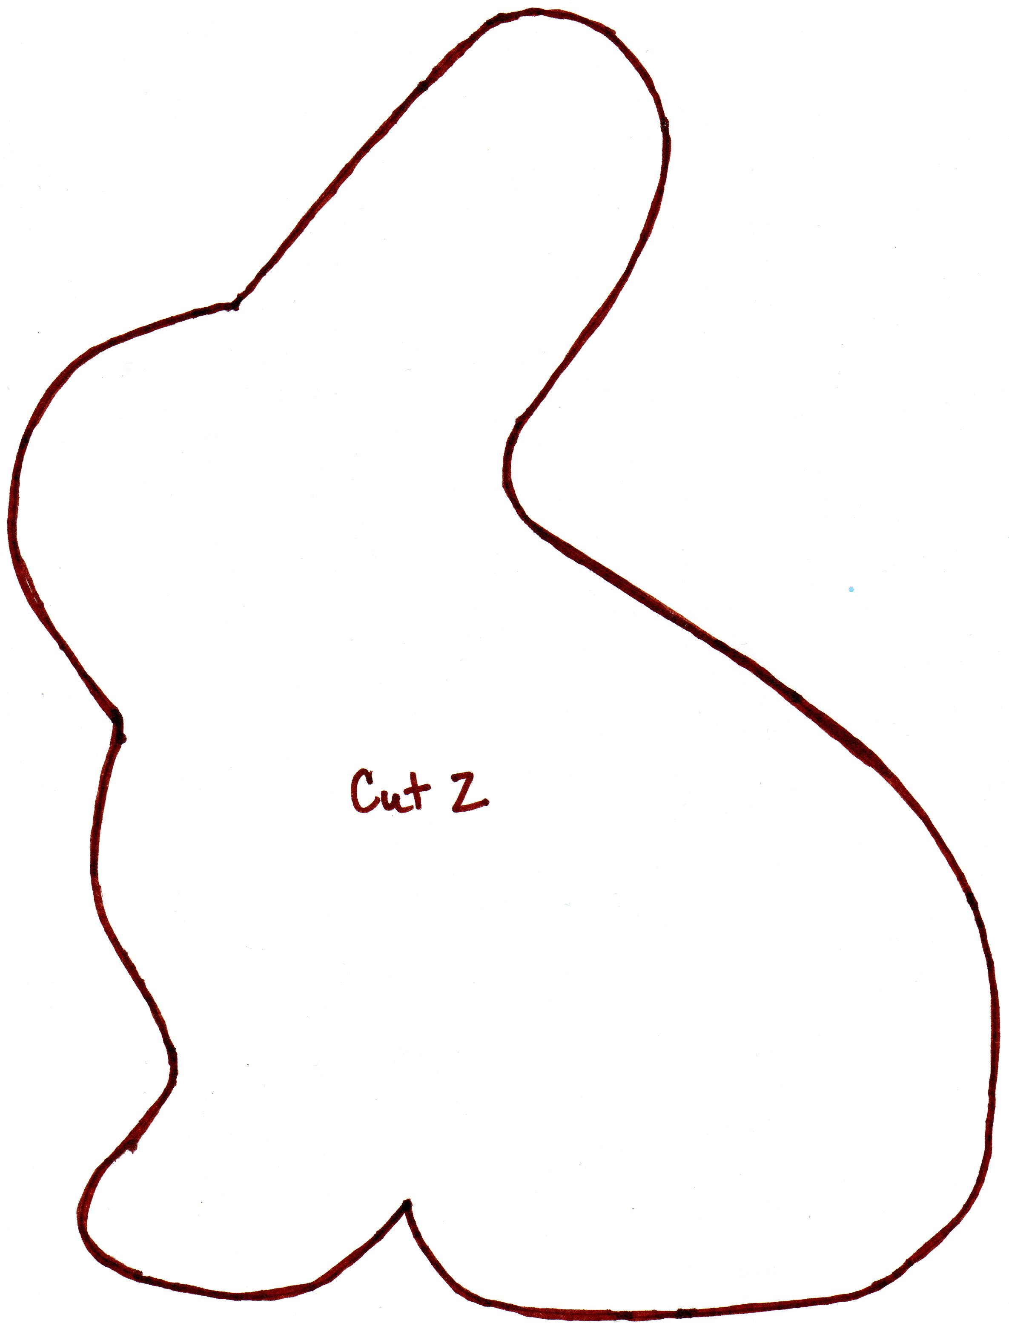
What is an attack pattern?
Pattern: “the regular way in which something happens or is done”
Attack pattern:
Common attributes and approaches employed by adversaries.
Exploit known weaknesses.
Challenges adversary faces and how they go about solving it.
Understand specific elements of an attack and how to stop them from succeeding.
Used to provide a consistent way of classifying and communicating about attacks.
This Photo by Unknown Author is licensed under CC BY-NC-ND
CYBR 271: Secure Programming
Slide
Notes:
"Attack Patterns" are descriptions of the common attributes and approaches employed by adversaries to exploit known weaknesses in cyber-enabled capabilities. Attack patterns define the challenges that an adversary may face and how they go about solving it. They derive from the concept of design patterns applied in a destructive rather than constructive context and are generated from in-depth analysis of specific real-world exploit examples.
Each attack pattern captures knowledge about how specific parts of an attack are designed and executed, and gives guidance on ways to mitigate the attack's effectiveness. Attack patterns help those developing applications, or administrating cyber-enabled capabilities to better understand the specific elements of an attack and how to stop them from succeeding.

Slide 7
Organisation of the library
Views – different perspectives looking at attack patterns
E.g. by mechanism or domain
Categories – collection of attack patterns organised by common characteristic
Patterns at different levels of abstraction:
Meta attack pattern – high level approach
Standard attack pattern – specific methodology or technique
Detailed attack pattern – low level of detail utilising one or standard attack patterns chained together
CYBR 271: Secure Programming
Slide

Slide 8
Views: Domains and Attack Mechanisms
Engage in Deceptive Interactions - (156)
Abuse Existing Functionality - (210)
Manipulate Data Structures - (255)
Manipulate System Resources - (262)
Inject Unexpected Items - (152)
Employ Probabilistic Techniques - (223)
Manipulate Timing and State - (172)
Collect and Analyze Information - (118)
Subvert Access Control - (225)
Software - (513)
Hardware - (515)
Communications - (512)
Supply Chain - (437)
Social Engineering - (403)
Physical Security - (514)
CYBR 271: Secure Programming
Slide

Slide 9
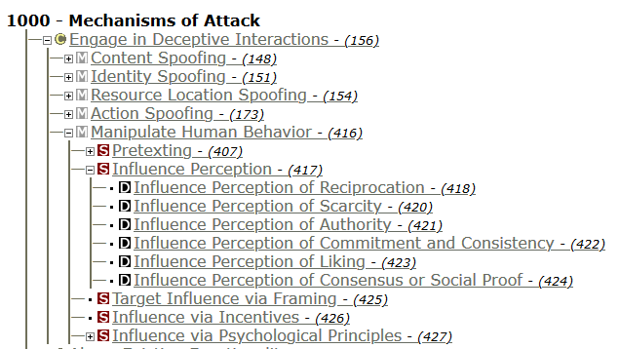
Example: Engage in Deceptive Interactions
Tree representation.
Categories.
Meta attack patterns.
Specific attack patterns.
Detailed attack patterns.
Example: https://capec.mitre.org/data/definitions/1000.html
CYBR 271: Secure Programming
Slide
Notes:
Spend time exploring one of these options – 5 minutes

Slide 10
Comparison
Checklist
CAPEC is less specific so can be applied to wider range of types of systems or problem
STRIDE
STRIDE is a set of security properties to prompt creativity
CAPEC has more specific guidance on attacks and mitigations
Easier for less experienced user to get started
Has lead to the development of tools to help threat modellers, see https://capec.mitre.org/community/usage.html
Apparent completeness might limit creativity of threat models
CYBR 271: Secure Programming
Slide

Slide 11
MITRE other related projects
Common Weakness Enumeration (CWE)– collection of community-sourced vulnerabilities
CAPEC is how the attackers exploit those vulnerabilities
Adversarial Tactics, Techniques & Common Knowledge (ATT&CK)
CAPEC focused on individual attacks
ATT&CK includes how attackers find vulnerabilities, exploit them and maintain access
CYBR 271: Secure Programming
Slide

Slide 12

OWASP top 10 Risks
A list of the top ten web application vulnerabilities
Determined by OWASP and the security community at large
Released every few years
Most recently released in 2017
First release in 2003
CYBR 271: Secure Programming
Slide
Notes:
OWASP refers to the Top 10 as an ‘awareness document’ and they recommend that all companies incorporate the report into their processes in order to minimize and/or mitigate security risks.
The OWASP Top 10-2017 is based primarily on 40+ data submissions from firms that specialize in application security and an industry survey that was completed by over 500 individuals. This data spans vulnerabilities gathered from hundreds of organizations and over 100,000 real-world applications and APIs. The Top 10 items are selected and prioritized according to this prevalence data, in combination with consensus estimates of exploitability, detectability, and impact.

Slide 13
OWASP Top 10 Risks (2017)
A1: Injection
A2: Broken Authentication
A3: Sensitive Data Exposure
A4: XML External Entities (XEE)
A5: Broken Access Control
A6: Security Misconfiguration
A7: Cross-Site Scripting
A8: Insecure Deserialization
A9: Using Components with Known Vulnerabilities
A10: Insufficient Logging and Monitoring
CYBR 271: Secure Programming
Slide
Notes:
These are the top 10 critical risks as of 2017.
The OWASP Top 10 is not set up to resolve every attack in the book, but to help teams avoid the common mistakes which are far more likely to get their applications breached.
A determined attacker can find many avenues to breach their target.
However, the smart risk management advisories do not focus on the minority of cases but instead seek to address the issues facing the widest audience

Slide 14
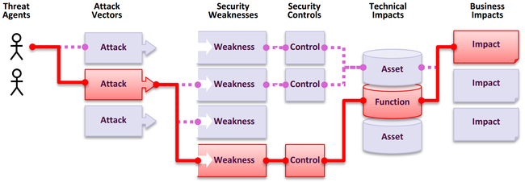
OWASP Top 10 Risk Model
CYBR 271: Secure Programming
Slide
Notes:
Each risk uses terminology based on this model of how attacks can happen, be mitigated and their impact.

Slide 15
Example: Broken Access Control (2017)
Each risk documents:
Threat agents/attack vectors
Security weaknesses
Security controls
Technical and business impacts
https://owasp.org/www-project-top-ten/OWASP_Top_Ten_2017/Top_10-2017_A2-Broken_Authentication
CYBR 271: Secure Programming
Slide
Notes:
This is an interesting list from the perspective of the threat modeler. The list is a good length, and many of these attacks seem like they are well-balanced in terms of attack detail and its power to provoke thought. A few (cross-site scripting and cross-site request forgery) seem overly specific with respect to threat modeling. They may be better as input into test planning.
Each has backing information, including threat agents, attack vectors, security weaknesses, technical and business impacts, as well as details covering whether you are vulnerable to the attack and how you prevent it.

Slide 16
Comparison
Checklist
OWASP is less specific than a checklist supporting it applicability to a wide range of web applications
STRIDE
OWASP has similar issues as CAPEC
Could use them together for a web application to help define threats
CAPEC
OWASP is more specific than CAPEC because of its focus on web applications
CYBR 271: Secure Programming
Slide

Slide 17
Summary
Libraries help people who are less experienced
Difficult to have the “perfect” library for threat modeling
Not too abstract
Not too specific
Useful for education, reviewing the attacks as part of training
Remember that they cannot capture all possible threats
CYBR 271: Secure Programming
Slide

Slide 18
Addressing Threats
Aim is to address or alleviate a problem
Protect customers
Design secure software
Why bother if you:
Create a great model
Identify lots of threats
Stop
So, find problems and fix them
Mitigate, Elminate, Transfer or Accept
CYBR 271: Secure Programming
Slide
Notes:
Accept isn’t a fix but the point is that you make a conscious decision to accept and document it for the person who has to maintain the system after you.

Slide 19
Mitigation
Mitigating a threat is about putting in place countermeasures to make it harder to take advantage of a threat.
Example:
Can access administrative function website via:
http://mysite.com/admin.pho
Can mitigate it by requiring a password
CYBR 271: Secure Programming
Slide
Notes:
Mitigating a threats is about doing things to make itharder to take advantage of a threat. Requiringpasswords to control who can log in mitigates thethreat of spoofing. Adding password controls thatenforce complexity or expiration makes it less likelythat a password will be guessed or usable if stolen.

Slide 20
Elimination
Eliminating threats = redesigning the system
Often comes down to eliminating features.
Example:
Can access administrative function website via:
http://mysite.com/admin.pho
Can mitigate it by requiring a password
What if the password is discovered?
Eliminate the threat by removing the interface requiring administration through the command line
CYBR 271: Secure Programming
Slide
Notes:
Eliminating threats is almost always achieved by eliminating features.
If you have a threat that someone will access the administrative function of a website by visiting the /admin/URL, you can mitigate it with passwords or other authentication techniques, but the threat is still present. You can eliminate it by removing the interface, handling administration through the command line.

Slide 21
Transfer
Transferring threats = let someone else handle the risk
Example:
Can access administrative function website via:
http://mysite.com/admin.pho
Can eliminate by removing feature, but what if we cannot do that?
Transfer the risk “at your own risk”, “you are responsible for what happens if you share your password”, End User Licence Agreements
There are legal limits to this – cannot contract out of liability in the physical world
Contract out responsibility to someone else (RealMe handles Government authentication) – may require a contract with the other party
Share the risk “you are connecting to an untrusted network, do you wish to proceed?”
CYBR 271: Secure Programming
Slide

Slide 22
Accept
Accept threats = accept the outcome of successful attack
Example:
Can access administrative function website via:
http://mysite.com/admin.pho
Assume for some reason cannot eliminate, transfer or accept the risk.
Better example:
People take office supplies home at night.
Mitigations cost more than are lost and searching people isn’t cost effective or a great way to have a happy workplace => accept
CYBR 271: Secure Programming
Slide
Notes:
Accepting the risk is the final approach to addressing threats. For most organizations most of the time, searching everyone on the way in and out of the building is not worth the expense or the cost to the dignity and job satisfaction of those workers.(However, diamond mines and sometimes government agencies take a different approach.)
Similarly, the cost of preventing someone from inserting a back door in the motherboard isexpensive, so for each of these examples you might choose to accept the risk. And once you’ve accepted the risk, you shouldn’t worry over it. Sometimes worry is a sign that the risk hasn’t been fully accepted, or that the risk acceptance was inappropriate..

Slide 23
Process for Addressing Threats
Address each threat
Four ways to address threats
Eliminate through a redesign
Apply standard mitigation
What have similar software packages done and how has that worked out for them?
Invent new mitigations (riskier)
Transfer to risk to someone else – depends upon law, regulation and business requirements
Accept vulnerability in design – depends upon business requirements
CYBR 271: Secure Programming
Slide
Notes:
A list of STRIDE Standard Mitigations is included at the end of the presentation.

Slide 24
Inventing mitigations is hard – don’t do it!
Mitigations are an area of expertise, such as networking, databases, or cryptography
Amateurs make mistakes, but so do pros
Mitigation failures will appear to work
Until an expert looks at them
We hope that expert will work for us
When you need to invent mitigations, get expert help
CYBR 271: Secure Programming
Slide
Notes:
A list of STRIDE Standard Mitigations is included at the end of the presentation.

Slide 25
Example: Microsoft Security Development Lifecycle
Spoofing | Authentication | To authenticate principals: Cookie authentication Kerberos authentication PKI systems such as SSL/TLS and certificates To authenticate code or data: Digital signatures
Tampering | Integrity | Windows Vista Mandatory Integrity Controls ACLs Digital signatures
Repudiation | Non Repudiation | Secure logging and auditing Digital Signatures
Information Disclosure | Confidentiality | Encryption ACLS
Denial of Service | Availability | ACLs Filtering Quotas
Elevation of Privilege | Authorization | ACLs Group or role membership Privilege ownership Input validation
CYBR 271: Secure Programming
Slide
Notes:
A list of STRIDE Standard Mitigations is included at the end of the presentation.

Slide 26
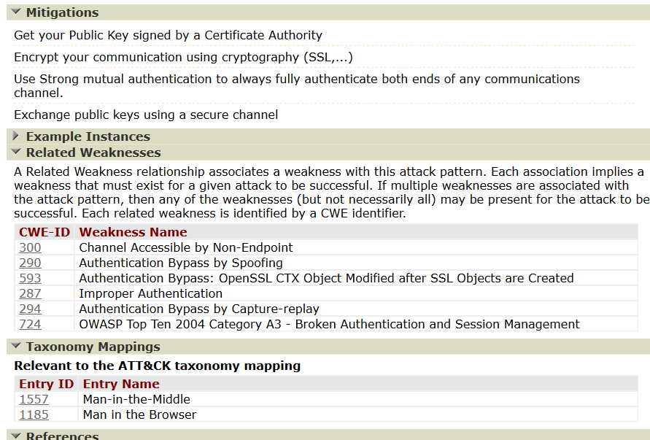
Example: CAPEC Man in the Middle Attack
Mitigations but also weaknesses that must be present and information on the tactics used by the attacker.
Defender would try and eliminate the weaknesses and find ways to disrupt the tactics. https://capec.mitre.org/data/definitions/94.html
CYBR 271: Secure Programming
Slide
Notes:
A list of STRIDE Standard Mitigations is included at the end of the presentation.

Slide 27
Ranking Threats
How do you choose which one to spend the money on if you have limited resources?
Risk ranking methods
Estimate the cost of the problem
CYBR 271: Secure Programming
Slide
Notes:
ccepting the risk is the final approach toaddressing threats. For most organizations most ofthe time, searching everyone on the way in and outof the building is not worth the expense or the costto the dignity and job satisfaction of those workers.(However, diamond mines and sometimesgovernment agencies take a different approach.)Similarly, the cost of preventing someone frominserting a back door in the motherboard isexpensive, so for each of these examples you mightchoose to accept the risk.And once you’ve accepted the risk, you shouldn’tworry over it. Sometimes worry is a sign that therisk hasn’t been fully accepted, or that the riskacceptance was inappropriate..

Slide 28
That’s it

Slide 29
DREAD
How do you choose which one to spend the money on if you have limited resources?
Risk ranking methods
Estimate the cost of the problem
CYBR 271: Secure Programming
Slide
Notes:
DREAD

Slide 30
DREAD
How do you choose which one to spend the money on if you have limited resources?
Risk ranking methods
Estimate the cost of the problem
CYBR 271: Secure Programming
Slide
Notes:
CVSS

Slide 31
DREAD
How do you choose which one to spend the money on if you have limited resources?
Risk ranking methods
Estimate the cost of the problem
CYBR 271: Secure Programming
Slide
Notes:
OWASP

Slide 32
Probabilistic
How do you choose which one to spend the money on if you have limited resources?
Risk ranking methods
Estimate the cost of the problem
CYBR 271: Secure Programming
Slide
Notes:
OWASP

