Slide 1

School of
Engineering and Computer Science
Te Kura Mātai Pūkaha, Pūrorohiko
CYBR 271 T2 2020 Secure Programming
Security code reviews Ian Welch, Harith Al-Sahaf
Chapter 20 from Writing Secure Code by Michael Howard and David LeBlanc 2002
Notes:
Michael Howard (first)
David LeBlanc (Microsoft).

Slide 2
Security code review
Security code review is the process of auditing the source code for an application to verify that the proper security controls are present, that they work as intended, and that they have been invoked in all the right places. Code review is a way of ensuring that the application has been developed so as to be “self-defending” in its given environment.
OWASP project: https://www.owasp.org/index.php/Code_Review_Introduction
Notes:
https://www.owasp.org/index.php/Code_Review_Introduction
https://docs.microsoft.com/en-gb/azure/devops/learn/devops-at-microsoft/code-reviews-not-primarily-finding-bugs

Slide 3
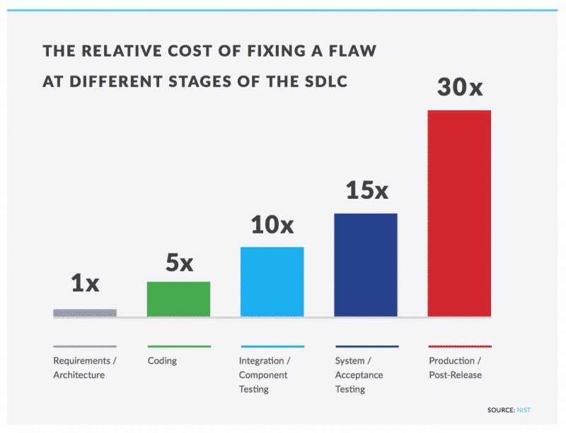
Why perform code reviews?
Sooner you find a security issue.
Easier it is to fix, same principles as software bugs.
Cost at different stages of the Software Development Life Cycle (SDLC)
https://www.checkmarx.com/2016/02/26/security-testing-sdlc-beginners-guide/
Notes:
https://www.nowsecure.com/blog/2017/05/10/level-up-mobile-app-security-metrics-to-measure-success/

Slide 4
Secure code review
Considered as part of the security testing process.
Integrated into standard code review process.
Audit the application to verify security controls are present.
Ideally done during coding phase but often left to the end of the coding phase (if done at all!)
Notes:
https://docs.microsoft.com/en-gb/azure/devops/learn/devops-at-microsoft/code-reviews-not-primarily-finding-bugs
https://www.owasp.org/index.php/Code_Review_Introduction

Slide 5
Source Analysis Tools
Source analysis tools – analyze source code or compiled versions of code to help find security flaws.
Also known as Static Application Security Testing (SAST) Tools.
Examples: https://owasp.org/www-community/Source_Code_Analysis_Tools
Notes:
https://www.checkmarx.com/2016/02/05/5-best-practices-perfect-secure-code-review/

Slide 6
Coverity
https://www.synopsys.com/software-integrity/security-testing/static-analysis-sast.html
Marketing video:
https://youtu.be/bkcGVkrtOQI
Notes:
https://www.checkmarx.com/2016/02/05/5-best-practices-perfect-secure-code-review/

Slide 7
Manual versus automated
Manual – human auditor:
can find logical flaws related to context
better at finding authorization and authentication problems
expensive in terms of resources if done at the end of the process
Automated - static code analysis tools:
detects low-hanging fruits like SQL injection etc.
scales well, test quickly and in large chucks of code
false negatives and false positives
Notes:
https://www.checkmarx.com/2016/02/05/5-best-practices-perfect-secure-code-review/

Slide 8
Code review variations
Inspection: A more formalized code review with:
roles (moderator, author, reviewer, scribe, etc.)
several reviewers looking at the same piece of code
specific expected outcomes (e.g. report, list of defects)
Walkthrough: informal discussion of code between author and a single reviewer
Code reading: reviewers look at code by themselves (possibly with no actual meeting)
Notes:
https://www.checkmarx.com/2016/02/05/5-best-practices-perfect-secure-code-review/

Slide 9
Standards and checklists
Key components in the secure code review
Organisations might adopt cyber security standards
NIST Cybersecurity framework and publications
New Zealand Information Security Manual (GCSB)
Payment card industry data security standard (PCI)
Coding standards and checklists
Common Weakness Enumeration list (MITRE)
SANS Institute “Top 25 Most Dangerous Software Errors”
MISRA C 2012
CERT C , C++ and Java Standards
OWASP Secure Coding Practices Checklist
Notes:
https://blog.parasoft.com/a-guide-to-the-jungle-of-secure-coding-standards
https://www.softwaresecured.com/security-code-review-introduction/
/

Slide 10
Example - checklist
OWASP Secure Coding Practices Checklist
https://www.owasp.org/index.php/OWASP_Secure_Coding_Practices_Checklist
Notes:
https://blog.parasoft.com/a-guide-to-the-jungle-of-secure-coding-standards
https://www.softwaresecured.com/security-code-review-introduction/
/

Slide 11
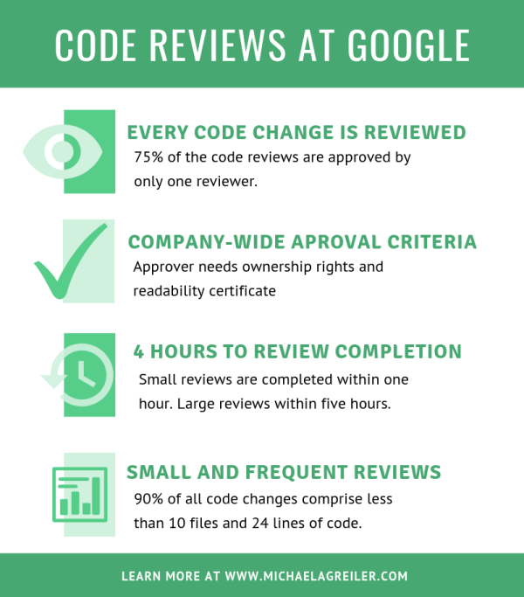
Example - Google
"All code that gets submitted needs to be reviewed by at least one other person, and either the code writer or the reviewer needs to have readability in that language … obviously, we spend a good chunk of our time reviewing code."
-- Amanda Camp, Software Engineer, Google
Notes:
https://blog.parasoft.com/a-guide-to-the-jungle-of-secure-coding-standards
https://www.softwaresecured.com/security-code-review-introduction/
/

Slide 12
Example – Typical Process
Code is prepared for review
Code management tool like git to identify changes to the code base
Use static analysis tool to find the obvious problems before sending for review
Applies linter to identify stylisic errors and enforce a consistent style
Reviewer give feedback
Leaves comments or asks for clarification
Address each comment or reply to comment
Uploads again, repeats review cycle
Reviewer marks it as LGTM (looks good to me)
Notes:
https://www.michaelagreiler.com/code-reviews-at-google/
Counter argument:
https://www.microsoft.com/en-us/research/publication/code-reviews-do-not-find-bugs-how-the-current-code-review-best-practice-slows-us-down/?from=https%3A%2F%2Fresearch.microsoft.com%2Fapps%2Fpubs%2F%3Fid%3D242201

Slide 13
Example - Facebook
"At Facebook, we have an internally-developed web-based tool to aid the code review process. Once an engineer has prepared a change, she submits it to this tool, which will notify the person or people she has asked to review the change, along with others that may be interested in the change -- such as people who have worked on a function that got changed. At this point, the reviewers can make comments, ask questions, request changes, or accept the changes. If changes are requested, the submitter must submit a new version of the change to be reviewed. All versions submitted are retained, so reviewers can compare the change to the original, or just changes from the last version they reviewed. Once a change has been submitted, the engineer can merge her change into the main source tree for deployment to the site during the next weekly push, or earlier if the change warrants quicker release."
- Ryan McElroy, Software Engineer, Facebook

Slide 14
Success stories
11 programs developed by the same group of people
First 5 without reviews: average 4.5 errors per 100 lines of code
Remaining 6 with reviews: average 0.82 errors per 100 lines of code
Errors reduced by >80 percent
IBM’s Orbit project: 500,000 lines, 11 levels of inspections. Delivered early and 1% of the errors that would normally be expected.
(From Steve McConnell’s Code Complete)
Notes:
Note that these are results for ordinary code reviews, they still are quite relevant.

Slide 15
Security testing
A security test is a method of evaluating the security of a computer system or network by methodically validating and verifying the effectiveness of application security controls.
OWASP project: https://www.owasp.org/index.php/Testing:_Introduction_and_objectives
Notes:
Ok, you have reviewed the code but what next?
We are at the point of testing the program.

Slide 16
Security testing
What is the relationship with software testing (e.g. SWEN 221)?

Slide 17
Software testing
Testing
Specification
Development
Program
Code
Why test?
Notes:
From SWEN221
Basically, I try and get them to answer the question!
When they say, to find the bugs! I say: what is a bug?

Slide 18
Software testing
Testing
Specification
Development
Program
Code
Why test?
Code never works first time!
You must test it to find the bugs!
But, what is a bug?
Obvious ones e.g. divide-by-zero
Subtle failures to meet functional specification
Testing only increases confidence in software
It cannot guarantee there are no bugsnce
Notes:
Bugs are defined by the specification

Slide 19

Testing
Edsger Wybe Dijkstra:
“Program testing can be used to show the presence of bugs, but never to show their absence!”
http://www.cs.utexas.edu/users/EWD/

Slide 20
Security testing
Testing
Specification
Development
Program
Code
How is security testing different?
Notes:
Ask them how security testing might be different?

Slide 21
Security testing
Testing
Specification
Development
Program
Code
How is security testing different?
Bugs are caused accidentally
Tester needs to think like the attacker
So, what is a security bug?
Notes:
Ask the for some examples of a security bug.

Slide 22
Security testing
Testing
Security requirements
Development
Program
Code
How is security testing different?
Security bugs are caused deliberately
Tester need to think like th attacker
So, what is a security bug?
spoofing another’s identity
failed to meet the security requirements
Testing still just increases confidence in the software
no guarantee that system is secure against motivated attacker
Notes:
Ask the for some examples of a security bug.

Slide 23
Security testing
Testing
Security requirements
Development
Program
Code
Ordinary testing focuses on ...
Happy path
Unhappy path
is this the same as a security bug?
Notes:
Happy path tests what the users are supposed to do when using an application.
Unhappy paths are the ways that users might break your application.
The difference between this and security testing that it is still about the functionality where a function either works or doesn’t.
Security testing is about the functionality doing something it was never intended to do or operating outside the security policy.
This means that it is even harder to be exhaustive in security testing than ordinary testing.

Slide 24
Security testing
Testing
Security requirements
Development
Program
Code
Ordinary testing focuses on ...
Happy path
Unhappy path
is this the same as a security bug?
No, different because
Paths are about the intended functionality
Unhappy paths are failures due to errors made by programmer
Security bugs are caused deliberately by attacker

Slide 25
Security testing
Testing
Security requirements
Development
Program
Code
Ordinary bugs:
focus on failures most likely to occur
affecting the most users
highest return on investment (tester)
Security bugs are:
focus on less likely to occur failures
meeting the attackers goals
highest return on investment (attacker)

Slide 26
Building Security Test Plans
How do you start?
How do you select where to put your resources?
One approach ... use information from the threat model you developed at the design stage.
Threat model
Security Test Plan

Slide 27
The End.
Notes:
https://docs.microsoft.com/en-gb/azure/devops/learn/devops-at-microsoft/code-reviews-not-primarily-finding-bugs
https://www.owasp.org/index.php/Code_Review_Introduction

