Slide 1
School of
Engineering and Computer Science
Te Kura Mātai Pūkaha, Pūrorohiko
CYBR 271 T2 2020 Secure Programming
Ian Welch, Harith Al-Sahaf
Tutorial – Week 6

Slide 2
Attacks via Environment Variables
How an attacker may use environment variables to exploit vulnerabilities inside a Set-UID programme
What are environment variables?
A special type of inputs
‘Name=value’ pairs
Can be used to pass data from parent processes to the child processes
Used if needed

Slide 3
Attacks via Environment Variables
The user has control on the environment variables
When a Set-UID programme is executed by a normal user in the shell
The environment variables are put into the memory of the Set-UID process
The EUID is set to 0 if the owner of the Set-UID programme is root
The environment variables can effect the behaviour of the Set-UID programme

Slide 4
Attacks via Environment Variables
A simple program to printout the calendar on the shell
A Set-UID programme
Owner=root
We need to understand how the ‘system’ function works
The actual aim of the attacker is to run his own code rather than the ‘cal’ programme
But the Set-UID programme is assumed to be secure as it only executes what the owner (root) has provided
#include <stdlib.h>
int main()
{
system("cal");
return 0;
}

Slide 5
How ‘system’ works
The ‘system’ function invoke a shell process
The shell process executes the ‘cal’ programme
But how will the system find ‘cal’?
It relies on the ‘PATH’ environment variable
The system search the list of folders listed in the PATH variable
The environment variable PATH is controlled by the user
The problem is the user can direct the system where to find the ‘cal’ programme
He only needs to
add ‘.’ (current folder) to the bigning of the PATH variable, and
put his own implementation in a programme named ‘cal’
What can be a potential solution?

Slide 6
IFS Attack
Do not let the shell to search for the programme
Provide the absolute path to the programme
Is this a good/safe solution?
No
There is another environment variable called ‘IFS’
Turns characters into whitespaces
The user can specify which character is treated as a whitespace

Slide 7
IFS Attack
Set the IFS variable to ‘/’
cmd
args

Slide 8
Other methods
In the previous two cases, the user relies on a program that uses the ‘system’ function to run his own code
What if the ‘system’ function is not used, can he run his own code?
YES

Slide 9
Libraries
When the program is compiled into a binary
Self-contained (static linking)
Dependent (dynamic linking)
What are the pros and cons of static and dynamic linking?
Example:
#include <stdio.h>
int main()
{
printf(“hello world");
return(0);
}

Slide 10
Dynamic-link libraries
During the run-time, the system needs to know where to find the external libraries
Problem: if the user can instruct the system where to find those libraries, this will have effect on the linker

Slide 11
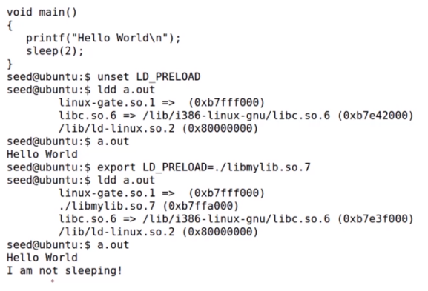
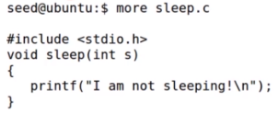
The LD_PRELOAD environment variable
Which means
I can use environment variables to link to my own implementation

Slide 12
Set-UID and libraries
A Set-UID program is a normal program with a special bit
Contains many functions, e.g., printf, that require external libraries
The user needs to
provide his own implementation of some of these functions
Compile as a library
Use environment variables to link his library
Good news
The system provides a protection when a Set-UID program is invoked
The critical environment variables get filtered-out

Slide 13
The end…

