Slide 1
School of
Engineering and Computer Science
Te Kura Mātai Pūkaha, Pūrorohiko
CYBR 271 T2 2020 Secure Programming
Ian Welch, Harith Al-Sahaf
Buffer Overflow – Countermeasures
Du, Wenliang, “Computer & Internet Security: A Hands-on Approach”, 2nd ed, 2019 (Chapter 4)

Slide 2
Outline
The Shellcode
Structure
Challenges/considerations
Content
Buffer overflow countermeasures
Defeating buffer overflow countermeasures

Slide 3
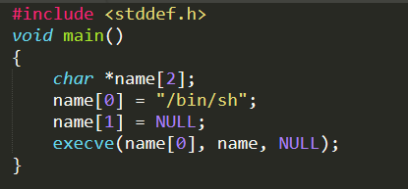
Shellcode
Aim of the malicious code: Allow to run more commands, i.e., to gain access of the system.
Solution: Shell Program
Challenges:
Loader issue
Zeros in the code

Slide 4
Writing Shellcode in Assembly
Assembly code (machine instructions) for launching a shell.
Goal: Use execve(“/bin/sh”,argv,0) to run shell
Registers used:
eax = 0x0000000b (11) : Value of system call execve()
ebx = address to “/bin/sh”
ecx = address of the argument array.
argv[0] = the address of “/bin/sh”
argv[1] = 0 (i.e., no more arguments)
edx = zero (no environment variables are passed).
int 0x80: invoke execve()
ebx
“/bin/sh”
ecx
0
name
edx
0
stack
/bin/sh 0
ebx
esp
0
ebx
ecx
esp

Slide 5
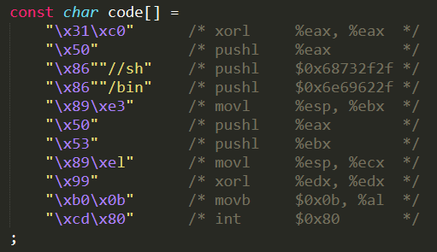
Shellcode (continue)

Slide 6
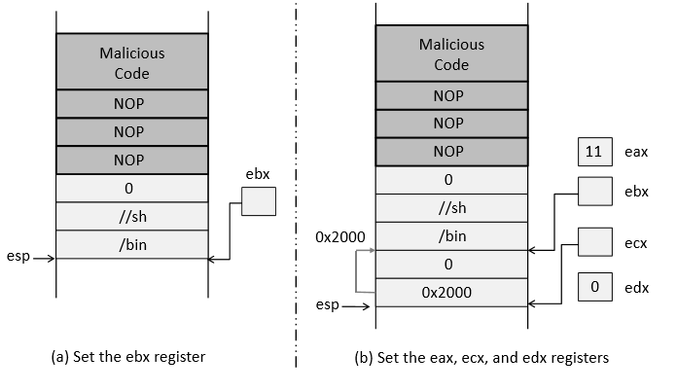
Shellcode (continue)

Slide 7
Countermeasures
OS venders have spent the last 15 years developing more and more mitigations
Developer approaches
OS approaches
ASLR (Address Space Layout Randomization)
Shell program’s defense
Non-Executable Stack
Compiler approaches
Stack-Guard

Slide 8
Developer’s approaches
Check data length
Do not let users set the length; set it yourself (Use of safer functions)
char *strcpy(char *dest, const char *src);
char *strncpy(char *dest, const char *src, size_t n);
char *strcat(char *dest, const char *src);
char *strncat(char *dest, const char *src, size_t n);
int *sprintf(char *str, const char *format, . . .);
int *snprintf(char *str, size_t size, const char *format, . . .);
char *gets(char *s);
char *fgets(char *dest, int size, FILE *stream);
Use safer library (libsafe)
Use safer languages (if you have a choice)
A related attack is Heartbleed

Slide 9
OS Approaches
Address Space Layout Randomization (ASLR)
Principle of ASLR
To randomize the start location of the stack that is every time the code is loaded in the memory, the stack address changes.
Difficult to guess the stack address in the memory.
Difficult to guess %ebp address and address of the malicious code

Slide 10
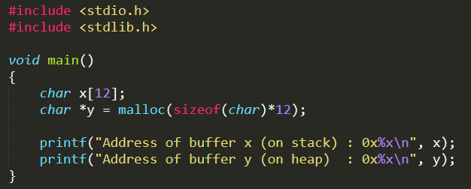
ASLR Impact

Slide 11
ASLR Impact (continue)
1. When set to 0, the address space is not randomized.
1
2
2. When set to 1, only stack memory address is randomized.
3
3. When set to 2, both stack and heap memory address is randomized.

Slide 12
ASLR: Defeat It (settings)
Turn on address randomization (countermeasure)
2. Compile Set-UID root version of stack.c
32-bit -> 2³² space
BUT!!

Slide 13
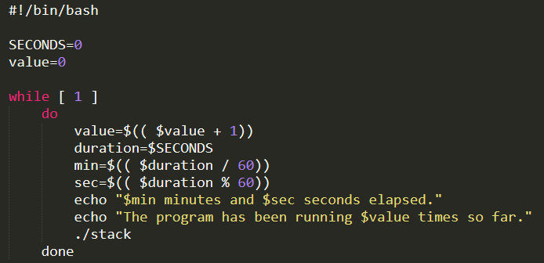
ASLR: Defeat It
Defeat it by running the vulnerable code in an infinite loop

Slide 14
ASLR: Defeat It
On running the script for about 19 minutes on a 32-bit Linux machine, we got the access to the shell (malicious code got executed).

Slide 15

Defeat ASLR in real attacks

Slide 16
Shell program’s defense
Specifically associated with Set-UID programs
The attacker want’s to run the shell
The shell will check the RUID and EUID
The same: allows
Different: downgrade the EUID to RUID
dash has this countermeasure but zsh does not

Slide 17
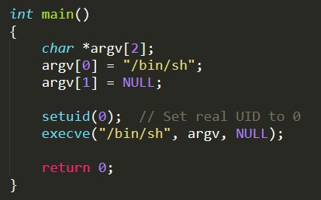
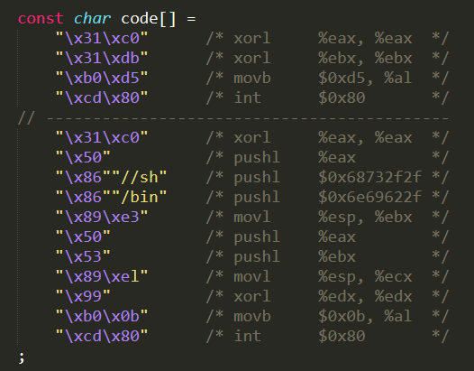
Defeat shell’s countermeasures

Slide 18
Non-executable Stack
NX bit, standing for No-eXecute feature in CPU separates code from data which marks certain areas of the memory as non-executable.
This countermeasure can be defeated using a different technique called Return-to-libc attack
In 1997, the first implementation of non-executable stack was given to Linux
The same author developed the first public attack against non-executable data

Slide 19
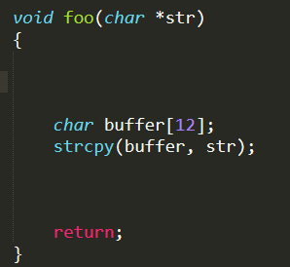
Question
Can you modify the following code, so even if buffer overflow happens, the program still safe?

Slide 20
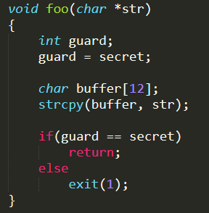
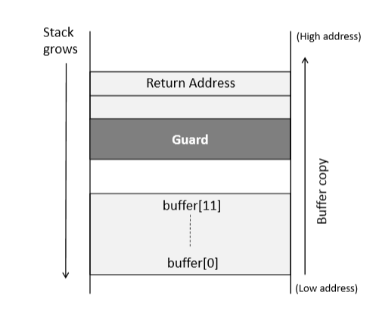
Compiler Approaches (Stack Guard)

Slide 21
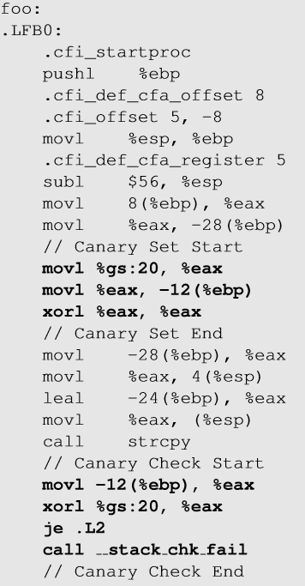
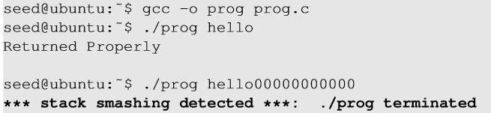
Execution with Stack Guard
Canary check done by compiler.

Slide 22
More and more mitigations
Heap Allocator Hardening
Protecting metadata
Isolating Heaps
Control Flow Integrity
Pointer Authentication
Control Flow Guard

Slide 23
Summary
Buffer overflow shellcode
Structure
Challenges
Content
Defend against buffer overflow attack
Developer approaches
OS approaches
Compiler approaches
Hardware approaches
Defeating some of the countermeasures
Next
Format String attacks

