Slide 1
School of
Engineering and Computer Science
Te Kura Mātai Pūkaha, Pūrorohiko
CYBR 271 T2 2020 Secure Programming
Ian Welch, Harith Al-Sahaf
Format String – Attacks
Du, Wenliang, “Computer & Internet Security: A Hands-on Approach”, 2nd ed, 2019 (Chapter 6)

Slide 2
Outline
Function with varying length of arguments
How format string works
How printf() works
Vulnerability caused by format string
Attacks via format-string vulnerability
Code injection

Slide 3
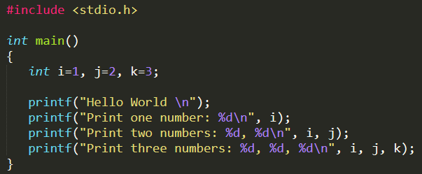
Format string

Slide 4
The definition of the printf() function
NAME
printf, fprintf, dprintf, sprint, snprintf, vprintf, vfprintf, vdprintf, vsprintf, vsnprintf – formatted output conversion
SYNOPSIS

Slide 5
The definition of the printf() function (cont.)
Printf() – To print out a string according to a format.
The argument list of printf() consists of:
One concrete argument format
Zero or more optional arguments
Hence, compilers do not complain if less arguments are passed to printf() during invocation.

Slide 6
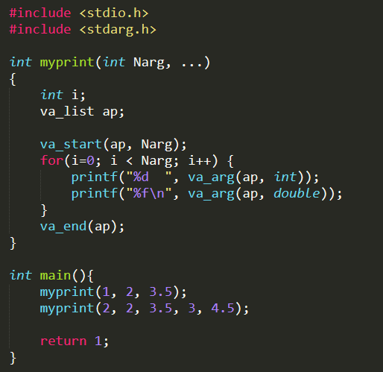
Access optional arguments
myprint() shows how printf() actually works.
Consider myprint() is invoked in line 7.
va_list pointer (line 1) accesses the optional arguments.
va_start() macro (line 2) calculates the initial position of va_list based on the second argument Narg (last argument before the optional arguments begin)
1
2
3
4
5
6
7

Slide 7
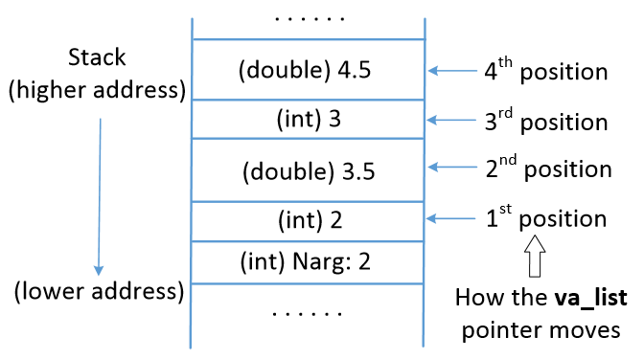
Access optional arguments (cont.)
va_start() macro gets the start address of Narg, finds the size based on the data type and sets the value for va_list pointer.
va_list pointer advances using va_arg() macro.
va_arg(ap, int): Moves the ap pointer (va_list) up by 4 bytes.
When all the optional arguments are accessed, va_end() is called.

Slide 8
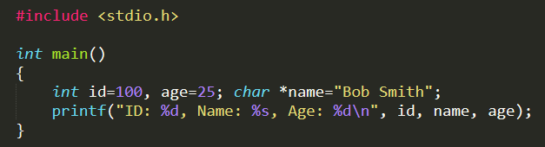
How printf()access optional arguments
Here, printf() has three optional arguments. Elements starting with “%” are called format specifiers.
printf() scans the format string and prints out each character until “%” is encountered.
printf() calls va_arg(), which returns the optional argument pointed by va_list and advances it to the next argument.

Slide 9
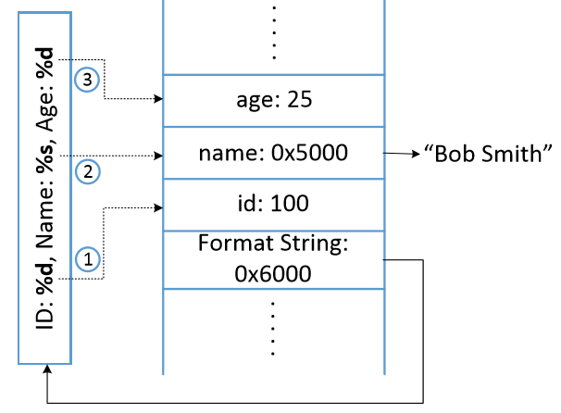
How printf()access optional arguments
When printf() is invoked, the arguments are pushed onto the stack in reverse order.
When it scans and prints the format string, printf() replaces %d with the value from the first optional argument and prints out the value.
va_list is then moved to the position 2.

Slide 10
Format specifiers
Specifier | Meaning | Passed as | Example
%d | decimal (int) | value | 392
%u | unsigned decimal (unsigned int) | Value | 7235
%x | hexadecimal (unsigned int) | Value | 7fa
%s | String ((const) (unsigned) char *) | Reference | Sample
%n | Number of bytes written so far,(* int) | Reference

Slide 11
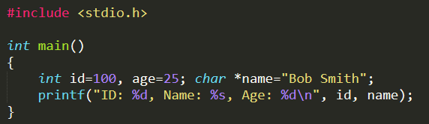
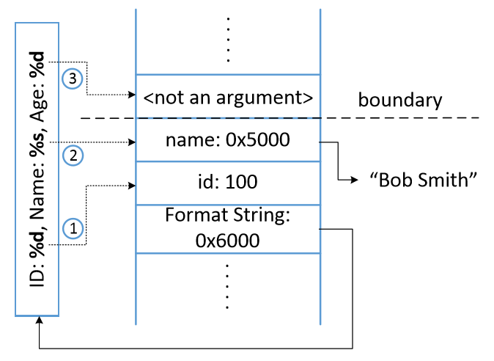
Missing optional arguments
It can lead to memory read/write
va_arg() macro doesn’t understand if it reached the end of the optional argument list.
It continues fetching data from the stack and advancing va_list pointer.

Slide 12
Untrusted user input becomes format string
Format string treated as code
A fundamental security principle
Do not treat user data as code
Read from memory
Format string:
code
Write to memory
User input
code
Format string

Slide 13


Format string vulnerability
In these three examples, user’s input (user_input) becomes part of a format string.
Q: What will happen if user_input contains format specifiers?

Slide 14
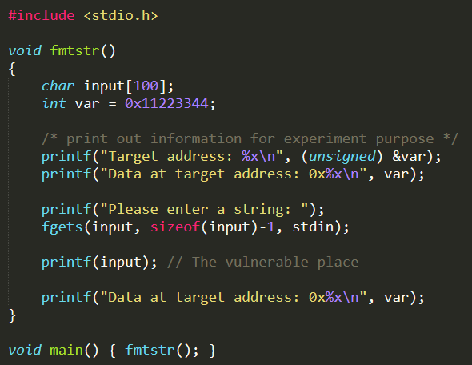
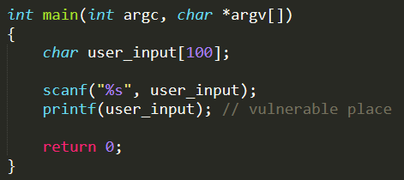
Vulnerable (Set-UID) codes

Slide 15
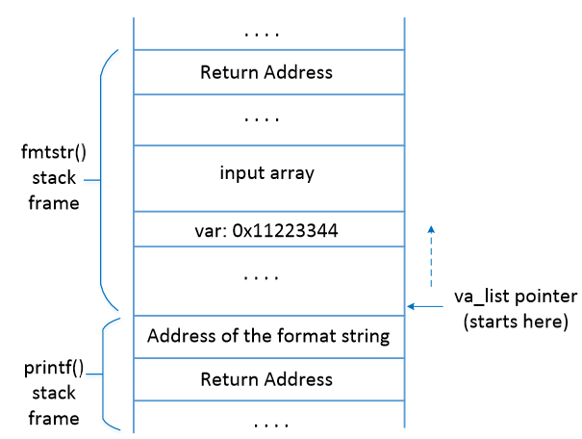
Vulnerable program’s stack layout
Inside printf(), the starting point of the optional arguments (va_list pointer) is the position right above the format string argument.

Slide 16
What can we achieve?
Attack 1: Crash program
Attack 2: Print out data on the stack
Attack 3: Change the program’s data in the memory
Attack 4: Change the program’s data to specific value
Attack 5: Inject malicious code

Slide 17
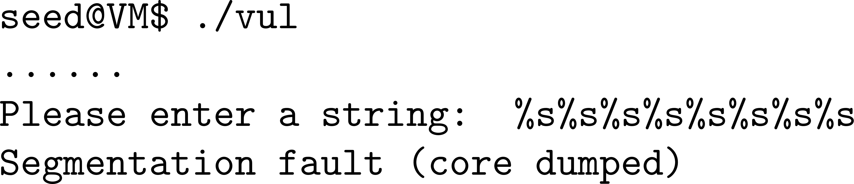
Crash Program
Use input: %s%s%s%s%s%s%s%s
printf()parses the format string.
For each %s, it fetches a value where va_list points to and advances va_list to the next position.
As we give %s, printf() treats the value as address and fetches data from that address. If the value is not a valid address, the program crashes.

Slide 18
Print out data on the stack
Suppose a variable on the stack contains a secret (constant) and we need to print it out.
Use user input: %x%x%x%x%x%x%x%x
printf() prints out the integer value pointed by va_list pointer and advances it by 4 bytes.
Number of %x is decided by the distance between the starting point of the va_list pointer and the variable. It can be achieved by trial and error.

Slide 19
Print out data on the stack (cont.)
Print out secret value on the stack
}
0xaabbccdd
20 bytes

Slide 20
Print out data not on the stack
How do you print out a secret string that is NOT stored on the stack, but its address is stored on the stack?

Slide 21
Print out data at a specific address
How do you print out some secret value stored at address 0xBFFFF304, but this address is NOT stored on the stack?

Slide 22
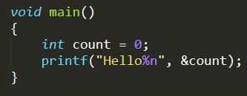
Memory modification via format string
Goal: change the value of var variable from 0x11223344 to some other value.
%n: Writes the number of characters printed out so far into memory.
printf(“Hello%n”,&count) ⇒ When printf() gets to %n, it has already printed 5 characters, so it stores 5 to the provided memory address.
%n treats the value pointed by the va_list pointer as a memory address and writes into that location.
Hence, if we want to write a value to a memory location, we need to have it’s address on the stack.

Slide 23
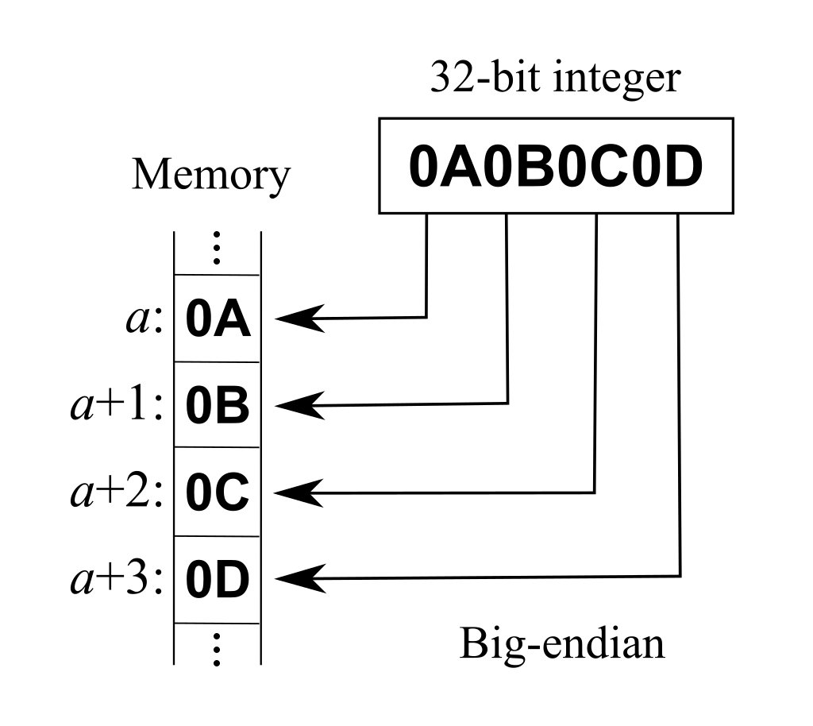
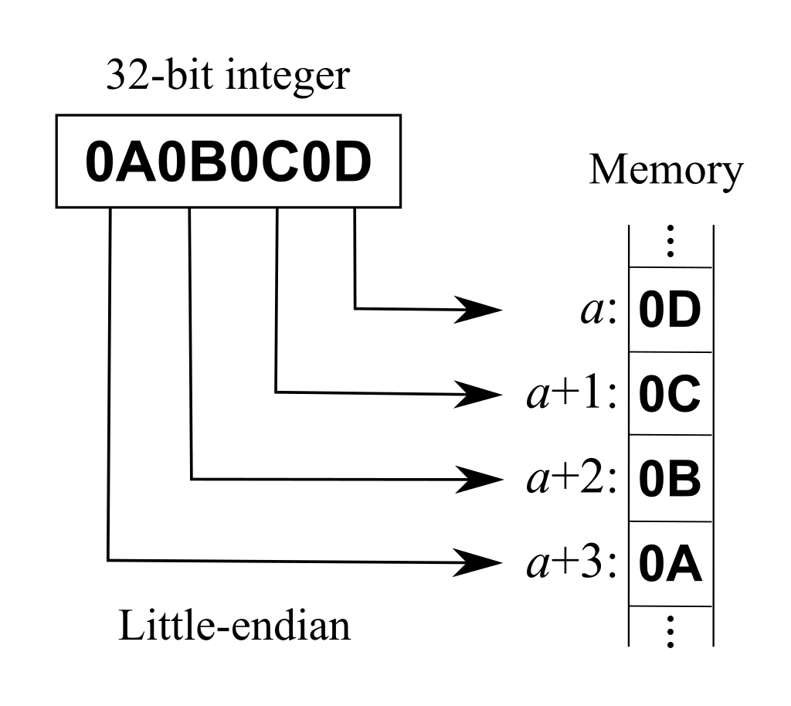
Endianness
Definition: “is the order or sequence of bytes of a word of digital data in computer storage.” (Wikipedia)
Big-endian (BE)
The most significant byte at the smallest memory address
The least significant byte at the largest memory address
Little-endian (LE)
The most significant byte at the largest memory address
The least significant byte at the smallest memory address
https://en.wikipedia.org/wiki/Endianness

Slide 24
Change program’s data in the memory
Assuming the address of var is 0xbffff304 (can be obtained using gdb)
The address of var is given in the beginning of the input so that it is stored on the stack.
$(command): Command substitution. Allows the output of the command to replace the command itself.
“\x04” : Indicates that “04” is an actual number and not as two ascii characters

Slide 25
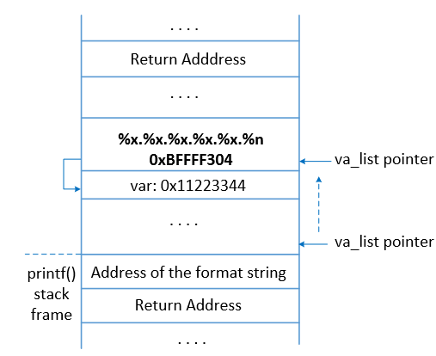
Change program’s data in the memory (cont.)
var’s address (0xbffff304) is on the stack.
Goal : To move the va_list pointer to this location and then use %n to store some value.
%x is used to advance the va_list pointer.
How many %x are required?

Slide 26
Change program’s data in the memory (cont.)
Using trial and error, we check how many %x are needed to print out 0xbffff304.
Here we need 6 format specifiers, indicating 5 %x and 1 %n.
After the attack, data in the target address is modified to 0x2c (44 in decimal).
Because 44 characters have been printed out before %n.

Slide 27
Summary
How format string works
Format string vulnerability
Exploiting the vulnerability
Next
Exploiting the vulnerability (continue)
Injecting malicious code by exploiting the vulnerability
Format string countermeasures

