Slide 1
School of
Engineering and Computer Science
Te Kura Mātai Pūkaha, Pūrorohiko
CYBR 271 T2 2020 Secure Programming
Ian Welch, Harith Al-Sahaf
Format String – Countermeasures
Du, Wenliang, “Computer & Internet Security: A Hands-on Approach”, 2nd ed, 2019 (Chapter 6)

Slide 2
Outline
How to exploit the vulnerability
Countermeasures

Slide 3
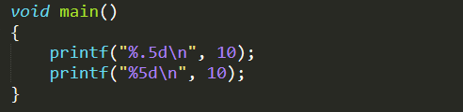
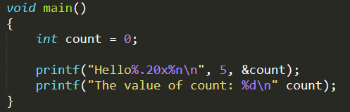
The width modifier and the %n format specifier
The width modifier
Combine it with %n

Slide 4
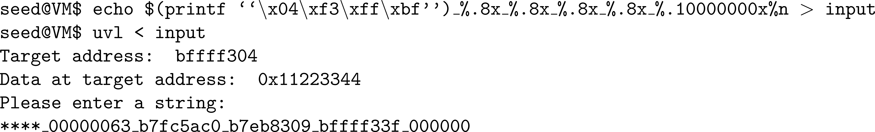
Change program’s data to a specific value
Goal: To change the value of var from 0x11223344 to 0x9896a9
printf() has already printed out 41 characters before %.10000000x, so, 10000000+41 = 10000041 (0x9896a9) will be stored in 0xbffff304.

Slide 5
Modify two memory locations with specific values
How do you modify the data stored at address 0xBFFFF304 with value 0x6688, and the data stored at address 0xBFFFF360 with value 0x7799? You can only use one format string.

Slide 6
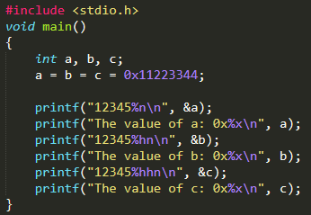
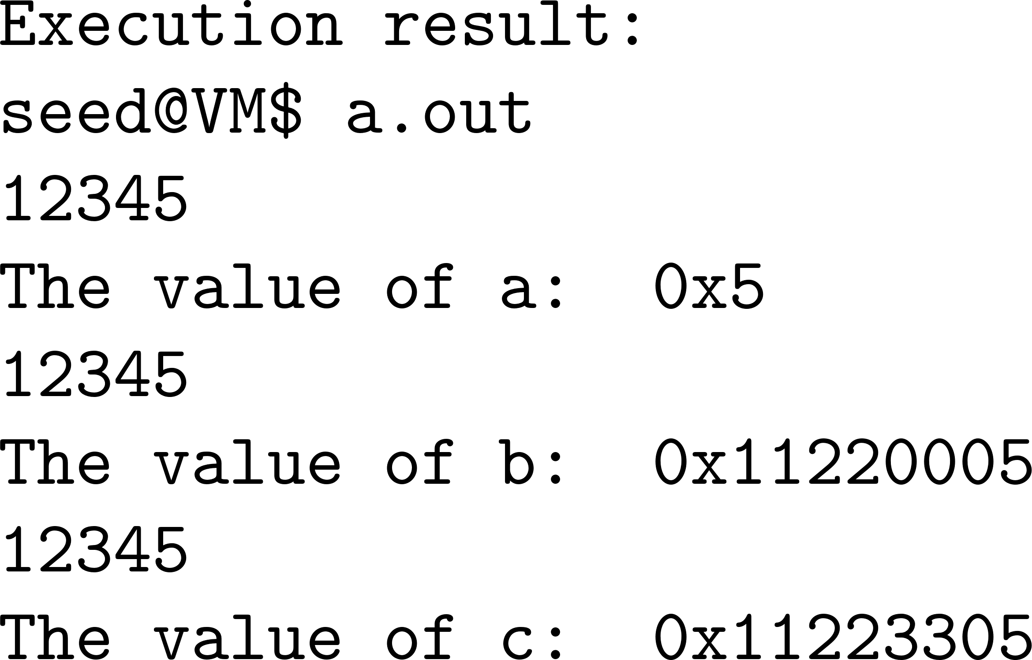
The length modifiers for %n
%n : Treats argument as a 4-byte integer
%hn : Treats argument as a 2-byte short integer. Overwrites only 2 significant bytes of the argument.
%hhn : Treats argument as a 1-byte char type. Overwrites the least significant byte of the argument.

Slide 7
A faster approach
Goal: change the value of var to 0x66887799
Use %hn to modify the var variable two bytes at a time.
Break the memory of var into two parts, each with two bytes.
Most computers use the Little-Endian architecture
The 2 least significant bytes (0x7799) are stored at address 0xbffff304
The 2 significant bytes (0x6688) are stored at 0xbffff306
If the first %hn gets value x, and before the next %hn, t more characters are printed, the second %hn will get value x+t.

Slide 8
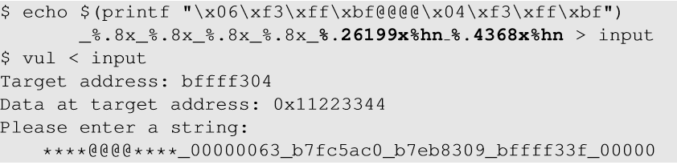
A faster approach (cont.)
Overwrite the bytes at 0xbffff306 with 0x6688.
Print some more characters so that when we reach 0xbffff304, the number of characters will be increased to 0x7799.

Slide 9
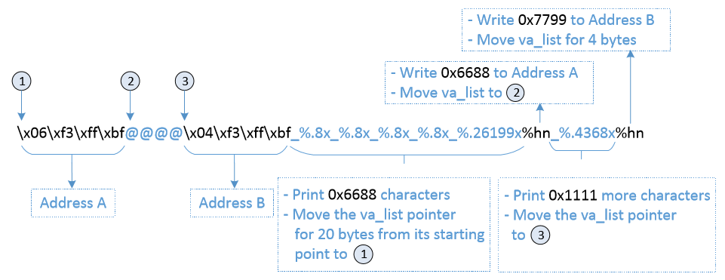
A faster approach (cont.)
Address A : first part of address of var ( 4 chars )
Address B : second part of address of var ( 4 chars)
4 %.8x : To move va_list to reach Address 1 (Trial and error, 4x8=32)
@@@@ : 4 chars
5 _ : 5 chars
Total : 12+5+32 = 49 chars

Slide 10
A faster approach (cont.)
To print 0x6688 (26248), we need 26248 - 49 = 26199 characters as precision field of %x.
If we use %hn after first address, va_list will point to the second address and same value will be stored.
Hence, we put @@@@ between two addresses so that we can insert one more %x and increase the number of printed characters to 0x7799.
After first %hn, va_list pointer points to @@@@, the pointer will advance to the second address. Precision field is set to 4368=30617-26248-1 in order to print 0x7799 (30617) when we reach second %hn.

Slide 11
Inject malicious code
Goal
To modify the return address of the vulnerable code and let it point it to the malicious code (e.g., shellcode to execute /bin/sh). Get root access if vulnerable code is a SET-UID program.
Challenges
Inject Malicious code in the stack
Find starting address (A) of the injected code
Find return address (B) of the vulnerable code
Write value A to B

Slide 12
Inject malicious code (cont.)
Using gdb to get the return address and start address of the malicious code.
Assume that the return address is 0xbffff38c
Assume that the start address of the malicious code is 0xbffff358
Goal : Write the value 0xbffff358 to address 0xbffff38c
Steps :
Break 0xbffff38c into two contiguous 2-byte memory locations : 0xbffff38c and 0xbffff38e.
Store 0xbfff into 0xbffff38e and 0xf358 into 0xbffff38c

Slide 13
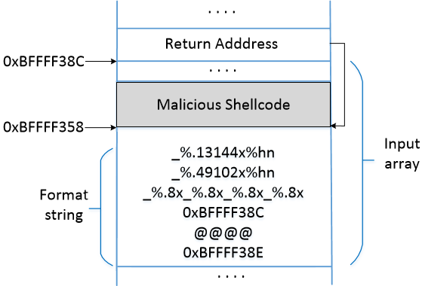
Inject malicious code (cont.)
Number of characters printed before first %hn
= 12 + (4x8) + 5 + 49102
= 49151 (0xbfff).
After first %hn,
13144 + 1 = 13145 are printed
49151 + 13145 = 62296 (0xbffff358) is printed on 0xbffff38c

Slide 14
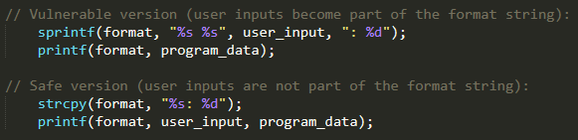
Countermeasures: Developer
Avoid using untrusted user inputs for format strings in functions like
printf()
sprintf()
fprintf()
vprintf()
scanf()
vfscanf()
Fundamental problem

Slide 15
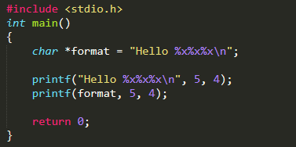
Countermeasure: Compiler
Compilers can detect potential format string vulnerabilities
Use two compilers to compile the program: gcc and clang.
We can see that there is a mismatch in the format string.
1
2

Slide 16
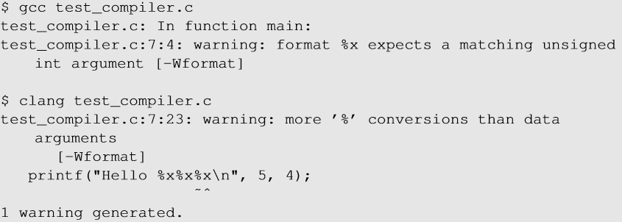
Countermeasure: Compiler (cont.)
With default settings, both compilers gave warning for the first printf().
No warning was given out for the second one.

Slide 17
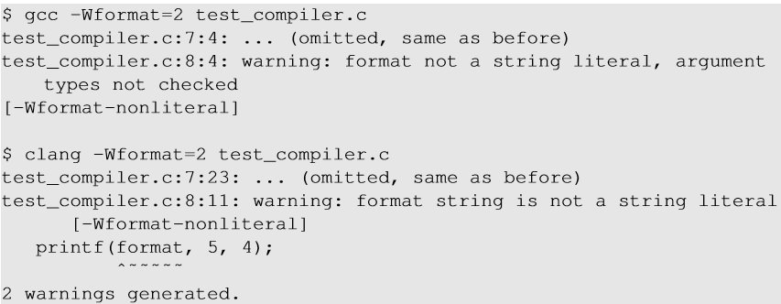
Countermeasure: Compiler (cont.)
On giving an option -wformat=2, both compilers give warnings for both printf statements stating that the format string is not a string literal.
These warnings just act as reminders to the developers that there is a potential problem but nevertheless compile the programs.

Slide 18
Countermeasures (cont.)
Address randomization: Makes it difficult for the attackers to guess the address of the target memory (return address, address of the malicious code)
Non-executable Stack/Heap: This will not work. Attackers can use the return-to-libc technique to defeat the countermeasure.
StackGuard: This will not work. Unlike buffer overflow, using format string vulnerabilities, we can ensure that only the target memory is modified; no other memory is affected.

Slide 19
Summary
Exploiting the vulnerability
Injecting malicious code by exploiting the vulnerability
Countermeasures
Developer
Compiler
Next
SQL-injection: Attacks and countermeasures

