Slide 1
School of
Engineering and Computer Science
Te Kura Mātai Pūkaha, Pūrorohiko
CYBR 271 T2 2020 Secure Programming
Ian Welch, Harith Al-Sahaf
SQL-injection – Attacks
Du, Wenliang, “Computer & Internet Security: A Hands-on Approach”, 2nd ed, 2019 (Chapter 12)

Slide 2
Outline
Web application components
Brief tutorial of SQL
SQL-injection attack

Slide 3
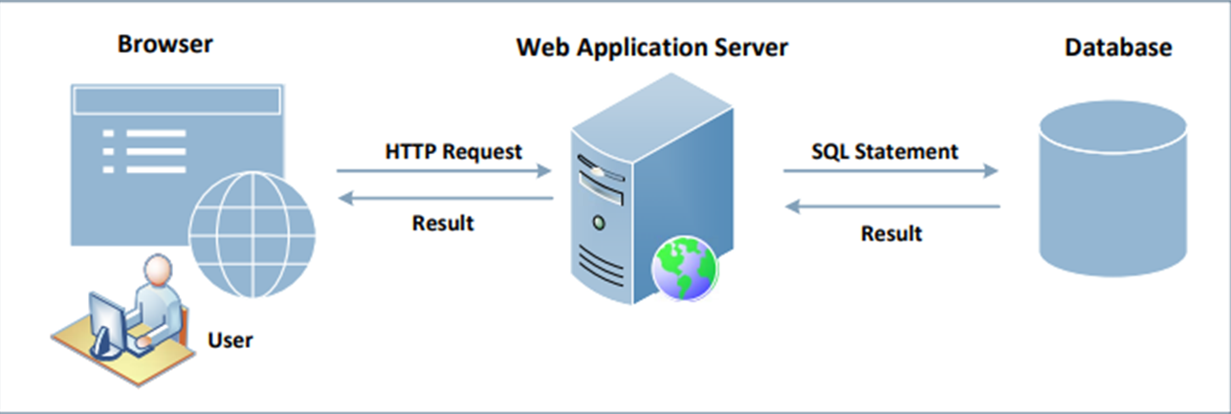
Interacting with database in web application
A typical web application consists of three major components:

Slide 4
Brief tutorial of SQL
Log in to MySQL: We will use MySQL database, which is an open-source relational database management system. We can log in using the following command:
Create a Database: Inside MySQL, we can create multiple databases. “SHOW DATABSES” command can be used to list existing databases. We will create a new database called dbtest:

Slide 5
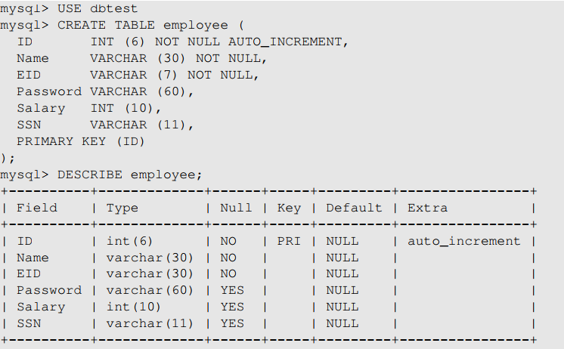
SQL tutorial: Create a table
A relational database organises its data using tables. Let us create a table called employee with seven attributes (i.e. columns) for the database “dbtest”
We need to let the system know which database to use as there may be multiple databases
After a table is created, we can use DESCRIBE (or DESC) to display the structure of the table

Slide 6
SQL tutorial: Insert a row
We can use the INSERT INTO statement to insert a new record into a table :
Here, we insert a record into the “employee” table.
We do not specify a value of the ID column, as it will be automatically set by the database.

Slide 7
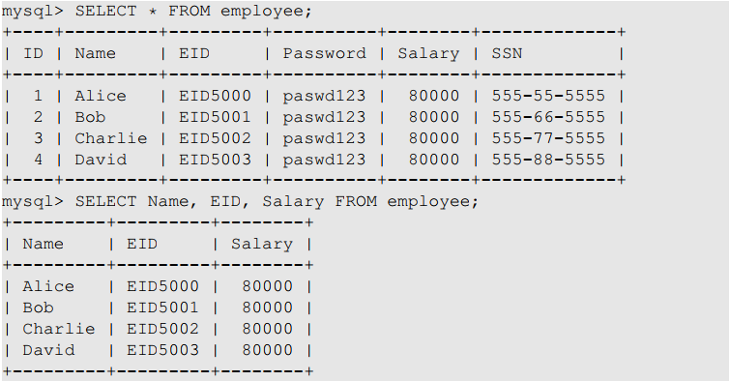
SQL tutorial: SELECT statement
The SELECT statement is the most common operation on databases
It retrieves information from a database
Asks the database for all its records, including all the columns
Asks the database only for Name, EID and Salary columns

Slide 8
SQL tutorial: WHERE clause
It is uncommon for a SQL query to retrieve all records in a database.
WHERE clause is used to set conditions for several types of SQL statements including SELECT, UPDATE, DELETE etc.
The above SQL statement only reflects the rows for which the predicate in the WHERE clause is TRUE.
The predicate is a logical expression; multiple predicates can be combined using keywords AND and OR.

Slide 9
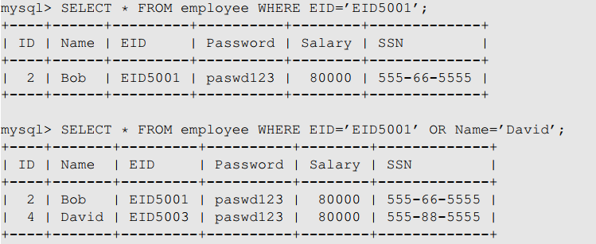
SQL tutorial: WHERE clause (cont.)
The first query returns a record that has EID5001 in EID field
The second query returns the records that satisfy either EID=‘EID5001’ or Name=‘David’

Slide 10
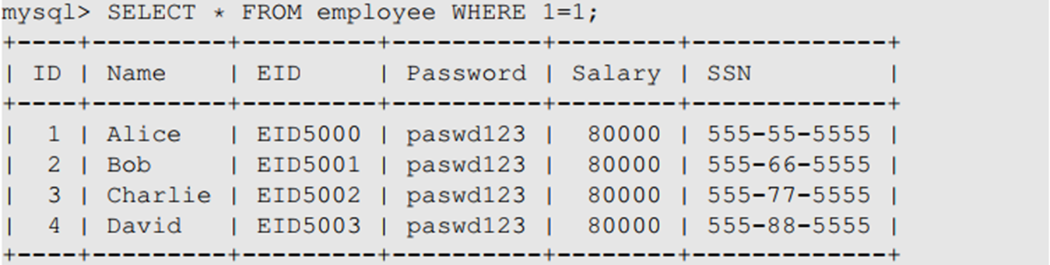
SQL tutorial: WHERE clause (cont.)
If the condition is always TRUE, then all the rows are affected by the SQL statement
This 1=1 predicate looks quite useless in real queries, but it will become useful in SQL-injection attacks

Slide 11
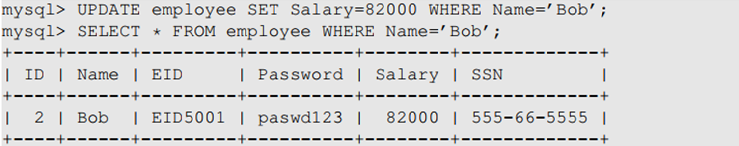
SQL tutorial: UPDATE statement
We can use the UPDATE Statement to modify an existing record

Slide 12
SQL tutorial: Comments
MySQL supports three comment styles
Text from the # character to the end of line is treated as a comment
Text from the “--” to the end of line is treated as a comment.
Similar to C language, text between /* and */ is treated as a comment

Slide 13
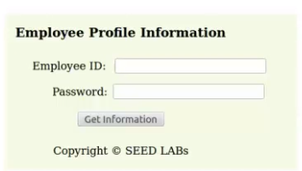
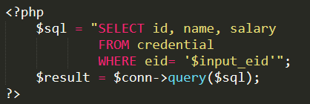
Programming involved

Slide 14
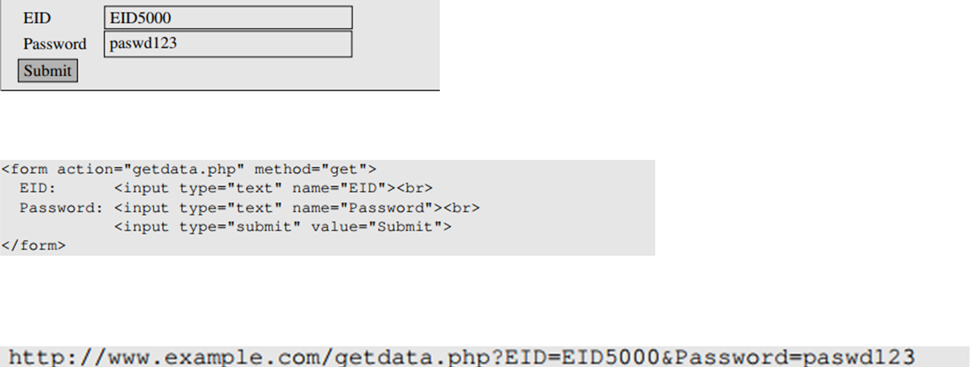
Getting data from user
This example shows a form where users can type their data. Once the submit button is clicked, an HTTP request will be sent out with the data attached
The HTML source of the above form is given below:
Request generated is:

Slide 15
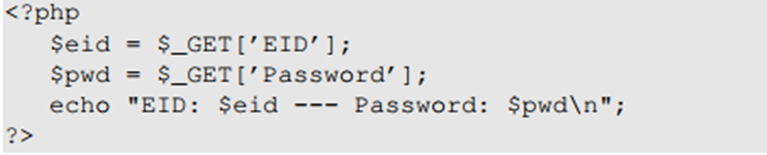
Getting data from user (cont.)
The request shown is an HTTP GET request, because the method field in the HTML code specified the ‘get’ type
In GET requests, parameters are attached after the question mark in the URL
Each parameter has a name=value pair and are separated by “&”
In the case of HTTPS, the format would be similar but the data will be encrypted
Once this request reached the target PHP script, the parameters inside the HTTP request will be saved to an array $_GET or $_POST. The following example shows a PHP script getting data from a GET request

Slide 16
How web applications interact with database
Connecting to MySQL Database
PHP program connects to the database server before conducting query on database.
The code shown here uses new mysqli(…) along with its 4 arguments to create the database connection.

Slide 17
SQL-injection
Typical PHP code
Question
If you do not know any eid, can you get the database return some records?
Conditions:
The syntax is valid
It is true for all record
Work sheet

Slide 18
Lunching SQL-injection attacks
Everything provided by user will become part of the SQL statement. Is it possible for a user to change the meaning of the SQL statement?
The intention of the web app developer by the following is for the user to provide some data for the blank areas.
Assume that a user inputs a random string in the password entry and types “EID5002’#” in the eid entry. The SQL statement will become the following

Slide 19
Lunching SQL-injection attacks (cont.)
Everything from the # sign to the end of line is considered as comment. The SQL statement will be equivalent to the following:
The statement will return the name, salary and SSN of the employee whose EID is EID5002 even though the user doesn’t know the employee’s password. This is security breach.
Let’s see if a user can get all the records from the database assuming that we don’t know all the EID’s in the database.
We need to create a predicate for WHERE clause so that it is TRUE for all records.

Slide 20
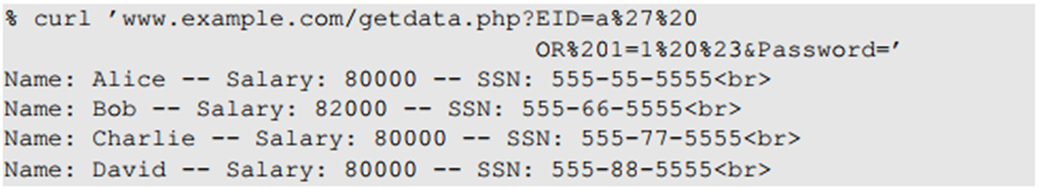
Lunching SQL-injection attacks (cont.)
More convenient to use a command-line tool to launch attacks.
Easier to automate attacks without a graphic user interface.
Using cURL, we can send out a form from a command-line, instead of from a web page.
The above command will not work. In an HTTP request, special characters are in the attached data needs to be encoded or they maybe mis-interpreted.
In the above URL we need to encode the apostrophe(%27), whitespace(%20) and the #(%23) sign and the resulting cURL command is as shown below:

Slide 21
Summary
Typical web application components
Brief tutorial of SQL
SQL-injection attack and how to launch this type of attacks
Next
The fundament cause of the vulnerability
Countermeasures

