Slide 1
School of
Engineering and Computer Science
Te Kura Mātai Pūkaha, Pūrorohiko
CYBR 271 T2 2020 Secure Programming
Ian Welch, Harith Al-Sahaf
SQL-injection – Countermeasures
Du, Wenliang, “Computer & Internet Security: A Hands-on Approach”, 2nd ed, 2019 (Chapter 12)

Slide 2
Outline
Modify Database
Multiple SQL Statements
The Fundamental Cause
Countermeasures

Slide 3
Modify database
If the statement is UPDATE or INSERT INTO, we will have chance to change the database.
Consider the form created for changing passwords. It asks users to fill in three pieces of information, EID, old password and new password.
When Submit button is clicked, an HTTP POST request will be sent to the server-side script changepasswd.php, which uses an UPDATE statement to change the user’s password.

Slide 4
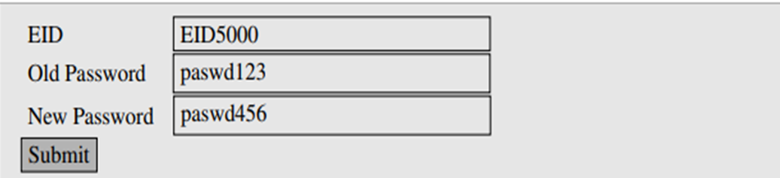
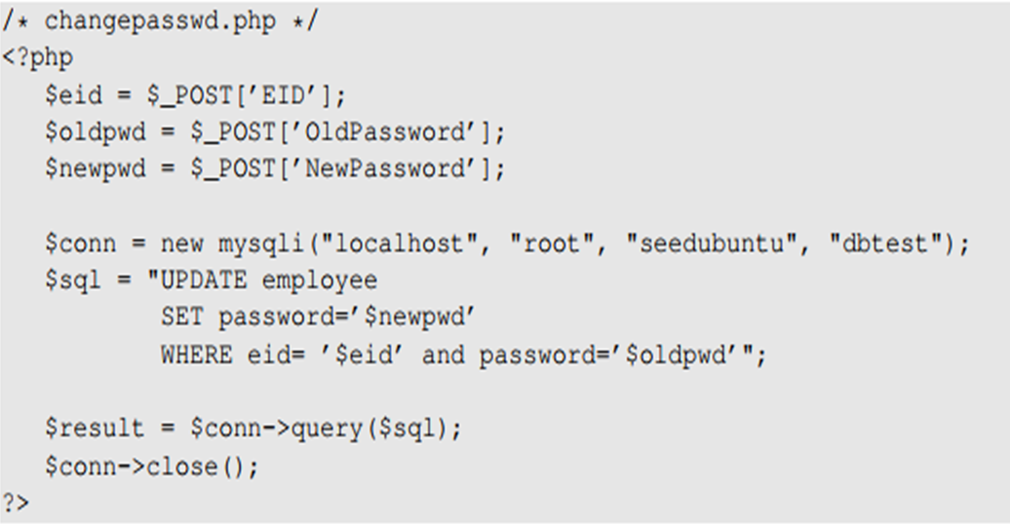

Modify database (cont.)
Can we update other fields or users’ info.?

Slide 5
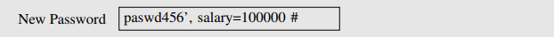


Modify database (cont.)
Let us assume that Alice (EID5000) is not satisfied with the salary she gets. She would like to increase her own salary using the SQL injection vulnerability. She would type her own EID and old password. The following will be typed into the “New Password” box :
By typing the above string in “New Password” box, we get the UPDATE statement to set one more attribute for us, the salary attribute. The SQL statement will now look as follows.
What if Alice doesn’t like Bob and would like to reduce Bob’s salary to 0, but she only knows Bob’s EID (eid5001), not his password. How can she execute the attack?

Slide 6

Multiple SQL statements
Damages that can be caused are bounded, because we cannot change everything in the existing SQL statement.
It will be more dangerous if we can cause the database to execute an arbitrary SQL statement.
To append a new SQL statement “DROP DATABASE dbtest” to the existing SQL statement to delete the entire dbtest database, we can type the following in the EID box
The resulting SQL statement is equivalent to the following, where we have successfully appended a new SQL statement to the existing SQL statement string.
The above attack doesn’t work against MySQL, because in PHP’s mysqli extension, the mysqli::query() API doesn’t allow multiple queries to run in the database server.

Slide 7
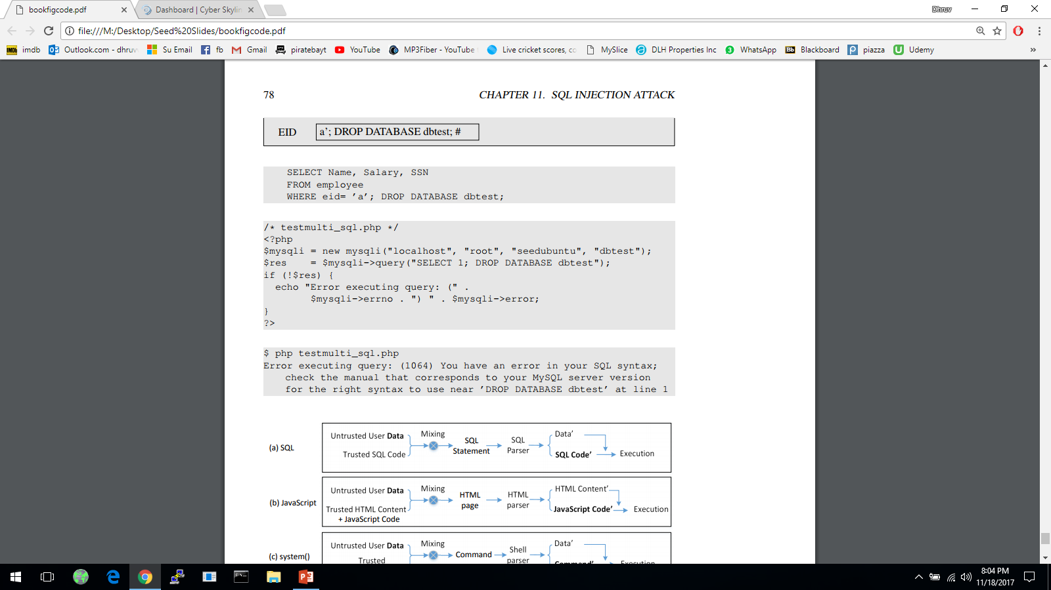
Multiple SQL statements (cont.)
The code below tries to execute two SQL statements using the $mysqli->query() API
When we run the code, we get the following error message:
If we do want to run multiple SQL statements, we can use $mysqli -> multi_query(). [not recommended]

Slide 8

Multiple SQL statements (cont.)

Slide 9
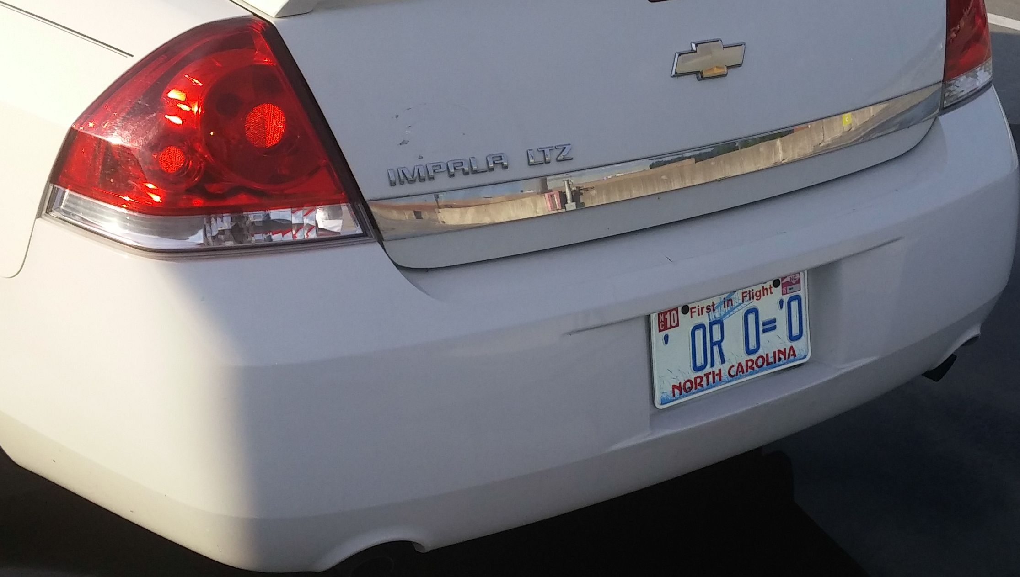
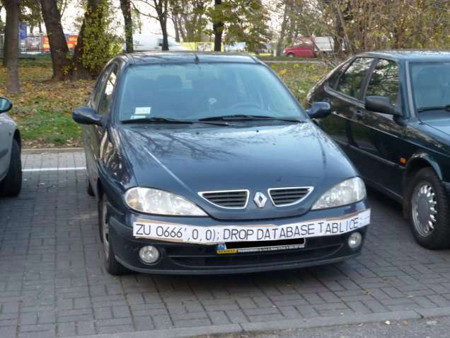

Multiple SQL statements (cont.)

Slide 10
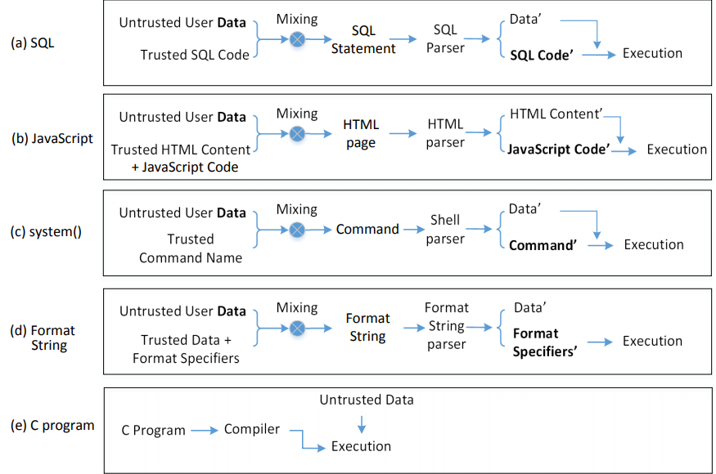
The fundamental cause
Mixing data and code together is the cause of several types of vulnerabilities and attacks including SQL Injection attack, XSS attack, attacks on the system() function and format string attacks.

Slide 11
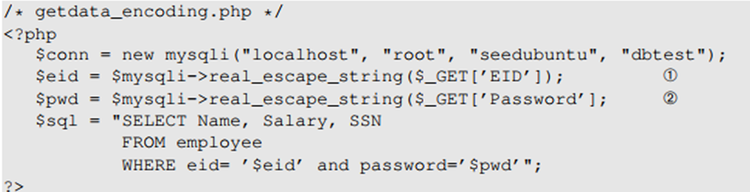
Countermeasures: Filtering and encoding data
Before mixing user-provided data with code, inspect the data. Filter out any character that may be interpreted as code.
Special characters are commonly used in SQL-injection attacks. To get rid of them, encode them.
Encoding a special character tells parser to treat the encoded character as data and not as code.
PHP’s mysqli extension has a built-in method called mysqli::real_escape_string(). It can be used to encode the characters that have special meanings in SQL.
BUT
Data sanitization does not address the fundamental cause of the problem

Slide 12
Countermeasures: Prepared statement
Fundament cause of SQL injection: mixing data and code
Fundament solution: separate data and code.
Main idea: Sending code and data in separate channels to the database server. This way the database server knows not to retrieve any code from the data channel.
How: using prepared statement
Prepared Statement: It is an optimized feature that provides improved performance if the same or similar SQL statement needs to be executed repeatedly. Using prepared statements, we send an SQL statement template to the database, with certain values called parameters left unspecified. The database parses, compiles and performs query optimization on the SQL statement template and stores the result without executing it. We later bind data to the prepared statement

Slide 13
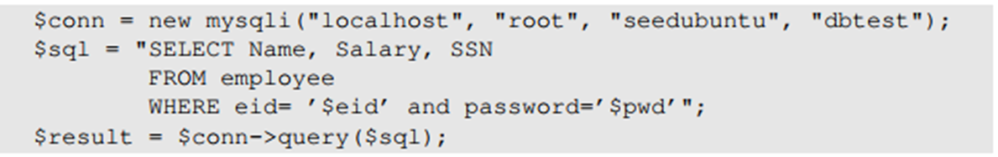
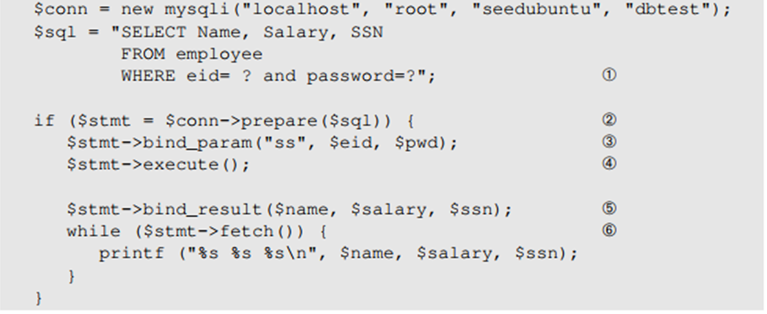
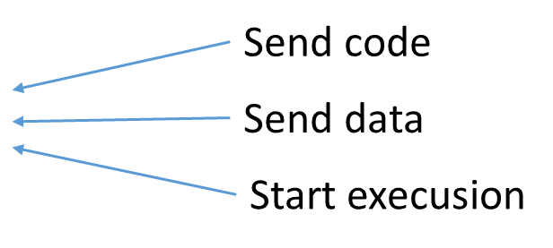
Countermeasures: Prepared statement (cont.)
Using prepared statements, we separate code and data.
The vulnerable version: code and data are mixed together.

Slide 14
Why is using prepared statements secure?
Trusted code is sent via a code channel.
Untrusted user-provided data is sent via data channel.
Database clearly knows the boundary between code and data.
Data received from the data channel is not parsed.
Attacker can hide code in data, but the code will never be treated as code, so it will never be attacked.

Slide 15
Countermeasures: Others
The Open Web Application Security Project (OWASP)
Primary defenses
Prepared statements
Stored procedures
Whitelist input validation
Escaping all user supplied input
Additional defenses
Enforcing least privilege
Whitelist input validation
https://cheatsheetseries.owasp.org/cheatsheets/SQL_Injection_Prevention_Cheat_Sheet.html

Slide 16
Summary
Update database
Multiple statements
The fundament cause of the vulnerability
How to defend against SQL-injection attacks
Prepared Statement
Next
Cross-Site Scripting (XSS) Attacks and countermeasures

