Slide 1
School of
Engineering and Computer Science
Te Kura Mātai Pūkaha, Pūrorohiko
CYBR 271 T2 2020 Secure Programming
Ian Welch, Harith Al-Sahaf
Cross-Site Scripting – Countermeasures
Du, Wenliang, “Computer & Internet Security: A Hands-on Approach”, 2nd ed, 2019 (Chapter 11)

Slide 2
Outline
Self-propagating XSS worm
Challenges
Solutions
Countermeasures
The filter approach
The encoding approach
Defeating XSS

Slide 3
Self-propagating XSS worm
Using Samy’s worm, not only will the visitors of Samy’s profile be modified, their profiles can also be made to carry a copy of Samy’s JavaScript code. So, when an infected profile was viewed by others, the code can further spread.
Challenges: How can JavaScript code produce a copy of itself?
Two typical approaches:
DOM approach: JavaScript code can get a copy of itself directly from DOM via DOM APIs
Link approach: JavaScript code can be included in a web page via a link using the src attribute of the script tag.

Slide 4
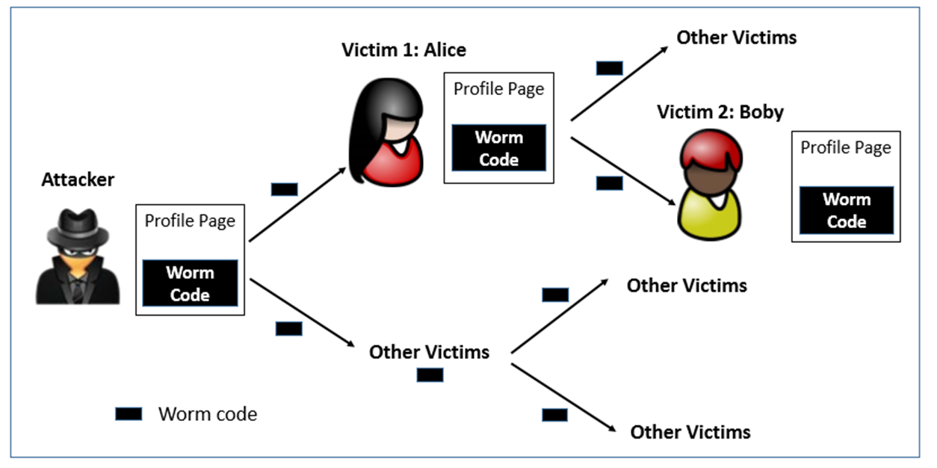
Self-propagating XSS worm (cont.)

Slide 5
Self-propagating XSS worm: The DOM approach
Document Object Model (DOM) Approach :
DOM organizes the contents of the page into a tree of objects (DOM nodes).
Using DOM APIs, we can access each node on the tree.
If a page contains JavaScript code, it will be stored as an object in the tree.
So, if we know the DOM node that contains the code, we can use DOM APIs to get the code from the node.
Every JavaScript node can be given a name and then use the document.getElementByID() API to find the node.

Slide 6
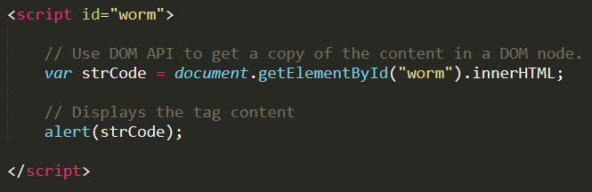
The DOM approach (cont.)
Use “document.getElementById(“worm”) to get the reference of the node
innerHTML gives the inside part of the node, not including the script tag.
So, in our attack code, we can put the message in the description field along with a copy of the entire code.

Slide 7
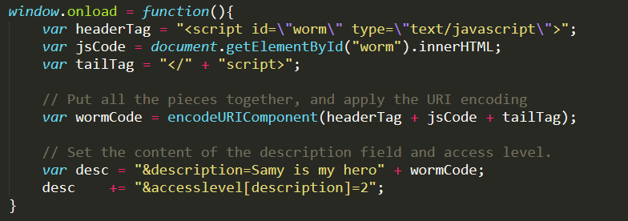
The DOM approach (cont.)
Line ① and ②: Construct a copy of the worm code, including the script tags.
Line ②: We split the string into two parts and use “+” to concatenate them together. If we directly put the entire string, Firefox’s HTML parser will consider the string as a closing tag of the script block and the rest of the code will be ignored.
①
②
③
④

Slide 8
The DOM approach (cont.)
Line ③: In HTTP POST requests, data is sent with Content-Type as “application/x-www-form-urlencoded”. We use encodeURIComponent() function to encode the string.
Line ④: Access level of each field: 2 means public.
After Samy places this self-propagating code in his profile, when Alice visits Samy’s profile, the worm gets executed and modifies Alice’s profile, inside which, a copy of the worm code is also placed. So, any user visiting Alice’s profile will too get infected in the same way.

Slide 9

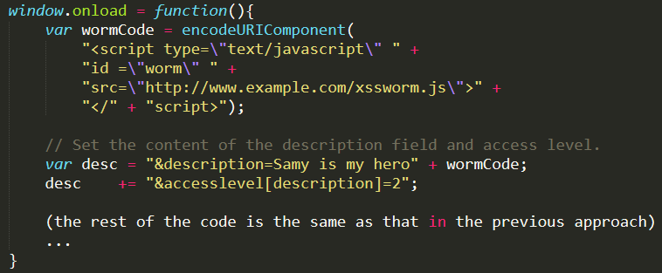
Self-Propagating XSS Worm: The Link Approach
The JavaScript code xssworm.js will be fetched from the URL.
Hence, we do not need to include all the worm code in the profile.
Inside the code, we need to achieve damage and self-propagation.

Slide 10
Countermeasures
The fundamental cause!
HTML allows JavaScript code to be mixed with data
Remove the code
The Filter Approach
The Encoding Approach
Enforce access control
Content security policy

Slide 11
Countermeasures: The Filter Approach
Removes code from user inputs.
It is difficult to implement as there are many ways to embed code other than <script> tag.
Use of open-source libraries that can filter out JavaScript code.
Example : jsoup provides an API called clean()

Slide 12
Countermeasures: The Filter Approach (cont.)
Filtering: MySpace blocks a lot of tags, including <script>, <body>, and onClick, onAnything.
Samy’s strategy
<div style=“background:url(‘javascript:alert(1)’)”>
Filtering: MySapce strips out the word javascript from anywhere.
Samy’s strategy
<div style=“background”url(‘java
script:alert(1)’)”>
Filtering: MySapce strips out the word “onreadystatechange”
Samy’s strategy
eval(‘xmlhttp.onread’ + ‘ystatechange = callback’);
https://samy.pl/myspace/tech.html

Slide 13
Countermeasures: The Encoding Approach
Replaces HTML markups with alternate representations.
If data containing JavaScript code is encoded before being sent to the browsers, the embedded JavaScript code will be displayed by browsers, not executed by them.
Example
Converts
to
<script> alert(‘XSS’) </script>
&lt;script&gt;alert(‘XSS’)

Slide 14
Countermeasures: Elgg’s Approach
PHP module HTMLawed:
Highly customizable PHP script to sanitize HTML against XSS attacks.
PHP function htmlspecialchars:
Encode data provided by users, s.t., JavaScript code in user’s inputs will be interpreted by browsers only as strings and not as code.

Slide 15
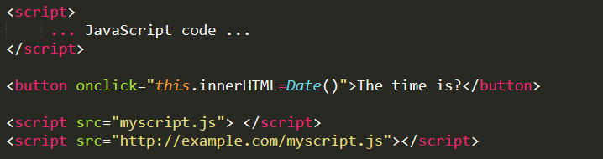
Defeating XSS using content security policy (CSP)
Fundamental Problem: mixing data and code (code is inlined)
Solution: Force data and code to be separated:
Don’t allow the inline approach (e.g. ① and ②).
Only allow the link approach (e.g. ③ and ④).
①
②
Provide a very important piece of information
③
④

Slide 16

The CSP mechanism
CSP was specifically designed to defeat XSS and ClickJacking attacks
Policy based on the origin of the code.
Code from self, example.com, and google will be allowed.
https://portswigger.net/research/burp-clickbandit-a-javascript-based-clickjacking-poc-generator
https://content-security-policy.com/

Slide 17
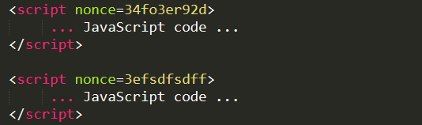
How to securely allow inlined code
Using nonce
Hashing
Put the hash value of the trusted code in the CSP rules
Allowed
Not allowed

Slide 18
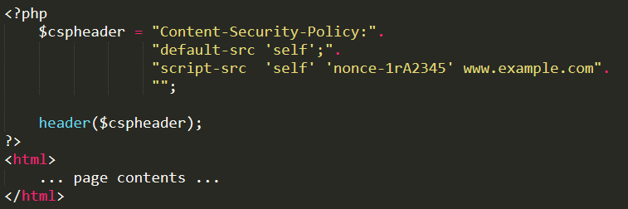
Setting CSP rules

Slide 19
Summary
Create a self-propagating XSS worm
The DOM approach
The link approach
Countermeasures against XSS attacks
The filter approach
The encoding approach
The Elgg approach
Content Security Policy (CSP)
Next
Cross-site Request Forgery (CSRF/XSRF) – attacks and countermeasures

