Slide 1
School of
Engineering and Computer Science
Te Kura Mātai Pūkaha, Pūrorohiko
CYBR 271 T2 2020 Secure Programming
Ian Welch, Harith Al-Sahaf
Cross-Site Request Forgery – Attacks
Du, Wenliang, “Computer & Internet Security: A Hands-on Approach”, 2nd ed, 2019 (Chapter 10)

Slide 2
Outline
Cross-Site Request
Cross-Site Request Forgery (CSRF) Attack
CSRF attacks on HTTP GET

Slide 3
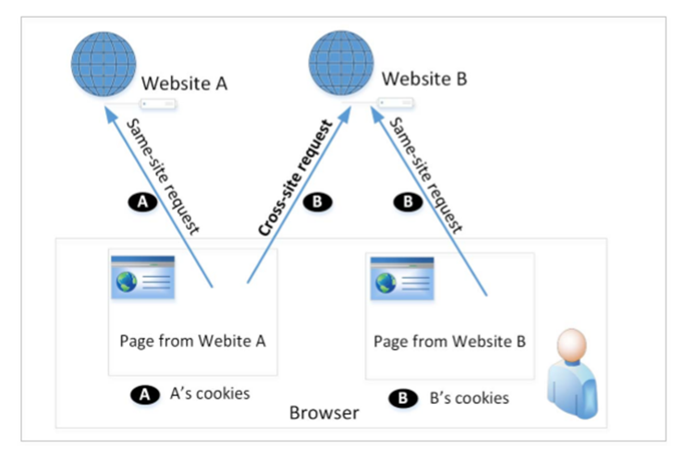
Cross-site request and its problems
When a page from a website sends an HTTP request back to the website, it is called same-site request.
If a request is sent to a different website, it is called cross-site request because the where the page comes from and where the request goes are different.
Example : A webpage (not Facebook) can include a Facebook link, so when users click on the link, HTTP request is sent to Facebook.

Slide 4
Cross-Site request and its problems (cont.)
When a request is sent to example.com from a page coming from example.com, the browser attaches all the cookies belonging to example.com.
Now, when a request is sent to example.com from another site (different from example.com), the browser will attach the cookies too.
Because of above behaviour of the browsers, the server cannot distinguish between the same-site and cross-site requests.
It is possible for third-party websites to forge requests that are exactly the same as the same-site requests.
This is called Cross-Site Request Forgery (CSRF).

Slide 5
Cross-site request forgery attack
Environment Setup:
Target website
Victim user who has an active session on the target website
Malicious website controlled by an attacker
Steps:
The attacker crafts a webpage that can forge a cross-site request to be sent to the targeted website.
The attacker needs to attract the victim user to visit the malicious website.
The victim is logged into the targeted website.

Slide 6
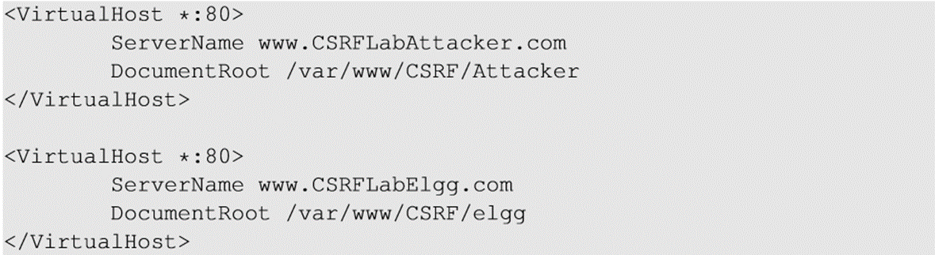
Environment setup
Elgg: open-source web application for social networking
Countermeasures for CSRF is disabled by us in the VM
Target website: http://www.csrflabelgg.com
Attacker’s website: http://www.csrflabattacker.com
These websites are hosted on localhost via Apache’s Virtual Hosting

Slide 7
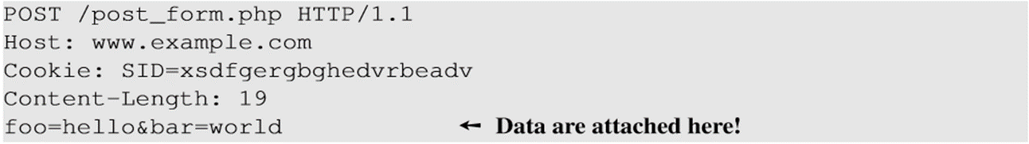
CSRF attacks on HTTP GET services
HTTP GET requests: data (foo and bar) are attached in the URL.
HTTP POST requests: data (foo and bar) are placed inside the data field of the HTTP request.

Slide 8
CSRF attack on GET request – Basic idea
Consider an online banking web application www.bank32.com which allows users to transfer money from their accounts to other people’s accounts.
An user is logged in into the web application and has a session cookie which uniquely identifies the authenticated user.
HTTP request to transfer $500 from his/her account to account 3220:
http://www.bank32.com/transfer.php?to=3220&amount=500
In order to perform the attack, the attacker needs to send out the forged request from the victim’s machine so that the browsers will attach the victim’s session cookies with the requests.

Slide 9
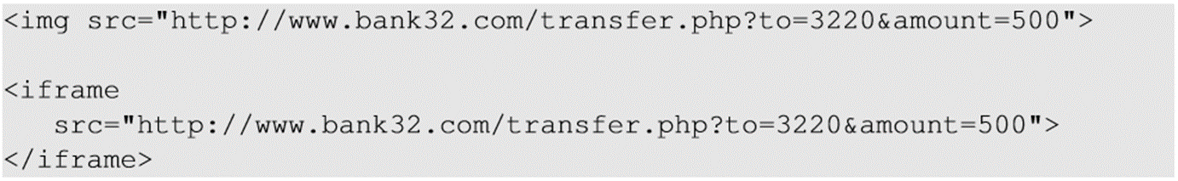
CSRF attack on GET request – Basic idea (cont.)
The attacker can place the piece of code (to trigger request) in the form of Javascript code in the attacker’s web page.
…but there is a much easier way to forge request without using JS code
HTML tags like img and iframe can trigger GET requests to the URL specified in src attribute. Response for this request will be an image/webpage.

Slide 10
Attack on Elgg’s add-friend service
Goal : Add yourself to the victim’s friend list without his/her consent.
Investigation taken by the attacker Samy:
Creates an Elgg account using Charlie as the name.
In Charlie’s account, he clicks add-friend button to add himself to Charlie’s friend list. Using FireFox LiveHTTPHeaders extension to capture the add-friend HTTP request.

Slide 11
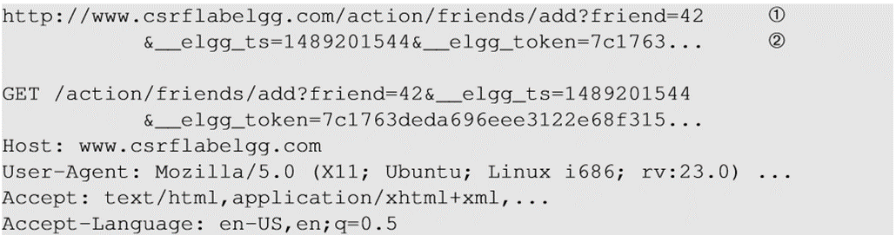
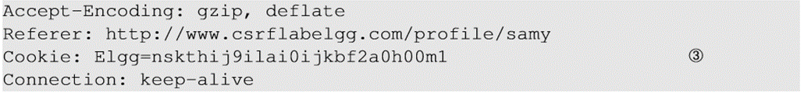
Capture HTTP header
Line ① : URL of Elgg’s add-friend request. UserID of the user to be added to the friend list is used. Here, Samy’s UserID (GUID) is 42.
Line ② : Elgg’s countermeasure against CSRF attacks which are disabled.
Line ③ : Session cookie which is unique for each user. It is automatically sent by browsers.

Slide 12
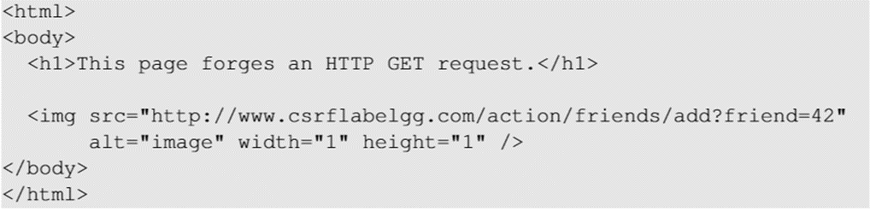
Create the malicious web page
The img tag will trigger an HTTP GET request. When browsers render a web page and sees an img tag, it sends an HTTP GET request to the URL specified in the src attribute.
The attacker use add-friend URL along with friend parameter. The size of the image is very small so that the victim is not suspicious.
The crafted web page is placed in the malicious website www.csrflabattacker.com (inside the /var/www/CSRF/Attacker folder).

Slide 13
Attract victim to visit your malicious page
Samy can send a private message to Alice with the link to the malicious web page.
If Alice clicks the link, Samy’s malicious web page will be loaded into Alice’s browser and a forged add-friend request will be sent to the Elgg server.
On success, Samy will be added to Alice’s friend list.

Slide 14
Summary
Cross-site requests vs same-site requests.
Why cross-site requests should be treated differently.
How to conduct CSRF attack on HTTP GET request
Next
How to conduct CSRF attack on HTTP POST request
The fundamental cause of the CSRF vulnerability
How to defend against CSRF attack

