Slide 1
School of
Engineering and Computer Science
Te Kura Mātai Pūkaha, Pūrorohiko
CYBR 271 T2 2020 Secure Programming
Ian Welch, Harith Al-Sahaf
Cross-Site Request Forgery – Countermeasures
Du, Wenliang, “Computer & Internet Security: A Hands-on Approach”, 2nd ed, 2019 (Chapter 10)

Slide 2
Outline
CSRF Attacks on HTTP POST
CSRF Countermeasures
Do you think that POST services are more secure against CSRF attacks than GET services?

Slide 3
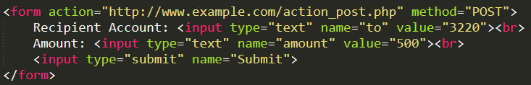
CSRF attacks on HTTP POST services
Constructing a POST Request Using JavaScript
POST requests can be generated using HTML forms. The above form has two text fields and a Submit button.
When the user clicks on the Submit button, POST request will be sent out to the URL specified in the action field with to and amount fields included in the body.
Attacker’s job is to click on the button without the help from the user.

Slide 4
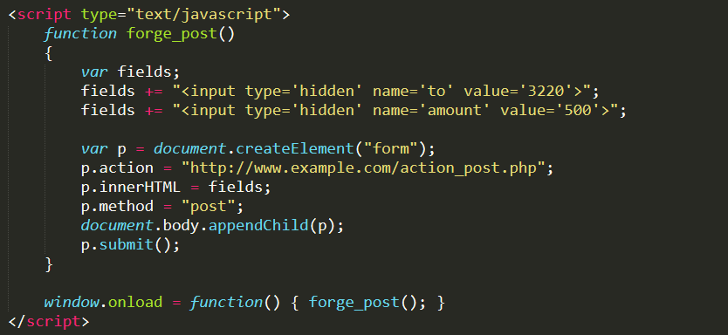
CSRF attacks on HTTP POST services (cont.)
Line ①: Creates a form dynamically; request type is set to “POST”
Line ②: The fields in the form are “hidden”. Hence, after the form is constructed, it is added to the current web page.
Line ③: Submits the form automatically.
①
②
③
④
Line ④: The JavaScript function “forge_post()” will be invoked automatically once the page is loaded.

Slide 5
Attack on Elgg’s edit-profile service
Goal : Putting a statement “SAMY is MY HERO” in the victim’s profile without the consent from the victim.
Investigation by the attacker Samy
Samy captured an edit-profile request using LiveHTTPHeader extension.

Slide 6
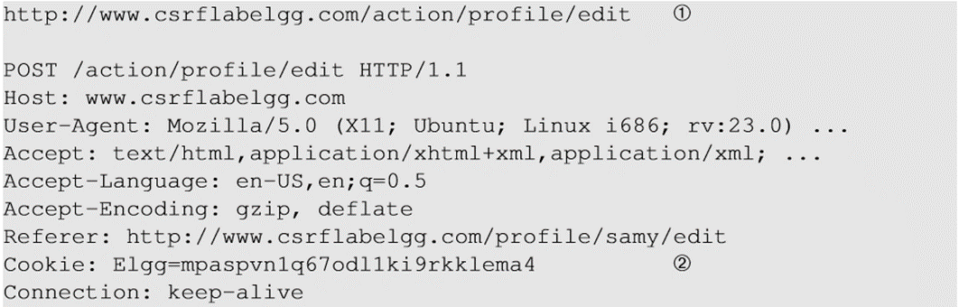
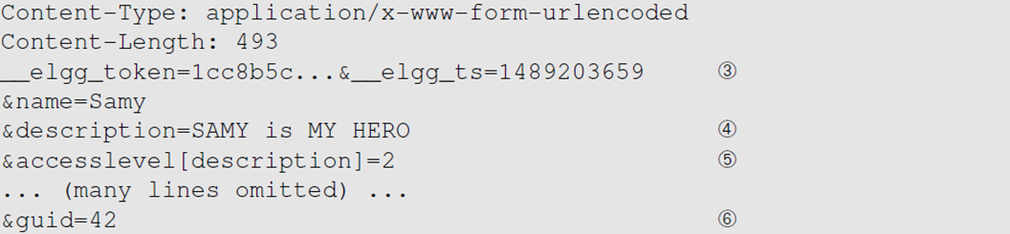
Attack on Elgg’s edit-profile service (cont.)
Line ① : URL of the edit-profile service.
Line ②: Session cookie (unique for each user). It is automatically set by browsers.
Line ③: CSRF countermeasures, which are disabled

Slide 7
Attack on Elgg’s edit-profile service (cont.)
Line ④: Description field with text “SAMY is MY HERO”
Line ⑤: Access level of each field : 2 means viewable by everyone
Line ⑥: User Id (GUID) of the victim. This can be obtained by visiting victim’s profile page source, looking for the following:
Elgg.page_owner={“guid”:39,”type”:”user”,...}

Slide 8
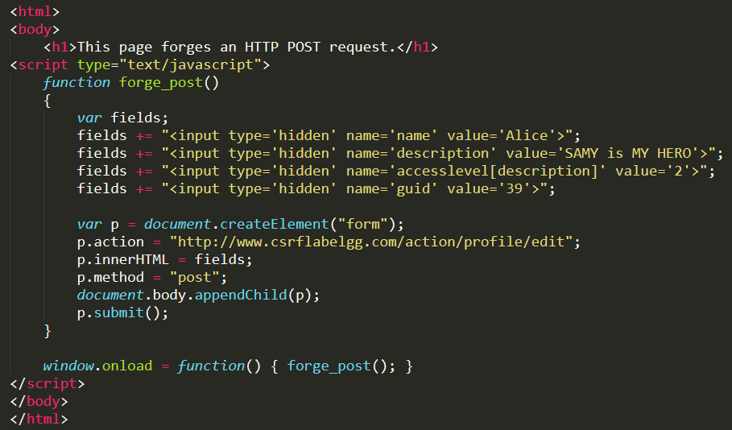
Craft the malicious web page
The JavaScript function creates a hidden form with the description entry as our text.
When the victim visits this page, the form will be automatically submitted (POST request) from the victim’s browser to the edit-profile service at “http://www.csrflabelgg.com/action/profile/edit” causing the message to be added to the victim’s profile.

Slide 9
Fundamental cause of CSRF
Many developers are not aware of the risk caused by cross-site request
The server cannot distinguish whether a request is cross-site or same-site
Same-site request: coming from the server’s own page. Trusted.
Cross-site request: coming from other site’s pages. Not trusted.
We cannot treat these two types of requests the same.
Does the browser know the difference?
Of course. The browser knows from which page a request is generated.
Can browser help?
How to help server?
Referer header (browser’s help)
Same-site cookie (browser’s help)
Secret token (the server helps itself to defend against CSRF)

Slide 10
Countermeasures: Referer header
HTTP header field identifying the address of the web page from where the request is generated.
A server can check whether the request is originated from its own pages or not.
This field reveals part of browsing history causing privacy concern and hence, this field is mostly removed from the header.
The server cannot use this unreliable source.

Slide 11
Countermeasures: Same-Site cookies
A special type of cookie in browsers like Chrome and Opera, which provide a special attribute to cookies called SameSite.
This attribute is set by the servers and it tells the browsers whether a cookie should be attached to a cross-site request or not.
Cookies with this attribute are always sent along with same-site requests, but whether they are sent along with cross-site depends on the value of this attribute.
Values
Strict (Not sent along with cross-site requests)
Lax (Sent with cross-site requests)

Slide 12
Countermeasures: Secret token
Two ways:
The server embeds a random secret value inside each web page.
When a request is initiated from this page, the secret value is included with the request.
The server checks this value to see whether a request is cross-site or not.
Pages from a different origin will not be able to access the secret value. This is guaranteed by browsers (the same origin policy)
“Under the policy, a web browser permits scripts contained in a first web page to access data in a second web page, but only if both web pages have the same origin.” (Wikipedia: https://en.wikipedia.org/wiki/Same-origin_policy)
The secret is randomly generated and is different for different users. So, there is no way for attackers to guess or find out this secret.

Slide 13
Elgg’s countermeasure
Uses secret-token approach : _elgg_ts and _elgg_token.
The values are stored inside two JavaScript variables and also in all the forms where user action is required.
The two hidden parameters are added to the form so that when the form is submitted via an HTTP request, these two values are included in the request.
These two hidden values are generated by the server and added as a hidden field in each page.

Slide 14

Elgg’s countermeasure (cont.)
JavaScript variables to access using JavaScript code.
Elgg’s security token is a MD5 digest of four pieces of information :
Site secret value
Timestamp
User session ID
Randomly generated session string

Slide 15
Questions
What is the difference between Cross-Site Scripting (XSS) and Cross-Site Request Forgery (CSRF)?
Can CSRF tokens prevent XSS attacks?

Slide 16
Summary
How to conduct CSRF attack (HTTP POST services)
The fundamental cause of the CSRF vulnerability
How to defend against CSRF attack
Next:
Tutorial: Return-to-libc attack
Next week: Revision

