Slide 1
School of
Engineering and Computer Science
Te Kura Mātai Pūkaha, Pūrorohiko
CYBR 271 T2 2020 Secure Programming
Ian Welch, Harith Al-Sahaf
Return-to-Libc Attack
Du, Wenliang, “Computer & Internet Security: A Hands-on Approach”, 2nd ed, 2019 (Chapter 5)

Slide 2
Outline
Non-executable Stack countermeasure
How to defeat the countermeasure
Tasks involved in the attack
Function Prologue and Epilogue
Launching attack

Slide 3
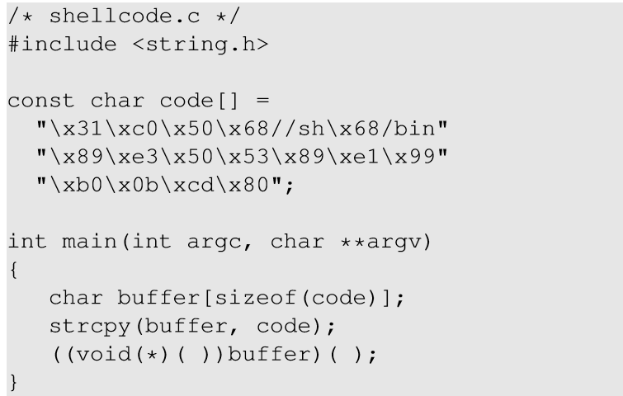
Non-executable Stack
Running shellcode in C program
Calls shellcode

Slide 4
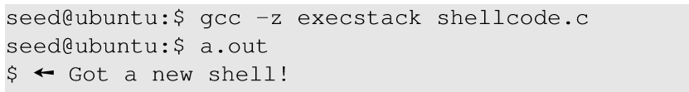
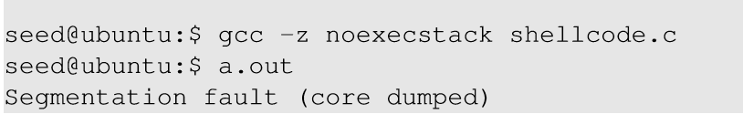
Non-executable Stack
With executable stack
With non-executable stack

Slide 5
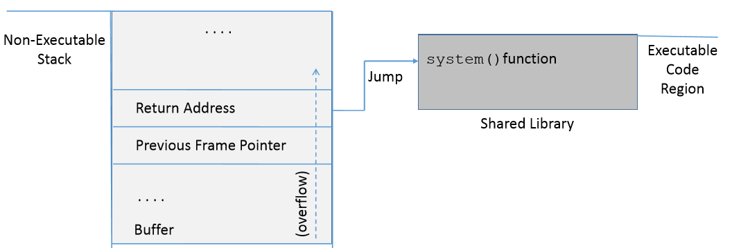
How to Defeat This Countermeasure
Jump to existing code: e.g. libc library.
Function: system(cmd): cmd argument is a command which gets executed.

Slide 6
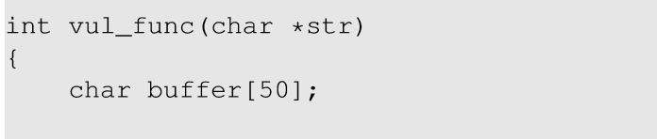
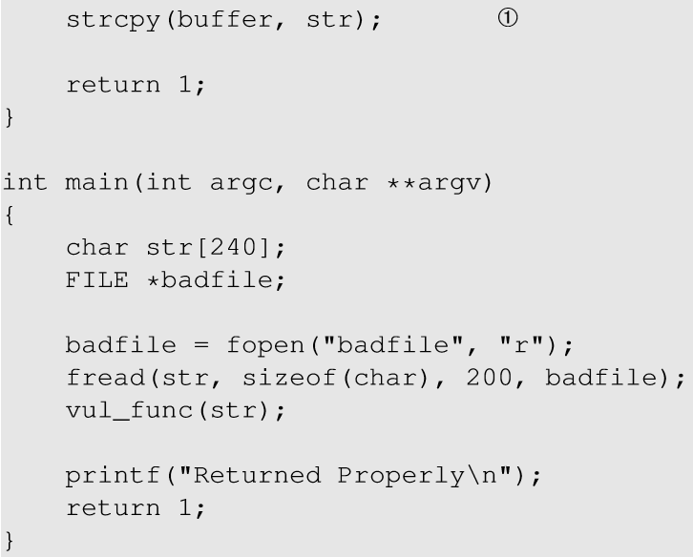
Environment Setup
This code has potential buffer overflow problem in vul_func()
Buffer overflow problem

Slide 7
Environment Setup
“Non executable stack” countermeasure is switched on, StackGuard protection is switched off and address randomization is turned off.
Root owned Set-UID program.

Slide 8
Overview of the Attack
Task A : Find address of system().
To overwrite return address with system()’s address.
Task B : Find address of the “/bin/sh” string.
To run command “/bin/sh” from system()
Task C : Construct arguments for system()
To find location in the stack to place “/bin/sh” address (argument for system())

Slide 9
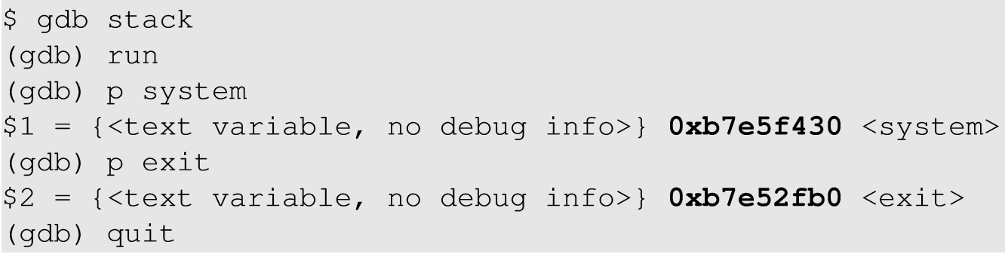
Task A : To Find system()’s Address.
Debug the vulnerable program using gdb
Using p (print) command, print address of system() and exit().

Slide 10
Task B : To Find “/bin/sh” String Address
Export an environment variable called “MYSHELL” with value “/bin/sh”.
MYSHELL is passed to the vulnerable program as an environment variable, which is stored on the stack.
We can find its address.

Slide 11
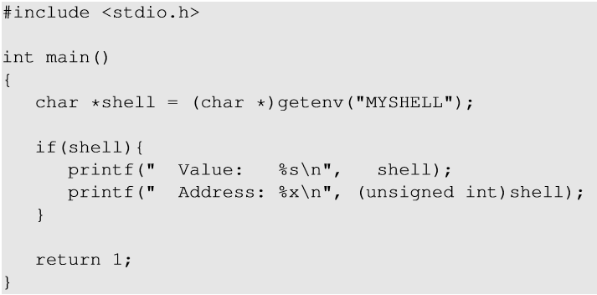
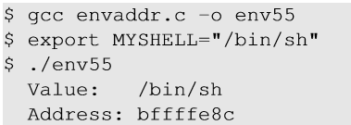
Task B : To Find “/bin/sh” String Address
Export “MYSHELL” environment variable and execute the code.
Code to display address of environment variable

Slide 12
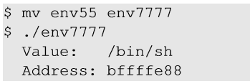
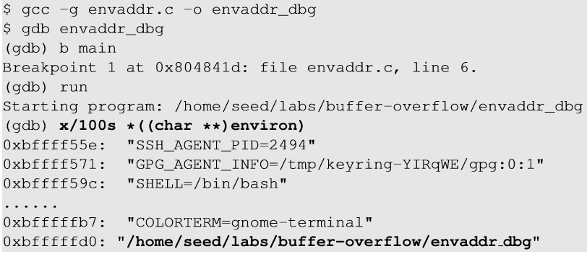
Task B : Some Considerations
Address of “MYSHELL” environment variable is sensitive to the length of the program name.
If the program name is changed from env55 to env77, we get a different address.

Slide 13
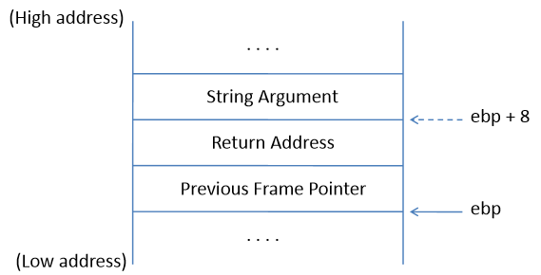
Task C : Argument for system()
Arguments are accessed with respect to ebp.
Argument for system() needs to be on the stack.
Need to know where exactly ebp is after we have “returned” to system(), so we can put the argument at ebp + 8.
Frame for the system() function

Slide 14

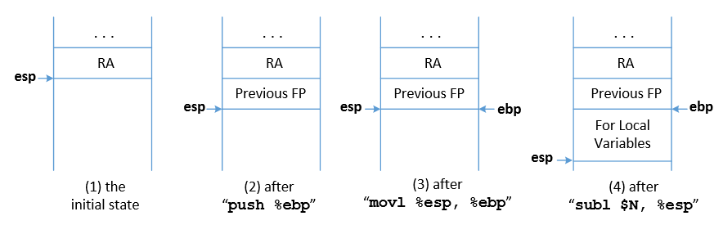
Task C : Argument for system()
Function Prologue
esp : Stack pointer
ebp : Frame Pointer

Slide 15

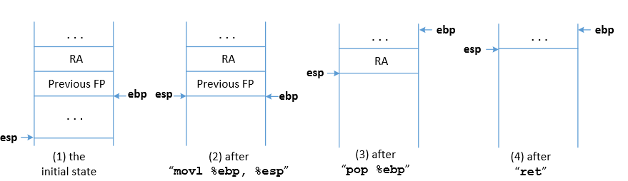
Task C : Argument for system()
Function Epilogue
esp : Stack pointer
ebp : Frame Pointer

Slide 16
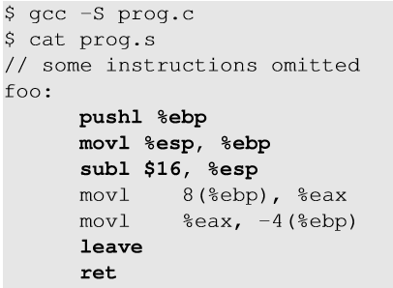
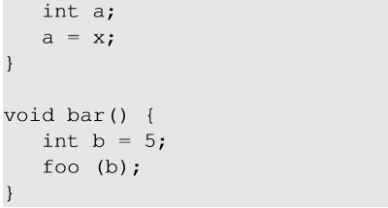
Function Prologue and Epilogue example
1
Function prologue
Function epilogue
2
1
2
8(%ebp) ⇒ %ebp + 8

Slide 17
Return to another function
Tracking the ebp value
 | Instructions | esp | ebp(=X)
Epilogue | movl %ebp, %esp popl %ebp ret | X X + 4 X + 8 | X Y=*(X) Y
Prologue | pushl %ebp movl %esp, %ebp | X + 4 X + 4 | Y X + 4

Slide 18
How to Find system()’s Argument Address?
Change ebp and esp
Modified Return Address
vul_func() epilogue
system() prologue
Use of system()’s argument
In order to find the system() argument, we need to understand how the ebp and esp registers change with the function calls.
Between the time when return address is modified and system argument is used, vul_func() returns and system() prologue begins.

Slide 19
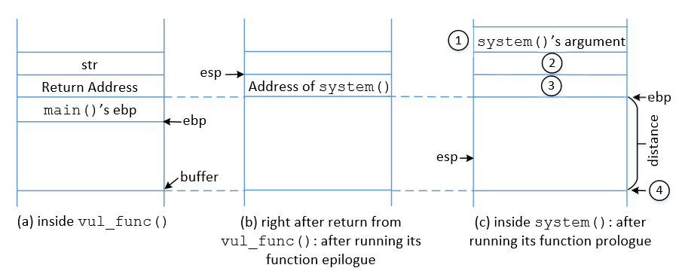
Memory Map to Understand system() Argument

Slide 20
Flow Chart to understand
system() argument
Return address is changed to system() address.
ebp is replaced by esp after vul_func() epilogue
Jump to system()
“/bin/sh” is stored in ebp+8
ebp is set to current value of esp
system() prologue is executed
Check the memory map
ebp + 4 is treated as return address of system(). We can put exit() address so that on system() return exit() is called and the program doesn’t crash.

Slide 21
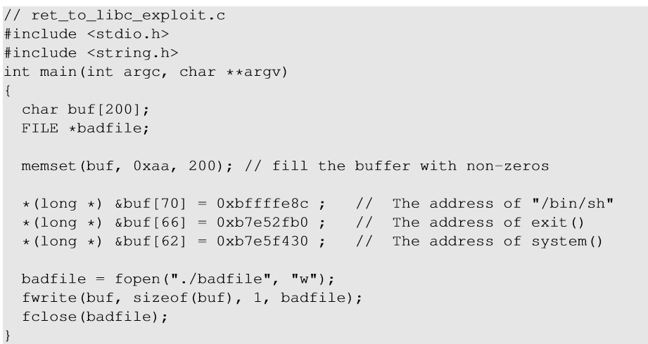
Malicious Code
ebp + 12
ebp + 8
ebp + 4

Slide 22
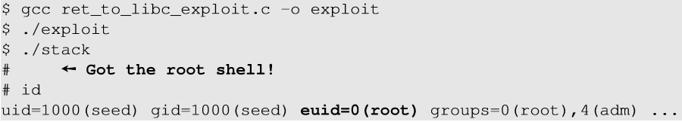
Launch the attack
Execute the exploit code and then the vulnerable code

Slide 23
Summary
The Non-executable-stack mechanism can be bypassed
To conduct the attack, we need to understand low-level details about function invocation

