Slide 1
School of
Engineering and Computer Science
Te Kura Mātai Pūkaha, Pūrorohiko
CYBR 271 T2 2020 Secure Programming
Ian Welch, Harith Al-Sahaf
Tutorial – Week 12 (Revision)

Slide 2
Outline
Format
Security principles
Threat modelling and Risk assessment
Addressing threats
Checklist and libraries
Set-UID programmes
Buffer-overflow attack
Format string vulnerability
SQL-inject attacks
Cross-site scripting (XSS)
Cross-site request forgery (CSRF)

Slide 3
Format of the test

Slide 4
Test format
Blackboard about one hour needed to complete but you have 24 hours
Starts Monday noon and ends Tuesday noon
You can leave this test by hitting the 'Save All Answers' button on the top (and bottom) right.
DO NOT press 'Save and Submit' until you have completely FINISHED all questions – until that point you can come back to a previous question
Prior to releasing marks we will audit the distributions and adjust accordingly … once released if you still have query please come and see me during office hours (physical or online)
Please don’t work together and discuss the questions …
CYBR 271: Secure Programming
Slide 4

Slide 5
Question format
Questions are all multichoice
Some are “best answer” – choose one
Some are “select all the apply” – choose multiple
CYBR 271: Secure Programming
Slide 5

Slide 6
Security principles

Slide 7
Secure by design:
Establish trust boundaries
Don’t reinvent the wheel
Economy of mechanism
Separation of duty
Open design
Minimize the attack surface
Secure the weakest link
Secure by implementation
Psychological acceptability
Validate inputs
Secure data at rest
Prevent bypass attacks
Defense in depth
Secure by default:
Least privilege
Default deny
Fail securely
Describe why each principle is important to security.
Identify the needed design principle that is being used here or violated.
CYBR 271: Secure Programming
Slide 7

Slide 8
Threat modelling and risk assessment

Slide 9
Threat and Risk Assessment
Asset
Something that should be protected
Vulnerability
Weakness or lack of protections
Threat
Something that could negatively impact an asset
Security Controls aka “mitigations”
Protect against threats, reduce vulnerability
Risk
The possibility that a threat will exploit a vulnerability to harm an asset
Risk = Threat * Vulnerability
More detail at: https://csrc.nist.gov/glossary/
CYBR 271: Secure Programming
Slide 9
Notes:
Asset - is anything within an environment that should be protected. This could be a computer file, a piece of software or hardware, a service, or some sensitive data within your database. If the asset was damaged or stolen, then there may be a negative impact on the owner’s productivity, profits or reputation, perhaps.
Vulnerability – is a weakness in an asset or the lack of an appropriate protection to safeguard the asset. If a vulnerability is exploited, then this may harm the asset. For example, this could be a flaw in an application code, an error made by an administrator, or a limitation of the technology used.
Threat – a threat a potential occurrence that causes harm to an asset. This could be an action or inaction, intentional or unintentional, and could originate from a person, a company, hardware, or nature. The easiest example here is a person might attack a system, but it also could be a hardware fault that might cause an outage or a natural disaster that floods a datacentre.
Risk - the possibility that a threat will exploit a vulnerability to harm an asset. It adds an assessment of likelihood, possibility or chance.
For example:
In IT, the risk may be that data in our database is disclosed (risk) because a hacker (threat) is able to use an injection attack in our web application because we aren’t sanitizing inputs.
Security Controls – anything that removes or reduces a vulnerability or protects against a specific threat. In the examples we used above, the controls may be: For our web application, we might do some sanitisation of inputs, disallow users to provide inputs or whatever other activities that are effective in mitigating that threat by removing the vulnerability.
If you want more detailed definitions checkout: https://csrc.nist.gov/glossary
Note that people will define these more than one way

Slide 10
Threat Modelling techniques
Unstructured
Persona non Grata
Misuse cases
Security cards
Structured
STRIDE
DREAD
Describe the concept of misuse cases, persona non grata and security cards to support brainstorming approach to threat modelling.
Discuss the pro’s and con’s of these concepts.
Explain how persona non grata can help with the development of misuse cases.
CYBR 271: Secure Programming
Slide 10
Notes:
Many threat-modeling methods have been developed. They can be combined to create a more robust and well-rounded view of potential threats. Not all of them are comprehensive; some are abstract and others are people-centric. Some methods focus specifically on risk or privacy concerns.
The varying structured approaches for threat modeling are usually called frameworks or methodologies (the two terms can basically be used interchangeably in this context).
Some are just called techniques.

Slide 11
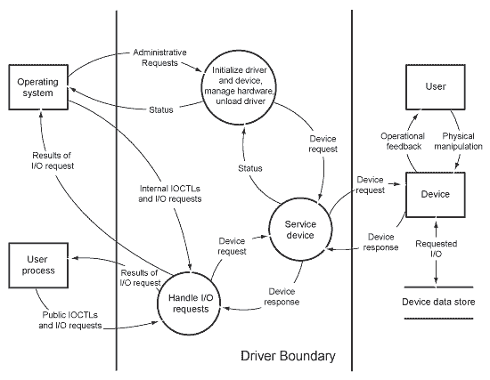
STRIDE Threat Modelling
Identify the main elements of a dataflow diagram (DFD) and be able to interpret the semantics of a DFD
Describe each of the different STRIDE threats
Apply STRIDE to a DFD to identify threats to security
CYBR 271: Secure Programming
Slide 11

Slide 12
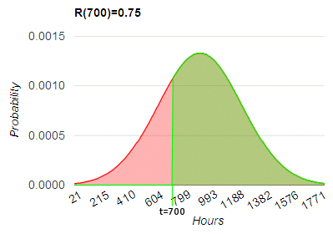
Ranking Threats - Probabilistic
Probability * Impact Ranking
Probability is chance of a failure within a certain time
Impact might be estimated loss
Basis of cyberinsurance
CYBR 271: Secure Programming
Slide 12

Slide 13
Heuristic - DREAD
DREAD Average Ranking
Damage Potential –If a threat exploit occurs, evaluate the damage caused
0 = Nothing
5 = Individual user data compromised
10=Complete system or data destruction
Reproducibility –How easy is it to reproduce the threat exploit?
0 = Very hard or impossible even for administrators/DBAs
5 = One or two steps required, may need an authorized user
10 = Just a web browser is enough
Exploitability –What is needed to exploit this threat?
0 = Advanced programming & networking knowledge
5 = Malware exists on the Net, or any tolls available
10 = Just a web browser is enough
Affected Users
How many users are affected?
0 = None
5 = Some users, but not all
10 = All users
Discoverability
How easy is it to discover the threat
0 = Very hard or impossible; needs source code or admin access
5 = Can figure it out by guessing or monitoring network traces
10 = Information is visible in the web browser or address bar or in the form or as a hidden variable
Finally use the formula:
Average Threat Ranking = (D + R + E + A + D)
CYBR 271: Secure Programming
Slide 13

Slide 14
Addressing threats

Slide 15
Addressing Threats
Aim is to address or alleviate a problem
Protect customers
Design secure software
Why bother if you:
Create a great model
Identify lots of threats
Stop
So, find problems and fix them
Mitigate, Elminate, Transfer or Accept
CYBR 271: Secure Programming
Slide 15
Notes:
Accept isn’t a fix but the point is that you make a conscious decision to accept and document it for the person who has to maintain the system after you.

Slide 16
Checklists and libraries

Slide 17
Checklists and libraries
Checklists, ATT&CK, CAPEC, OWASP Top ten
Pro’s and con’s of these different libraries
Libraries help people who are less experienced
Difficult to have the “perfect” library for threat modeling
Not too abstract
Not too specific
CYBR 271: Secure Programming
Slide 17

Slide 18
Set-uid programmes

Slide 19
Set-UID programmes
Access control mechanisms
Discretionary Access Control (DAC)
Mandatory Access Control (MAC)
Unix groups and permissions
Root
A specific user or a member of a group
Others
-rw-r--r-- 1 root ecs 897 Oct 22 2019 test.txt
drwxr-xr-x 2 john students 12 Jun 20 2016 Backup
Daemons and Set-UID programmes

Slide 20
Set-UID programmes (cont.)
Real UID
Effective UID
Attack surfaces of Set-UID programmes
System input
Environment variables
User inputs
CHSH
Invoking external commands
system()
execve()
Principles
Principle of isolation
Principle of least privilege

Slide 21
Buffer-overflow

Slide 22
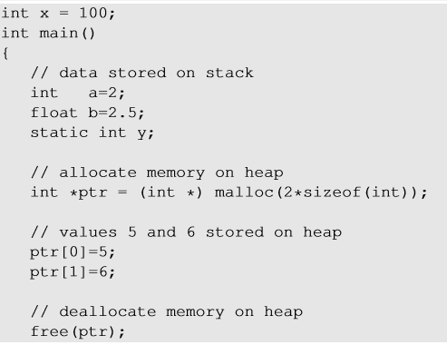
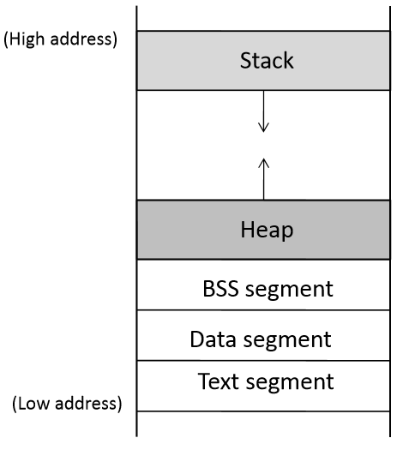

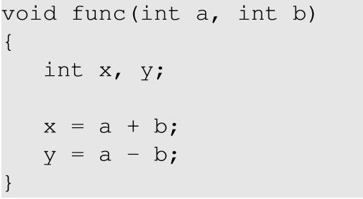
Memory layout
Order of function arguments in stack
a,b, ptr
ptr points to the memory here
y
x
Global variables are stored in Data segment.
Uninitialized static variables are stored in BSS.
Dynamic memory is allocated in heap.
Local variables are stored in Stack.

Slide 23
Buffer-overflow attacks
Q: what will be the subsequence of overwriting “Return Address” and “Previous Frame Pointer”?
Invalid instruction
Non-existing address
Access violation
Attacker’s code Malicious code to gain access
Countermeasures
Developer approaches
Use of safer functions like strncpy(), strncat() etc, safer dynamic link libraries that check the length of the data before copying.
OS approaches (Address Space Layout Randomization (ASLR))
Hardware approaches (Non-Executable Stack)
Compiler approaches (Stack-Guard)

Slide 24
Format String Vulnerability

Slide 25
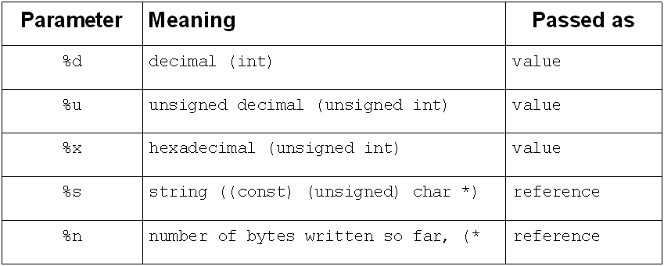
Format string vulnerability
The target value is 12 bytes above the va_list variable.
%d -> 0x00000000
%d -> 0x00000001
%d -> 0x00000002
%d -> 0x00000003
What will happen if user_input contains format specifiers?
Crash program
Print out data on the stack
Changes the program’s data in the memory
Change the program’s data to specific value
Inject malicious code

Slide 26
Format String vulnerability (cont.)
Fundamental cause?
Countermeasures
Developer approach
Compiler approach
Would the following help to prevent format string attacks?
Address randomization
Non-executable stack/heap
StackGuard

Slide 27
SQL-injection Attacks

Slide 28
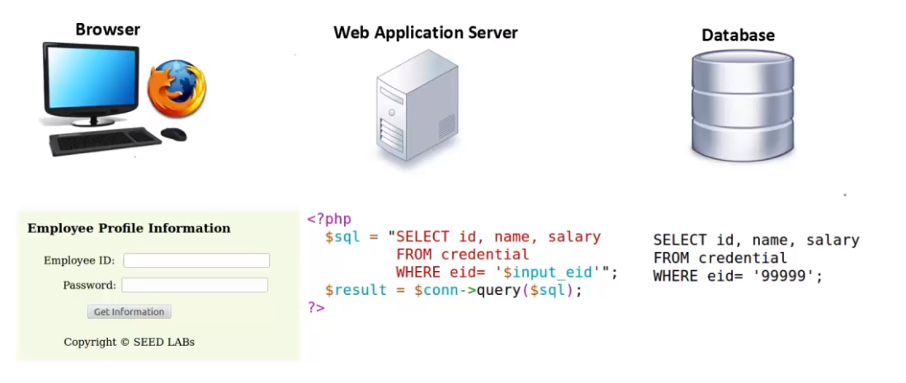
SQL-injection
View records
Modify database
Multiple SQL statements
Fundamental cause?
Countermeasures
Filtering
Encoding
Prepared statements

Slide 29
Prepared statements are secure
Trusted code is sent via a code channel.
Untrusted user-provided data is sent via data channel.
Database clearly knows the boundary between code and data.
Data received from the data channel is not parsed.
Attacker can hide code in data, but the code will never be treated as code, so it will never be attacked.

Slide 30
Cross-Site Scripting (XSS)

Slide 31
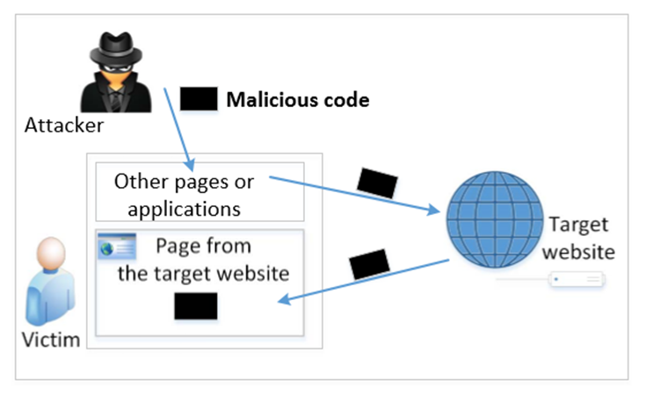
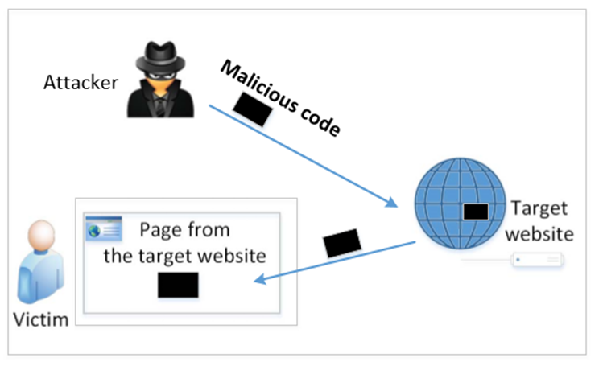
Cross-site scripting (XSS)
What is XSS?
A client-side code injection attack where an attacker can execute malicious script in a users browser and uses a vulnerable website as a delivery mechanism to deliver the script.
Types of XSS
Non-persistent (Reflected) XSS
Persistent (Stored) XSS

Slide 32
Cross-site scripting (cont.)
Damage caused by XSS:
Web defacing
Spoofing requests
Stealing information
Countermeasures
Filter approach
Encoding approach
What is the problem of the filter approach?

Slide 33
Cross-Site Request Forgery (CSRF)

Slide 34
Cross-site request forgery (CSRF)
What is Cross-Site Request Forgery?
Fundamental Cause of CSRF
The server cannot distinguish whether a request is cross-site or same-site
Same-site request: coming from the server’s own page. Trusted.
Cross-site request: coming from other site’s pages. Not Trusted.
How to help server?
Referer header (browser’s help)
Same-site cookie (browser’s help)
Secret token (the server helps itself to defend against CSRF)
Can CSRF tokens prevent XSS attacks?

Slide 35
Question #1
Which of the following will allow an attacker to reveal the value of a variable stored on the stack if the distance between the variable and va_list is 8 bytes?
%d%d
%s%s%s
%d%d%d
%d%d%n
%d%d%s
%d%d%d%d

Slide 36
Question #2 (width modifier)
Which of the following format strings will allow an attacker to change the value of a variable to be 0x4B (75 in decimal) if the distance between the address of the variable (stored on the stack) and va_list is 16 bytes?
%.70x%n
%.8x%.8x%.8x%.51x
%.8x%.8x%.8x%.51x%s
%.8x%.8x%.8x%.51x%n
%.8x%.8x%.8x%.8x%.43n
%x%x%x%.75x%n

Slide 37
evaluation
Please do it!!

