Slide 1

School of
Engineering and Computer Science
Te Kura Mātai Pūkaha, Pūrorohiko
Security Principles I CYBR 271 T2 2020
Ian Welch, Harith Al-Sahaf
Slides based upon these ones: https://www.cs.montana.edu/courses/csci476/topics/secure_coding_principles.pdf

Slide 2
Security principles
CYBR 271: Secure Programming
Slide 2

Slide 3
Secure Coding Principles
These principles have been known a long time.
They have evolved over time.
Mainframes -> web applications.
This lecture is based on a variety of sources:
Anderson, J. P., Computer Security Technology Planning Study (1972) (http://seclab.cs.ucdavis.edu/projects/history/seminal.html
Saltzer and Schroeder Protection of Information Systems (1975) (http://web.mit.edu/Saltzer/www/publications/protection/)
CERT (https://wiki.sei.cmu.edu/confluence/display/seccode/SEI+CERT+Coding+Standards)
OWASP Secure Coding Practices (https://owasp.org/www-project-secure-coding-practices-quick-reference-guide/migrated_content)
Personal experience
Ultimately this is a highlight reel, we’ll revisit many of these ideas throughout the course.
CYBR 271: Secure Programming
Slide 3

Slide 4
Secure by design
Establish trust boundaries
Don’t reinvent the wheel
Economy of mechanism
Separation of duty
Open design
Minimize the attack surface
Secure the weakest link
CYBR 271: Secure Programming
Slide 4

Slide 5
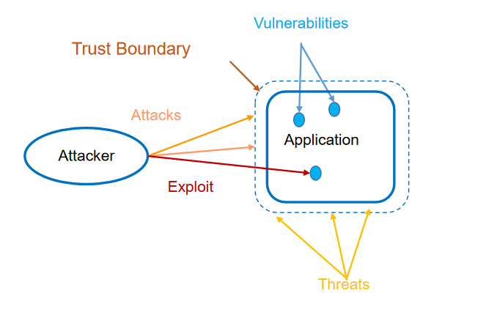
Trust boundary
Imaginary border that architects create.
Everything inside is assumed to be trustworthy.
Everything outside is untrusted.
CYBR 271: Secure Programming
Slide 5
Notes:
Talk about each of these elements.

Slide 6
Trust boundary - multiple
There might be different levels of trust.
Trust boundaries can be encapsulated by other ones.
Multiple trust boundaries may exist at the same level.
Should failure occur to one trust boundary it will not affect the assets within the others (ideally).
Trust boundary
Trust boundary
Trust boundary
Trust boundary
CYBR 271: Secure Programming
Slide 6
Notes:
Talk about each of these elements.

Slide 7
Trust boundary - example
Reference monitor (1972) defines set of requirements for enforcing trust boundary.
All four properties must hold:
non-bypassable
operation testable and analysable
always involved
tamper-proof
Trust boundary
Object
Reference monitor
Subject
Object
Object
Here the trust boundary is being enforced by the reference monitor.
CYBR 271: Secure Programming
Slide 7
Notes:
Talk about each of these elements.

Slide 8
Trust boundary - example
What might this mean if we are considering a firewall:
non-bypassable
operation testable and analysable
always involved
tamper-proof
Trust boundary
PC
Firewall
Client
Server
PC
CYBR 271: Secure Programming
Slide 8
Notes:
Talk about each of these elements.

Slide 9
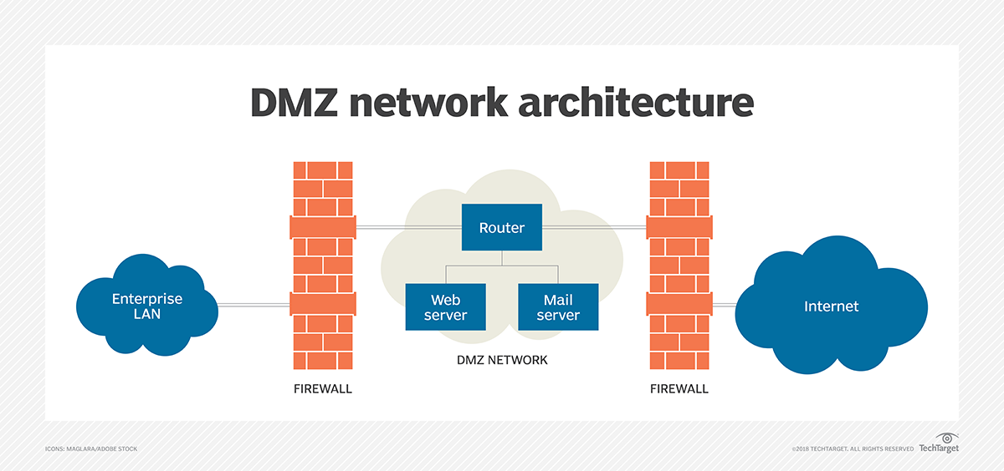
Trust boundary - example
What might this mean if we are considering a firewall:
non-bypassable
operation testable and analysable
always involved
tamper-proof
CYBR 271: Secure Programming
Slide 9
Notes:
Talk about each of these elements.

Slide 10
Secure by design
Establish trust boundaries
Don’t reinvent the wheel
Economy of mechanism
Separation of duty
Open design
Minimize the attack surface
Secure the weakest link
CYBR 271: Secure Programming
Slide 10

Slide 11
Don’t Reinvent the Wheel
There is a lot of code available
Some of it has been written by smart people
Some of it has been thoroughly vetted
Some of it is know to be secure or more secure than untested code you might write yourself
Check the Common Vulnerability Database
http://nvd.nist.gov
When there is good security code available, don’t try to create your own
Security is difficult to do
Mature frameworks provide features you don’t have time to develop
CYBR 271: Secure Programming
Slide 11

Slide 12
Don’t Reinvent the Wheel - Examples
Cryptography is difficult to implement well.
Can you trust your own algorithm?
Can you trust yourself to implement an existing algorithm correctly?
What is worth your time, finding a well-regarded cryptographic library or writing your own insecure one?
CYBR 372 Applications of Cryptography
Web application frameworks simplify development.
Do you have time to implement security features?
Is it better to use a framework that is mature and has had effort put into making it secure than writing your own insecure one?
Input validation, SQL injection avoidance, XSS avoidance, CSRF protection
Assignment 2 covers this issue
CYBR 271: Secure Programming
Slide 12

Slide 13
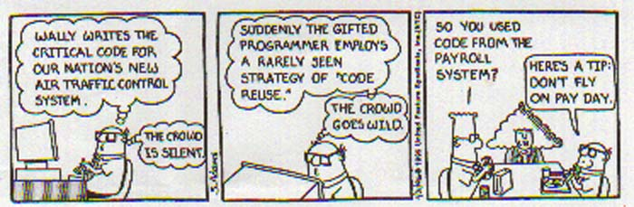
Don’t reinvent the wheel - Problems
There is potentially a drawback to this approach.
http://rohitn.com/images/java/dilbert_codereuse.jpg
CYBR 271: Secure Programming
Slide 13
Notes:
What is the problem here?

Slide 14
Secure by design
Establish trust boundaries
Don’t reinvent the wheel
Economy of mechanism
Separation of duty
Open design
Minimize the attack surface
Secure the weakest link
CYBR 271: Secure Programming
Slide 14

Slide 15
Don’t reinvent the wheel - Problems
There is potentially a drawback to this approach.
Open Web Application Security Project “Using Components with Known Vulnerabilities”.
https://owasp.org/www-project-top-ten/OWASP_Top_Ten_2017/Top_10-2017_A9-Using_Components_with_Known_Vulnerabilities
https://retirejs.github.io/retire.js/
CYBR 271: Secure Programming
Slide 15

Slide 16
Economy of Mechanism
Principle: Security mechanisms should be as simple as possible
- Security mechanism are technical tools and techniques implementing security
– Corollary: All code designs should be kept as simple as possible
The KISS adage, "Keep It Simple Stupid," applies to security
Complicated is the enemy of security
High complexity leads to more defects
Complicated code is more difficult to test and patch
Adding security means more code
Simple security constructs
Are more likely to be defect-free
Require less development and test time
Don't implement unnecessary security constructs
CYBR 271: Secure Programming
Slide 16
Notes:
What is a mechanism?

Slide 17
Economy of Mechanism
Complicated
consisting of parts intricately combined
Difficult to analyse, understand or explain
Complicated relates to how we have solved a problem
Problem might be complex, this is nothing to do with the solution.
Complex problems may have simple or complicated solutions.
More complicated the solution, the harder it is to get it right especially when it comes to security.
CYBR 271: Secure Programming
Slide 17

Slide 18
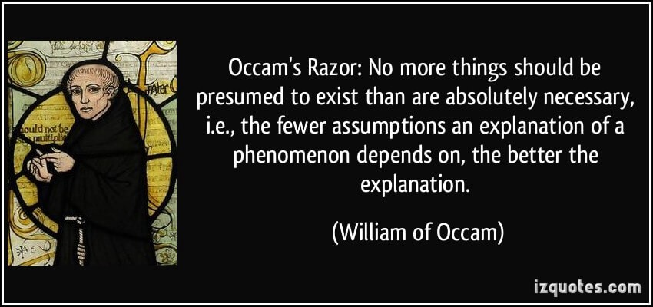
Economy of Mechanism – Occam’s Razor
CYBR 271: Secure Programming
Slide 18
Notes:
William of Occam
https://en.wikipedia.org/wiki/William_of_Ockham
Occam's razor, Ockham's razor, Ocham's razor (Latin: novacula Occami) or law of parsimony (Latin: lex parsimoniae) is the problem-solving principle that "entities should not be multiplied without necessity.“
The idea is attributed to English Franciscan friar William of Ockham (c. 1287–1347), a scholastic philosopher and theologian who used a preference for simplicity to defend the idea of divine miracles.

Slide 19
Economy of Mechanism
Developers tend to seek clever solutions that require complicated code.
Complicated code leads to more and more security defects.
Complicated security mechanisms are more likely to fail.
Simple security mechanisms are less likely to fail.
Simple system has fewer defects.
CYBR 271: Secure Programming
Slide 19

Slide 20
Economy of Mechanism - Examples
Multiple people using the same application, for example a database.
Security problem is how to prevent some information disclosure.
“top secret” users work with “top secret” data.
“confidential” users work with “confidential” data.
How do you prevent a “top secret” user writing “top secret” data to somewhere than a “confidential” user can see it and causing an information disclosure.
Answer ….
CYBR 271: Secure Programming
Slide 20

Slide 21
Economy of Mechanism - Examples
Implement code that checks when a “top secret” user attempts to write data to a place that it can be read by a “confidential” user.
Compartmentalise the systems
- two databases running on different physical computers
- “top secret” users only have logins for the “top secret” database.
“confidential” users only have logins for the “confidential” database.
B over A for the military because being able to demonstrate security is more important than saving costs (i.e. hardware) or flexibility.
CYBR 271: Secure Programming
Slide 21

Slide 22
Secure by design
Establish trust boundaries
Don’t reinvent the wheel
Economy of mechanism
Separation of duty
Open design
Minimize the attack surface
Secure the weakest link
CYBR 271: Secure Programming
Slide 22

Slide 23
Separation of Duty
Principle: Privileges should not be granted based on a single condition
- Corollary: Requiring multiple components to agree before access can be granted to a resource is more secure than requiring only one
A simple example is the need for two signatures in order for a bank to make a payment
The objective of this principle is to:
– Prevent the breach of one component leading to the breach of others
– Minimises the effect of a security breach
CYBR 271: Secure Programming
Slide 23

Slide 24
Separation of Duty - example
Two factor authentication.
attacker has to get hold of both a secret and token
Accounting systems.
one person can receive an invoice
another person makes the payment
CYBR 271: Secure Programming
Slide 24

Slide 25
Separation of Duty - example
Monolithic software:
- Is conceptually more complex
- Has more defects
- Is harder to maintain
- Is more expensive to test/deploy/update/patch
Consider a distributed system using services
- File mgmt., Mail handling, interface, dbaccess, …
- Faster to create/build/deploy/patch
- Easier to secure
- Easier to update/patch
CYBR 271: Secure Programming
Slide 25

Slide 26
Secure by design
Establish trust boundaries
Don’t reinvent the wheel
Economy of mechanism
Separation of duty
Open design
Minimize the attack surface
Secure the weakest link
CYBR 271: Secure Programming
Slide 26

Slide 27
Open design
Principle: The security of a component or system should not depend on the secrecy of the design or implementation
– Kerckhoff's Principle: Crypto-systems should remain secure even when the attacker knows all the internal details (stated in 1883)
Keys: the secret data that must be protected
Also known as avoiding "Security by Obscurity"
It is highly unlikely that any algorithm or method can be kept secret
– Many people know
– Attackers can guess and probe the application
– Your own documentation may reveal the secrets
CYBR 271: Secure Programming
Slide 27

Slide 28
Open design
Openness applies to algorithms and implementation details, but not to data like encryption keys and passwords (the Keys)
The more review and testing of security code, the more secure it becomes (assuming some skill!)
The security of a system should depend on the possession of easy to protect passwords and keys, not on the ignorance of the attacker
CYBR 271: Secure Programming
Slide 28

Slide 29
Open design
You should not depend on obscurity for protection
But using obscurity as camouflage is fine
– Port knocking
– Changing the name of the Admin user
– Changing cgi-bin to demos
– Changing the name of system administration executables
But making it more difficult, is never the wrong thing to do
CYBR 271: Secure Programming
Slide 29

Slide 30
Open design
Design security features as though only the keys are private
–The point of open design is that secrets usually are not secret
–If your software has proprietary algorithms, processes and procedures, assume they are public when you design
–Without proprietary algorithms, you need to be especially careful with keys
Areas where data is commonly assumed to be safe when it is not
–Registry keys
–Hard-coded passwords or encryption keys
–Data or code in HTML pages
–Anything stored on a client host
–Anything sent over an unencrypted communication channel
CYBR 271: Secure Programming
Slide 30

Slide 31
Open design
Obscure or customized security algorithms are seldom reliable which increases risk
- Encryption
- Randomization
- Session management
Any security mechanism that depends on no one noticing is doomed to failure
Keys are safe only if you make them so
– Inside of your Trust Boundaries
– Security features designed to protect them even if everyone knows how they work
CYBR 271: Secure Programming
Slide 31

Slide 32
Secure by design
Establish trust boundaries
Don’t reinvent the wheel
Economy of mechanism
Separation of duty
Open design
Minimize the attack surface
Secure the weakest link
CYBR 271: Secure Programming
Slide 32

Slide 33
Minimise the attack surface
The smaller the attack surface, the safer the application.
The risk to an application is:
– Size of the Attack Surface x The Probability of a Vulnerability
– The probability of a vulnerability is not going to be zero
Attack surface reduction (ASR) requires an acceptance of the idea that code is never completely secure
– Design or implementation failures
– Poor configurations
– Failure to install patches or upgrades
– New attack types
– Mistakes
Decreased attack surface size decreases the opportunity for attackers
Decreased attack surface size simplifies the overall security problem
CYBR 271: Secure Programming
Slide 33

Slide 34
Secure by design
Establish trust boundaries
Don’t reinvent the wheel
Economy of mechanism
Separation of duty
Open design
Minimize the attack surface
Secure the weakest link
CYBR 271: Secure Programming
Slide 34

Slide 35
Minimise the attack surface
Attack Surface Reduction focuses on
– Reduce the amount of running code - By default, only necessary code should be running
- This is greatly enhanced by modularizing and isolating software components
- Consider a distributed architecture
Limit access to code when not universally required
– Minimize open ports and services
- Only allow services to run that are necessary
- Close all unnecessary ports
- Obscure or often unused protocols are often vulnerable
e.g. finger, whois, gopher
CYBR 271: Secure Programming
Slide 35

Slide 36
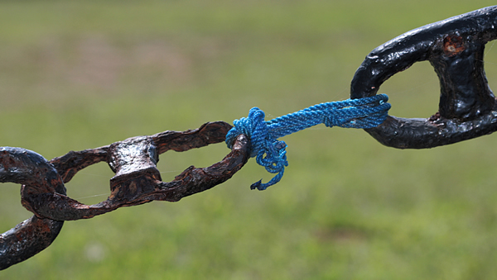
Secure the weakest link
Principle: Attackers will attack the weakest security point in the application
– Corollary: One valid secure coding outcome is encouraging the attacker to go after someone else
– Corollary: A chain is as strong as its weakest link
Adversaries will expend the least amount of effort possible to penetrate a system
–They will work no harder than necessary
–If they have to work too hard, they may move on to another target (depending on how attractive the asset is)
http://www.businessearth.com/wp-content/uploads/supply_chain_sustainability.jpg
CYBR 271: Secure Programming
Slide 36

Slide 37
Secure the weakest link
Threat Models will lead you to the weakest areas
–Invest in remediating weakest security defenses
–There will always be a new weakest link
–Attackers will go after weakest links simply because they are easy
They are looking for a foothold or information to use
Factor in the four sources of threats
–Social: People
–Operational: Processes (and People)
–Technological: The application and network
–Environmental: Facilities
Which threat sources are more likely to be weak?
CYBR 271: Secure Programming
Slide 37

Slide 38
Secure the weakest link - example
HP Printers using Jetdirect firmware include an embedded web server
–Allows for remote administration of the device
–Due to an undisclosed design flaw, the server handles passwords in an insecure manner
–Attacker can gain unauthorized access to the device and also create a denial of service.
Networked printers, in general, are poorly secured.
CYBR 271: Secure Programming
Slide 38

Slide 39
Secure the weakest link – tips
Use Threat Models to understand your attack surface
Make sure you don't ignore operational and social threats
Test your application thoroughly
–Have a test plan
–Use Red Teaming and/or third-party audits
–Test for all of the obvious vulnerabilities
- SQL Injection
- XSS
- Authentication Bypass
CYBR 271: Secure Programming
Slide 39

Slide 40
What’s next?
Secure by default
Secure by implementation
CYBR 271: Secure Programming
Slide 40

