Slide 1
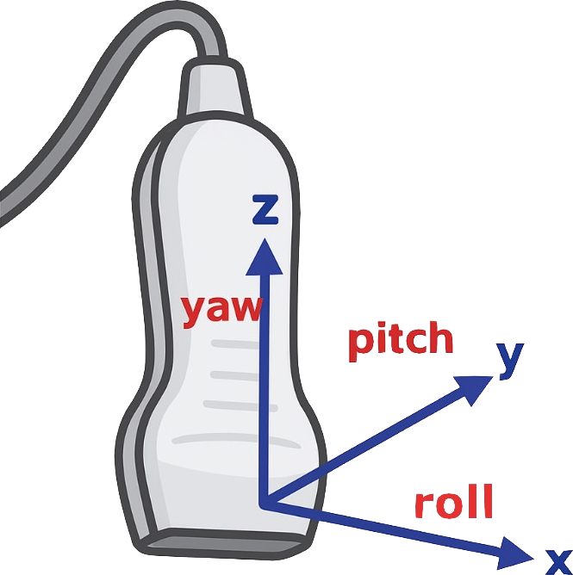

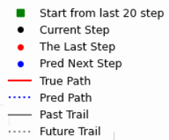


$$Model1 Translation$$
$$Model1 Rotation$$

Slide 2


$$Model2 Translation$$
$$Model2 Rotation$$

