Slide 1
Superconductivity
Jack Barlow, Stefano Falero, Yuchen Kan, Yunjie Wang

Slide 2
Introduction
Cooper Pair
Hamiltonian
Mean-Field Approximation
Bogoliubov Transformation
Result
Ground State
Gap Function
Experimental
Analytical

Slide 3
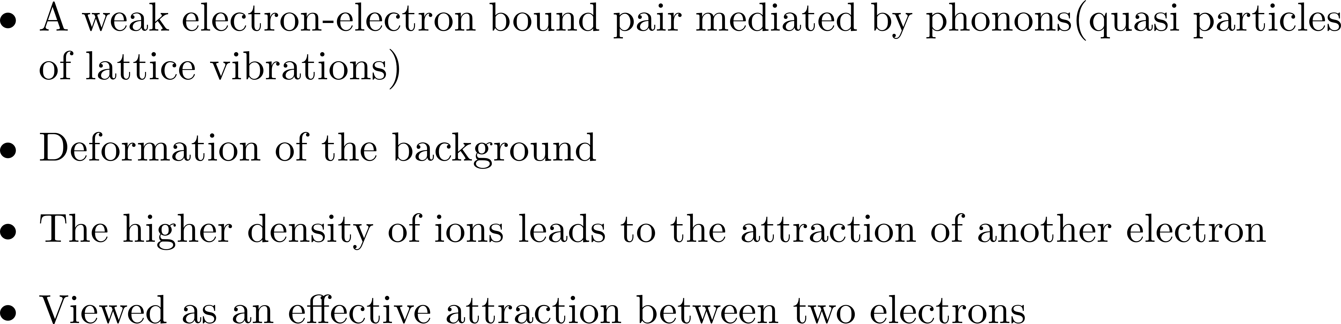
Cooper Pair
Source: http://ffden-2.phys.uaf.edu/212_fall2003.web.dir/T.J_Barry/bcstheory.html

Slide 4
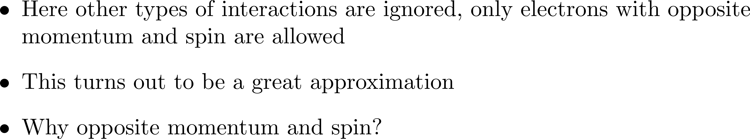
Hamiltonian

Slide 5
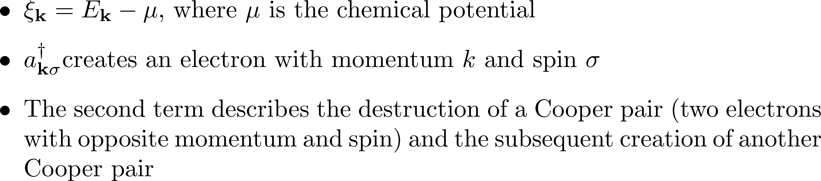
Hamiltonian

Slide 6
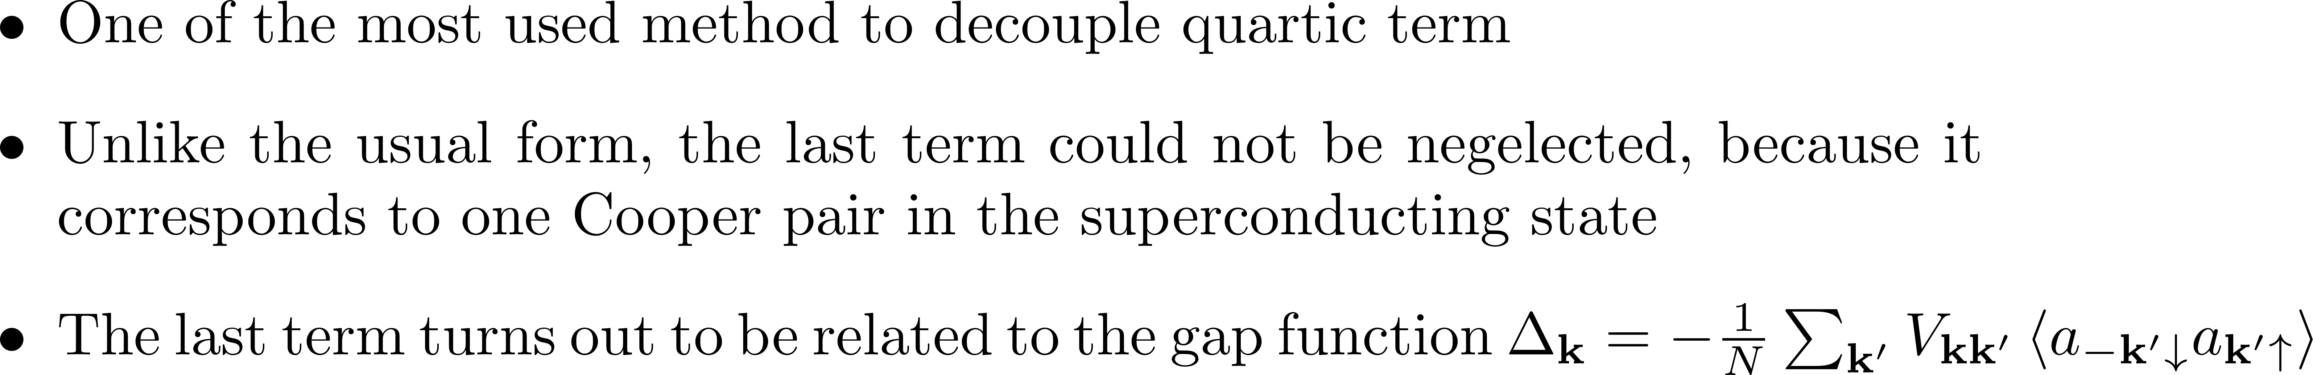
Hamiltonian – Mean-Field Approximation

Slide 7
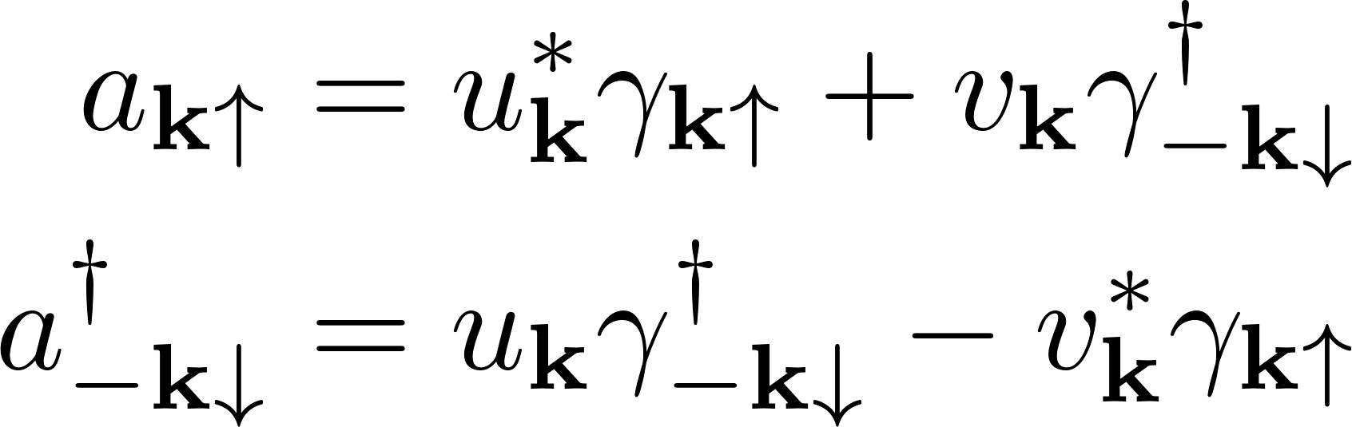
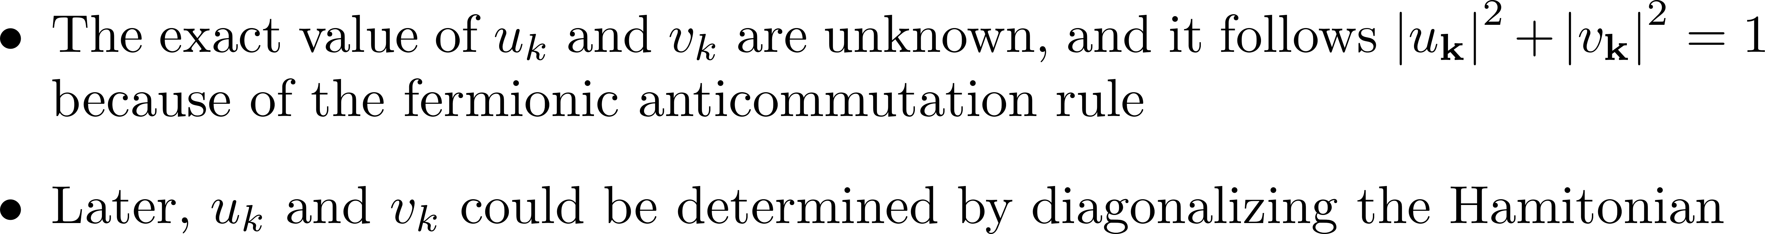
Hamiltonian – Bogoliubov Transformation

Slide 8
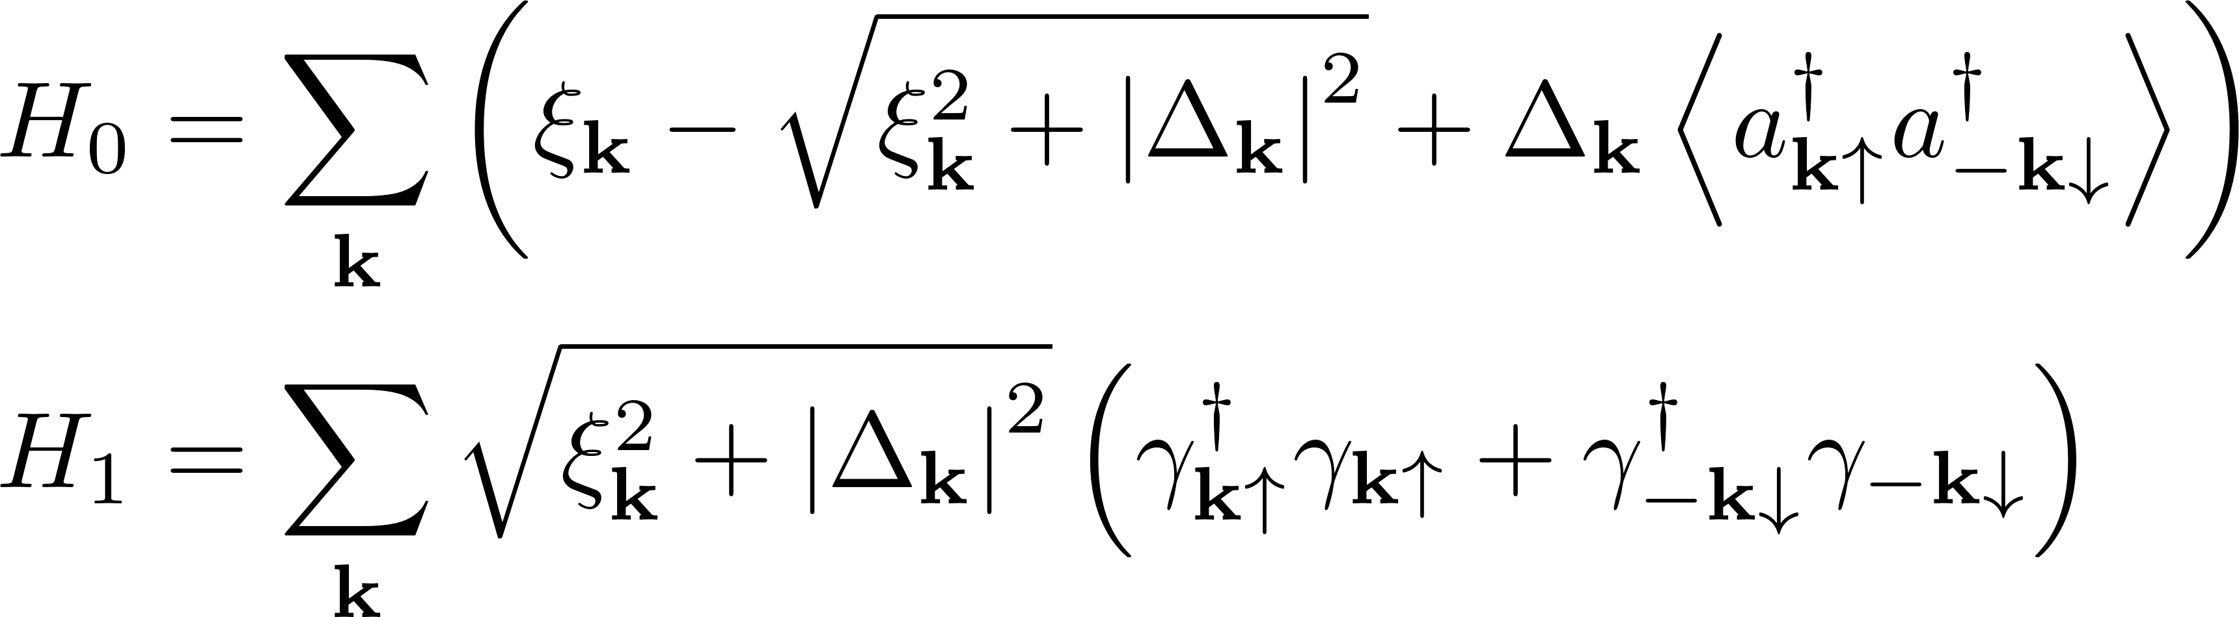
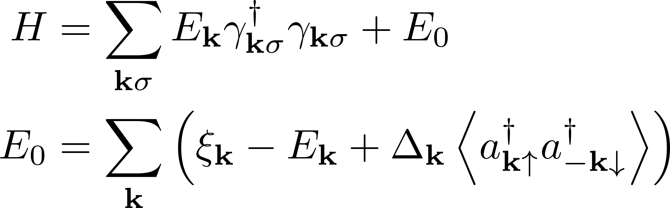
Hamiltonian – Result

Slide 9
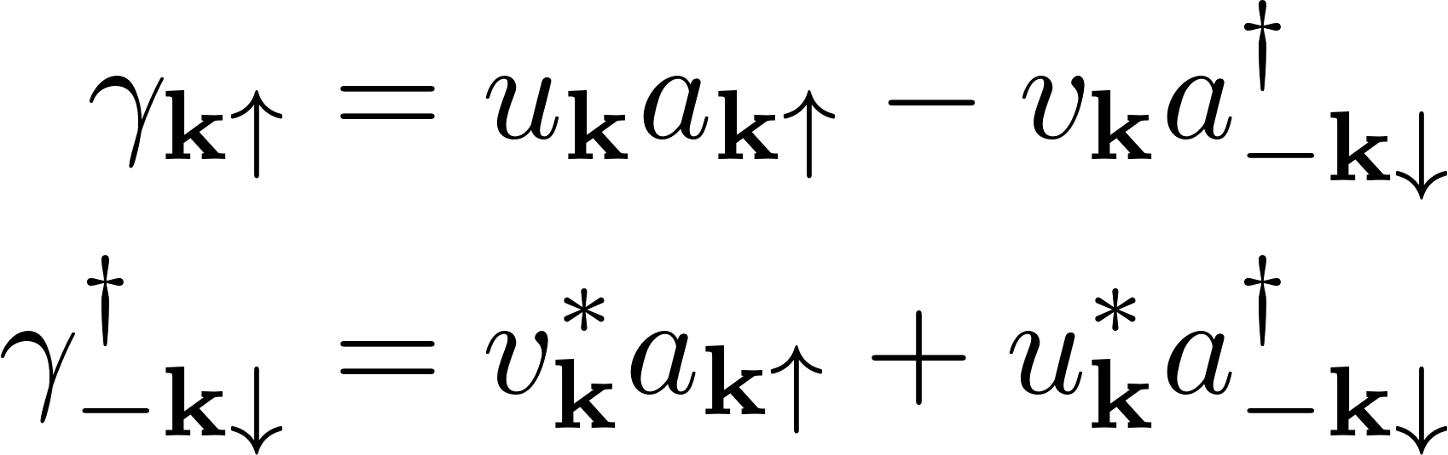
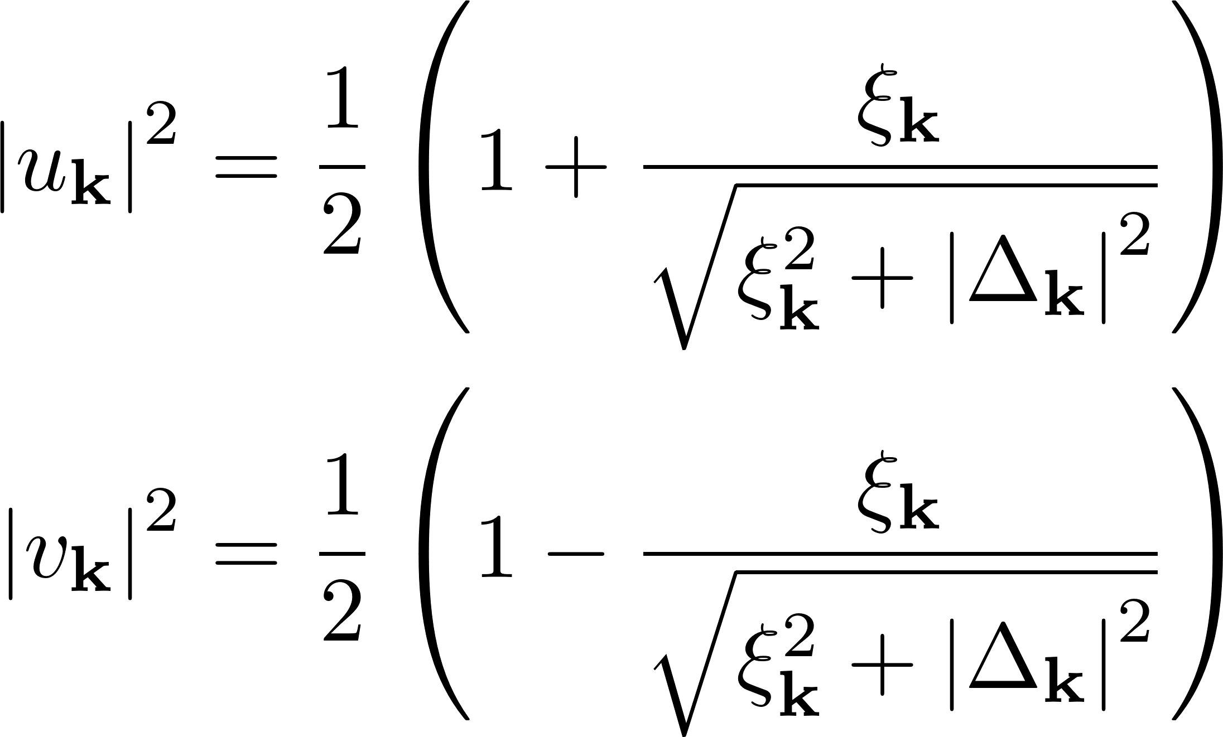
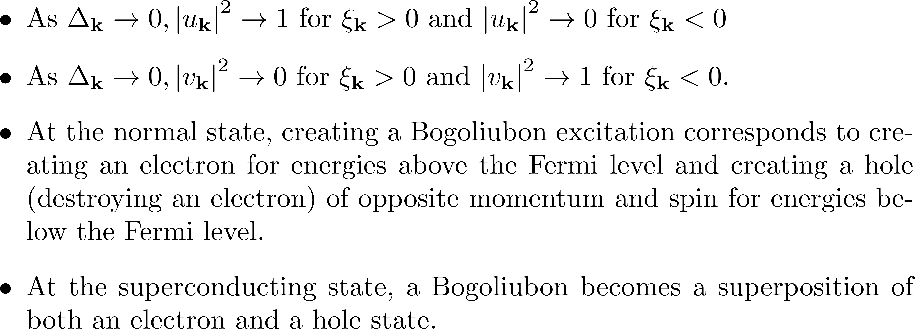
Hamiltonian – Bogoliubov Transformation Revisit

Slide 10
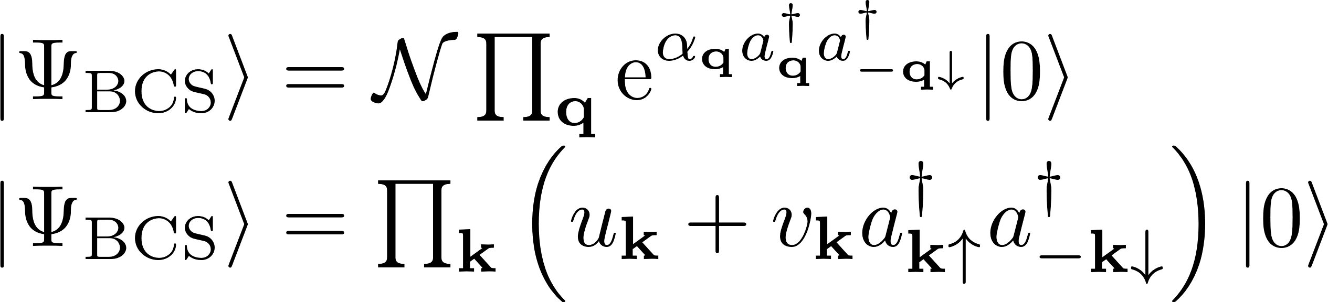
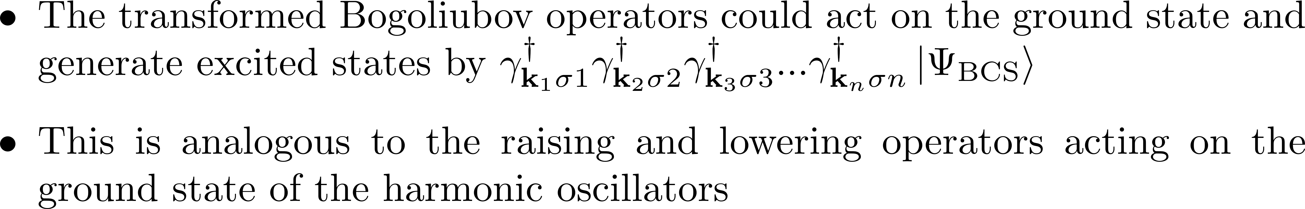
Ground State

Slide 11
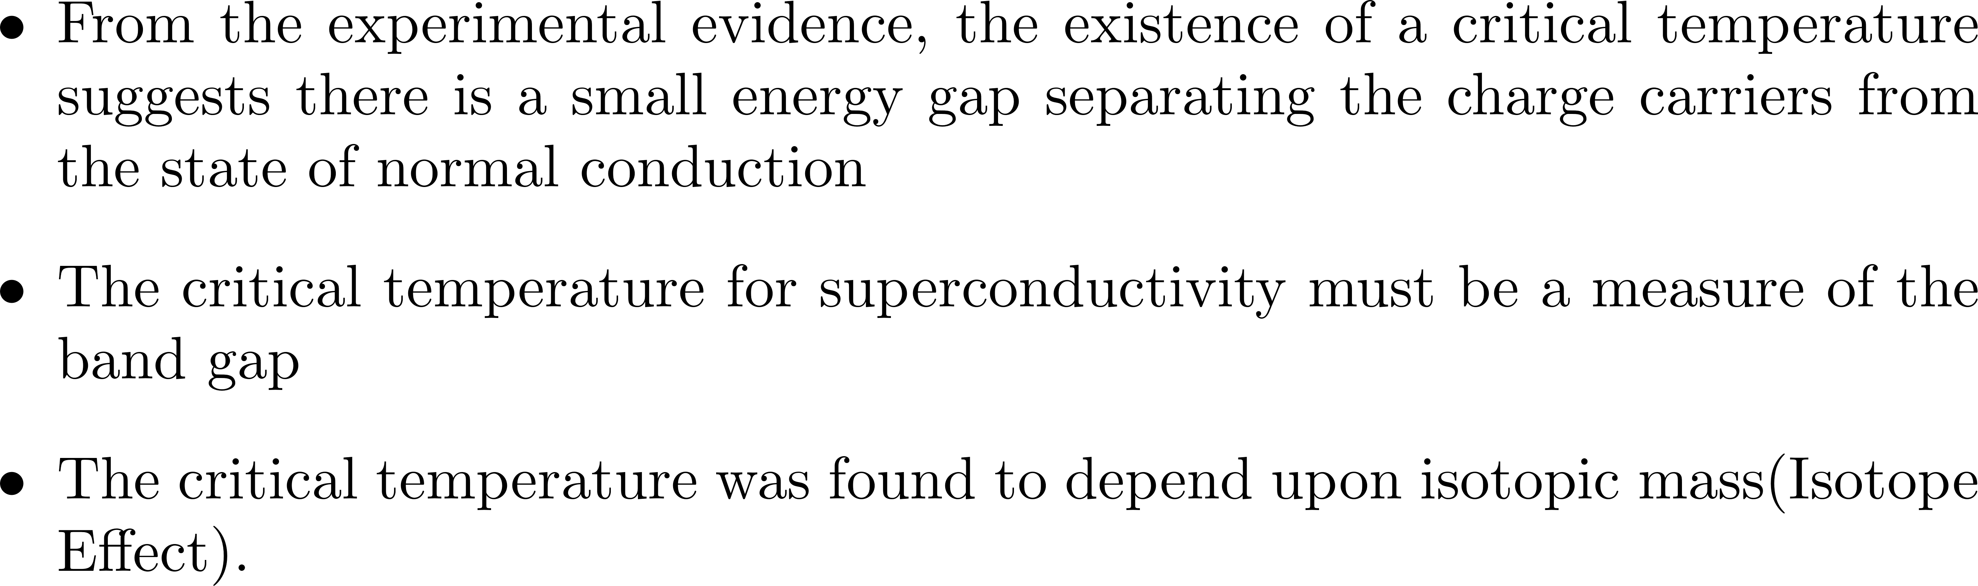
The Gap Function (Experimental)

Slide 12
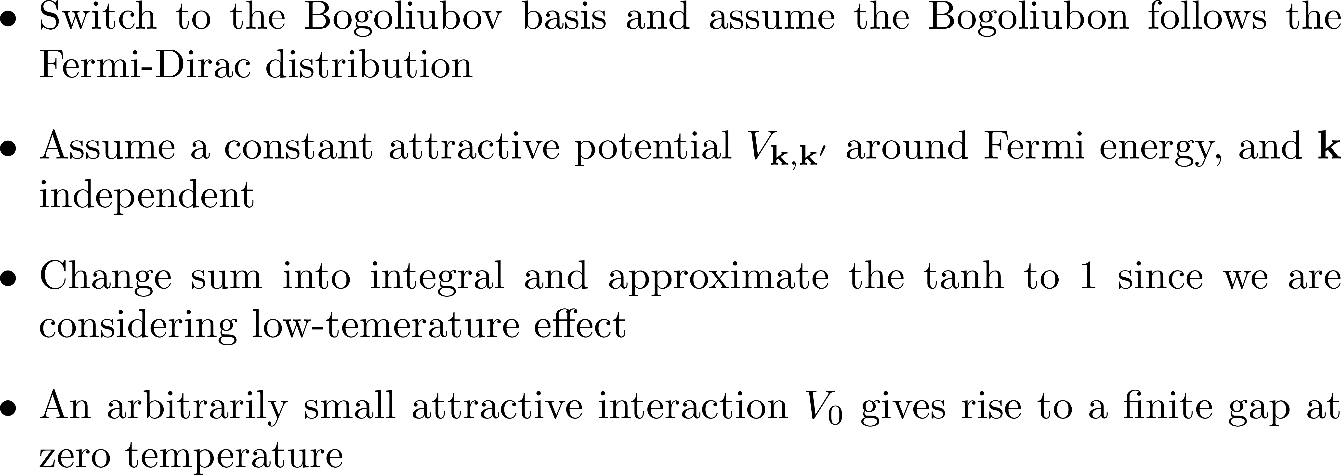
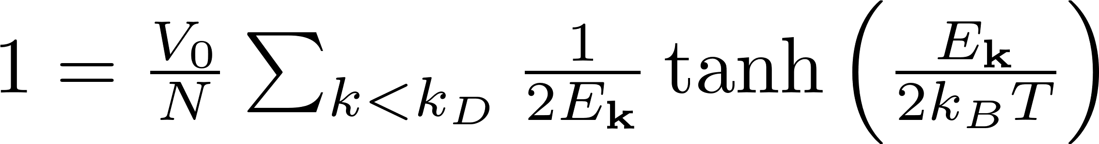
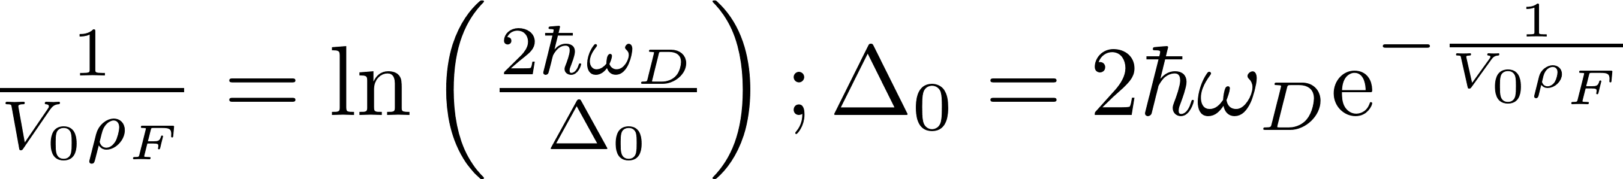
Gap Function (Analytical)

Slide 13
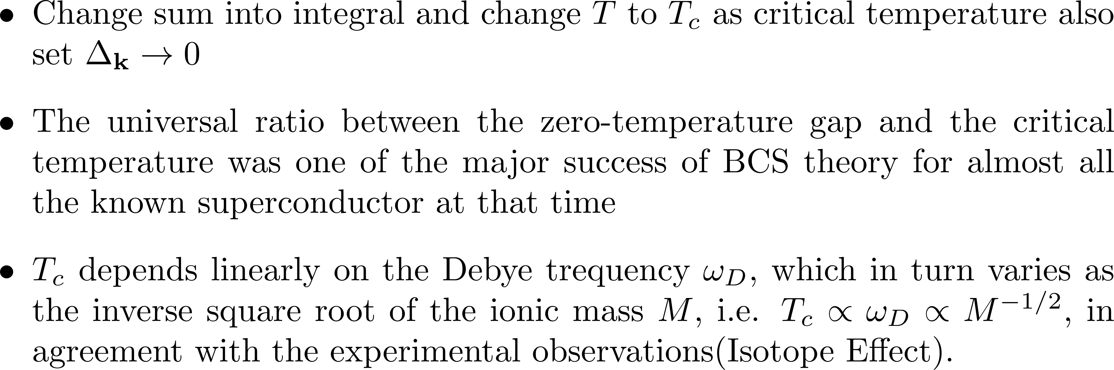
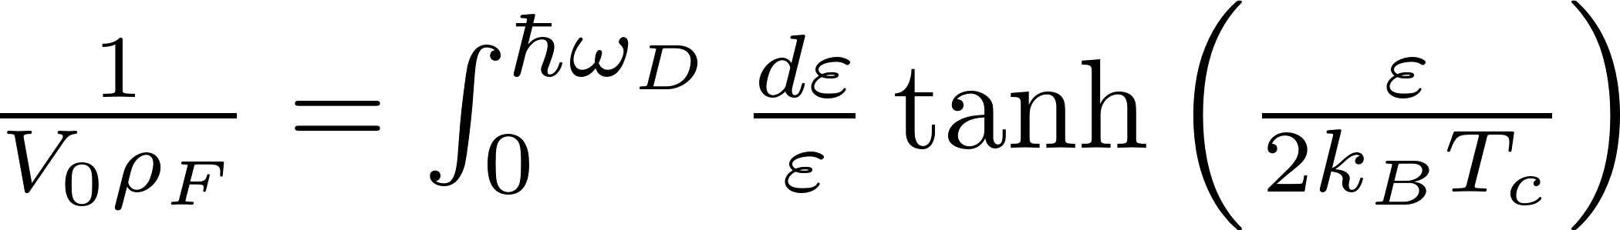
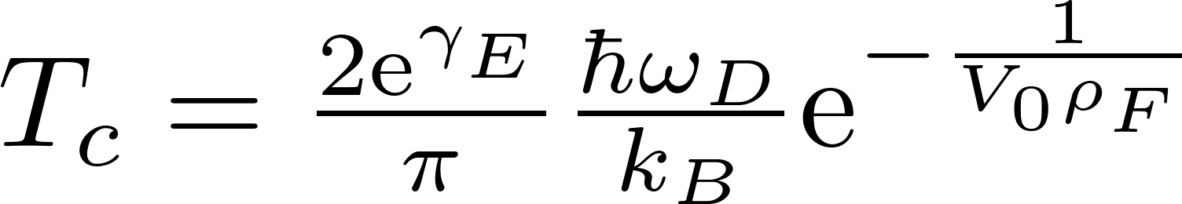
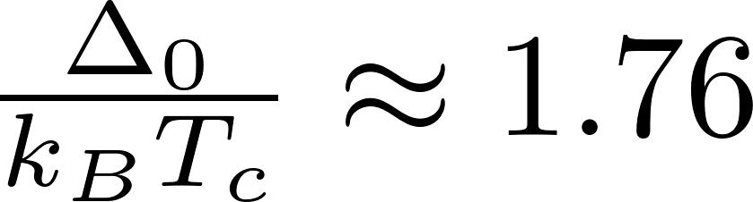
Gap Function (Analytical)

