Slide 1
Quantum Teleportation
By Yifan Shen, Yunjie Wang, Chengdao Yu and Wade Wu

Slide 2
Part 2: Experimental Setup(Optical) - Yunjie
Motivation
Initial State Preparation
Building Blocks
Hadamard Gate and Control-NOT Gate

Slide 3


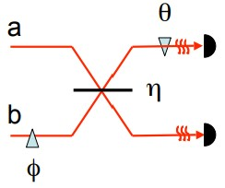
Motivation

Slide 4
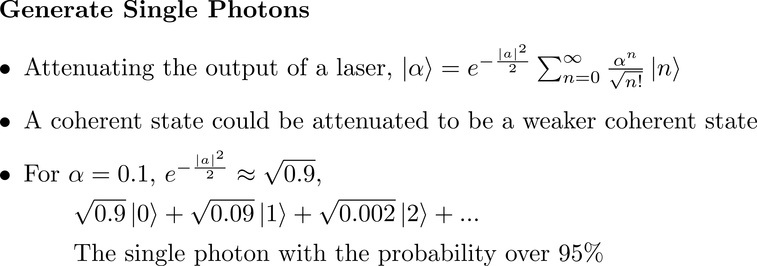


Initial State Preparation

Slide 5




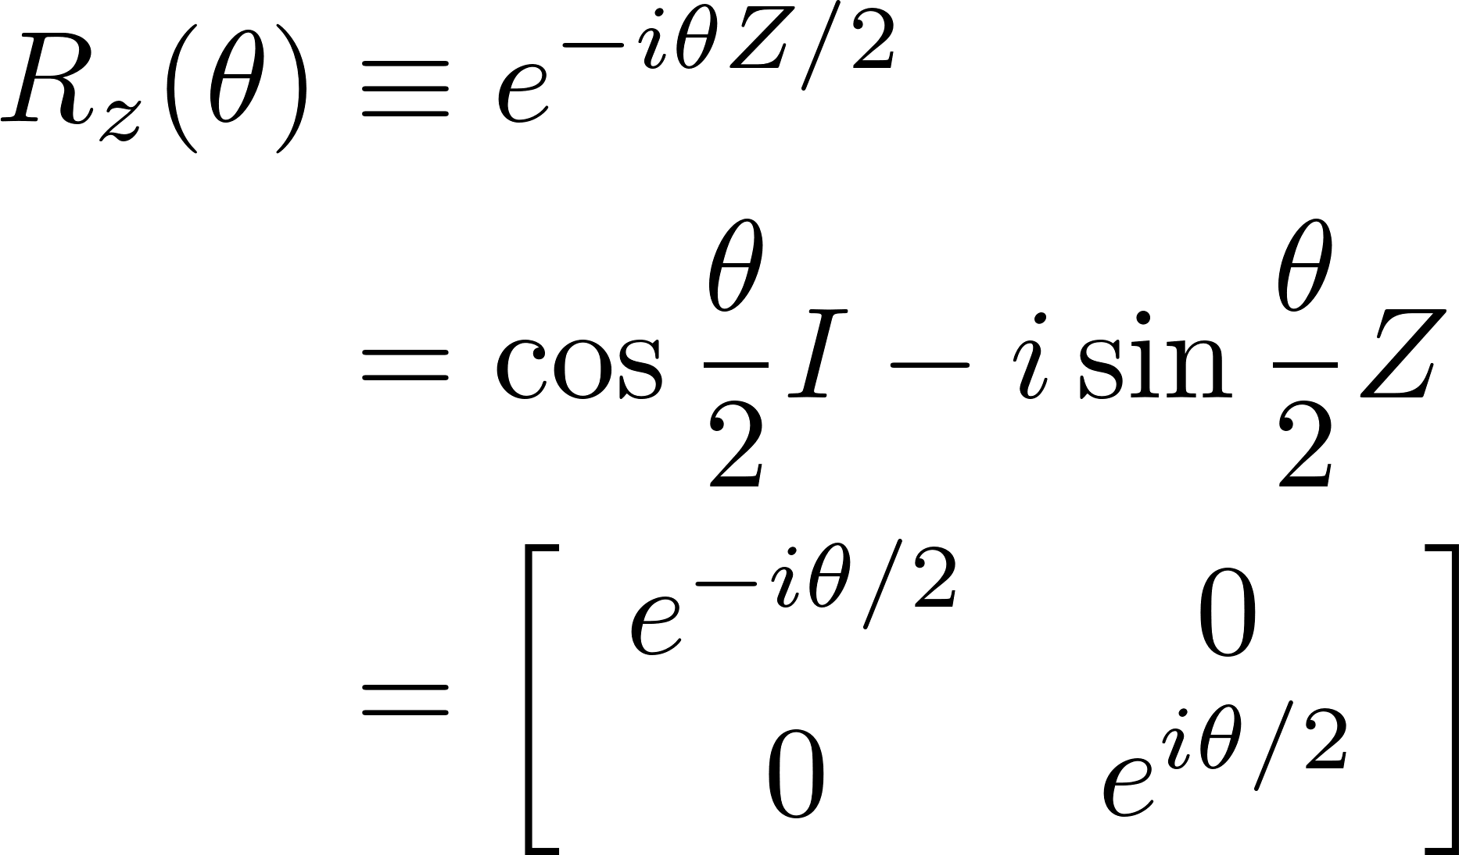
Building Blocks – Phase Shifters

Slide 6

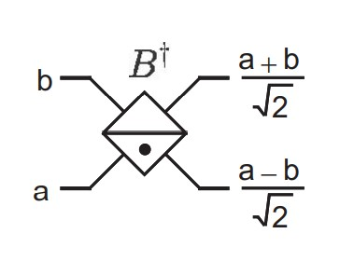
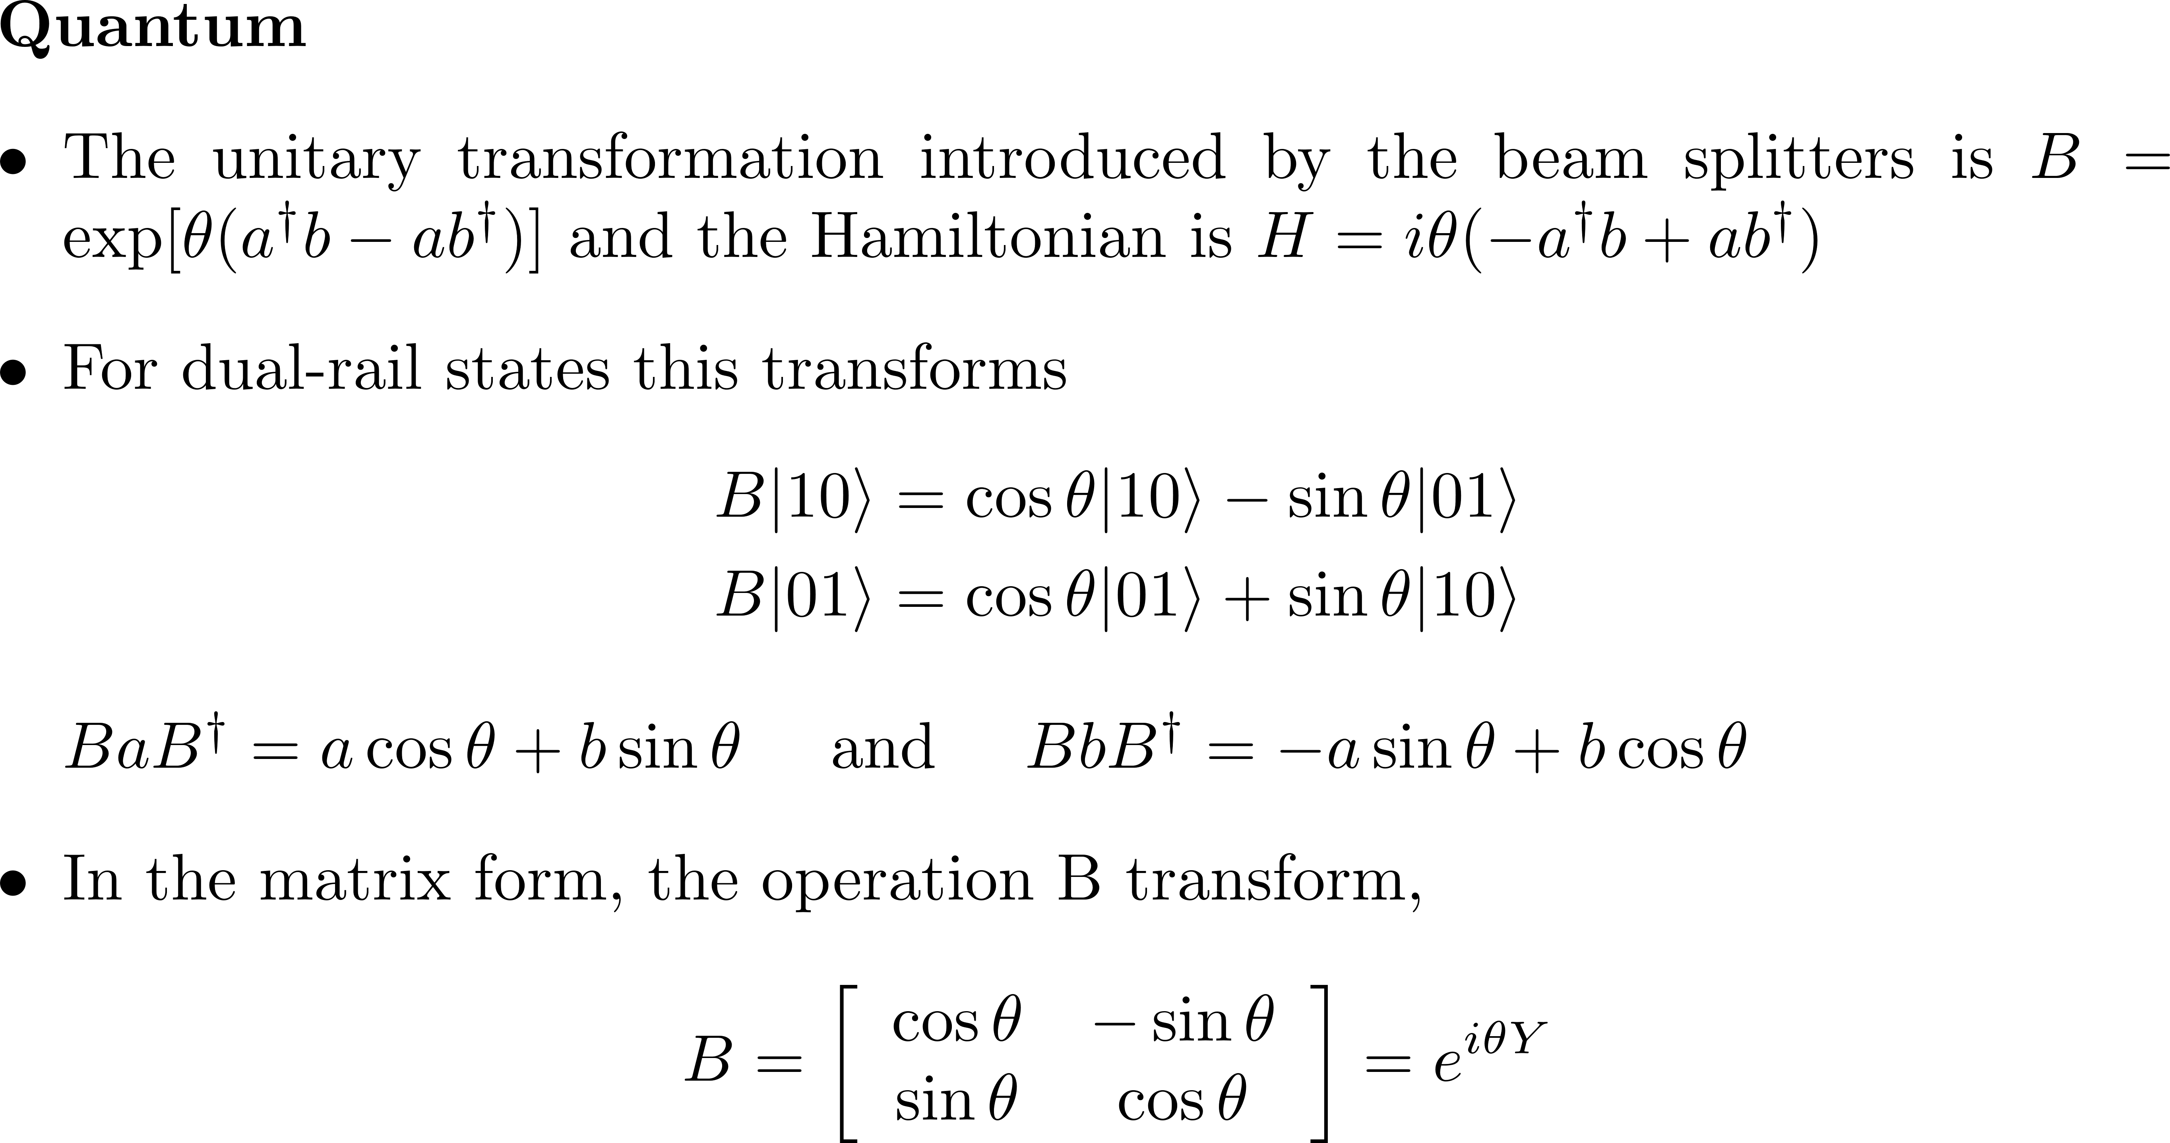
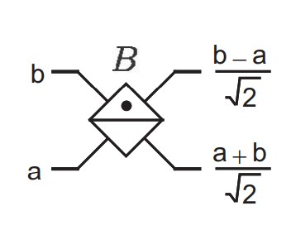
Building Blocks – Beam Splitters

Slide 7



Building Blocks – Non-Linear Kerr Media

Slide 8
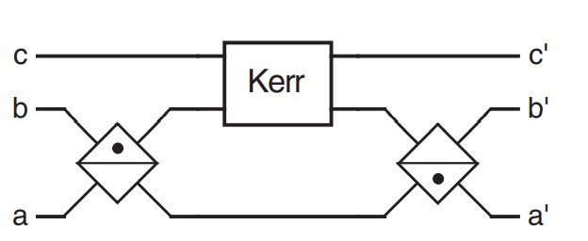
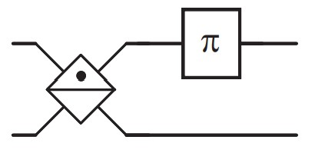


(Optical) Hadamard Gate/ CNOT Gate

Slide 9
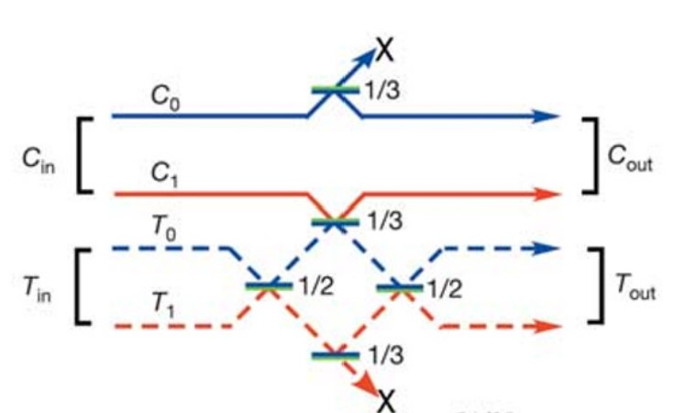

Only Linear Optics?

