Slide 1
Manage your little memory
It's too expansive to expand memory
team char / 22.08.25

Slide 2
Feedbacks
by peers
Need summary of concepts about 'Page replacement algorithm' in subject 과제와 관련된 개념을 간단하게 명시해 줬으면 좋겠다.
Add other algorithms except OPT OPT 이외의 알고리즘도 다뤘으면 좋겠다.
Improvement of tester's readability 테스터 출력의 시인성을 개선했으면 좋겠다.

Slide 3
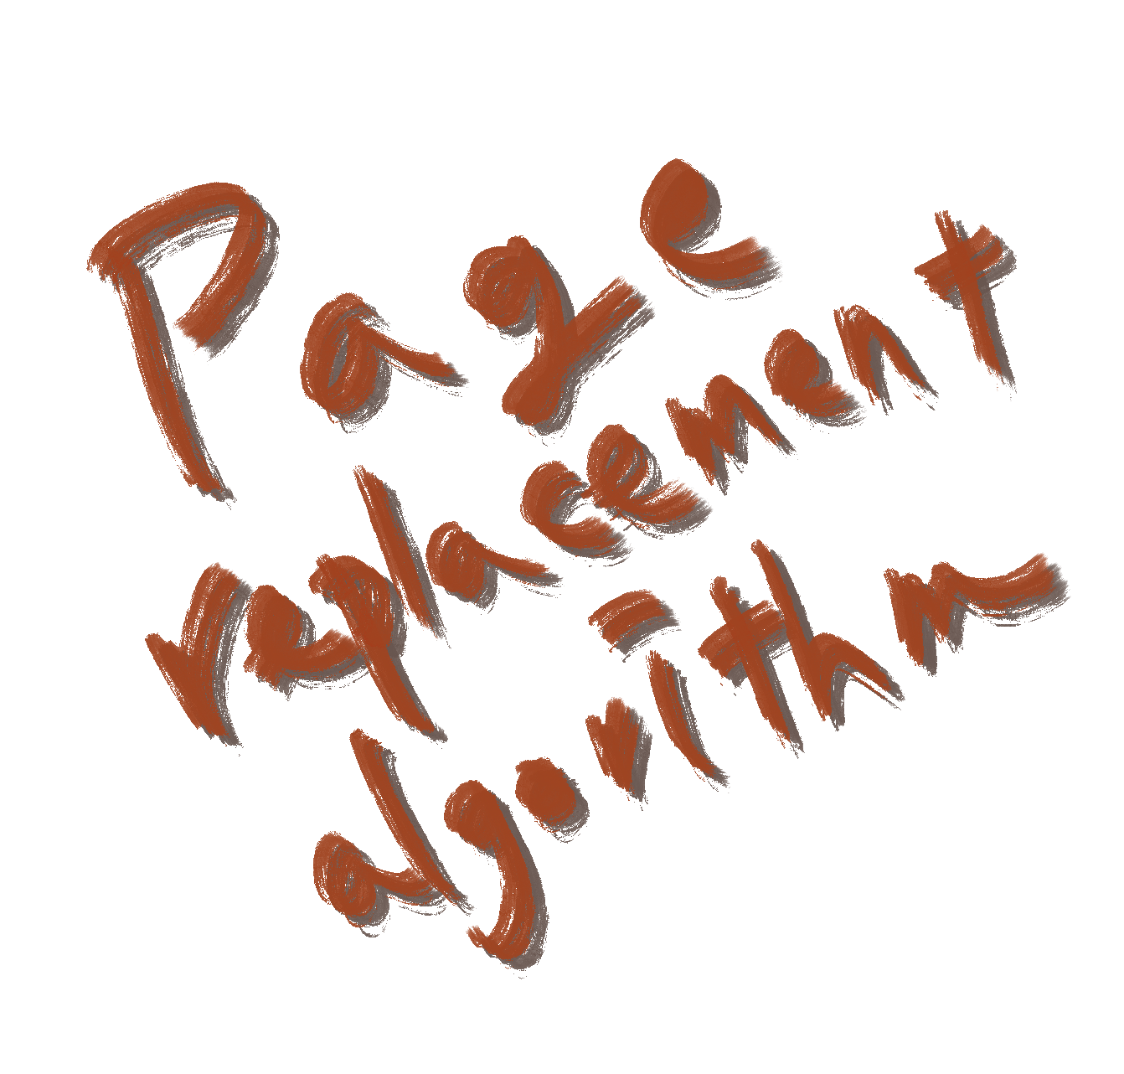
What to do
Page replacement algorithm
Simulate 'Optimal page replacement algorithm'
Learn 'How OS manage memory efficiently'
Never be embarrassed in an interview

Slide 4
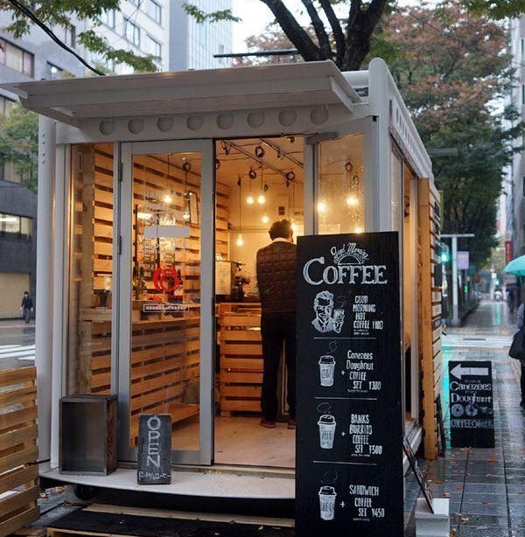
Page replacement
Choose a victim
You finally open a small cafe with only four tables.
Your cafe is very busy and every tables are full every day.
When a new guest come in, you must let someone out to make a empty table.
Which table will you choose?

Slide 5
Page replacement
Choose a victim
Customer who First In
Customer who Least Recently ordered
Customer who Least Frequently ordered
Customer who won't order for the longest time (you know the future)

Slide 6
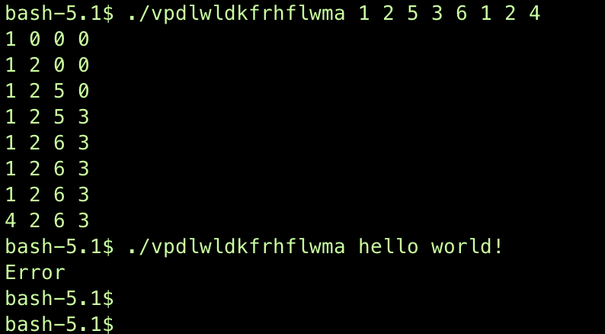
Mandatory
page algorithm
Arguments : list of Page Index
Output : Each Page Table after processing arguments per line
Need Error Handling
Must use OPT algorithm

Slide 7
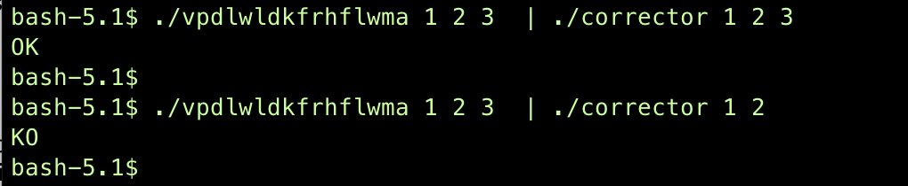
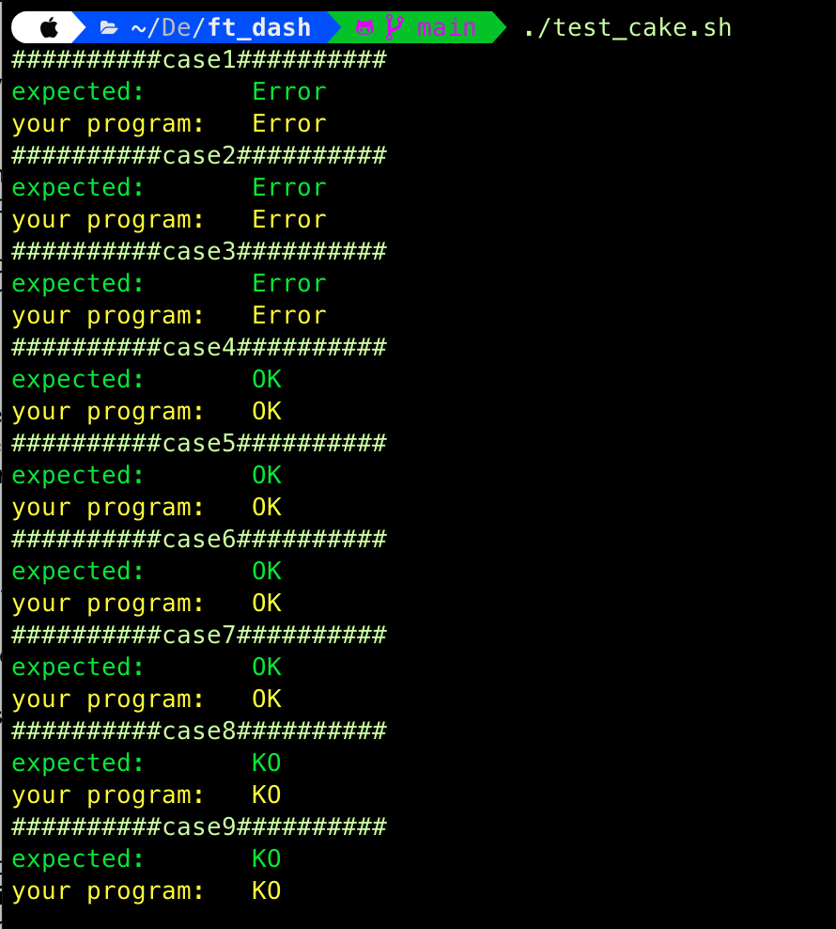
Test
corrector / tester
You can test your program with a provided binary 'corrector'
'corrector' will verify your program's output with "KO" or "OK"

Slide 8
Bonus
Be feasible
In Bonus, your program will read each index per line
And print output each times after read arguments.
So, you must choose victim only with past informations.
You must explain 'What algorithm you choose' and 'Why you choose your algorithm' in peer-evaluation.
Bonus will evaluate only by peer-evaluation.

Slide 9
QnA

