Slide 1


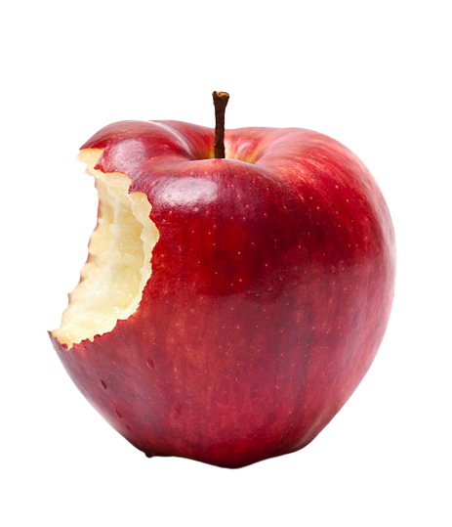

Prediction of Apple Sweetness, Using Deep Learning
2023.06.06
DLIP Final Project Progress Presentation
21800226 YunKi Noh
21801017 EunChan Kim
Sweet!

Slide 2
Prediction of Apple Sweetness, Using Deep Learning
2023.06.06
DLIP Final Project Progress Presentation
21800226 YunKi Noh
21801017 EunChan Kim
Sweet!

Slide 3
The Accomplished Progress
DLIP Final Project Progress report
TASK / PROCESS | WEEK 14 | WEEK 15 | WEEK 16
Classification
Regression
Instance Segmentation
Reduce Loss
Develop Application
Noh
100%
Kim
100%
Noh
10%
Kim
10%
Noh & Kim
Training approximately 50,000 apple-sweetness data using CNN

Slide 4
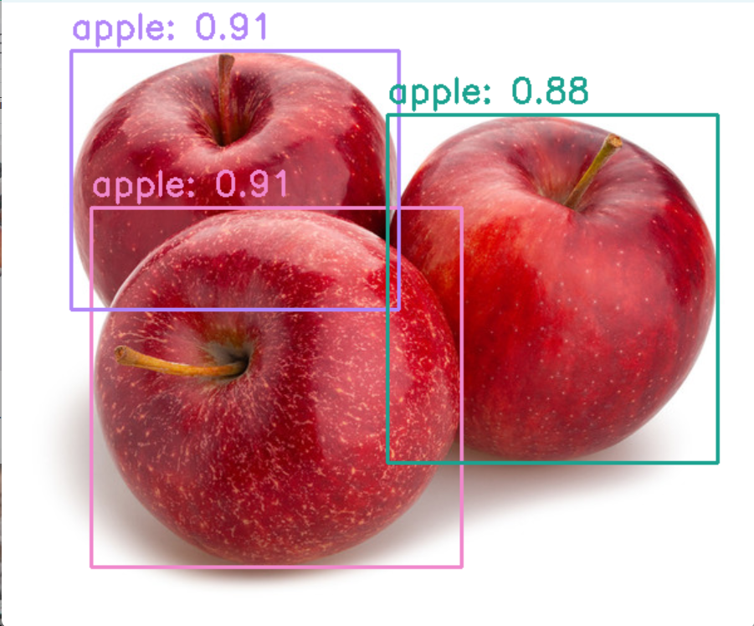
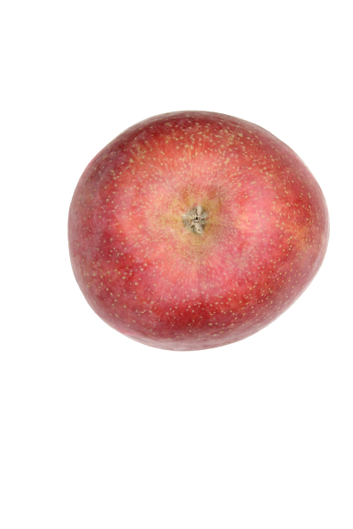
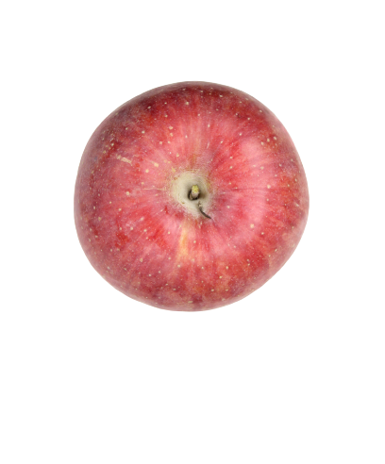
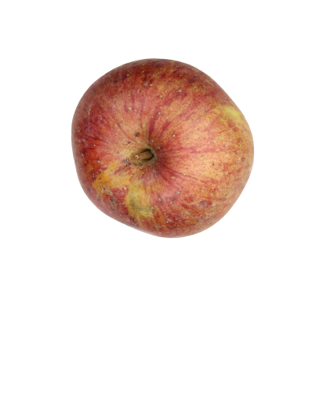
The Accomplished Progress
DLIP Final Project Progress report
Classification
Train Output
Train loss :
(MSE)
ResNet50 > DensNet > VGG16 > Inception v3
5.07
5.24
8.36
11.03
Brix Prediction
Class A
(Over 14 brix)
Class B
(between 11~14 brix)
Class C
(Under 11 brix)
100% classification performance
for apples with below 4 instances
13.0 brix
12.3 brix
11.5 brix
→ The trend is correct,
but the predicted value is not accurate

Slide 5
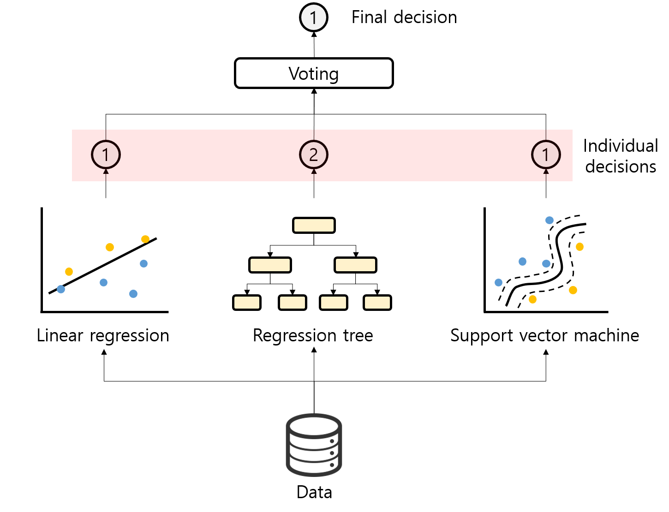
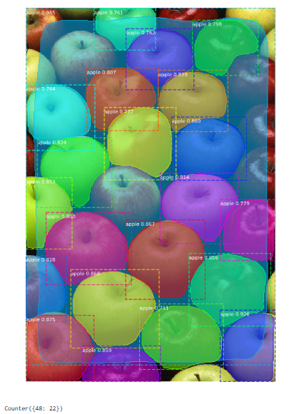
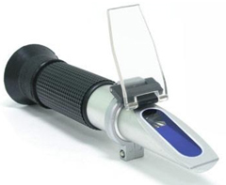
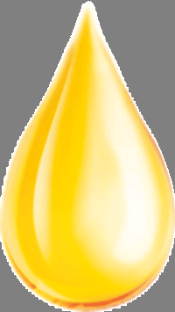
The Upcoming Process
DLIP Final Project Progress report
1. Plan to reduce the MSE loss to below 2.00
2. Detect apple along the edges to predict more precisely when we test with real apple
3. Verifying the variance between actual sweetness measurement and predicted values
Ensemble Method
Instance Segmentaion
Sugar Content Test Device
Notes:
Instance Segmentaion을 사용해서 배경을 제외하고 정확히 사과만 입력한다면 예측 결과가 더 좋을 것임.
Ensemble Method를 사용하여 사과가 어떤 등급에 위치하는지를 확인하고 가중치를 줘서 사과 당도 예측의 정확도를 높일 수 있을 것임.

