Slide 1
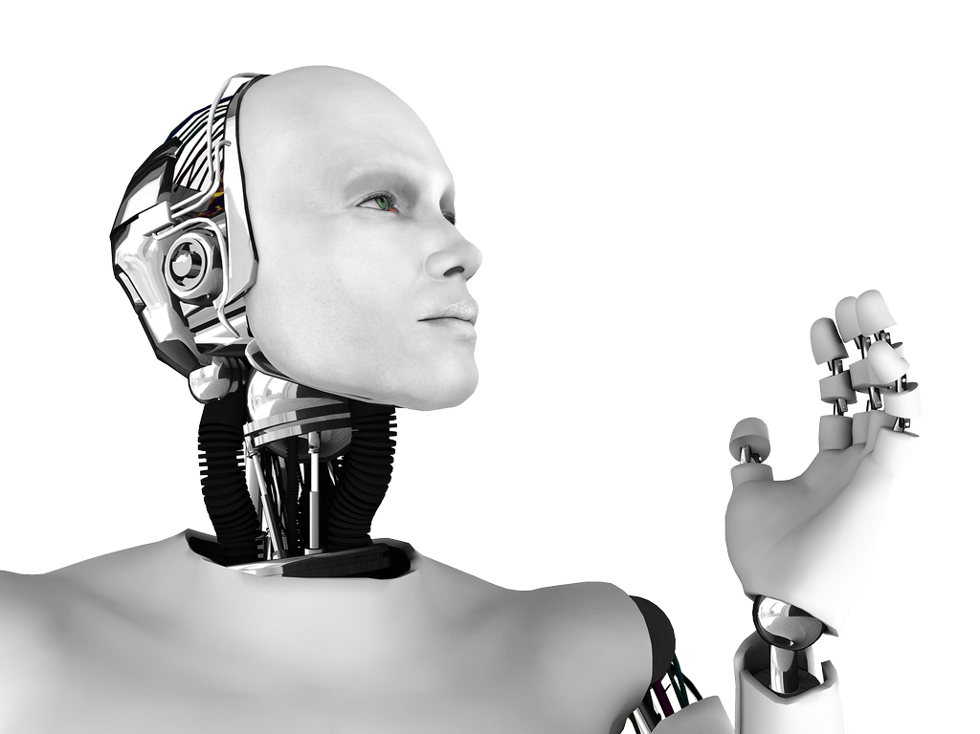

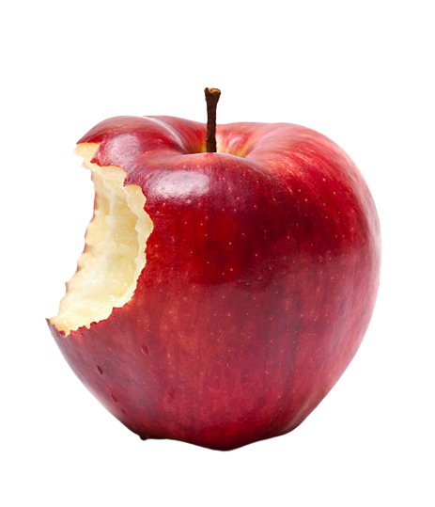

Prediction of Sweetness of Apple, Using Deep Learning
2023.05.26
DLIP Final Proposal
21800226 YunKi Noh
21801017 EunChan Kim
Sweet!

Slide 2
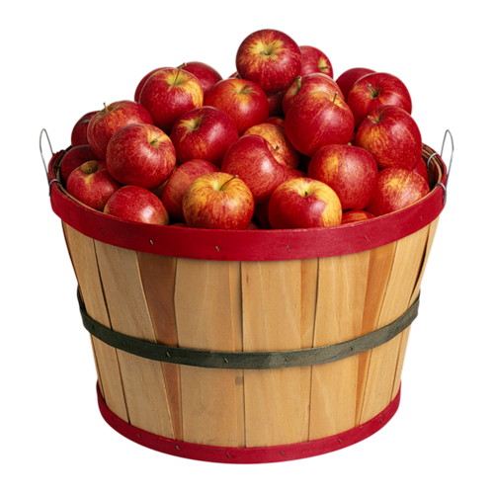
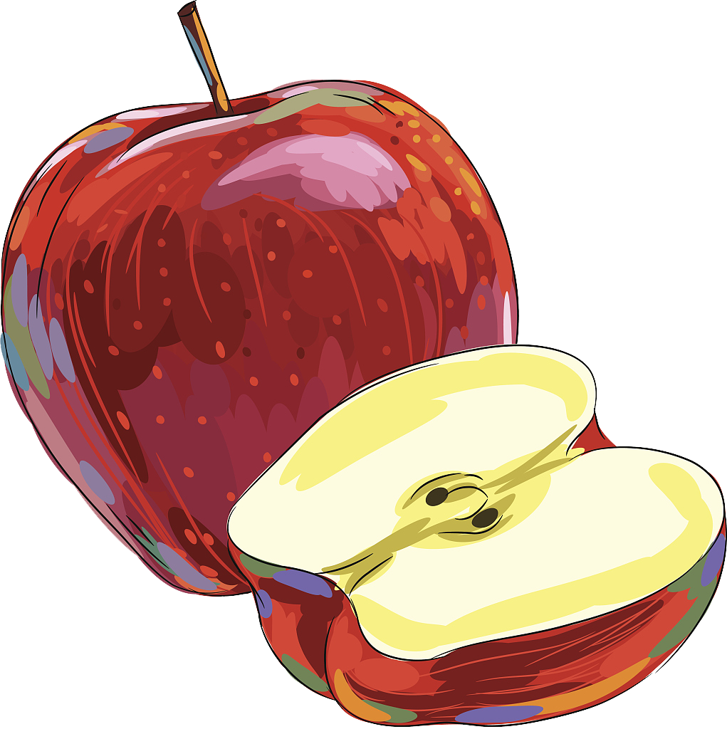
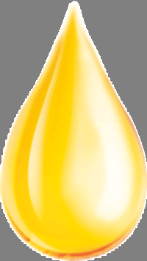
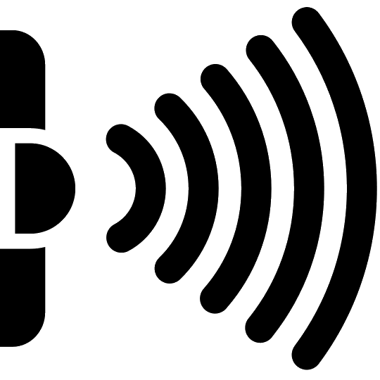
Problem
DLIP Final Proposal
”
Which Apple will be Sweetest?
Tasting?
Juice Drop?
Using Infrared Light?
: Damage to Apple
: Long Time & Cost

Slide 3



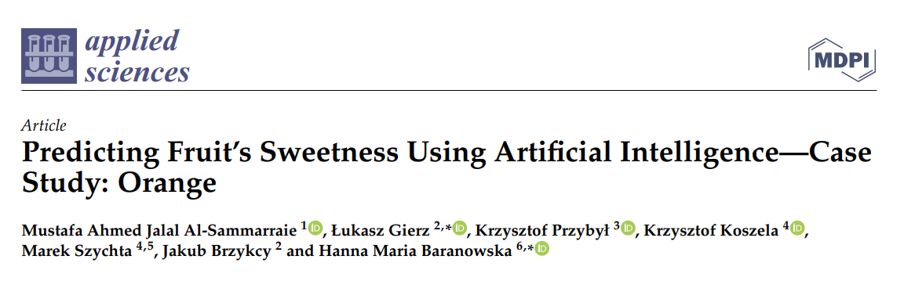
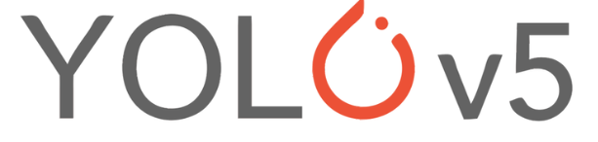
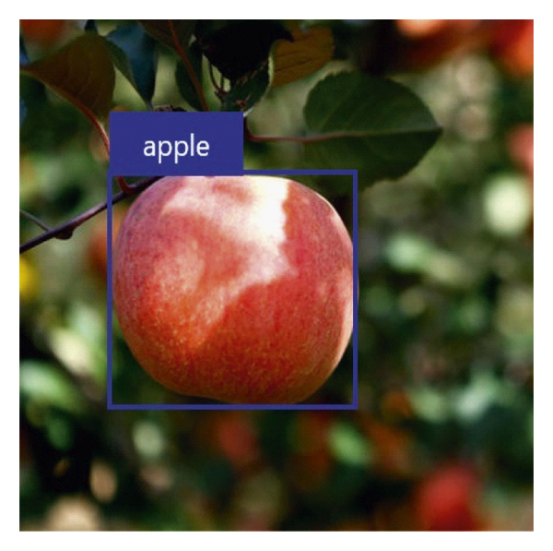

Solution
DLIP Final Proposal
Quality Data of Apple Sugar
Training Apple-Sweetness Data
Validating the Training Model
Testing with actual Apples
Developing for Smartphone Compatibility
450,187 Images of
Apple-Sweetness Labeling
Matching Apple Images with
Sweetness Levels using Deep Learning

Slide 4
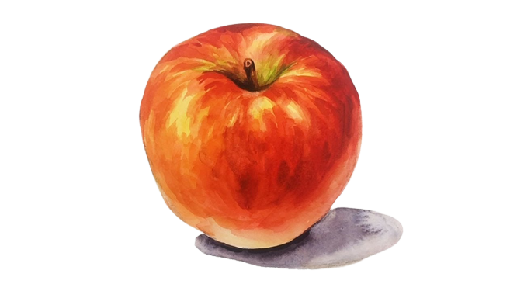

Expected benefits
DLIP Final Proposal
1. Simplicity
2. Measuring without Damage
3. Low Cost
Apple Brix: 14.5
Apple Brix: 10.7
High[2]
Medium[3]
:
→
→
Apple Brix: 18.6
Apple Brix: 6.3
Very High[1]
Low[4]
Rating criteria:
Very High: 18 °Brix or above (Blue)
High: 14 - 18 °Brix (Green)
Medium: 10 - 14 °Brix (Yellow)
Low: 6 - 10 °Brix (Red)

