Slide 1

24-2 Industrial AI & Automation
RUL Prediction of Oscillation Dataset
using Hjorth’s Parameters
Handong Global University
School of Mechanical & Control Engineering
21800226 Yun-Ki Noh
21800360 Si-On Seo
22100645 Ho-Jin Jang
Date: 2024.10.22 (Week 9)
Prof. Young-Keun Kim
1
Notes:
Hello, My name is Jang Ho Jin. And my partner is Seo Sion and Noh Yun Ki. We've worked on a project on the topic of RUL Prediction of Oscillation Dataset using Hjorths(Yort) Parameters.

Slide 2
Contents
Proposal Summary (p.3)
Datasets (p.6)
Data Analysis (p.7)
Discussion (p.15)
Conclusion (p.17)
Appendix (p.18)
2
Notes:
We organized the contents in the order of Proposal Summary, Datasets, Data Analysis, Discussion, Conclusion, and Appendix.

Slide 3
Proposal Summary (1)
Oscillation fault
Replace to
RUL Prediction
RUL Method
System Pause
Feature Extraction
Repair
Feature Selection
Reworking
RUL Prediction
Figure. 1 Previous Method to Improved Method (RUL)
3
Notes:
I'll summarize what we have announced in our proposal presentation. If the oscillation problem occurred, like bearing unit fails, the factory will have to stop the machine and replace the part, which is time-consuming and expensive. So, we selected building the RUL system to diagnose the system's failure as our purpose.

Slide 4
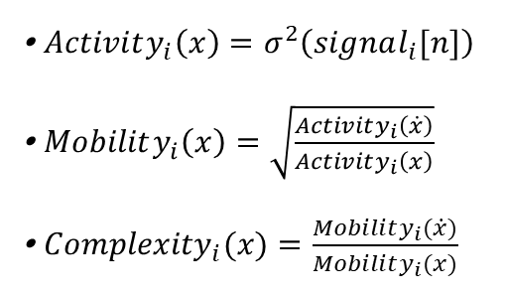
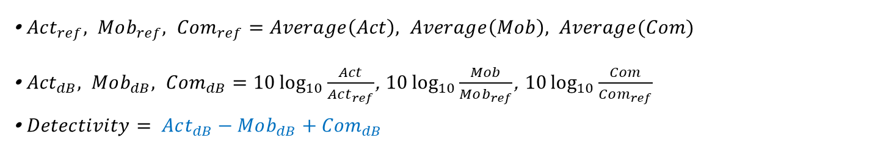
Proposal Summary (2)
Hjorth’s parameters
Activity
Consist Hyperparameter
Detectivity
Effective
Fault Diagnosis
Mobility
Complexity
Figure. 2 Three types of Hjorth’s Parameter and Detectivity
∙ $Activity_{i}\left(x\right)=σ^{2}\left(signal_{i}[n]\right)$
∙ $Mobility_{i}\left(x\right)=\sqrt{\frac{Activity_{i}\left(\dot{x}\right)}{Activity_{i}\left(x\right)}}$
∙ ${Complexity}_{i}(x)=\frac{Mobility_{i}(\dot{x})}{Mobility_{i}(x)}$
∙ $Act_{ref}, Mob_{ref}, Com_{ref}=Average\left(Act\right), Average\left(Mob\right), Average(Com)$
∙ ${Act}_{dB}, Mob_{dB}, Com_{dB}=10\log_{10}{\frac{Act}{Act_{ref}}}$, $10\log_{10}{\frac{Mob}{Mob_{ref}}}$, $10\log_{10}{\frac{Com}{Com_{ref}}}$
∙ $Detectivity= Act_{dB}−Mob_{dB}+Com_{dB}$
4
Notes:
-Hjort parameter로 detectivity에 관한 설명 간단하게

Slide 5
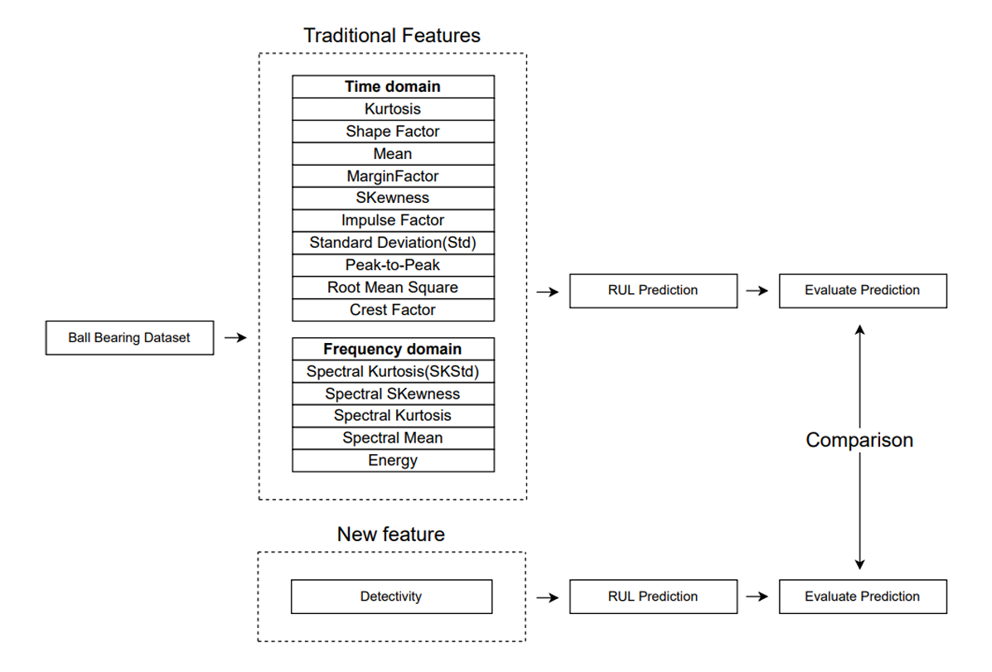
[1] Cocconcelli, M., Strozzi, M., Camargo Molano, J. C., & Rubini, R. (2022). Detectivity: A combination of
Hjorth’s parameters for condition monitoring of ball bearings. Mechanical Systems and Signal
Processing, 164, 108247. https://doi.org/10.1016/j.ymssp.2021.108247
Proposal Summary (3)
We will extract dominant traditional
features to compare traditional
RUL prediction with new
RUL prediction by using
new parameter named detectivity
Figure. 3 Flow Chart of Overall Project
5
Notes:
-Hjort parameter로 detectivity에 관한 설명 간단하게

Slide 6
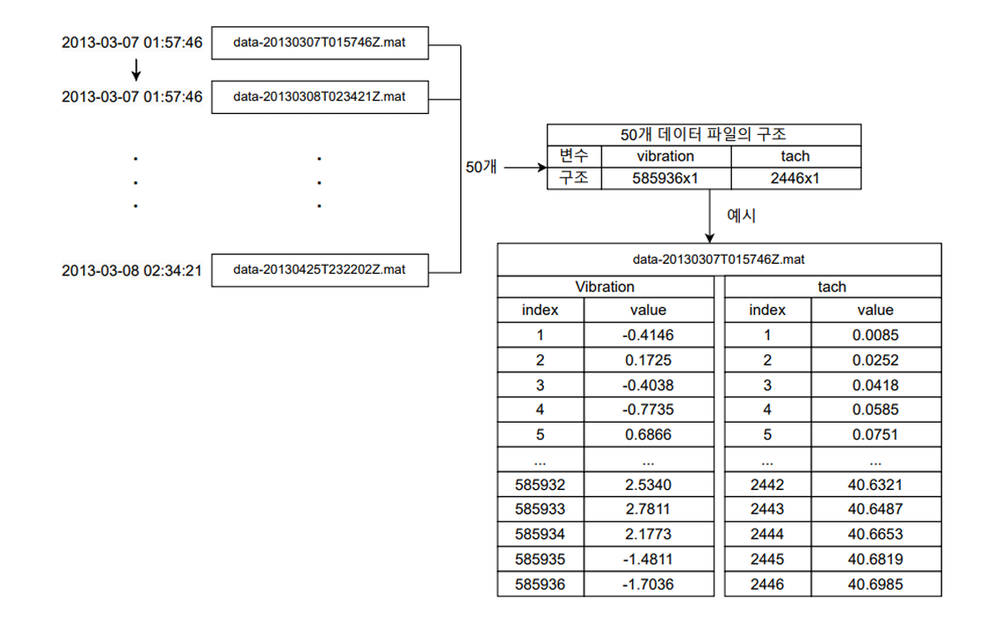
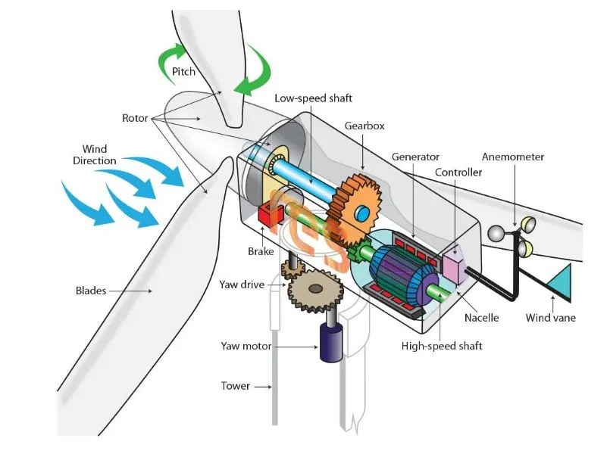
[2] Link 1: GitHub - mathworks/WindTurbineHighSpeedBearingPrognosis-Data: Data set for Wind Turbine High-Speed Bearing Prognosis example in Predictive Maintenance Toolbox
Datasets
Figure. 4 Wind Turbine
Dataset
Hardware: 20-tooth pinion gear / 2 [MW]
Sampling frequency: 97.66 [kHz]
Sampling time: 6 [s/day]
Data number: 585,936 data of each 50 files
Sampling period: 50 [day]
Figure. 5 Structure of Wind Turbine Dataset
6
Notes:
First of all, we will compare the RUL method and evaluate whether the Detectiviy method, which excludes characteristic extraction, is efficient.
Next, we will determine whether the Detectivity method is valid on other datasets, and evaluate the evaluation of how well it predicts real signals based on errors.
Dataset 설명

Slide 7
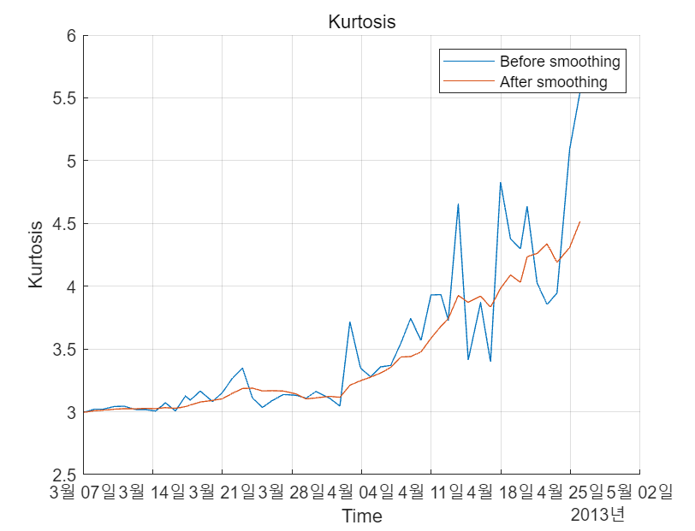
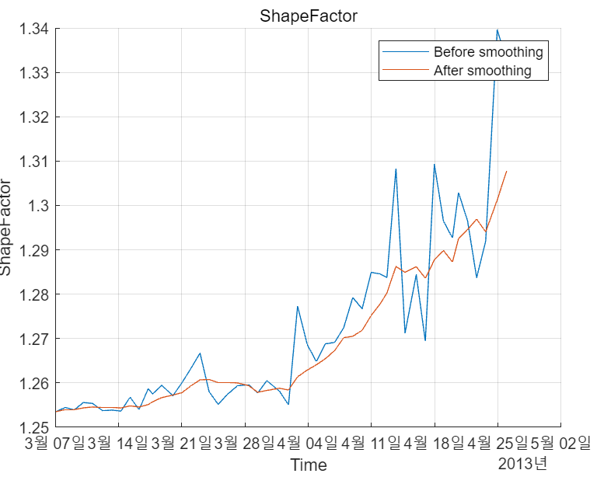
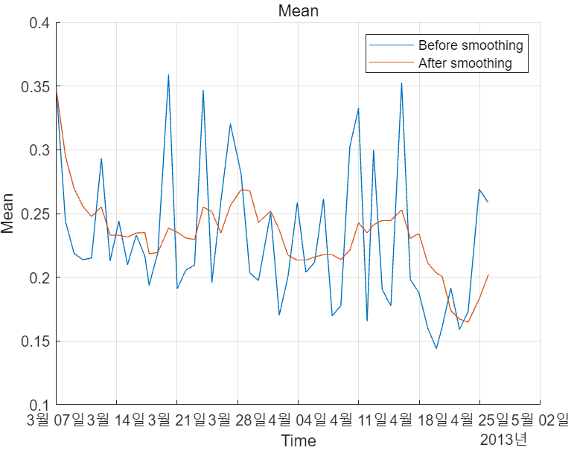
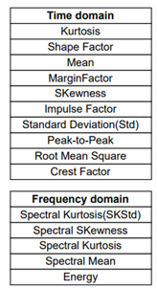
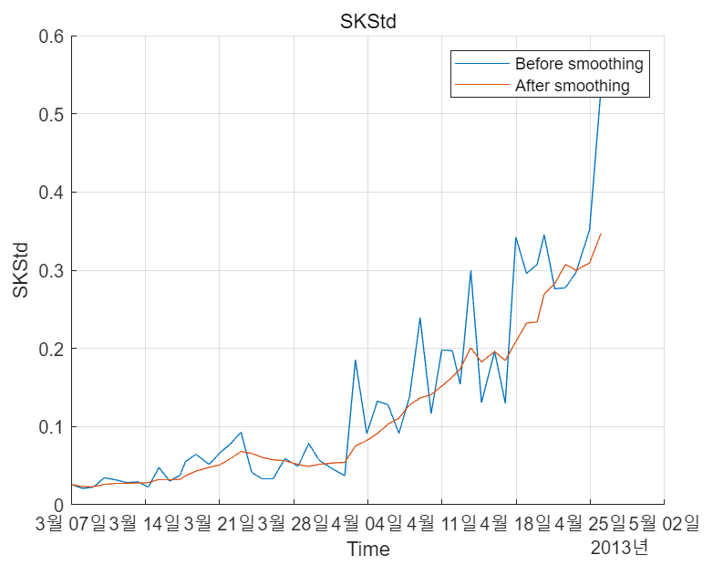
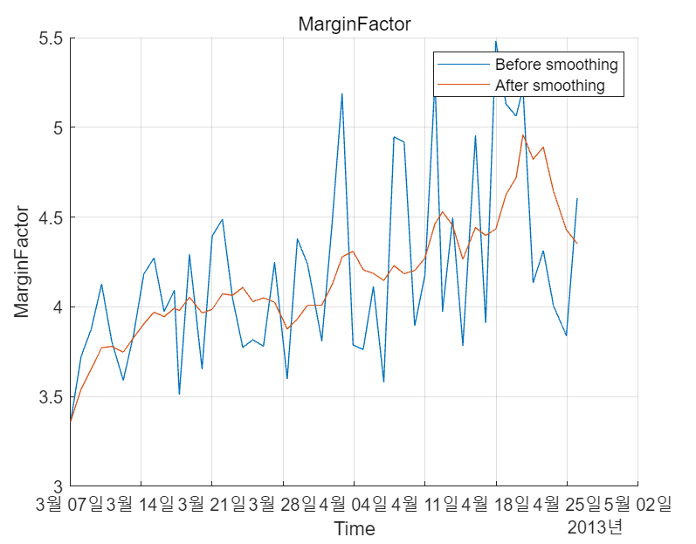
Data Analysis 1 (Compare RUL Methods: General Method)
Smoothing Option:
Moving Average Filter
(Window Size = 5)
Figure. 6 Plot Traditional Features (Smoothed)
Figure. 7 Traditional Feature List
7

Slide 8
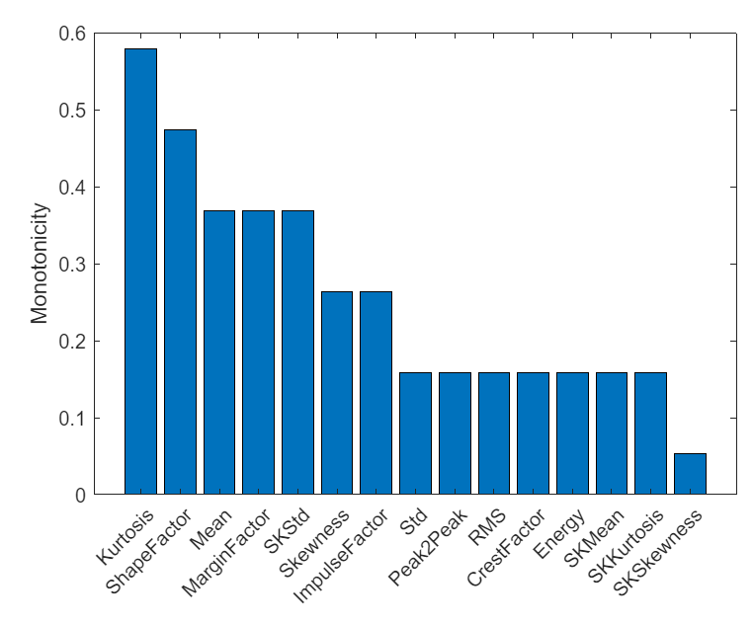
Data Analysis 1 (Compare RUL Methods: General Method)
Traditional Features: Kurtosis, Shape Factor, Mean, Margin Factor…
Select Criteria: Monotonicity > 0.3 (30 [%])
Selected Data: Kurtosis, Shape Factor, Mean, Margin Factor, SKStd
Figure. 6 Monotonicity of the Data
8

Slide 9
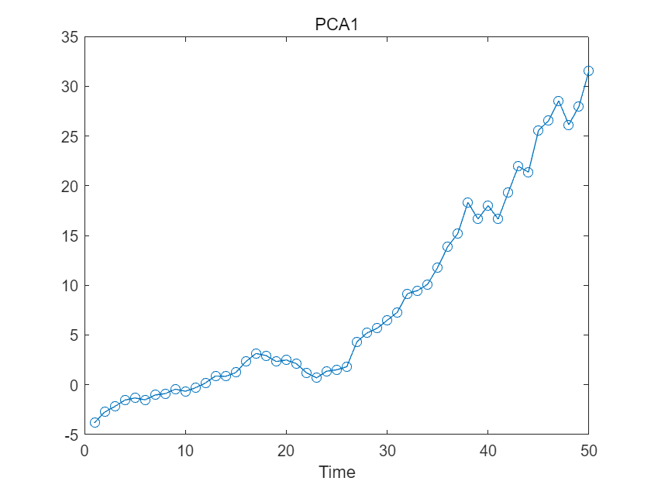
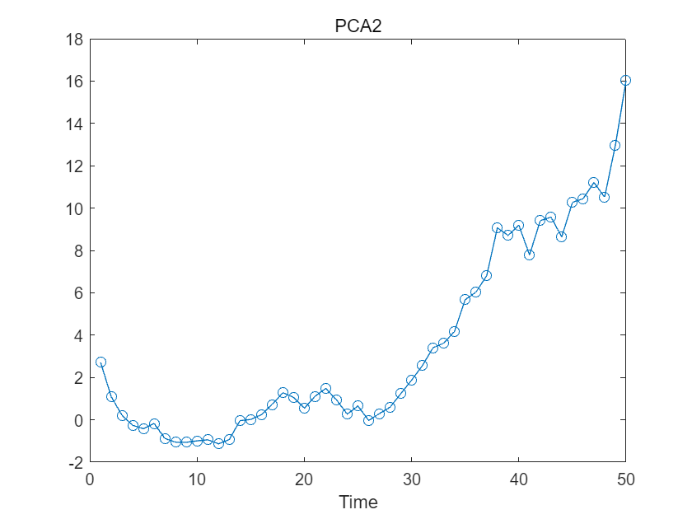
Data Analysis 1 (Compare RUL Methods: General Method)
After selecting five features, we extracted
PCA value to reduce the channel of features
and organize all features into one feature.
We selected PCA1. because PCA1
shows higher monotonicity than PCA2.
Figure. 8 Plot Tendency of the Data (Consist of 5 Selected Features)
9

Slide 10
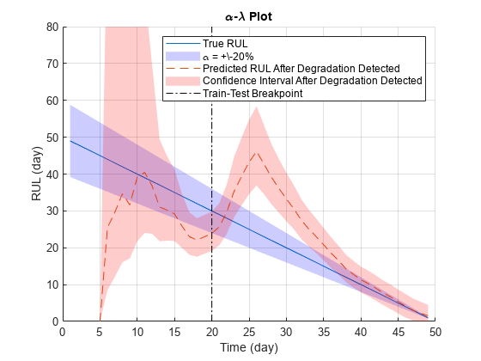
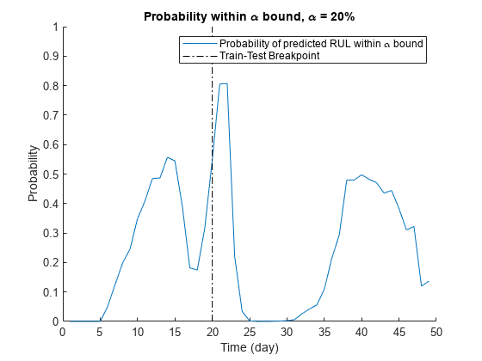
Data Analysis 1 (Compare RUL Methods: General Method)
Probability means how near the true RUL
between predicted RUL lines.
Around the breakpoint, probability is max.
Figure. 9 Plot RUL Prediction using PCA data
10

Slide 11
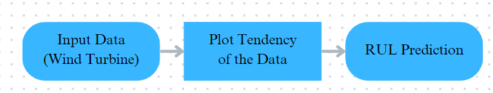

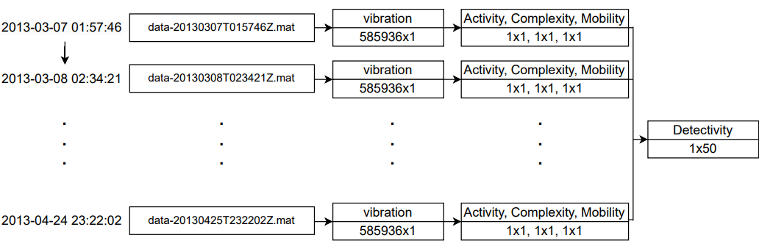
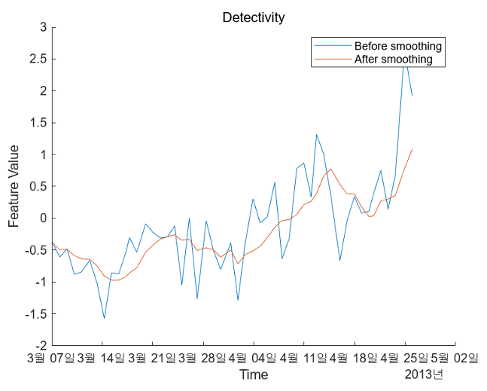
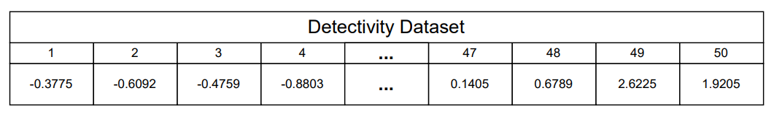
Data Analysis 1 (Compare RUL Methods: Detectivity Method)
Figure. 10 Detectivity Extract
Figure. 11 Detectivity Plot (Moving Average Filter, Window Size = 5)
11

Slide 12
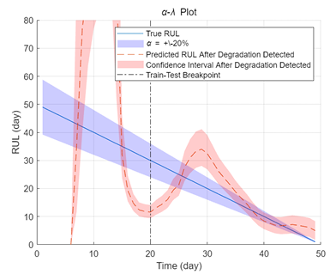
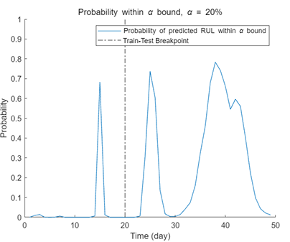
Data Analysis 1 (Compare RUL Methods: Detectivity Method)
Probability means how near the true RUL
between predicted RUL lines.
Around the breakpoint, probability is max.
Figure. 12 Plot RUL Prediction using Detectivity hyperparameter
12

Slide 13
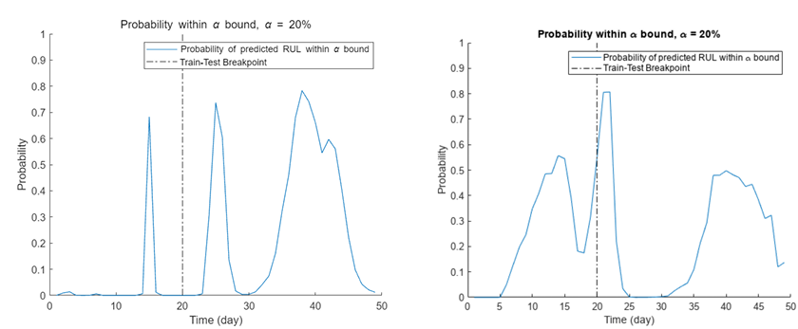
Discussion (Compare RUL Methods)
Figure. 13 Compare Probability of RUL Prediction (Left: Detectivity, Right: Traditional Features)
We evaluated the validity of the criteria: probability 0.6 (60 [%])
The RUL is only valid before the time of failure.
In this term, RUL using Detectivity can be evaluated as having the effect of improving failure prediction performance.
13

Slide 14
Discussion (Compare RUL Methods, Improvement Points)
Figure. 14 Compare Probability of RUL Prediction Including Changed Criteria (Left: Detectivity, Right: Traditional Features)
RUL prediction using Detectivity is valid for probability 0.6 (60 [%]).
However, if the standard is lowered to 0.4 (40 [%]), the performance is poor in detecting failures early.
14

Slide 15
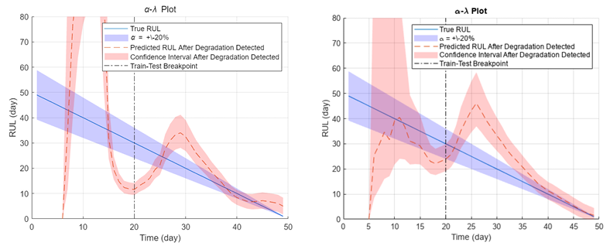
Discussion (Compare RUL Methods, Improvement Points)
Figure. 15 α-λ plot (Left: Detectivity, Right: Traditional Features)
We predicted two causes of the problem.
First, it is the appropriateness of true RUL. Detectivity is a hyperparameter obtained by processing raw data into a
[dB] scale. The settings of equivalent true RUL may be one of the reasons for performance degradation.
15

Slide 16
Discussion (Compare RUL Methods, Improvement Points)
Figure. 16 α-λ plot (Left: Detectivity, Right: Traditional Features, Same as Figure. 15)
The second reason is the large variability of the predictive RUL.
Perceived RUL showed various trends every time whenever α-λ plot was performed.
The true RUL was set to a fixed graph beforehand. So, there is a need for improvement in the predicted RUL.
16

Slide 17
Conclusion
We conducted RUL using Detectivity,
to save time for feature extraction
and produce effects similar traditional
feature extraction method.
It is possible to evaluate indicator improvement by high probability criteria, but it was difficult to evaluate it by relatively low criteria. (60 [%], 40 [%])
We will further investigate the case of improving the surface performance through RUL prediction parameter adjustment such as true RUL and RUL evaluation for indicators on the [dB] scale.
Figure. 17 Probability of RUL Prediction (Left: Detectivity, Right: Traditional Features)
17

Slide 18
Appendix
[1] Cocconcelli, M., Strozzi, M., Cavagliato Camargo Molano, J., & Rubini, R. (2022). Detectivity: A combination of Hjorth’s parameters for condition monitoring of ball bearings. Mechanical Systems and Signal Processing, 164, 108247. https://doi.org/10.1016/j.ymssp.2021.108247
[2] Saxena, A., Celaya, J., Balaban, E., Goebel, K., Saha, B., Saha, S., & Schwabacher, M. (2008). Metrics for evaluating performance of prognostic techniques. 2008 International Conference on Prognostics and Health Management (PHM), 1-8. https://doi.org/10.1109/PHM.2008.4711436
18

