Slide 1
Factors Behind Successful Movies
Yun Mai
Gurpreet Singh
Chirag Vithalani

Slide 2
Prelude
What makes movies good or bad?
Factors Behind Successful Movies,as the name suggests, is an endeavour towards performing exploratory data analysis on a movie related dataset. Our intentions behind this exploration is to simply study a dataset that could provide some insight into movies, its audiences and to an extent it's commerce

Slide 3
The Beginning

Slide 4

Early Exploration
Scratching the surface

Slide 5
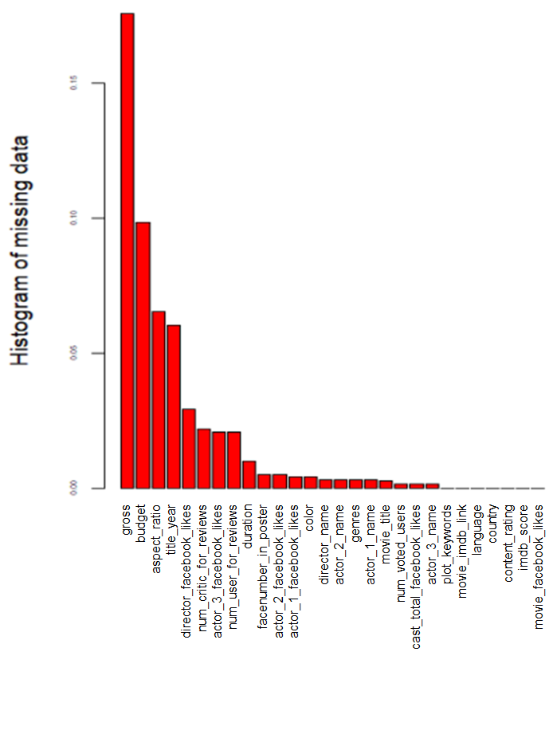
5043 movies
2399 directors
100 years
66 countries
48 languages
28 variables
Showing missing Data

Slide 6
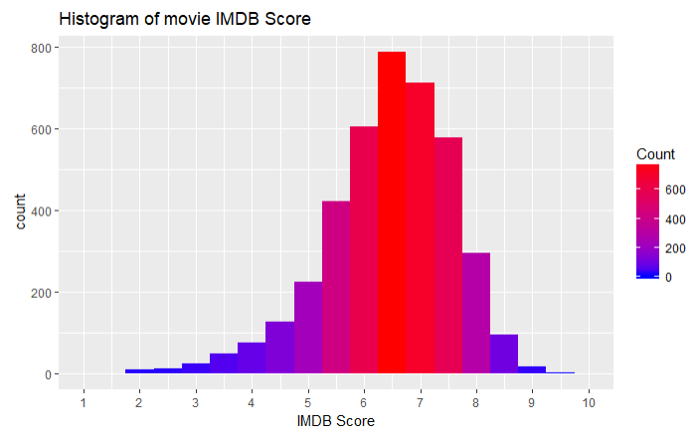
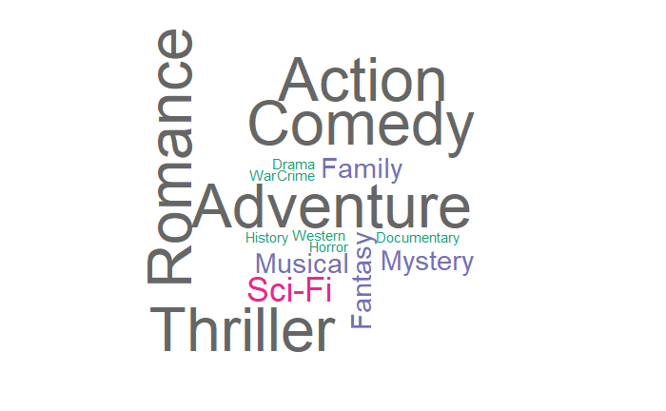
There are less number of family movies, less documentaries and very few history related movies. More and more movies are of genres action,comedy, romance or thriller.
IMDB score looks normal. Many movies scored from 5 to 8 and few movies have score less than 4 or greater than 8.

Slide 7

Data Preparation

Slide 8
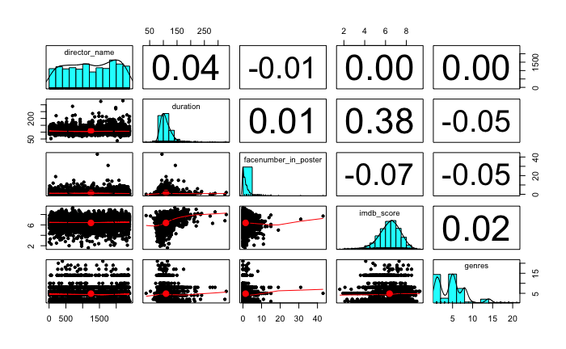
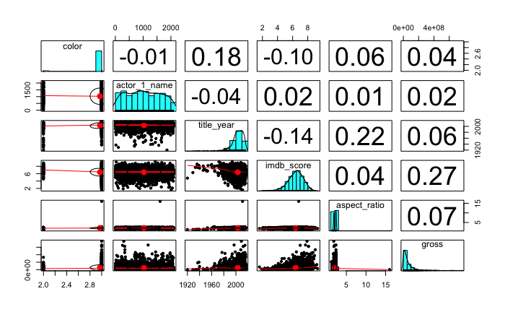
correlation matrix
Face number in posters has a negative correlation with IMDB score. genre has little correlation with score Interesting, director name has no correlation with IMDB score.Color and title year has highly positive correlation. Color and aspect ratio,gross has smaller positive correlations. Actor1_name has very small positive correlation with gross, meaning who plays the movies does not have impact on the gross.
Title year and aspect ratio and color are highly positively correlated. IMDB score has very small positive correlation with actor 1 name ,which means who was the actor 1 does not make the movie has a higher score. Interestingly, IMDB score has a negative correlation with title year,which means the old movies seems to have a higher score. IMDB and aspect ratio has small positive correlation.
IMDB has a strong positive correlation with gross.

Slide 9
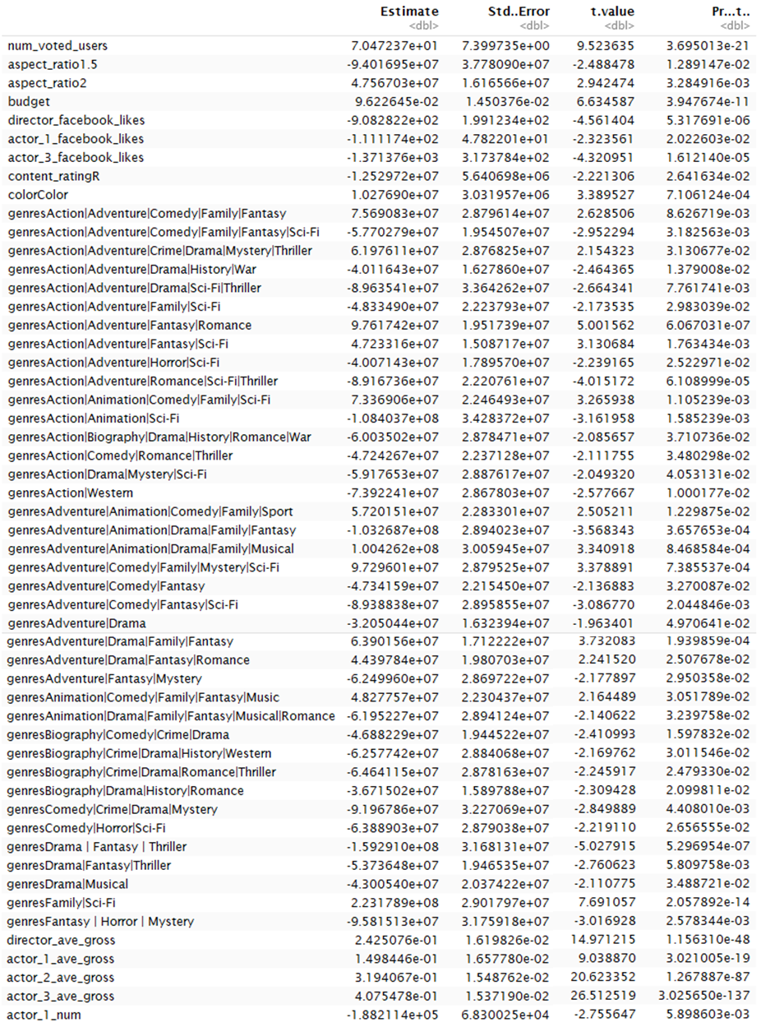
Multiple linear regression model - I : based on untransform data

Slide 10
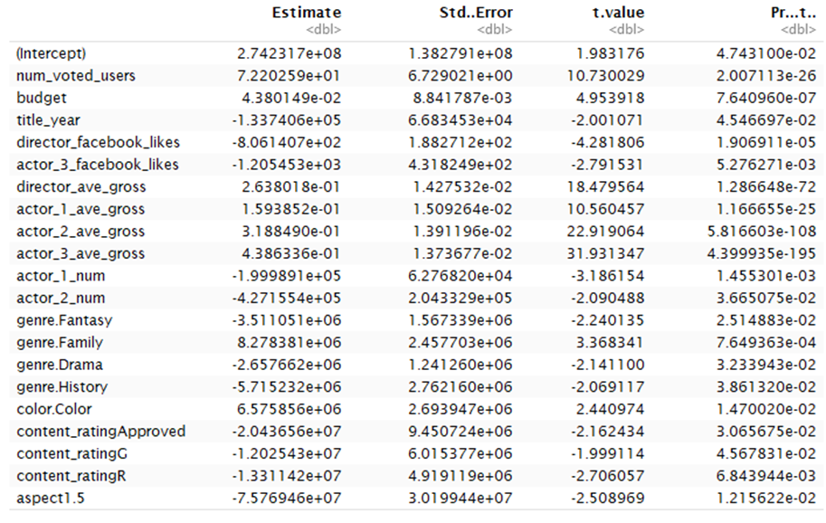
Multiple linear regression model - Ii : based on dummy coded data

Slide 11
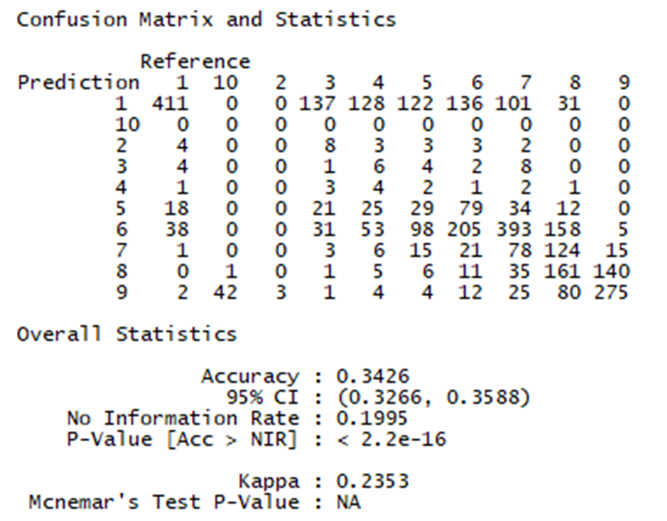
Ordinal regression model

Slide 12
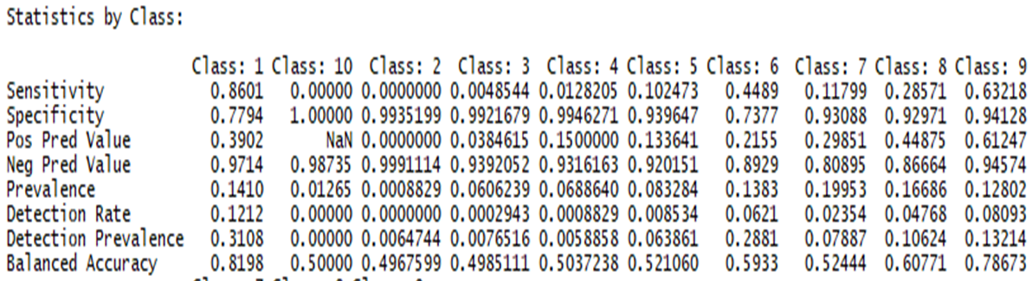
Ordinal regression model

Slide 13
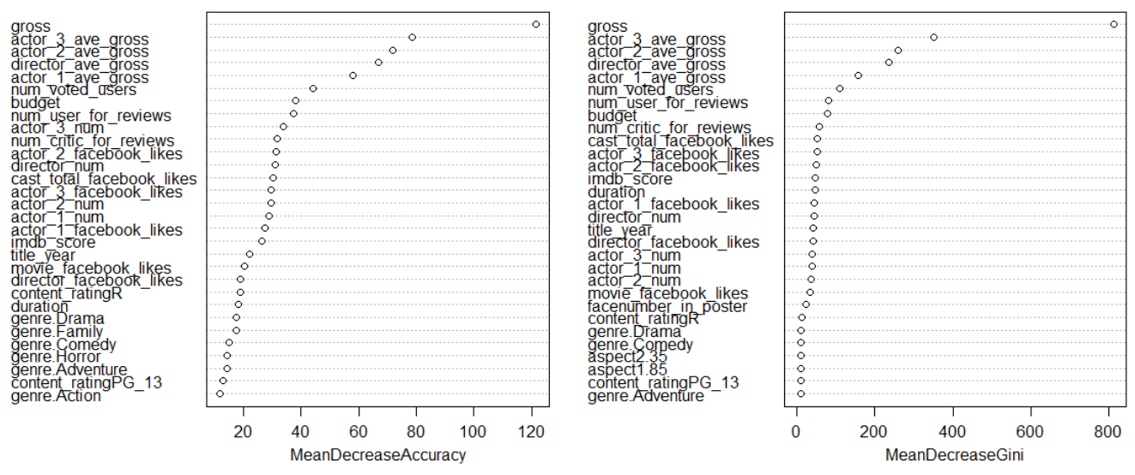
Random forest model

Slide 14
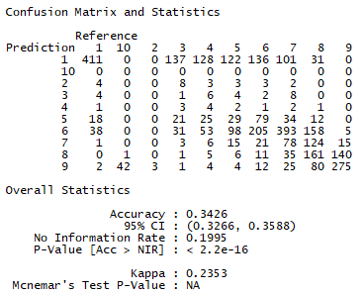
Random forest model

Slide 15
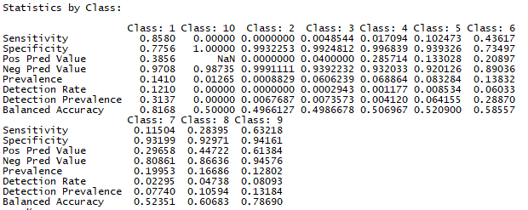
Random forest model

Slide 16
The End

