Slide 1

RTSP Client
Reporter: 杨睿
2019.12.09

Slide 2
Project Pupose
1
What should we do?
Backgroud Knowlegde
TOC
Table Of Contents
2
What do we need?
Program Process
3
How the program works？
Program Design
4
How to design it?

Slide 3







Target
Open the door
In this project, we should write a RTSP client that should work with LIVE555 Media Server.
Like this.
Before my body is dry
0:36
4:36

Slide 4





Functions
Basic and advanced
Play, Pause, and
Start from everywhere
Input RTSP URL
to request data
Show progress bar
and volume bar

Slide 5
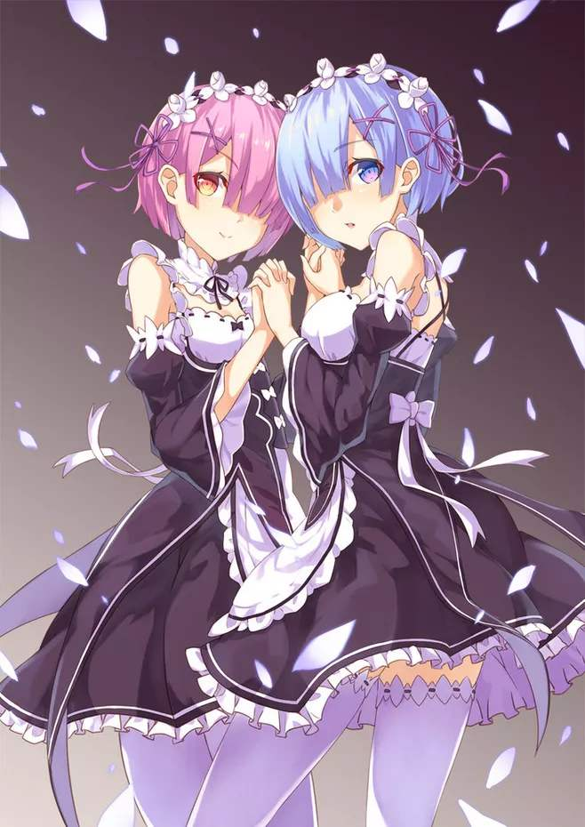
RTSP
Real Time Streaming Protocol
The Real Time Streaming Protocol is a network control protocol designed for use in entertainment and communications systems to control streaming media servers.
The protocol is used for establishing and controlling media sessions between end points.
Clients of media servers issue VCR-like commands, such as play and pause, to facilitate real-time control of playback of media files from the server.
Default ports are 554(Linux) and 8554(Windows).
He have two maids.

Slide 6


RTP
Real-time Transport Protocol
The transmission of streaming data itself is not a task of the RTSP protocol.
But RTP.
Most RTSP servers use the Real-time Transport Protocol for media stream delivery.
(however some vendors implement proprietary transport protocols.)
She has a sister called RTCP.️

Slide 7

RTCP
Real-time Transport Control Protocol
RTCP provides out-of-band statistics and control information for an RTP session.
It partners with RTP in the delivery and packaging of multimedia data, but does not transport any media data itself.
In contrast, she has a sister called RTP.️

Slide 8
Overall
RTSP/RTP/RTCP
M️e
🙋
Our Program
Application Layer
RTSP
The RTSP client will issue a request based on its environment to decide whether to use TCP or UDP.
Transport Layer
Usually，
TCP for RTSP
UDP for RTP
are better.
RTP & RTCP need two ports over UDP.
RTP & RTCP
UDP | TCP
Network Layer
Data Link Layer
Physical Layer

Slide 9
RTSP has state;
The GET_PARAMETER request retrieves the value of a parameter of a presentation or stream specified in the URI. GET_PARAMETER with no entity body may be used to test client or server liveness ("ping").
RTSP
identifier, RTSP has state.
A DESCRIBE request includes an RTSP URL (rtsp://...), and the type of reply data that can be handled. The default port for the RTSP protocol is 554 or 8554 for both UDP and TCP transports. This reply includes the presentation description,
typically in Session Description Protocol (SDP, RFC 4566) format.
OPTIONS
DESCRIBE
SETUP
GET_
PARAMETER
A SETUP request specifies how a single media stream must be transported. This must be done before a PLAY request is sent. The request contains the media stream URL and a transport specifier. This specifier typically includes a local port for receiving RTP data (audio or video), and another for RTCP data (meta information).
An OPTIONS request returns the request types the server will accept.

Slide 10
RSTP
identifier
A PLAY request will cause one or all media streams to be played. A range can be specified. If no range is specified, the stream is played from the beginning and plays to the end, or, if the stream is paused, it is resumed at the point it was paused.
PLAY
A TEARDOWN request is used to terminate the session. It stops all media streams and frees all session related data on the server.
A PAUSE request temporarily halts one or all media streams, so it can later be resumed with a PLAY request. A range parameter on a PAUSE request specifies when to pause. When the range parameter is omitted, the pause occurs immediately and indefinitely.
TEARDOWN
PAUSE

Slide 11
RTSP Interaction
OPTION request
OPTION response
Client
Server
Ask the server what methods are available
Respond all available methods

Slide 12
RTSP Interaction
SETUP request
SETUP response
Client
Server
Specifies how a single media stream must be transported.
Establish a session
The server reply usually confirms the chosen parameters, and fills in the missing parts, such as the server's chosen ports.

Slide 13
RTSP Interaction
DESCRIBE request
DESCRIBE response
Client
Server
A DESCRIBE request includes an RTSP URL (rtsp://...), and the type of reply data that can be handled.
This reply includes the presentation description, typically in Session Description Protocol (SDP, RFC 4566) format.

Slide 14
RTSP Interaction
PLAY request
PLAY response
Client
Server
A PLAY request will cause one or all media streams to be played. Play requests can be stacked by sending multiple PLAY requests.

Slide 15
RTP&RTCP Interaction
Send Stream Data
Close by RTCP
Client
Server

Slide 16
RTSP Interaction
TEARDOWN request
TEARDOWN response
Client
Server
Terminate the session.
It stops all media streams and frees all session related data on the server.

Slide 17
Design Thought
How to implement it ?
Recv RTP Packet by UDP
Control RTP by RTCP
3
4
Establish RTSP session to send RTSP command
2
5
Read buffer by vlc lib to play audio
1
6
Establish a TCP connection to the server based on the url
Send PAUSE to pause
Send TRACEDOWN to terminate the session

Slide 18
Thanks for your time.

