Slide 1
Week2 Catch-UP

Slide 2
Current Challenges
1. Cloud Computing in Trouble（Colab）
2. Edge Device Storage(8GB)
3. Industrial Focus

Slide 3
Background
Problems
Solution
Unsupervised learning Methods
(Only need normal dataset)
1. Overall image data is less than a few hundred
2. Lack of anomalous samples in the dataset
3. Diversity of defects
4. No hardware accelerator likeGPU in edge training model
1. Initial training on ImageNet
2. Enables CNNs to learn to recognize various features, patterns and structures in images
3. Save time and computing resources

Slide 4
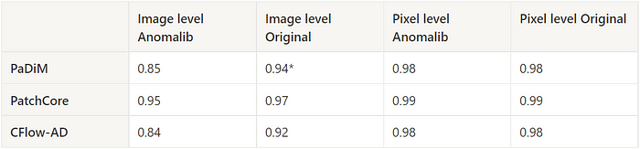
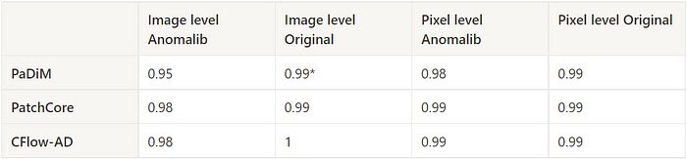
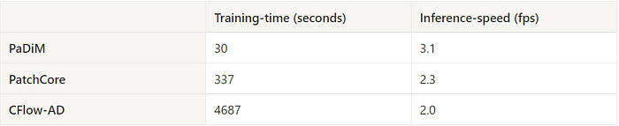
Literature Review
Target: Compare the implementation of the three models and compare it to the results in their respective papers with MVTec dataset.
Device: Google Colab with Nvidia K80, 2 threads and 13Gb RAM
AUROC comparison for the Screw object class
AUROC comparison for the Carpet texture class
Train and inference speeds of PaDiM, PatchCore, and CFlow-AD
Sources: https://blog.ml6.eu/a-practical-guide-to-anomaly-detection-using-anomalib-b2af78147934

Slide 5
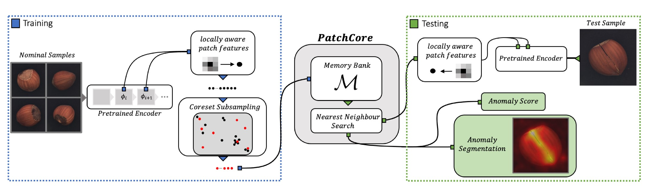
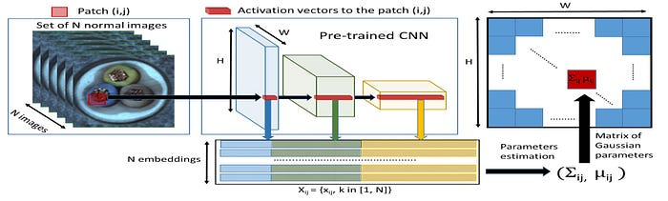
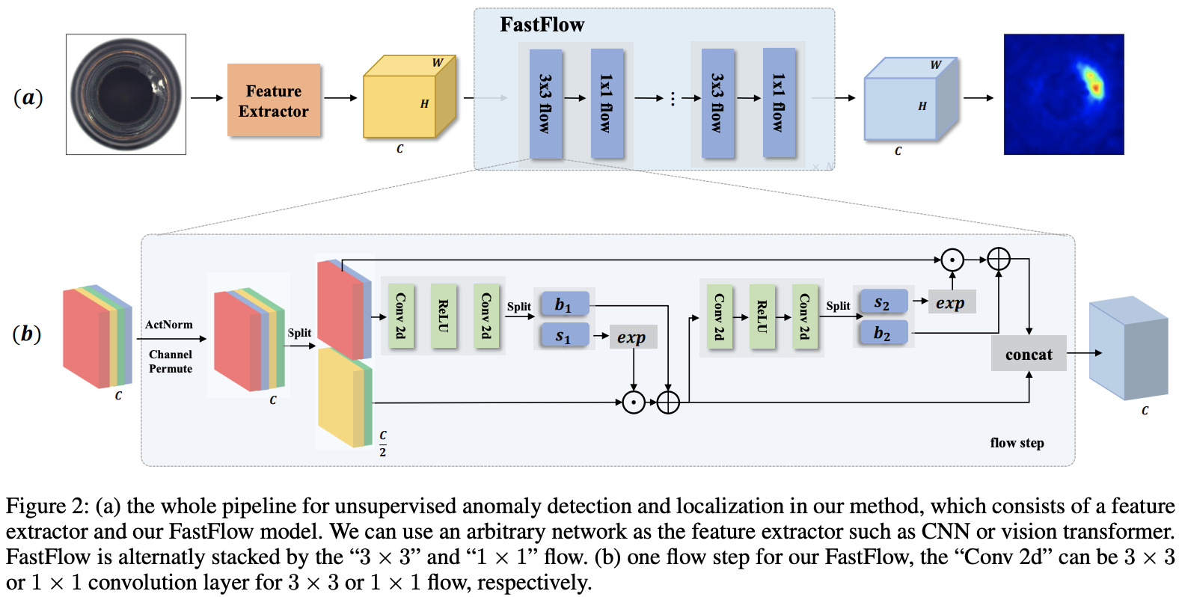
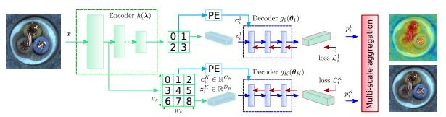
Theoretical Model comparison
PaDiM
PatchCore
CFlow-AD
Fastflow
Notes:
AUROC: AUROC is a widely used metric for binary classification tasks, especially when dealing with imbalanced datasets.
F1 Score: The F1 score combines precision and recall, making it suitable for cases where you want to balance both false positives and false negatives. It's particularly useful when the class distribution is imbalanced.

Slide 6
Experiments Design
Models Factors | PaDiM | PatchCore | CFlow-AD | Fastflow
Performance (AUROC and F1) (Fault Mode including Wrong parts Wrong parts positions Wrong parts angles Parts defects One placement Locations lights )
Speed on Training and Inference
Different devices (Raspberry Pi and PC)
Adaptive on inference (Image with Different Color) (Image with Different Angle) (Image with Different Location)
Notes:
AUROC: AUROC is a widely used metric for binary classification tasks, especially when dealing with imbalanced datasets.
F1 Score: The F1 score combines precision and recall, making it suitable for cases where you want to balance both false positives and false negatives. It's particularly useful when the class distribution is imbalanced.

Slide 7
Current results
Custom Datasets
34 Normal photos
7 Anormal photos
 | PaDiM | PatchCore | CFlow-AD | Fastflow
AUROC | 0.9523809 | 0.9523810 | 1.0 | 0.9761904
F1 | 0.9230769 | 0.9333333 | 1.0 | 0.9333333
Notes:
AUROC: AUROC is a widely used metric for binary classification tasks, especially when dealing with imbalanced datasets.
F1 Score: The F1 score combines precision and recall, making it suitable for cases where you want to balance both false positives and false negatives. It's particularly useful when the class distribution is imbalanced.

Slide 8
Current Challenges
1. Cloud Computing in Trouble（Colab）
2. Edge Device Storage(8GB)
3. Industrial Focus

