Slide 1
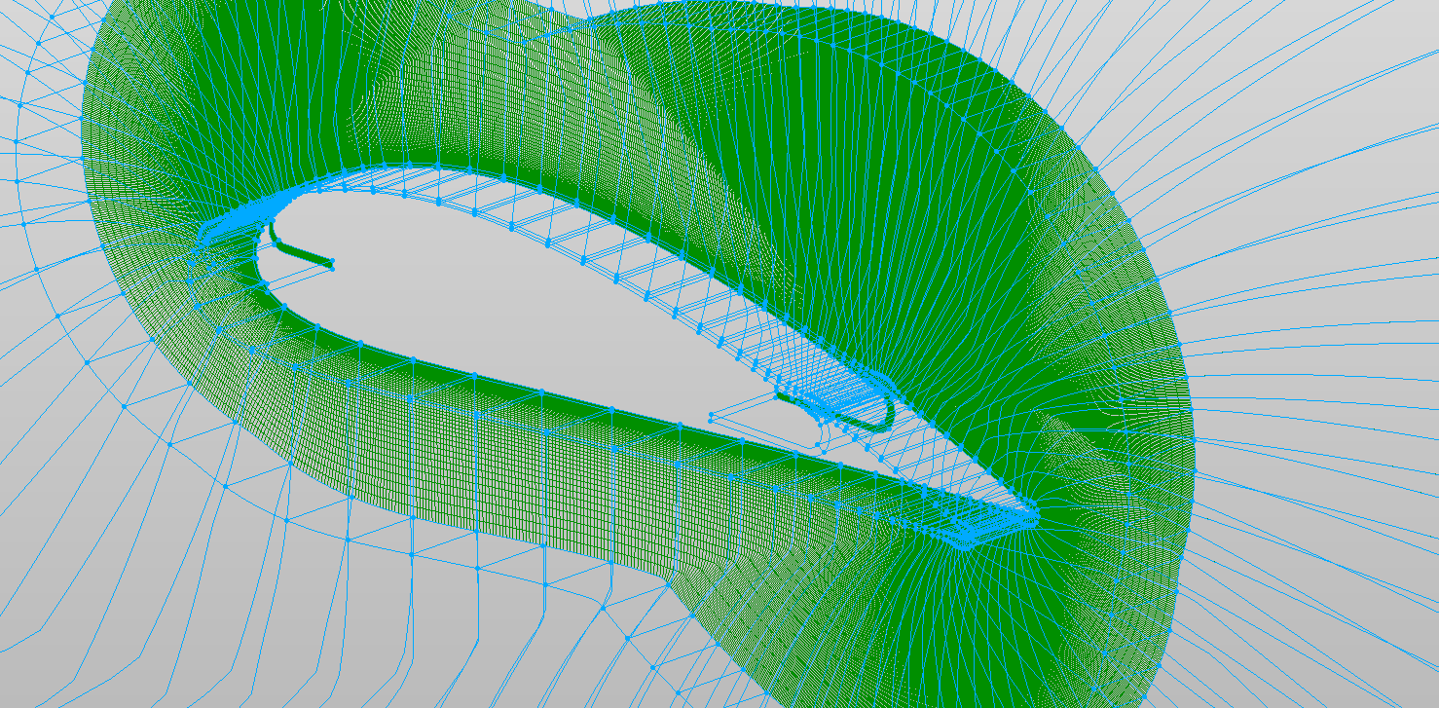



CFJ-A6421 – New case setup
Aerodynamics & CFD Lab
University of Miami
$$η$$
$$ξ$$
$$ζ$$

Slide 2
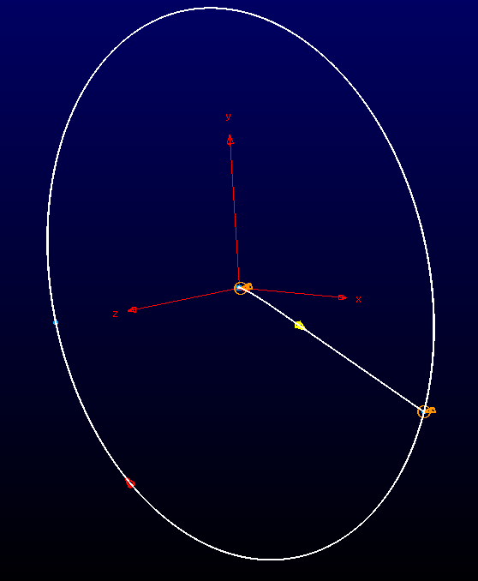
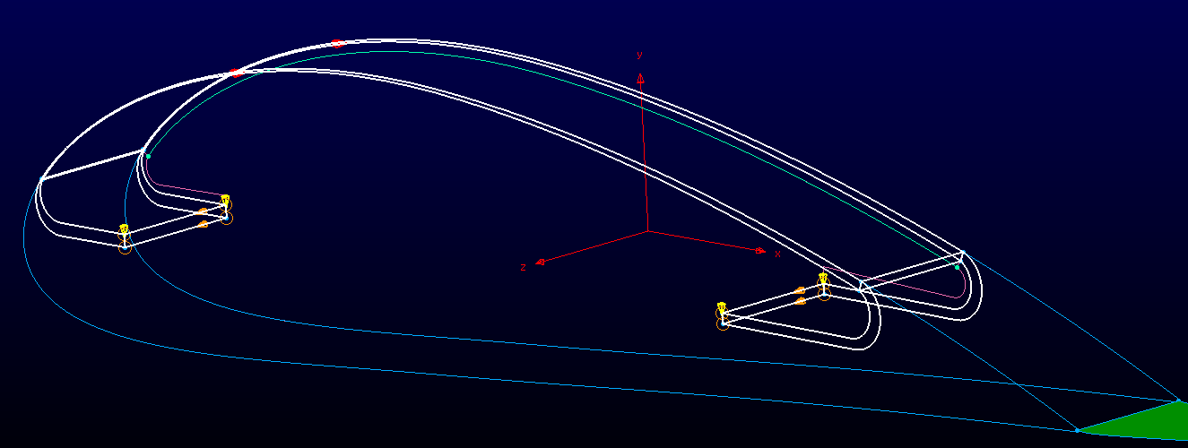
Steps to generate organized Large mesh
0 From the geometry, find the right mesh topology
1 Generate big blocks
Big blocks 1 for outer mesh
Big blocks 2 for inner mesh
2 use blocksplitter.o to split to small blocks
3 Import the splitted blocks to pointwise
4 check the volume and skewness
5 Export the whole mesh
Big blocks 1
Big block 2

Slide 3
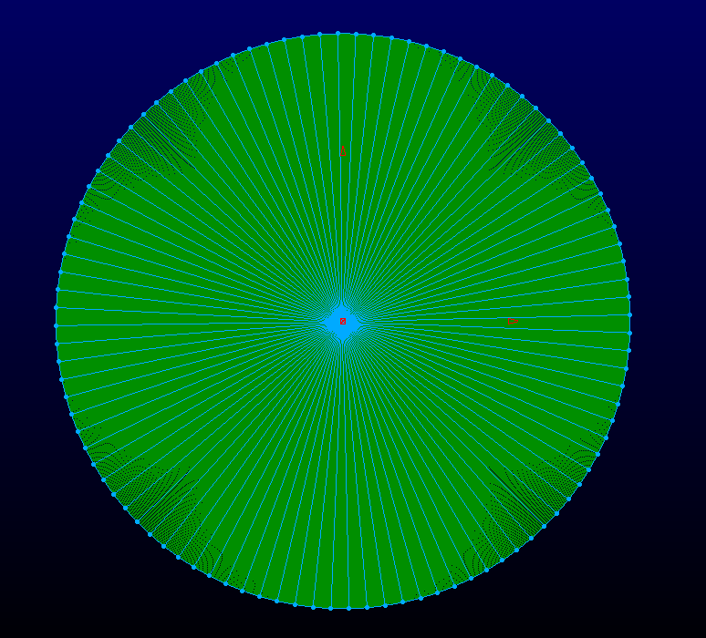
Multi-Block distribution
Block 1-300
Outer mesh 1-300
Inner mesh 301-348
INJ Block 301-304
Connect 305-344
SUC Block 345-348
Block 301-348

Slide 4
BC setup
Inlet bctype = 6: eta=60, block 201-249(49)
Outlet bctype = 5: eta=60, block 250-300(51)
CFJ Inj bctype = 9: xie = 1, block 301-304(4)
CFJ Suc bctype = 5: xie=10, block 345-348(4)
Periodic bctype = 10
zta=1, block 1-348(348)
zta=50, block 1-348(348)

Slide 5
Edit the bcdefine.datain.small
The BC definition for each groups are represented by two consecutive lines
eg, the first two lines represent the inlet blocks definition,
6,49 ! bctype, number of blocks, Inlet
201,2,60 ! start block, bc-dir(1,2,3), bc_minmax(1,max)
The file ends with -1, 0
6,49 ! bctype, number of blocks, Inlet
201,2,60 ! start block, bc-dir(1,2,3), bc_minmax(1,max)
5,51 ! bctype, number, Outlet
250,2,60 ! start block, bc-dir(1,2,3), bc_minmax(1,max)
10, 348 ! bctype, number, Periodic
1,3,1 ! start block, bc-dir(1,2,3), bc_minmax(1,max)
10, 348 ! bctype, number, Periodic
1,3,50 ! start block, bc-dir(1,2,3), bc_minmax(1,max)
9,1 ! bctype, number, Injection inlet
301,1,1 ! start block, bc-dir(1,2,3), bc_minmax(1,max)
5,1 ! bctype, number, Suction outlet
348,1,20 ! start block, bc-dir(1,2,3), bc_minmax(1,max)
-1, 0 !last line
Inlet bctype = 6: 49 blocks, eta=60, 201-249
Outlet bctype = 5: 51 blocks, eta=60, 250-300
CFJ Inj bctype = 9: 4 blocks xie = 1, 301-304
CFJ Suc bctype = 5: 4 blocks xie=10, 345-348
Periodic bctype = 10: 348 blocks zta=1, 1-348
Periodic bctype = 10: 348 blocks zta=50, 1-348

Slide 6
Edit & Run the NewCaseSetup1.sh Automatic
NewCaseSetup1.sh
4 steps
1 processing.out
bin_3d_001.dat …
init.input
2 Pre_bc7
Find all the bc7
pre_bc7_datain, pre_bc7.err
3 Sort out other BCs
bcdefine.datain
bcoutput7.datain
bcoutputbc.datain
bcoutputwall.datain
datain.bc
4 export to output folder
Inside the folder: bin, datain.bc,init.input
#! /bin/bash
#1. --> init.input, bin*.dat
echo "~~~~~~~~~~~~~~~FASIP Newcase BC setup~~~~~~~~~~~~~~~~"
echo "~~~~~~~~~~~~~~~~~~~~~~~~~~~~~~~~~~~~~~~~~~~~~~~~~~~~~"
echo "Attention: make sure bcdefine.datain.small is correctly defined"
echo "Step 1 generate bin file and init.input"
./processing.out <<EOF
1
LES-grid-348-206050.x
3
1
62.0
0.25
0
EOF
echo "Step 1 finished"
echo "Step 2 find bc7"
./pre_bc7_2d3d.o <<EOF
1d-8
3
EOF
echo "Step 2 finished, check the pre_bc7.err file "
echo "Step 3 sort datain.bc"
python Sort-Combine_datain_output.py
echo "Step 3 finished"
#4 export to output
if [ ! -d output ]; then
mkdir output
fi
mv bin* datain.bc init.input output

Slide 7
Run the previous steps manually
./processing.out
./pre_bc7_2d3d.o
python Sort-Combine_datain_output.py

Slide 8
Things to remember
1 Before run the code, check the files are complete
bcdefine.datain.small
Grid file
NewCaseSetup1.sh (check the grid name, AoA and references)
pre_bc7_2d3d.f
pre_bc7_2d3d.o
PrebcAll.f
PrebcAll.o
processing.out
Processing.sh
Sort-Combine_datain_output.py
2 After run the code, remember to doublecheck the init.input and datain.bc
Init.input: special BC setup for CFJ
Datain.bc: check the correct BC definition

Slide 9
Boundary condition sequence principle
BC Issue description
BC common Edge:
The common edge between two face is defined twice
The latter definition overwrites the previous definition.
Category
7,
71,72,73
1,8,10,20,23
9,6,5,2,21,22,24,28
3,32,33,34,35,19

Slide 10
Boundary conditions:
# Note: Boundary conditions
# 1 zero gradient
# 2 supersonic inflow
# 3 no slip adiabatic wall boundary
# 4 zero gradient with w = 0
# 5 subsonic outflow, fixed static pressure (poutlet in datain)
# 6 subsonic inflow, fixed rho, u, v, w at inlet
# 7 inner boundary for mpi
# 8 symmetry boundary
# 9 subsonic inlet BC with fixed total pressure and temperature
# (Note: direction of flow normal to face is not enforced and outflow is possible)

Slide 11
Boundary conditions:
# 10 periodic boundary condtion
# 19 isothermal wall, zero-gradient pressure
# 21 subsonic inflow for rotor (applied over plane i-k)
# 22 subsonic outflow (fixed static pressure at freestream, applied over plane i-k)
# 23 periodical boundary for o mesh
# 24 Reimann subsonic inflow BC for rotor (applied over plane i-k)
# 28 subsonic outflow (curved static pressure profile at outlet)
# 31 partial-slip wall boundary in rotation coordinates
# (if normal to wall in i direction- no treatment at all)
# (if normal to wall in j direction- bctype 3 treatment)
# (if normal to wall in k direction- wall functions treatment)

Slide 12
Boundary conditions:
# 32 moving wall boundary
# 33 dpdn = 0 wall boundary in rotation coordinates
# 34 dpdn = 0, dtdn = 0, psi changes wall boundary in rotation coordinates
# 35 dpdn = rv^2/r, dtdn = 0, wall boundary in rotation coordinates
# 70 Actuator boundary condition (only works if i direction is perpendicular to actuator line of actuator plane made by i-j)
# 71 rotating periodic boundary condition
# 72 Mixing plane boundary condition (Note: Normal to the mixing plane should be in j direction)
# 73 Periodic boundary condition
# 92 subsonic inlet BC with fixed total pressure and temperature
# (Note: direction of flow normal to face is enforced)
# 95 special case: specify u=1, v=w=0 (eg. lid cavity), j-upper boundary
# 100 special case: shock/boundary layer interaction, j-upper boundary

Slide 13
Boundary condition sequence Setup
Inner BC
7
Mixing plane
Turbo periodic
71,72,73
Symmetry
Periodic
Zero Gradient
1,8,10,20,23
Wall
Moving Wall
3,32,33,34,35,19
101-110
Inlet
Outlet
9,6,5,2,21,22,24,28
Integrated in the Newcase_Setup_Utility

