Slide 1
SME309 – Microprocessor Design Lab3
Unsigned Multiplication & Division Unit
SME309 – Microprocessor Design

Slide 2
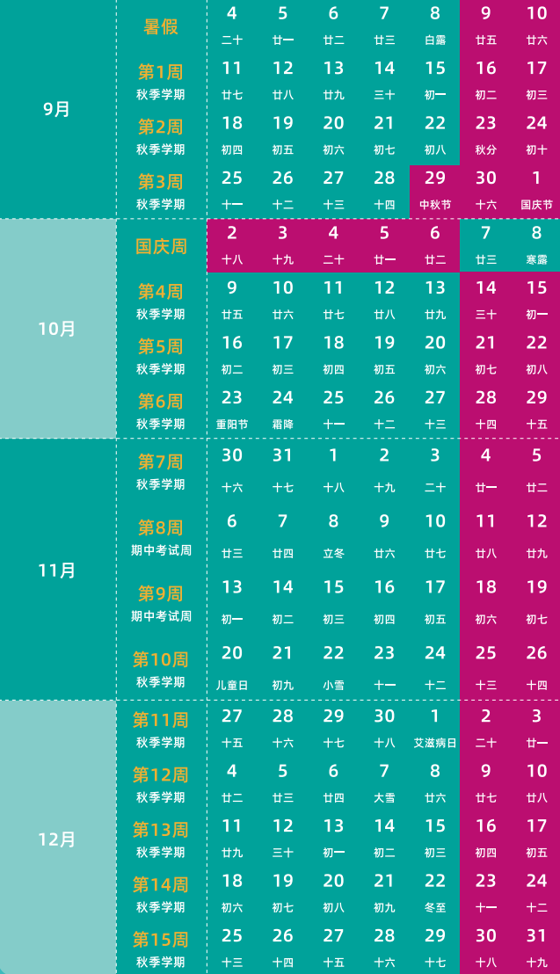
Lab Schedule
Vivado installation and quick start. Verilog basic and practice.
Lab1 release
Q & A
Lab1 checkpoint
Lab2 release
Q & A
Lab2 checkpoint
Lab3 release
Here Now
Q & A
Lab3 checkpoint
Project release
Q & A

Slide 3
Content
Objective & Overview
Multi-cycle multiplier & divider: Mcycle Design
Extended Instruction
Hardware Implement: How Mcycle integrate .. ?
On-board Test
SME309 – Microprocessor Design

Slide 4
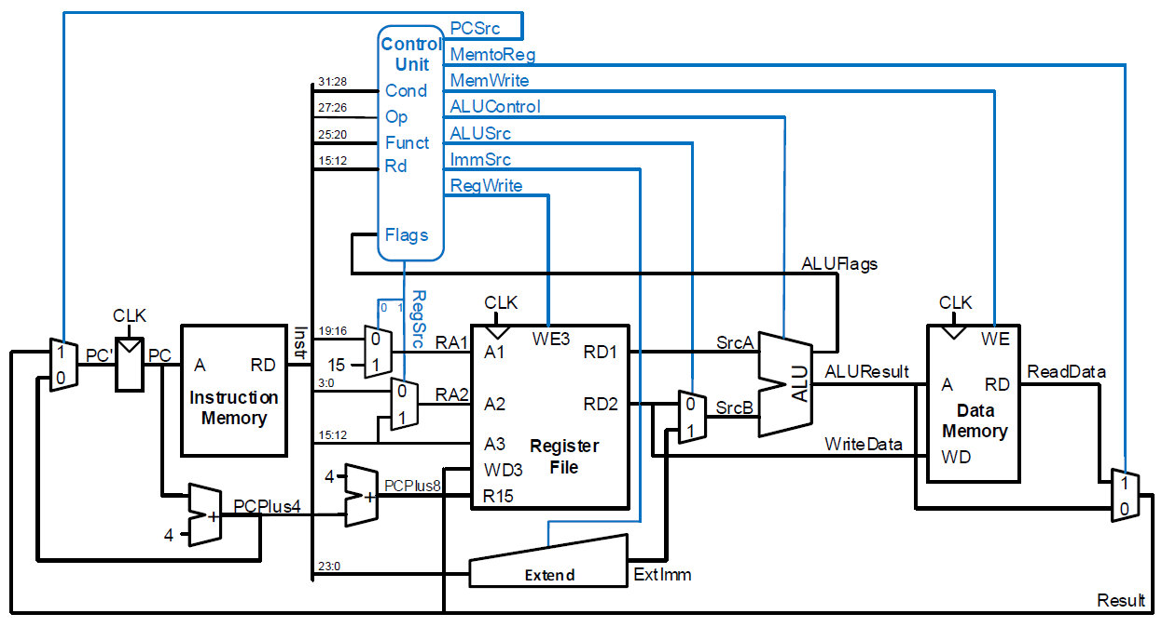

Overview
A new module “Mcycle” will be inserted to CPU in this lab!
√
√
√
√
√
√
√
SME309 – Microprocessor Design

Slide 5
Lab Tasks
Design a module – “Mcycle”, which implements multi-cycle unsigned Multiplication & Division. A multiplier template is given to you, but you should improve it to the improved version first to reduce resource utilization, then try to share the hardware resource to design the divider. Moreover, you should simulate its function using a good testbench. (The testbench and the correct waveform will be provided.)
Add “Mcycle” to the existing single-cycle processor to support the extended instruction “MUL” (in ARM Reference Manual A4-66). However, the division instruction doesn’t be directly implemented in ARM instruction set, so in this lab, we will learn how to design a new instruction for unsigned division with a reasonable decoding logic.

Slide 6
Mcycle.v
module MCycle(
input CLK, // Connect to CPU clock
input RESET, // Connect to the reset of the ARM processor.
input Start, // Multi-cycle Enable. The control unit should assert this when MUL or DIV instruction is detected.
input MCycleOp, // Multi-cycle Operation. "0" for unsigned multiplication, "1" for unsigned division. Generated by Control unit.
input [width-1:0] Operand1, // Multiplicand / Dividend
input [width-1:0] Operand2, // Multiplier / Divisor
output reg [width-1:0] Result //For MUL, assign the lower-32bits result; For DIV, assign the quotient.
output Busy // Set immediately when Start is set. Cleared when the Results become ready. This bit can be used to stall the processor while multi-cycle operations are on.
);
endmodule

Slide 7
How Mcycle integrate … ?
Control signals for Mcycle working Datapath?
When Mcycle is busy working?
How Mcycle connect to others ?
SME309 – Microprocessor Design

Slide 8
Content
Objective & Overview
Multi-cycle multiplier & divider: Mcycle Design
Extended Instruction
Hardware Implement: How Mcycle integrate .. ?
On-board Test
SME309 – Microprocessor Design

Slide 9
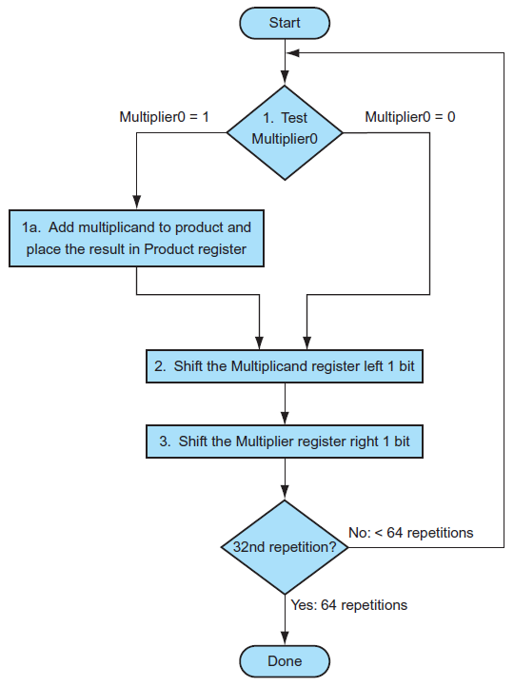
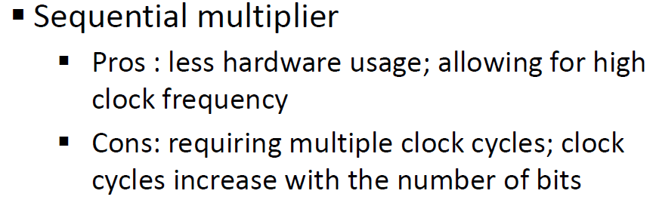
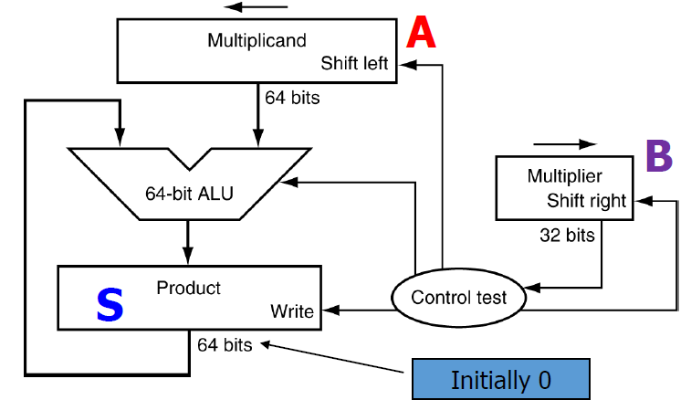
Multi-cycle multiplier

Slide 10
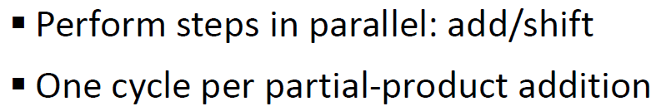
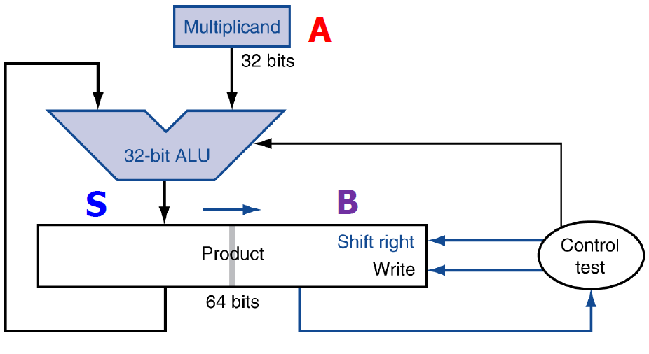
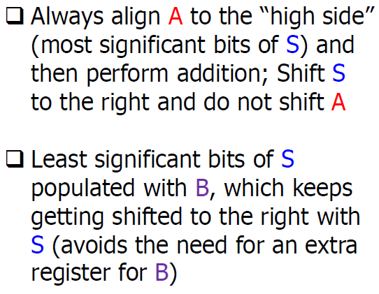
Multi-cycle multiplier
Improved sequential multiplier
Implement this version!
(Or any other multicycle version better than this,
if you have further research on it)
“Operand_reg”
“temp_sum”

Slide 11
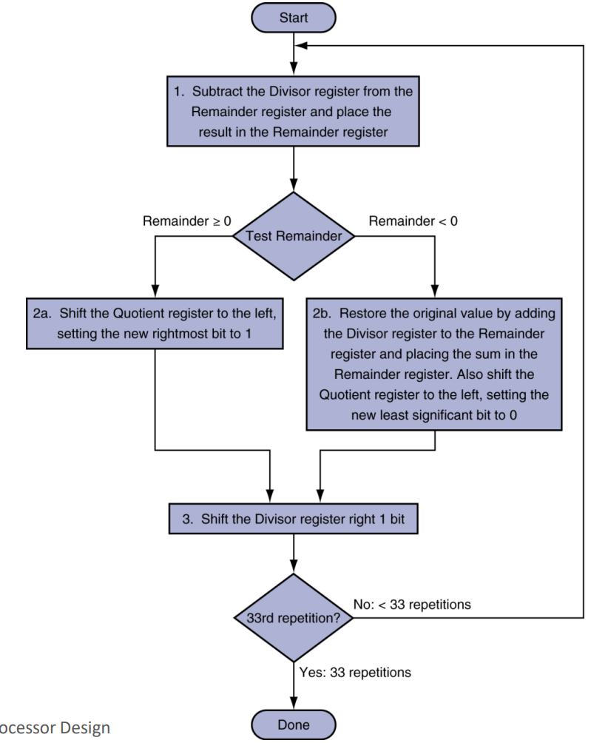
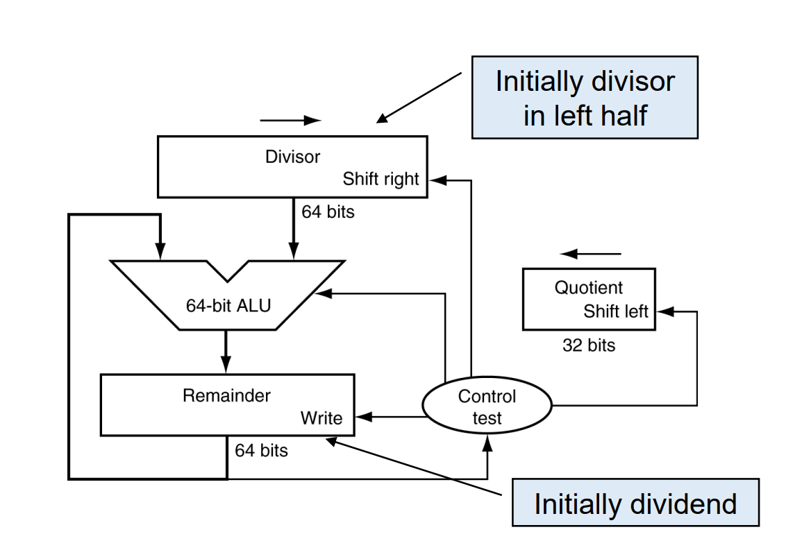

Multi-cycle divider
Sequential divider
Multiplier and Divider can share most of the hardware.

Slide 12


Multi-cycle divider
Improved sequential divider
The hardware of improved divider can be similar to the improved multiplier.
Add a sign-extended bit (S) to judge if the substruction result (Remainder) is little than 0. (S = 1 means satisfy this).
In division, the inserting bit in the left shift is the quotient bit. Whether “1” or “0” depends on the substruction result. (Set 1 when the remainder is >= 0).
After 33 cycles, the quotient should be calculated at the rightmost of “Product” register.
Divisor
Zero init leftmost
Dividend rightmost
Left-shift
S

Slide 13
Multi-cycle divider
Operation | Divisor | Result
Before calculation Result-Divisor<0, Result LSL , Result[0]=0 | 0_0010 0_0010 0_0010 | 0_0000_1110 1_1110_1110 0_0001_1100
Before calculation Result-Divisor<0, Result LSL , Result[0]=0 | 0_0010 0_0010 0_0010 | 0_0001_1100 1_1111_1100 0_0011_1000
Before calculation Result-Divisor>0, Result-Divisor LSL , Result[0]=1 | 0_0010 0_0010 0_0010 | 0_0011_1000 0_0001_1000 0_0011_0001
Before calculation Result-Divisor>0, Result-Divisor LSL ,Result[0]=1 | 0_0010 0_0010 0_0010 | 0_0011_0001 0_0001_0001 0_0010_0011
Before calculation Result-Divisor>0, Result-Divisor LSL , Result[0]=1 | 0_0010 0_0010 0_0010 | 0_0010_0011 0_0000_0011 0_0000_0111

Slide 14
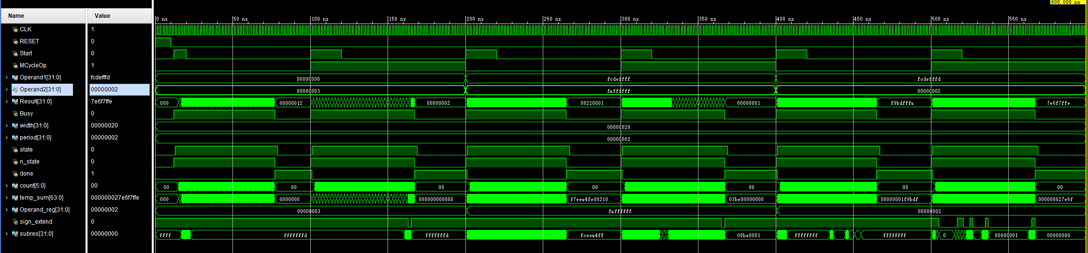
Simulation Waveform
“Result” from multiplication and division among three sets of representative input are correct.
“Busy” is asserted immediately to stall the CPU when Start is set.
“Busy” is cleared to stall the CPU when the Results become ready.

Slide 15
Content
Objective & Overview
Multi-cycle multiplier & divider: Mcycle Design
Extended Instruction
Hardware Implement: How Mcycle integrate .. ?
On-board Test
SME309 – Microprocessor Design

Slide 16
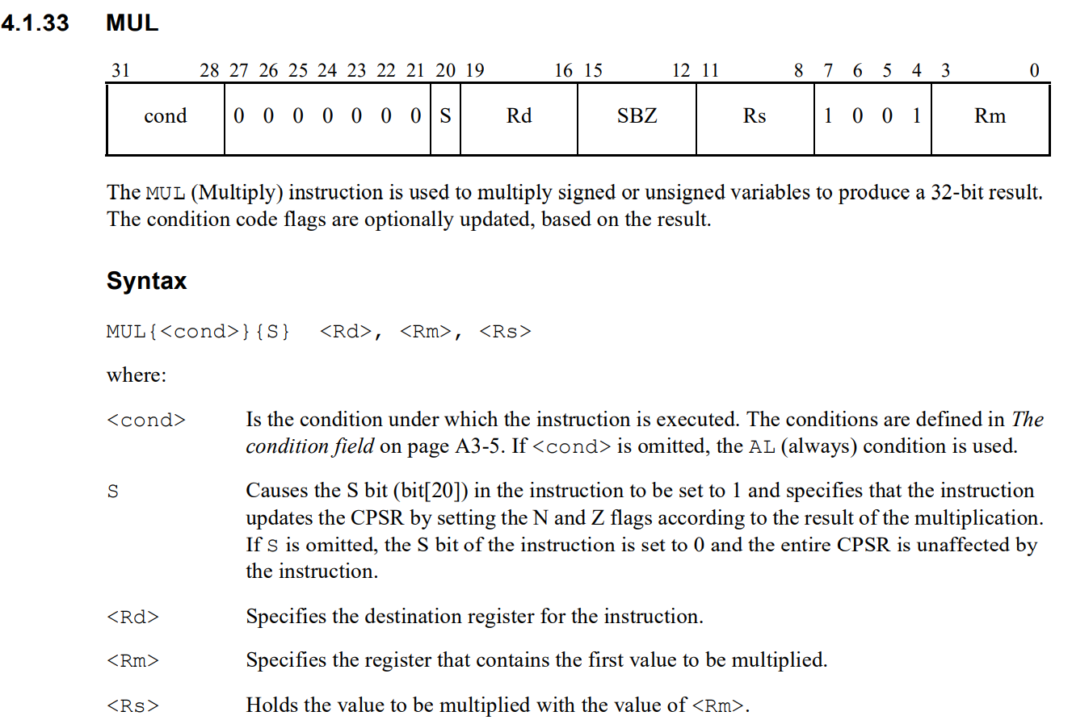

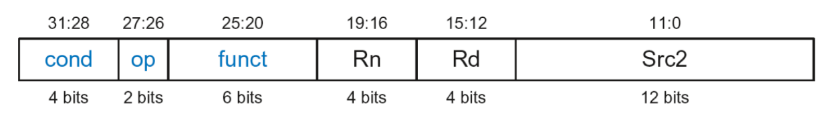

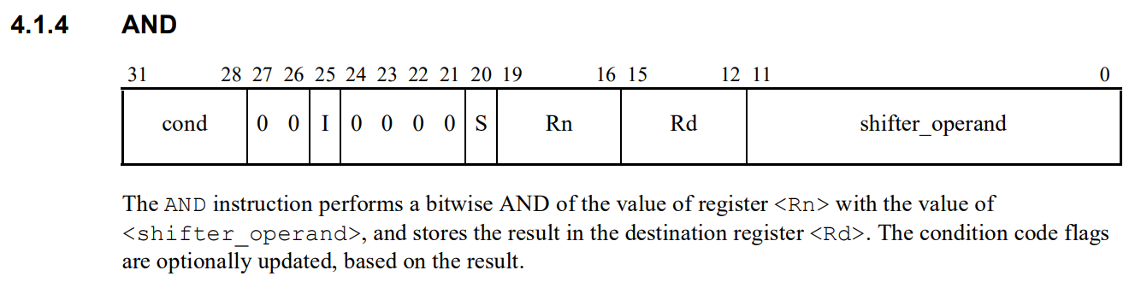
Extended Instruction
MUL
The encoding style seems to have been met before?
Rd = Rs * Rm
0
0000
1001
SBZ means “Set Bits Zero”
*In this lab, the implementation for flag updating(S) is not requested.

Slide 17
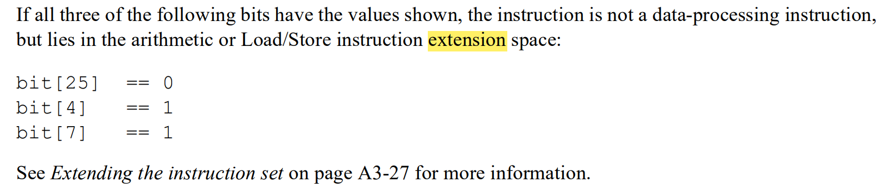
Extended Instruction
MUL
The encoding style seems to have been met before?
Rd = Rs * Rm
Rd = Rs * Rm
SBZ means “Set Bits Zero”
Not DP! It’s Extended Instruction!
*In this lab, the implementation for flag updating(S) is not requested.

Slide 18
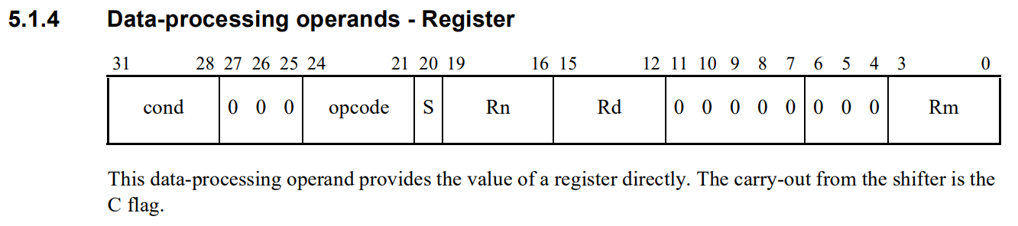
Extended Instruction
MUL
“MUL” and “AND” Conflict?
Rd = Rs * Rm
Rd = Rs * Rm
SBZ means “Set Bits Zero”
If it’s a data-processing instruction, when bit25(I) = 0, bit7-4 can’t be 1001!(refer to AMR Reference Manual 5.1.4 to 5.1.13)
*In this lab, the implementation for flag updating(S) is not requested.

Slide 19
Extended Instruction
MUL
So, to implement the “MUL” in hardware, the decoding logic in decoder module should be changed like this:
case(op)
2'b00: begin
if(Instr[25] == 0 && Instr[7:4] == 4'b1001 && Instr[24:21] == 4'b0000)
// MUL instruction operation
else
// DP instructions operation
end
2'b01: // Memory instructions
2'b10: // Branch instructions
......
endcase
case(op)
2'b00: // DP instructions
2'b01: // Memory instructions
2'b10: // Branch instructions
......
endcase
Not DP! It’s Extended Instruction!

Slide 20
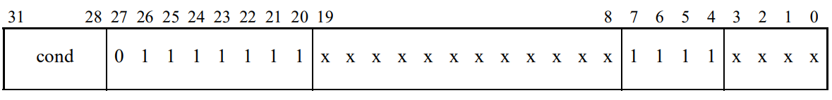
Extended Instruction
DIV
ARM doesn’t directly support division instruction, so we should design a new instruction to implement it.
How to design a new instruction?
Refer to “MUL”, we can design the undefined instruction for division like this:
16
15
12
11
Rd
SBZ
Rs
Rm
SBZ means “Set Bits Zero”

Slide 21
Extended Instruction
DIV
Rd = Rs / Rm
16
15
12
11
Rd
SBZ
Rs
Rm
case(op)
2'b00: begin
if(Instr[25] == 0 && Instr[7:4] == 4'b1001 && Instr[24:21] == 4'b0000)
// MUL instruction operation
else
// DP instructions operation
end
2'b01: begin
if(Instr[25:20] == 6’b111111 && Instr[7:4] == 4’b1111)
// DIV instruction operation
else
// Memory instructions operation
end
2'b10: // Branch instructions
......
endcase
case(op)
2'b00: // DP instructions
2'b01: // Memory instructions
2'b10: // Branch instructions
......
endcase

Slide 22
Content
Objective & Overview
Multi-cycle multiplier & divider: Mcycle Design
Extended Instruction
Hardware Implement: How Mcycle integrate .. ?
On-board Test
SME309 – Microprocessor Design

Slide 23
Hardware implement
Some new Control signals and datapath are added!

Slide 24
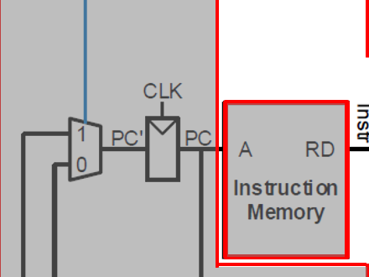
Hardware implement
When the CPU executes MUL or DIV instructions, what’s the difference from ADD or other arithmetic instructions?
1. For multi-cycle instruction, What’s the PC’s behavior? Is another mux for PC’ is needed? (Controlled by “Busy”?)
When multi-cycle operation is still executing, the CPU should stall, which means PC doesn’t change!

Slide 25
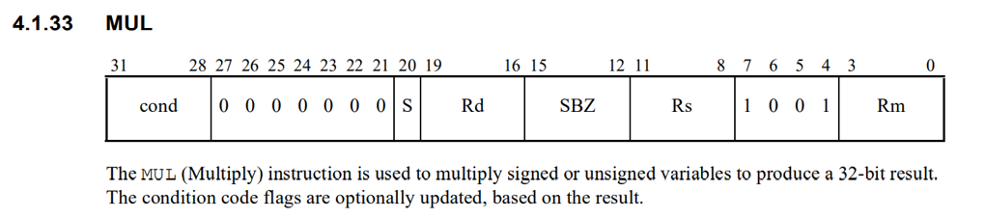
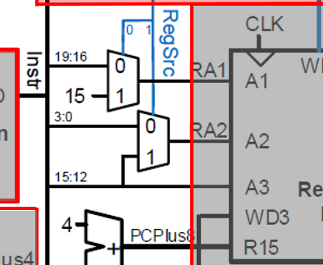
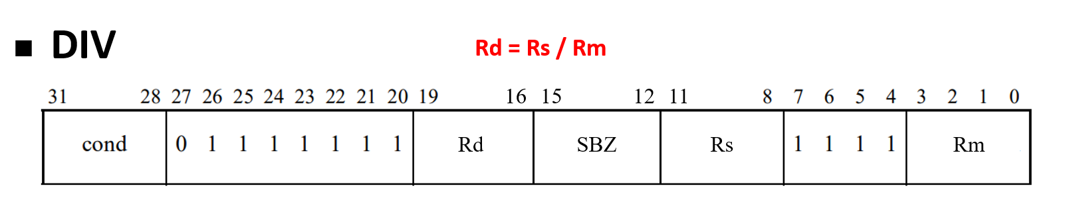
Hardware implement
When the CPU executes MUL or DIV instructions, what’s the difference from ADD or other arithmetic instructions?
2. The location of Rn(Rs),Rd is different from other arithmetic instructions, maybe a few more bits of RegSrc is needed for MUL and DIV instruction?

Slide 26
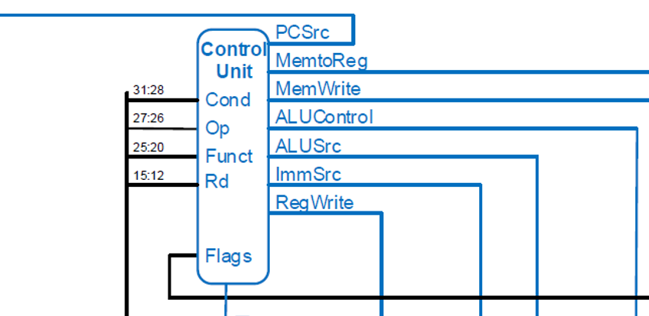
Hardware implement
When the CPU executes MUL or DIV instructions, what’s the difference from ADD or other arithmetic instructions?
3. More control signals is needed for Mcycle from Control Unit!
“M_Start” and “MCycleOp” are connected to “Mcycle” module
“Mwrite” is for result write to RegisterBank
M_Start
MCycleOp
MWrite

Slide 27
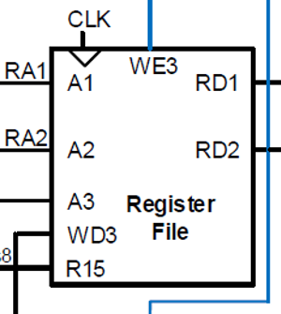
Hardware implement
When the CPU executes MUL or DIV instructions, what’s the difference from ADD or other arithmetic instructions?
4. Datapath modification
“Operand1” and “Operand2” are connected to “RD1” and “RD2” in “RegisterFile”.
“Result” is connected to “WD3” selected through a multiplexer controlled by “MWrite”.

Slide 28
Content
Objective & Overview
Multi-cycle multiplier & divider: Mcycle Design
Extended Instruction
Hardware Implement: How Mcycle integrate .. ?
On-board Test
SME309 – Microprocessor Design

Slide 29
On-Board Test
In this lab, you should learn to design the test instructions by yourself to verify your design refer to Lab2 (“TOP” module and “Wrapper” module can be still used in this lab. The modification is just to replace the instruction and data memory initialization contents. Moreover, the assemble file in lab2 is recommended to understand and refer). However, in lab check, we will provide a unified instruction sample, which contain LDR, STR, ADD, MUL , DIV, only five kinds of instruction.
After designing your test instructions, you should use Keil to translate them to machine code (refer to lab1 note), and replace the instruction and data memory initialization contents in “Wrapper”.
Note: DIV is the user-definied instruction, so we can’t use Keil to translate DIV. Instead, we should decode the machine code for DIV manually.

Slide 30

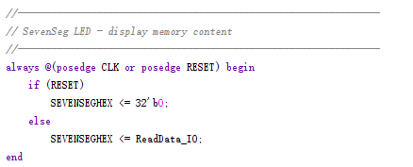
On-Board Test
The role of FPGA peripherals:
Switches: Represents the read address of data memory (variable region).
LEDs: Indicates the real-time PC value.
SevenSegs: Indicates the data content of the data variable memory with the address corresponding to the switches.
BTNU: Pause; BTND: Reset;
100MHz Oscillator: Clock provider.
DIP -> SEVENHEX

Slide 31
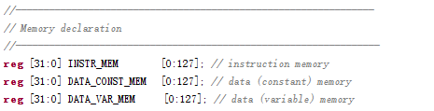
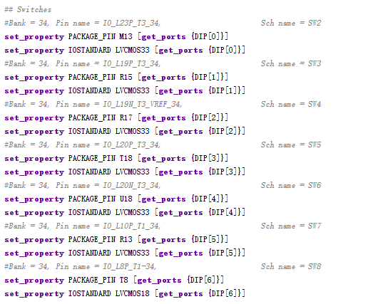
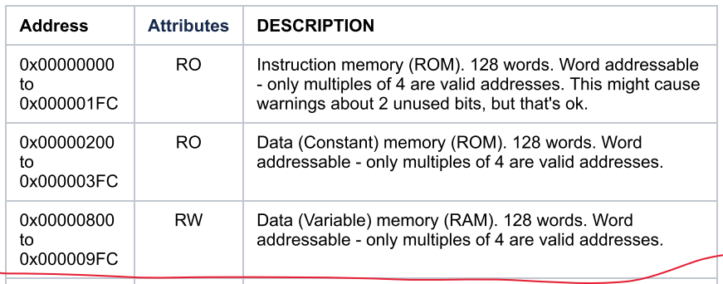
On-Board Test
The address base of memory declaration is word-base, but the address in ARMv3 architecture is byte-base. Therefore, in the constraint file, we connect DIP[0] with SW2 for an easier understanding.
The ARMv3 address mapping:
For example, ARMv3 address 0x00000830 corresponds to SW8-SW0: 000110000
0x830 - 0x800 = 0x30 = 48(decimal) = 110000(binary)

Slide 32
Q & A

